Slide 1
Reinforcement Learning for Aerobraking Autonomy
Mr. Andrew Harris
Research Assistant, CU Boulder
Dr. Hanspeter Schaub
Glenn L. Murphy Professor of Engineering, CU Boulder

Slide 2
Introduction
Motivation
Machine Learning Overview
Challenges for Astrodynamics
Sample Problem
Current Results and Conclusions
Notes:
We’ll be working through the motivation behind this work, a quick summary of the machine learning overview presented in the paper with a focus on challenges for spacecraft applications, and then attempt to apply this approach to a simplified version of the aerobraking problem.

Slide 3
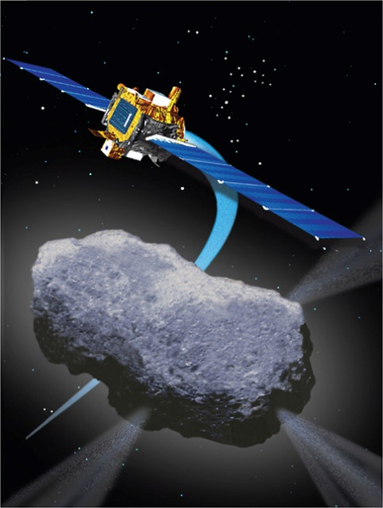
Motivation
Vehicle autonomy solves many problems
Ground ops costs
Light-speed lag
Fault tolerance (maybe)
Vehicle autonomy causes many problems
Software complexity
V&V is not easy
Notes:
- Space vehicle autonomy promises to both reduce mission costs and offer utility that ground-commanded missions could not achieve. At the same time, there are huge costs associated with the development and implementation of autonomy routines.

Slide 4
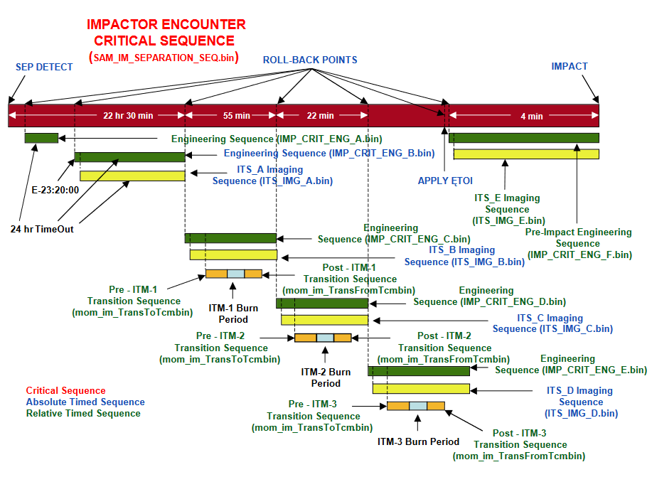
Motivation: Development Strategy
Old concept: Parameterize, enumerate mission states and behaviors
S/C modes address separate sub-problems
Define mode transition criterion
Hybrid systems theory (promising!)
Time-tested approach
Expensive to write, test, generalize
“Impactor Spacecraft Encounter Sequence Design for the Deep Impact Mission,” Kubitschek, 2005.
Notes:
- This is best exemplified in examining how prior missions have implemented and executed autonomy routines. Generalizing at a high level, autonomy is typically accomplished by specifying operational modes to address relevant sub-problems. This figure, taken from a 2005 paper about the final impact or sequence for Deep Impact, illustrates the approach of specifying an end-to-end mode sequence with defined transition criterion. This requires developers to extensively test via monte-carlo or random sampling, which is time consuming and provides no real guarantees beyond ad-hoc convergence.

Slide 5
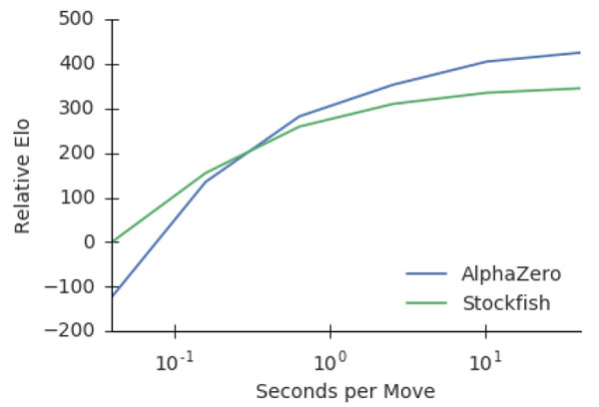
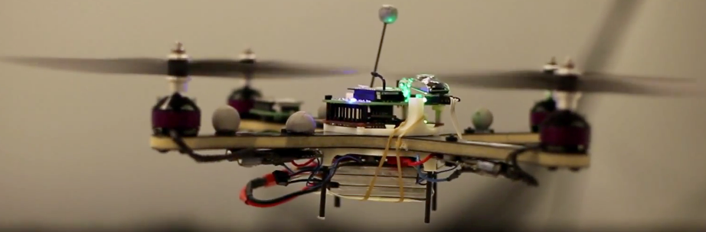
Motivation: Reinforcement Learning
Emerging control strategy for dynamically complex, uncertain systems
Example: Google’s AlphaZero game algorithm
Given basic rules of chess, played games against itself for four hours
Beat the current hand-tuned standard chess algorithm
Experimental use in other control problems (helicopter flight)
“Mastering Chess and Shogi by Self-Play with a General Reinforcement Learning Algorithm,” Silver et al, 2017
Notes:
At the same time, the field of machine learning and more specifically machine learning is emerging as a general-purpose strategy for controlling challenging, under-modeled, or highly nonlinear systems in an autonomous and robust manner. One prominent example of this is Google’s AlphaZero algorithm, which used deep reinforcement learning and adversarial training to improve its performance; after a few hours of self-training, the algorithm routinely beat the previous hand-tuned master Stockfish by exploiting strategies not admitted by human-driven methods.
Of course, not all problems are as observable or deterministic as chess, but the robotics field has made great use of reinforcement learning to control dynamically complex aircraft (such as this quadcopter) or bipedal walking robots, among other things
This work is intended to outline the relevance of these techniques to spacecraft applications, outline space-specific challenges, and present a sample of how one specific mission class – aerobraking – might be addressed by a reinforcement learning technique.

Slide 6
Reinforcement Learning Overview

Slide 7
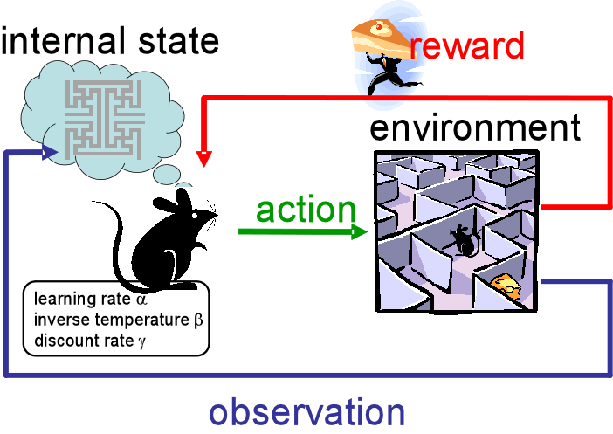
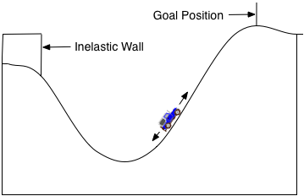
Reinforcement Learning
Subtype of Machine Learning
Objective: Maximize the earned reward over a set of action/state pairs
Theory is grounded in optimal control, implementation resembles other optimizers
Successful application to several nonlinear dynamics problems
Notes:
Reinforcement learning is a subtype of the general class of algorithms whose performance improves as they obtain additional data. Inspired by Pavlonian psychology, reinforcement learning techniques fundamentally aim to maximize the reward earned by an agent interacting with an environment which may or may not be well understood. The theory of these techniques is founded in optimal control, and some implementation details resembles other optimizers (such as dynamic programming) at a high level. This class of alggorithms has been used to address problems that are difficult to address with conventional techniques, such as the mountain-car problem shown here – in which a car must “learn” to rock back and forth in this valley to build up momentum.

Slide 8
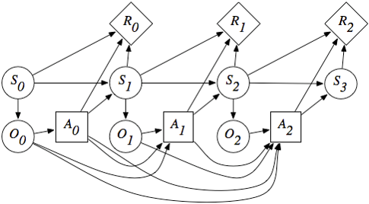
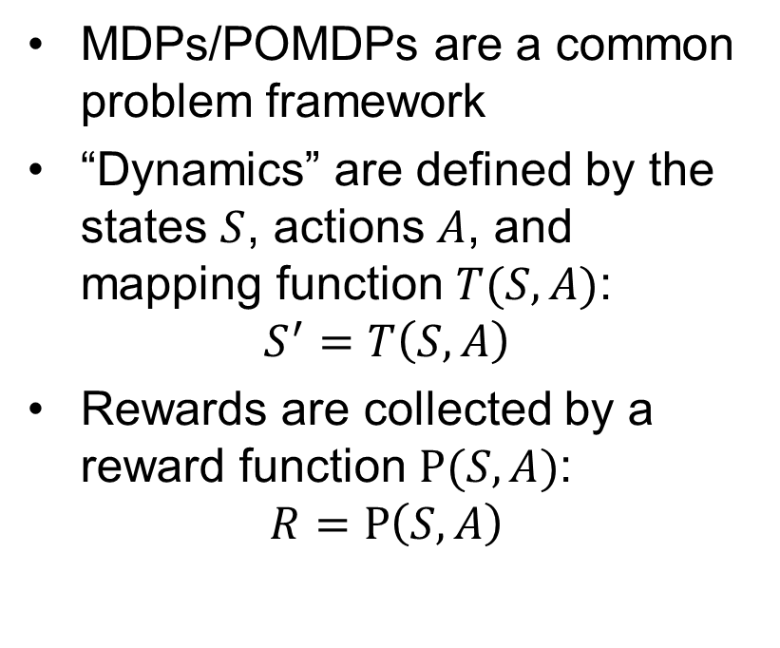
Decision Models
MDPs/POMDPs are a common problem framework
“Dynamics” are defined by the states $S$, actions $A$, and mapping function $T(S,A)$:
$$S^{′}=T\left(S,A\right)$$
Rewards are collected by a reward function $Ρ(S,A)$:
$$R=Ρ\left(S,A\right)$$
Notes:
Reinforcement learning is usually considered in the context of Markov Decision Processes or their partially observable cousins (MDPs and POMDPs, respectively). These systems consist of a set of states, S, a set of Observations O, a set of actions A, and a set of rewards R and the functions that map between them. While the general POMDP problem is not tractable, approximate solutions are found to provide good performance. Additionally, these frameworks can directly incorporate Bayesian networks (another sub-class known as bayes-adaptive decision processes), providing yet another framework for the learning of problem dynamics.

Slide 9
Astro-Specific Challenges
Continuous State, Action Spaces: Many RL algorithms are intended to work in discrete spaces. Transformations exist, but the “curse of dimensionality” is a spoiler.
Solution: Suggested by the “car-mountain” problem!
Prior information: Unlike common RL applications, good models exist for astrodynamics problems and solutions are usually well-known.
Solution: Train on expert priors, or learn parameters of known models
Data Sparsity: RL techniques typically use tens to thousands of samples for training. Space missions need to work the first time.
Notes:
A few astro-specific problems spoil the ease of this approach. First, most reinforcement learning techniques are considered in the context of discrete spaces; gridded rooms, classes of actions, etc. Even in a simple case, most spacecraft problems consider six continuous variables to represent spacecraft states alone, making discretization painful. The car=mountain problem, which also exists in a continuous space, suggests some solutions and Is actually readily solved with coarse discretization or function approximation.
Additionally, we have good models for the motion fo spacecraft on the whole, give or take knowledge of a few paramters (such as atmospheric density or reflectivity coefficients). Few reinforcement learning algorithms are set-up to easily incorporate this information. We can make sure this information is used by training on so-called “expert priors” – i.e., having a human specify an initial solution approach informed by knowledge of the system dynamics. We’re currently looking into other ways to incorporate these models while folding in uncertainty.
Finally, space missions are typically not data rich with respect to their environments and have limited opportunities to try to learn

Slide 10
Proposed Implementation Approach I
Frame autonomy problem within MDP/POMDP framework
Identify relevant problem features, dynamic models
Specify reward/value states
Select reinforcement-learning algorithm approach
Notes:
With these challenges established, a description of the implementation of one of these algorithms for general use autonomy outlines the advantages of the approach. First, a given autonomy problem would be reframed within the MDP/POMDP framework by identifying relevant problem features, reward states, and dynamic models. Based on these models, a suitable reinforcement learning approach would be selected; if this is hard to determine, many “general-purpose”

Slide 11
Proposed Implementation Approach II
2. Train selected algorithm using assumed dynamics
High-speed, medium-fidelity training model to capture relevant dynamics
Test using varied dynamics, state transition models
Reward function provides acceptance testing criterion
Notes:
Next, the selected algorithm would be trained using dynamic models that capture relevant dynamics and evaluate quickly. The use of a reward function provides a direct manner for evaluating algorithm performance and the convergence of the training process. Once acceptably trained, higher-fidelity models can be used to test the robustness of the algorithm under more realistic performance.

Slide 12
Proposed Implementation Approach III
3. On-Board implementation
Transfer learned algorithm to flight system
[Optional] Continue training on-board using real sensor data
Notes:
Finally, the trained algorithms would be transitioned to flight. A key advantage of this approach is that learning can continue on-board using real sensor data, allowing for on-flight adaptation. Most of the computational complexity of these algorithms lies in the creation of the training simulations, not in the actual implementation of the learning routines.

Slide 13
Sample Problem: Aerobraking
Notes:
It’s easy to discuss this approach at a high level. To really demonstrate it, we’ve crafted a simplified version of the aerobraking problem to be addressed by a reinforcement learning technique.

Slide 14

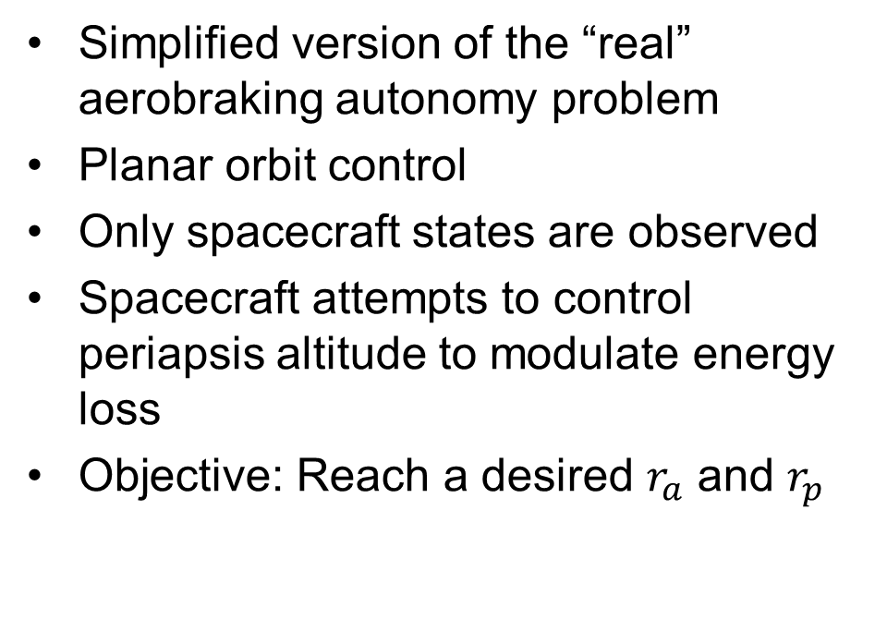


Aerobraking Problem
Simplified version of the “real” aerobraking autonomy problem
Planar orbit control
Only spacecraft states are observed
Spacecraft attempts to control periapsis altitude to modulate energy loss
Objective: Reach a desired $r_{a}$ and $r_{p}$
$r_{a}$
$r_{p}$
Desired Orbit
Notes:
For the context of this work, we define the “aerobraking problem” as the issue of reaching a specified reference orbit – a target radius of apoapsis and radius of periapsis – using only atmospheric drag and small control burns at apoapsis.
In the general case, this simplified problem takes that spacecraft position and velocity states are observed, but atmospheric states are not; additional sensors, such as accelerometers, are not considered.

Slide 15
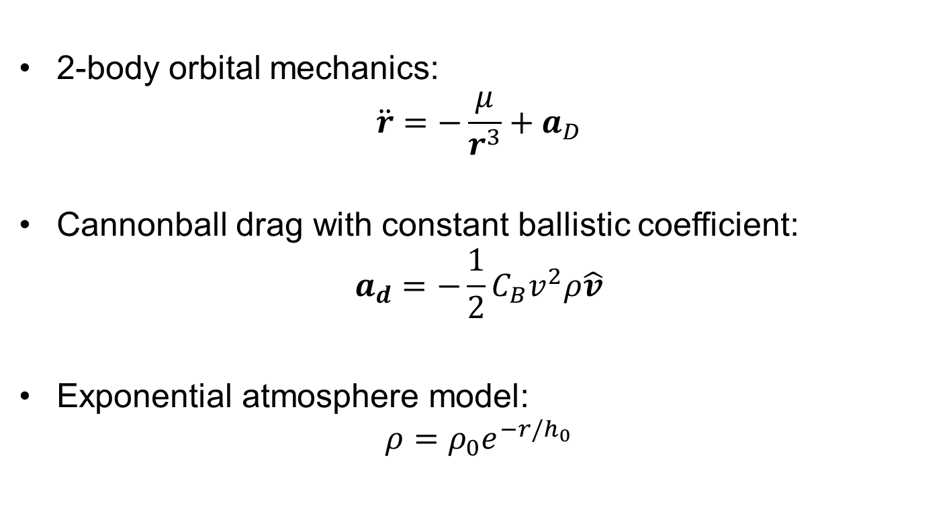
Considered Nonlinear Dynamics
2-body orbital mechanics:
$$\ddot{r}=−\frac{μ}{r^{3}}+a_{D}$$
Cannonball drag with constant ballistic coefficient:
$$a_{d}=−\frac{1}{2}C_{B}v^{2}ρ\hat{v}$$
Exponential atmosphere model:
$$ρ=ρ_{0}e^{−r/h_{0}}$$
Notes:
- Mathematically, we model the problem using 2-body orbital mechanics and considering simple cannonball drag as the only perturbing force. Additionally, we take the atmosphere to be exponentially distributed.

Slide 16



Problem Reformulation
{
Address by discretization
Bin states
Bin “unit” actions at apoapsis
Only re-evaluate states between orbits
Assume a finite aerobraking transfer, and optimize over the maximum allowed duration
$r_{a}$ bins
Reward States
{
$r_{a}$ bins
Notes:
This problem is underactuated and continuous, and in some ways resembles the car-mountain problem from earlier. As such, we’ve attempted to address the problem in a similar manner, and apply a discrete binning approach to the states and actions. Additionally, we discretize the problem such that the orbit and action are re-evaluated only once per orbit.

Slide 17
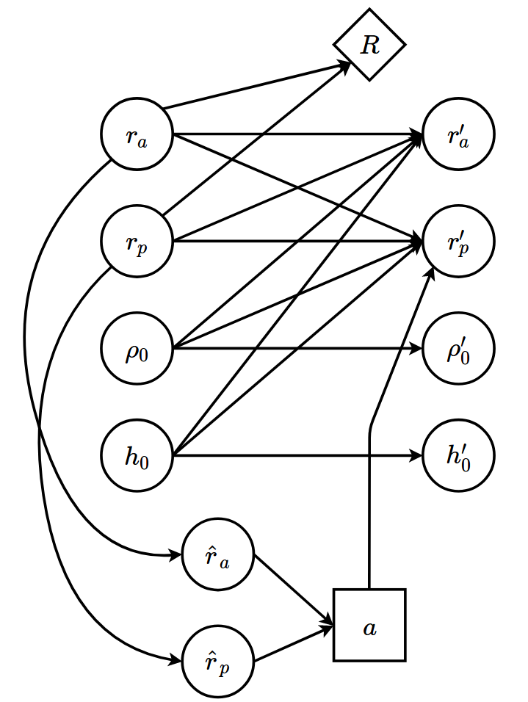
Problem Reformulation II
Problem can now be considered as a 4-state POMDP
Discrete w/ simple updates, amicable to “on-board” implementation
Notes:
Under this discretization, we can consider the problem as a 4-state, 2-observation, single-action POMDP

Slide 18
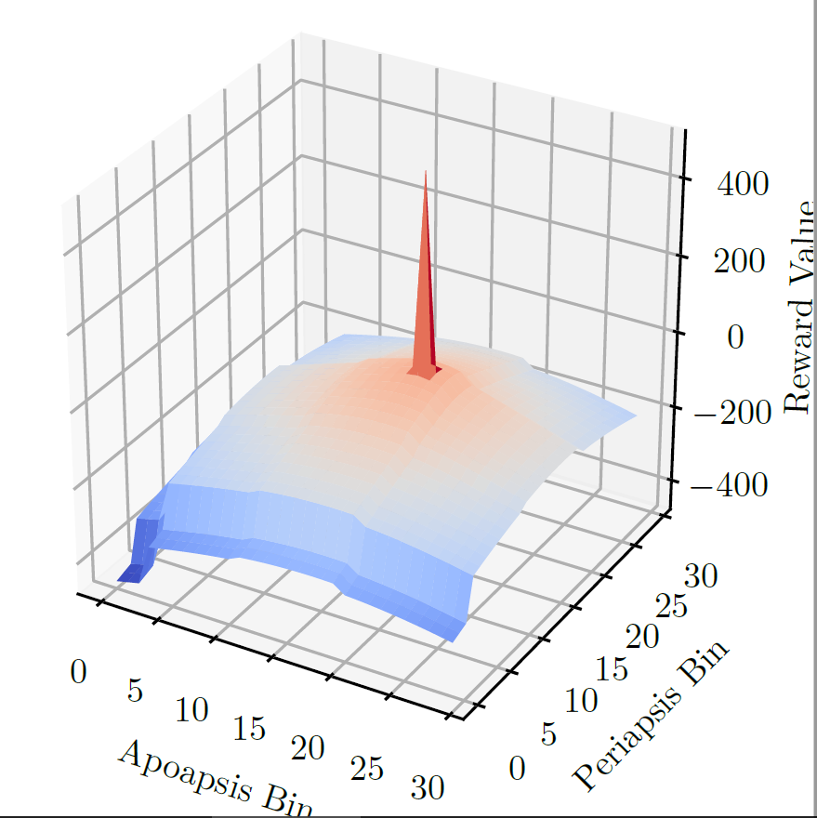
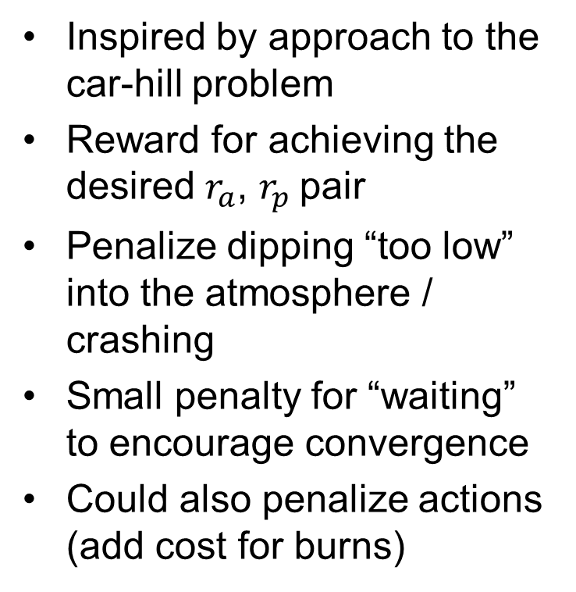
Reward Function
Inspired by approach to the car-hill problem
Reward for achieving the desired $r_{a}$, $r_{p}$pair
Penalize dipping “too low” into the atmosphere / crashing
Small penalty for “waiting” to encourage convergence
Could also penalize actions (add cost for burns)

Slide 19
Learning Approach I
Know that only a few states provide a reward/detriment
Also don’t really know the discretized dynamics, but know the “real” dynamics pretty well
Concept:
Use maximum-likelihood learning to approximate the real dynamics with a simple probabilistic model
Simultaneously learn a “state-value” function that takes into account future rewards to pick future action

Slide 20
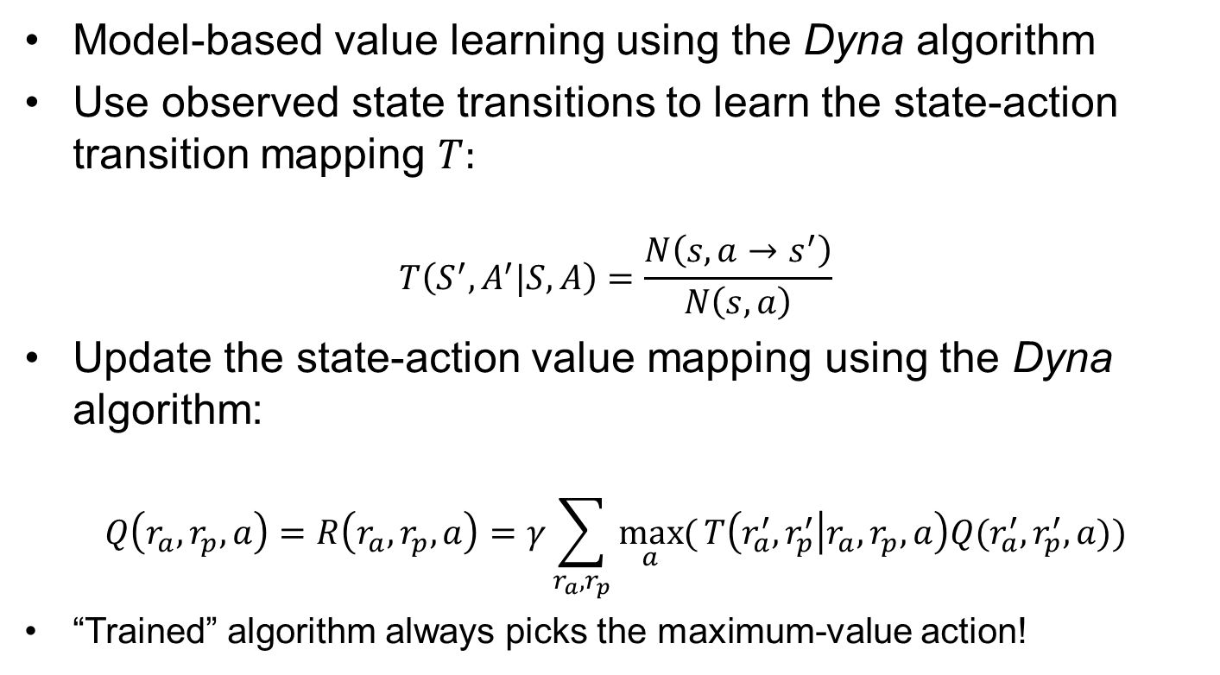
Learning Approach II
Model-based value learning using the Dyna algorithm
Use observed state transitions to learn the state-action transition mapping $T:$
$$T\left(S^{′},A^{′}|S,A\right)=\frac{N\left(s,a→s^{′}\right)}{N\left(s,a\right)}$$
Update the state-action value mapping using the Dyna algorithm:
$$Q\left(r_{a}, r_{p}, a\right)=R\left(r_{a}, r_{p}, a\right)=γ\sum_{r_{a}, r_{p}}{\max_{a}{(}T\left(r_{a}^{′},r_{p}^{′} | r_{a}, r_{p},a\right)Q(r_{a}^{′}, r_{p}^{′},a))}$$
“Trained” algorithm always picks the maximum-value action!

Slide 21
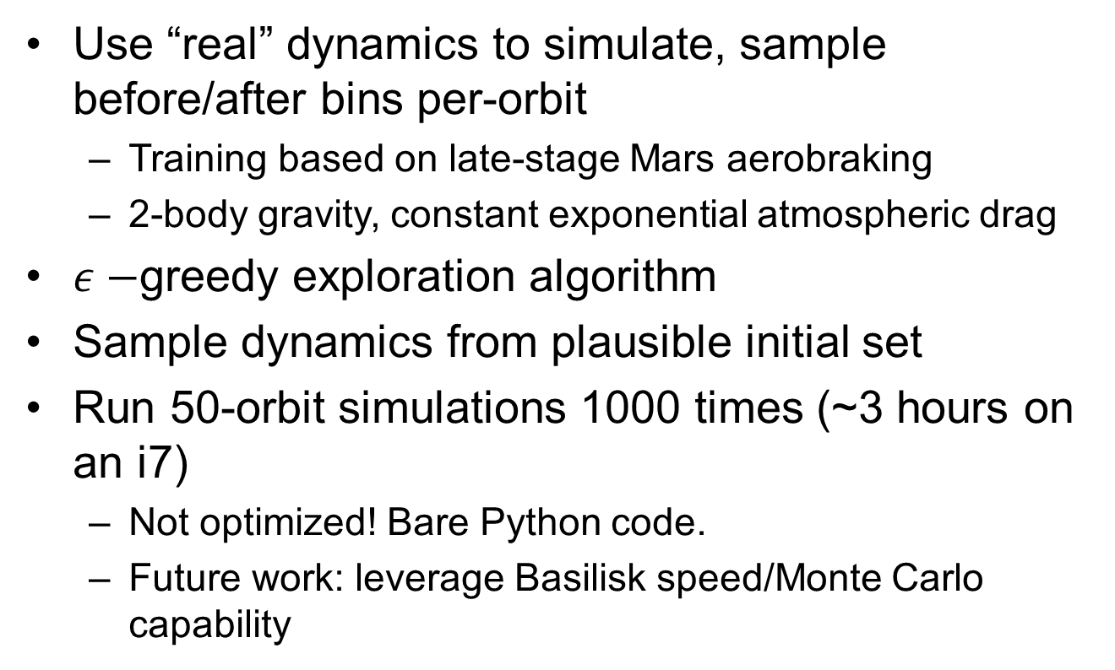
Training Simulation
Use “real” dynamics to simulate, sample before/after bins per-orbit
Training based on late-stage Mars aerobraking
2-body gravity, constant exponential atmospheric drag
$ε−$greedy exploration algorithm
Sample dynamics from plausible initial set
Run 50-orbit simulations 1000 times (~3 hours on an i7)
Not optimized! Bare Python code.
Future work: leverage Basilisk speed/Monte Carlo capability

Slide 22
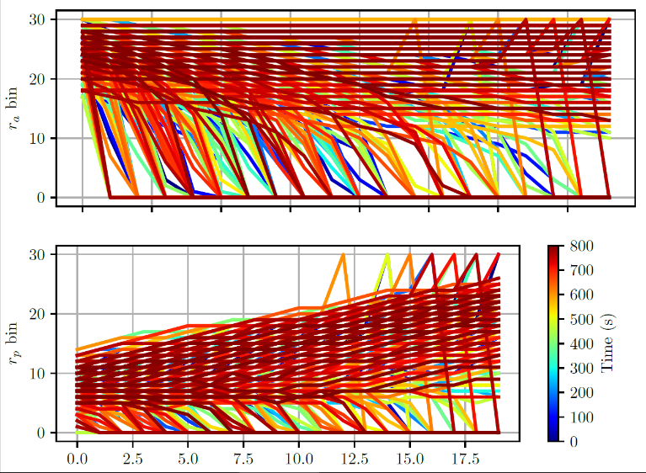
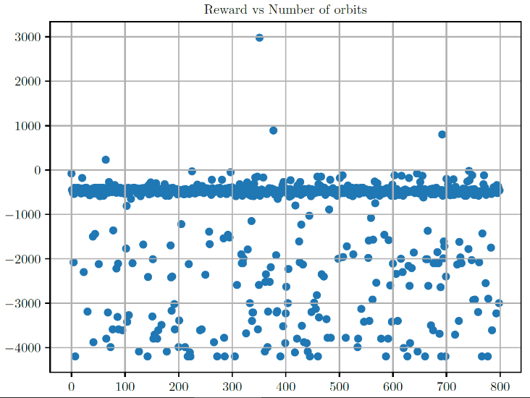
Current Status
Limited performance with selected setup, algorithm
S/C learns to raise periapsis to prevent collision
Very slow reward improvement
Trying several alternatives without leaving the discretization space
Expand out “value” from goal states
“Eligibility Traces” to back-flow value
Tile-summing methods

Slide 23
Conclusions, Future Work
Reinforcement Learning is promising for next-generation FSW development
POMDPs represent an interesting alternative portrait of the general autonomy problem
Plenty of work to be done in reformulating autonomy problems into the RL/POMDP framework
Solvers that work on continuous state, action spaces
Fast astrodynamics simulators to speed training times (Basilisk)
Exploration of on-board runtime

Slide 24
Questions?

