Slide 1
Reinforcement Learning
for Spacecraft Mode Control
Harris . Teil . Hammad . Mills

Slide 2
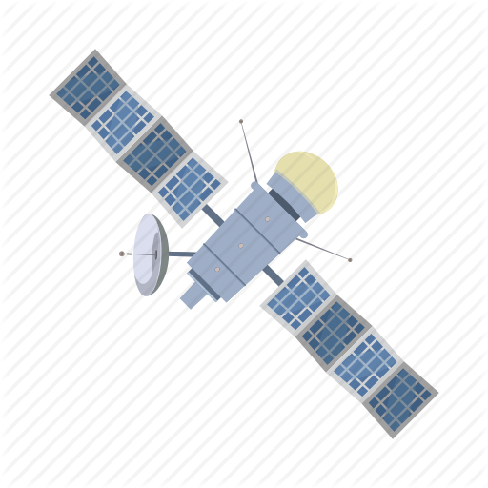
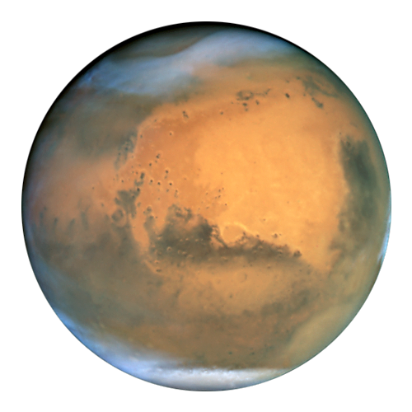




Gym Environment
Setting up the gym: creating actions the spacecraft can take and scenarios to apply these actions to learn optimal decisions.
Actions
Orbit Determination (OD): increase knowledge of position and velocity, without control
Control orbit: reduce error between estimated trajectory and reference trajectory, slowly losing knowledge of position
Thrust (apply large thrust to enter orbit)
Safe-Mode (Mitigate error, without control or orbit determination)
$t_{i}$
$t_{f}$
$r_{a}$
Environments
Station Keeping (SK): control and OD only to stay on the reference trajectory .
Orbit Insertion (OI): Apply no error on trajectory and apply variable thrust along the reference arc
SK+OI+SK: chain initial station keeping with orbit insertion, followed by more station keeping.
$r_{p}$
Notes:
Motivation:
Space mission operation costs

Slide 3
Learning Methods

Slide 4
Timeline and Questions
Timeline:
Finish development and testing of the environment
Adapt q-learning methods to the new scenarios
Add complexity to the models in order to test the limits of the learnability
Environment Questions:
Is the problem learnable given the parameters? Many of the functions are tunable, and depending on the values used, they may not allow for learning.
How fast is the integrated simulation? In order to do many runs, the scenarios must run fast enough to allow for iteration
Current solutions:
Start with the simplest case. Minimal variables and errors, and progressively increase the complexity. Ensure that control time is much faster than error propagation.
If the simulation runs slowly, allow for bigger time steps to at least allow for coarse learning.

