Slide 1
Pair Parallax
Group #14
Abdullah Sajjad BSCS14044
Anum Rafi BSCS14021
M Athar Siddiqui BSCS13025
Phase 2: Requirements Engineering

Slide 2
Requirement Elicitation
Scenarios
Use cases

Slide 3
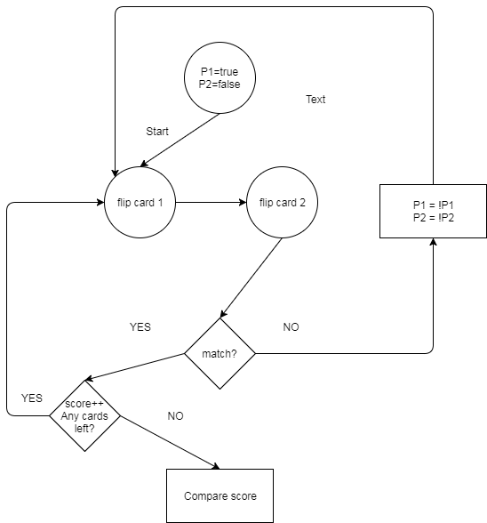
Flow Diagram

Slide 4
Lenses
The lens of emotion
The lens of essential experience
The lens of fun
The lens of curiosity
The lens of endogenous value
The lens of problem solving

Slide 5
Functional Requirements
Game flow
Android 4.4 KitKat or greater
Minimum 1GHz processor
Minimum 512Mb RAM

Slide 6
Non-functional Requirements
6 byte rate per transfer
Stored graphics
Java script
IDE will be unity

Slide 7
Types of non-functional requirements (1)
Product requirements
Efficiency
Usability
Security
Dependability
Organizational requirements:
Organizational requirements
Operational requirements
Developmental requirements

Slide 8
Types of non-functional requirements (2)
External requirements
Regulatory requirements
Ethical requirements
Legislative requirement
Accounting requirements
Safety/security requirements

Slide 9
Requirements Validation
Consistency check
No conflicts
Realism Check
Buildable using current technology
Verifiability Check
Prototyping
Test cases

