Slide 1


Slide 2
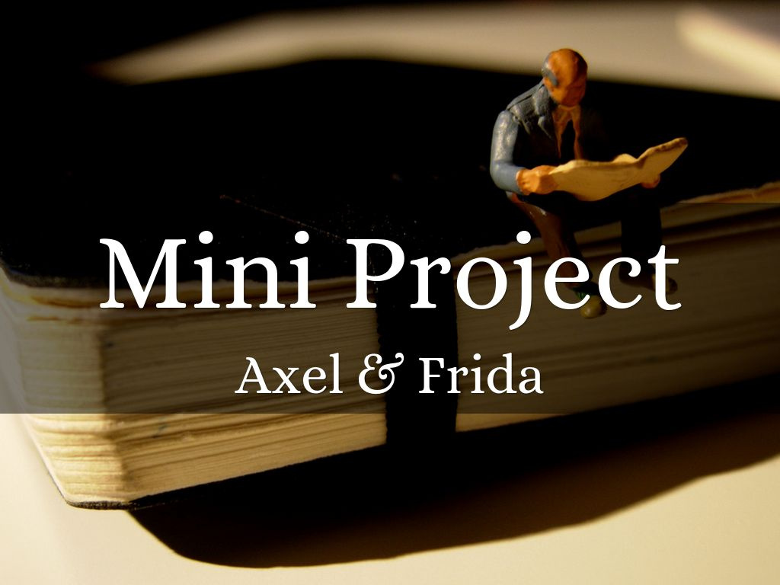

Slide 3
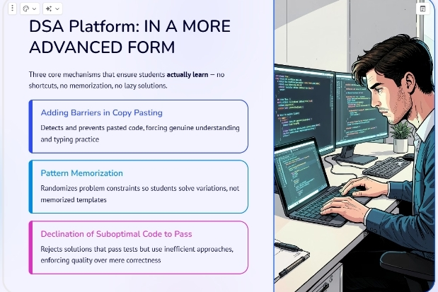

Slide 4


A
GAME
CHANGING
PLATFORM
IN A
CODING
WORLD.

Slide 5


Slide 6
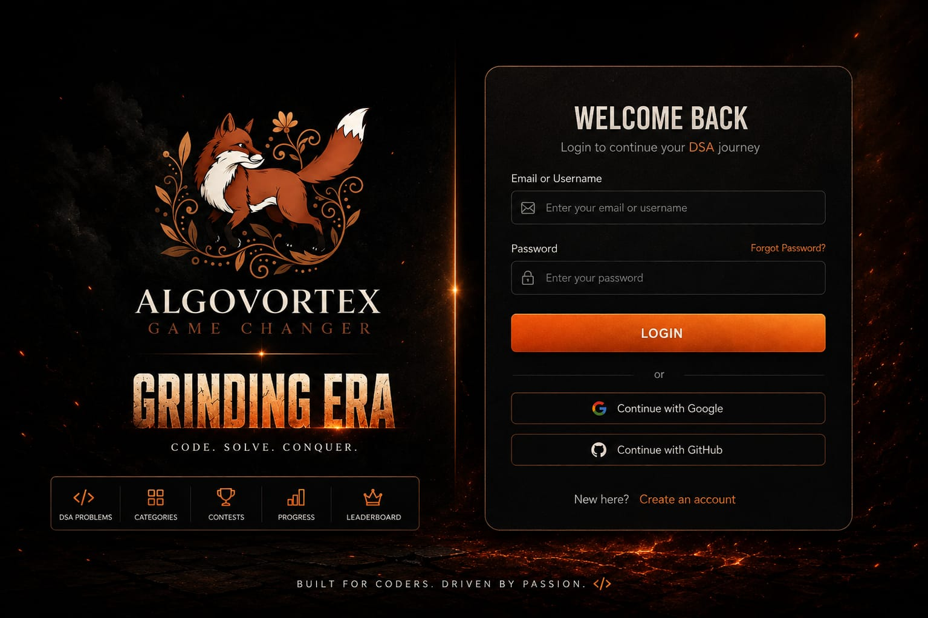

Slide 7
