Slide 1
Comparative Analysis of BFT Consensus Frameworks for Secured Smart Grid Energy Trading
A Four-Group Evaluation Using the Static-Temporal Security Framework (STSF)
VJTI Mumbai • Department of Electrical Engineering • June 2026
Based on: Sheikh et al., IEEE Access, 2020 Extended with STSF: Tower BFT & RVR Consensus

Slide 2
The Problem
Sheikh et al. (2020) proved blockchain reduces attack probability from P_TA to P_TAb ≈ 10⁻¹⁷³
But: They assumed INSTANTANEOUS consensus finalization
Reality: OM(m) takes 43.35 seconds per block at f=16
During this window: 867 independent attack attempts possible
P_temporal = 1 - (1 - P_TA)⁸⁶⁷ ≈ 0.987 → GUARANTEED compromise!
Question: How do different BFT algorithms affect temporal security?

Slide 3
Static-Temporal Security Framework (STSF)
P_secure = (1 - P_TAb) × (1 - P_temporal)
P_TAb (Static) → Sheikh's Eq. 17-21: blockchain reduces attack probability
P_temporal (Temporal) → Our extension: latency creates attack window
P_temporal = 1 - (1 - P_TA)^N
where N = ⌊ L_consensus / τ_attack ⌋
Key insight: ALL algorithms share the same P_TAb
The ONLY differentiator is consensus LATENCY → P_temporal

Slide 4
Four Groups of BFT Consensus
Group 1: Baselines
Group 2: Enterprise
Group 3: Clustered
Group 4: Next-Gen
Lamport OM(m) Classic PBFT
IBFT 2.0 QBFT
CE-PBFT, G-PBFT SV-PBFT
Tower BFT RVR Consensus
L = 15-43 s N = 306-867
→
L = 1.5-2.5 s N = 30-50
→
L = 0.5-0.8 s N = 10-16
→
L ≤ 250 ms N = 4
P_secure: 0.013 → 0.819 → 0.937 → 0.980

Slide 5
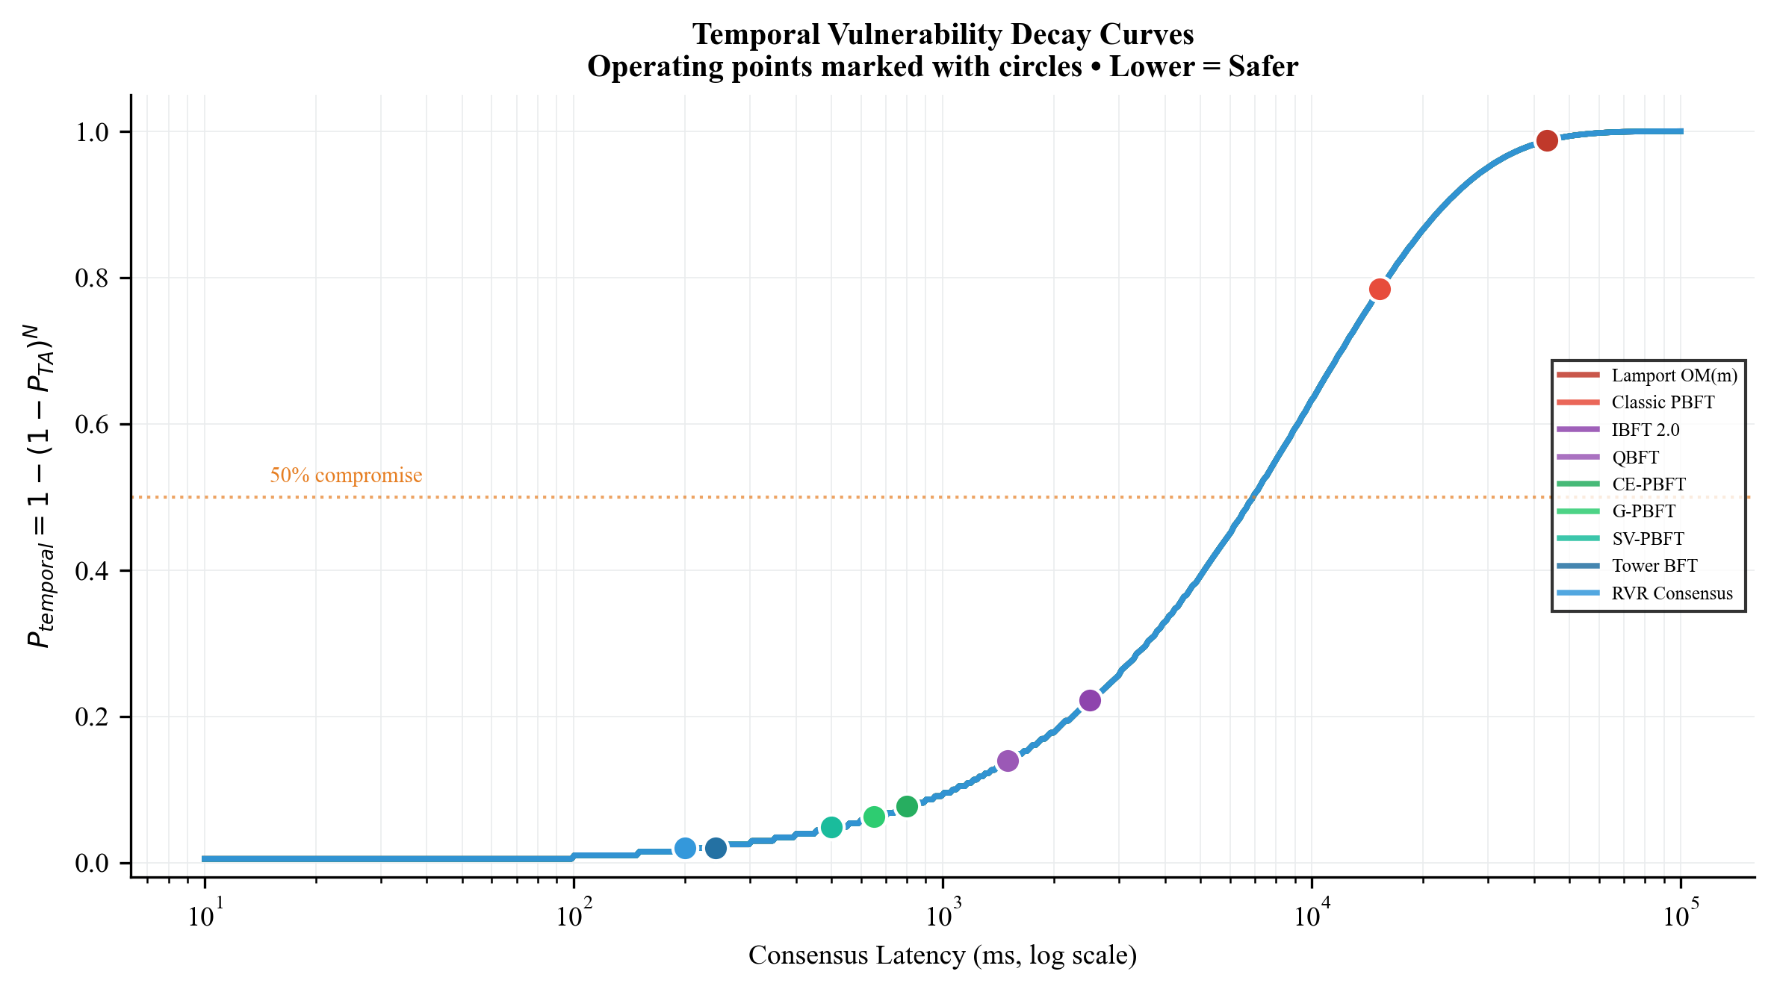
Group 1: Baselines — OM(m) & Classic PBFT
Full network topology: n_sen = 3854, no clustering
OM(m): O(n^m) messages → 10¹⁸ at f=16
Latency: L_OM = (m+1) × n × τ = 43.35 seconds
Attack window: N = 867 attempts
P_temporal = 1 - (0.995)^867 ≈ 0.987
P_secure = (1 - P_TAb)(1 - 0.987) ≈ 0.013
RESULT: Static security COLLAPSES under temporal exposure

Slide 6
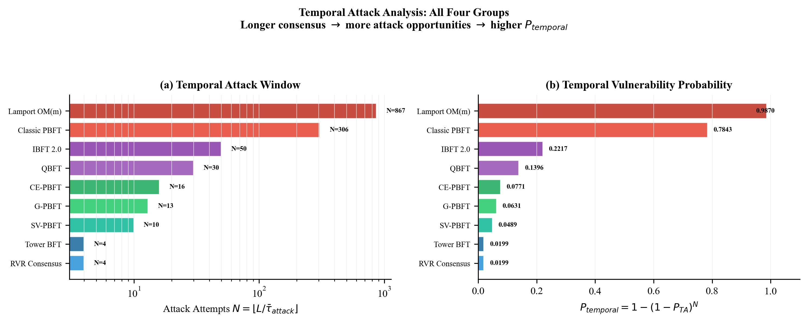
Group 2: Enterprise Consortium — IBFT 2.0 & QBFT
Validator subset: N_val = 15-21 (≪ n_sen = 3854)
Round-robin leader selection → deterministic & predictable
Latency: L ≈ 1.5-2.5 seconds
Attack window: N = 30-50 attempts
P_temporal ≈ 0.14 - 0.22
P_secure ≈ 0.778 - 0.860
IMPROVEMENT: 6× better than Group 1
WEAKNESS: Predictable leader = localized vulnerability

Slide 7
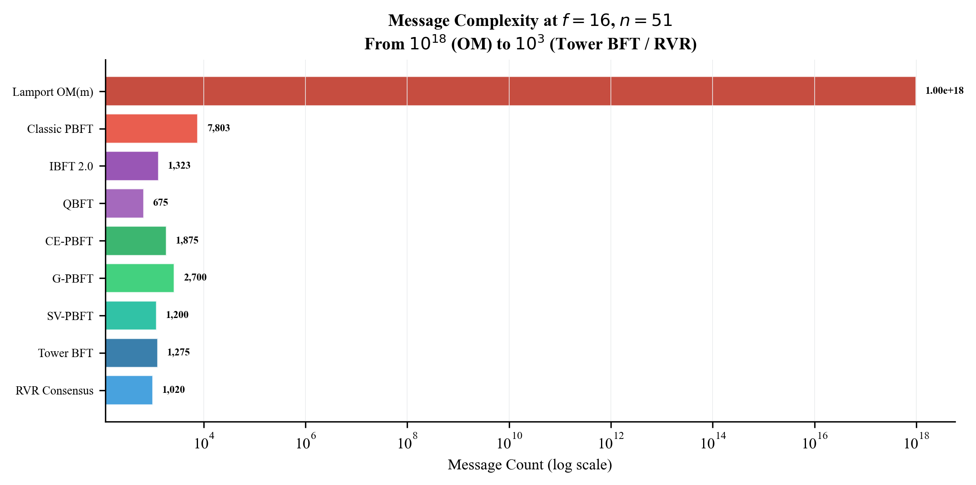
Group 3: Clustered Energy PBFT — CE/G/SV-PBFT
Grid partitioned into small committees (c = 20-30)
Spectral clustering / geohashing / V2V reputation
Comm. channels: c(c-1)/2 vs n_sen(n_sen-1)/2
→ 300 vs 7,426,681 links!
Latency: L ≈ 400-800 ms
Attack window: N = 10-16 attempts
P_temporal ≈ 0.049 - 0.077
P_secure ≈ 0.923 - 0.951
BEST TRADEOFF for legacy infrastructure

Slide 8
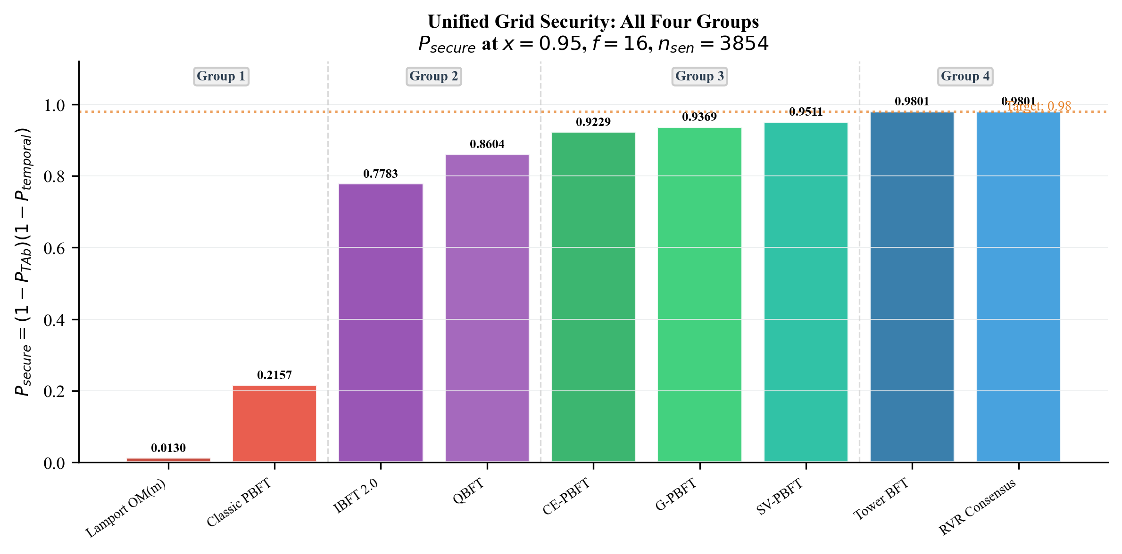
Group 4: Next-Gen — Tower BFT & RVR Consensus
Tower BFT: PoH VDF clock → O(n) messages, L ≤ 243 ms
RVR: VRF leader hiding → L ≈ 200 ms
Attack window reaches THEORETICAL MINIMUM: N = 4
P_temporal = 1 - (0.995)⁴ ≈ 0.0199
P_secure ≈ 0.980
VRF leader hiding (RVR) additionally reduces P_R:
P_R,VRF = P_R / n_validators = 0.01/51 ≈ 0.000196
RESULT: Definitively seals the temporal vulnerability

Slide 9
Unified Grid Security: P_secure Across All Groups

Slide 10
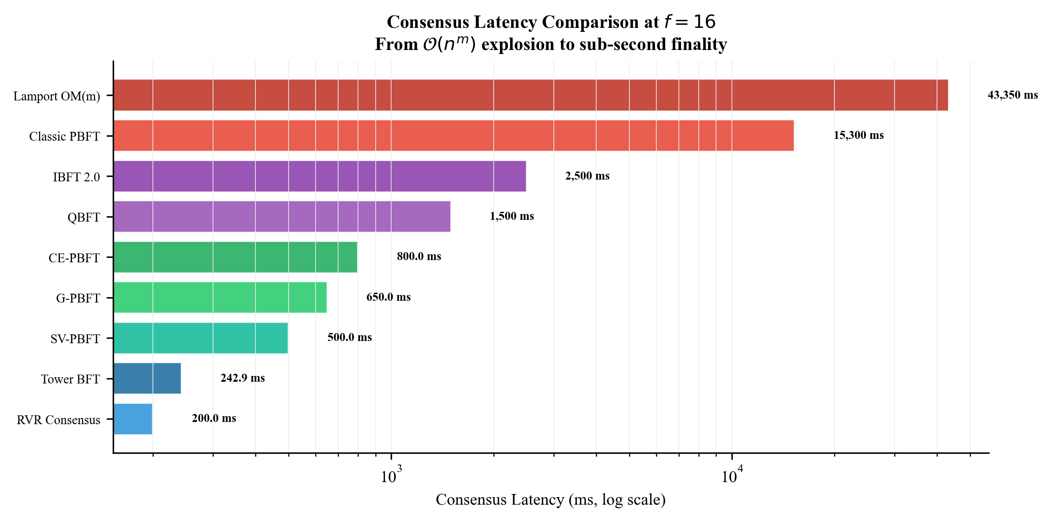
Consensus Latency: The Critical Differentiator

Slide 11
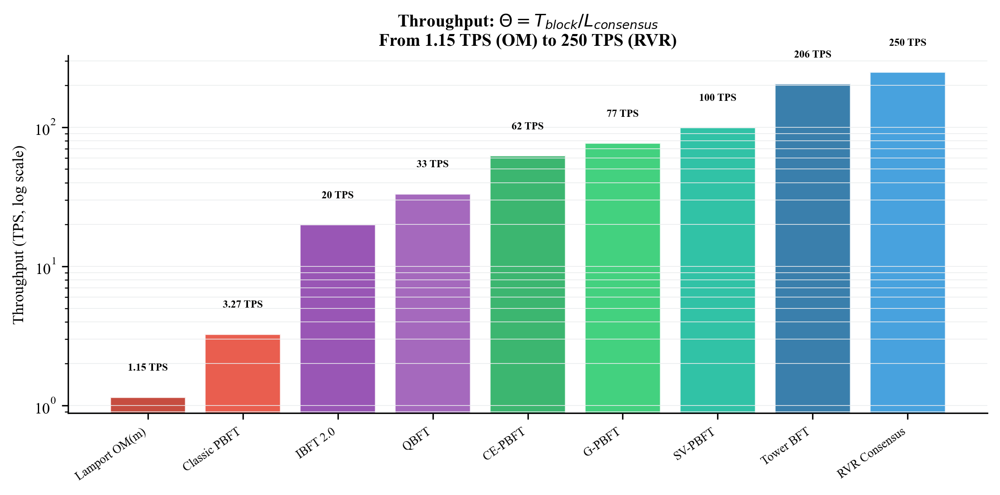
Throughput: Transactions Per Second (TPS)

Slide 12
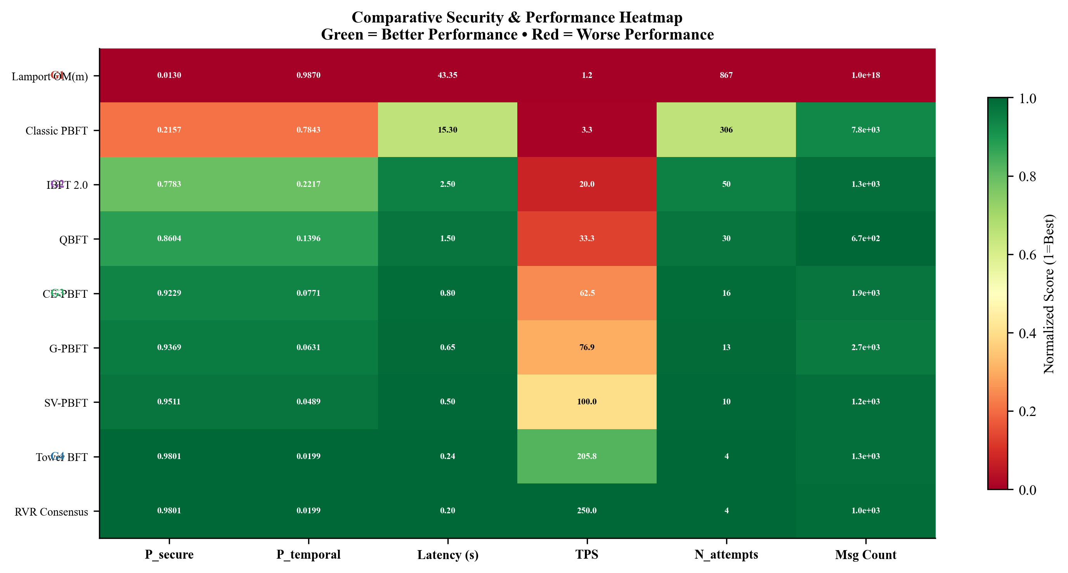
Comparative Security & Performance Heatmap

Slide 13
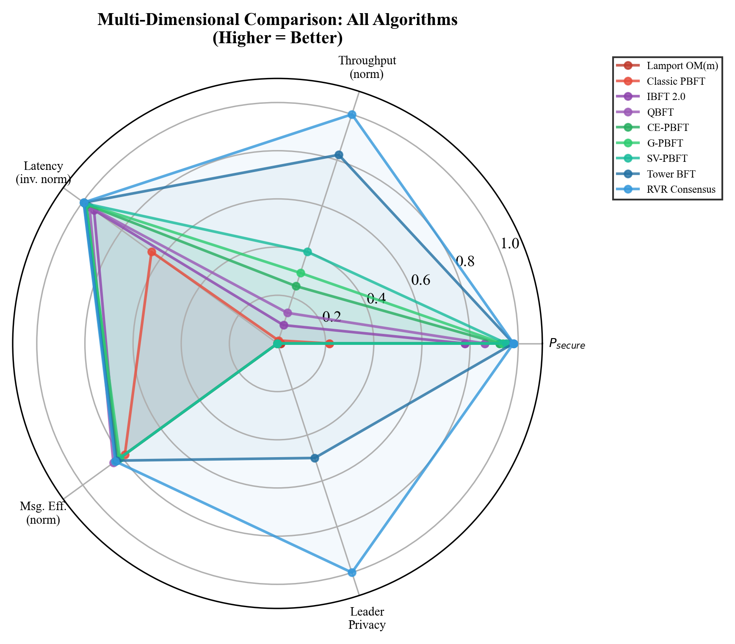
Multi-Dimensional Radar Comparison

Slide 14
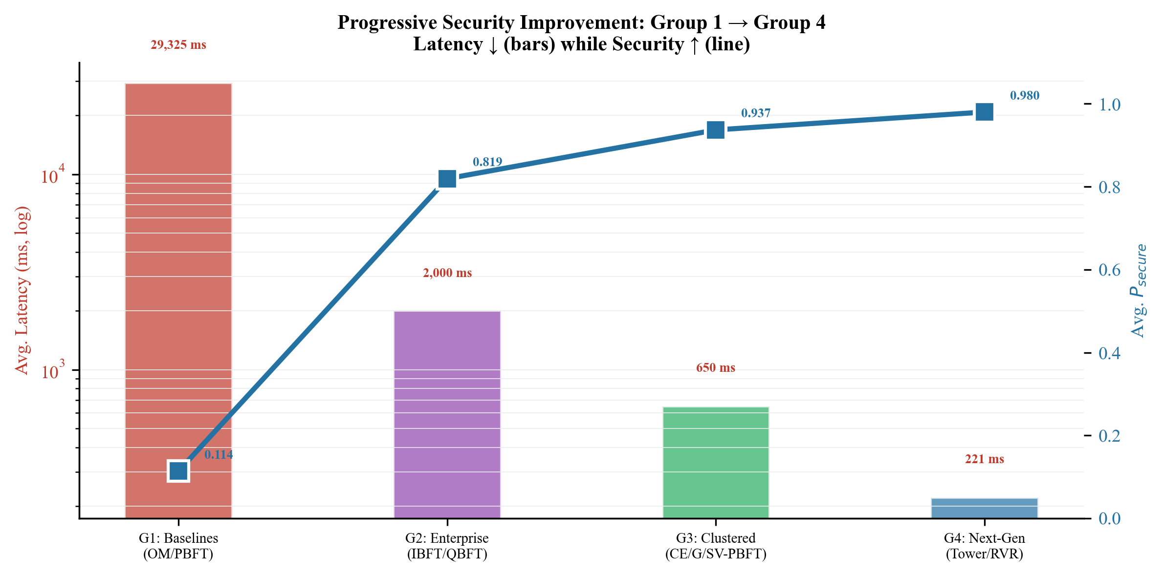
Progressive Improvement: Group 1 → Group 4

Slide 15
Temporal Vulnerability Decay: Operating Points

Slide 16
Comprehensive Results Table
Algorithm | Group | Latency | TPS | N_att | P_temporal | P_secure | Msgs
Lamport OM(m) | G1 | 43,350 ms | 1.2 | 867 | 0.9870 | 0.0130 | 10¹⁸
Classic PBFT | G1 | 15,300 ms | 3.3 | 306 | 0.7843 | 0.2157 | 7,803
IBFT 2.0 | G2 | 2,500 ms | 20.0 | 50 | 0.2217 | 0.7783 | 1,323
QBFT | G2 | 1,500 ms | 33.3 | 30 | 0.1396 | 0.8604 | 675
CE-PBFT | G3 | 800 ms | 62.5 | 16 | 0.0771 | 0.9229 | 1,875
G-PBFT | G3 | 650 ms | 76.9 | 13 | 0.0631 | 0.9369 | 2,700
SV-PBFT | G3 | 500 ms | 100.0 | 10 | 0.0489 | 0.9511 | 1,200
Tower BFT | G4 | 243 ms | 205.8 | 4 | 0.0199 | 0.9802 | 1,275
RVR | G4 | 200 ms | 250.0 | 4 | 0.0199 | 0.9802 | 1,020

Slide 17
Key Findings
1. Latency is the DOMINANT security parameter
• Static P_TAb is identical for ALL algorithms
• Only P_temporal differentiates viable from non-viable protocols
2. Group progression is monotonically improving
• G1: P_secure ≈ 0.01 → G4: P_secure ≈ 0.98
• Each group achieves ~1 order of magnitude improvement
3. The N ≤ 4 threshold is critical
• Consensus must complete within ~250 ms for P_secure ≥ 0.98
4. Clustering (G3) provides 85-95% of security benefit
• Best tradeoff for legacy infrastructure
5. VRF leader hiding (RVR) provides defence-in-depth
• Reduces P_R through cryptographic unpredictability

Slide 18
Deployment Roadmap
Legacy SCADA Grids → Group 3 (CE-PBFT, SV-PBFT)
• P_secure > 0.92 without sub-ms synchronization
• Compatible with existing SCADA infrastructure
Enterprise Microgrids → Group 2 (IBFT 2.0, QBFT)
• Familiar Hyperledger/ConsenSys tooling
• P_secure ≈ 0.78-0.86 — acceptable for controlled environments
Modern 5G-Connected Grids → Group 4 (Tower BFT, RVR)
• P_secure ≥ 0.98 with 200+ TPS
• Optimal for V2G and real-time energy markets
Research Direction → Hybrid approaches
• Group 3 clustering + Group 4 sub-second consensus

Slide 19
Thank You
References
[1] Sheikh et al., IEEE Access, 2020 — Secured Energy Trading Using Byzantine Consensus
[2] Lamport et al., ACM TOPLAS, 1982 — The Byzantine Generals Problem
[3] Yakovenko, 2018 — Solana Whitepaper (PoH / Tower BFT)
[4] X. Ding et al., IEEE Trans. Smart Grid, 2024 — CE-PBFT
[5] Z. Xu et al., Applied Energy, 2025 — G-PBFT
[6] Y. Suo et al., IEEE IoT Journal, 2025 — SV-PBFT
[7] H. Wang et al., IEEE TPDS, 2025 — RVR Consensus
[8] Z. Li et al., IEEE Trans. Ind. Informatics, 2020 — Secure P2P Trading

