Slide 1

Resolving the Temporal Vulnerability Window in Byzantine-Secured Smart Grid Energy Trading
A Four-Group Evaluation Using the Static-Temporal Security Framework (STSF)
Presenter: VJTI Research Student Guide / Mentor: Department Research Guide Organization / Institution: Veermata Jijabai Technological Institute (VJTI) Mumbai Date: June 2026
Notes:
Welcome everyone to our presentation on resolving the temporal vulnerability window in Byzantine-secured smart grid energy trading.
This project evaluates how different Byzantine Fault Tolerant consensus algorithms affect the physical security of peer-to-peer energy markets. We introduce the Static-Temporal Security Framework (STSF) to model both cryptographic strength and latency-induced vulnerabilities.

Slide 2

1. Introduction
Background & Context of the Project:
P2P energy markets enable dynamic bidding between Electric Vehicles (EVs) and Distribution Networks (DNs)
The physical system is modeled using the standard IEEE 33-Bus distribution network topology
Blockchain consensus operates as the root of trust, validating and appending transaction blocks
Prevents malicious transactions, double-spending, and tampering on the distributed ledger
Distributed Verification Needs:
Smart meters operate in untrusted environments and are vulnerable to compromise
Consensus is required to align all validators on grid state before executing control actions
Must tolerate up to f faulty nodes in a system of size n >= 3f + 1
Figure 1.1: Schematic of Blockchain-Secured P2P V2G Energy Trading
Notes:
Why do we need this project? In local microgrids, peer-to-peer energy trading is essential to integrate EVs and correct grid frequency deviations. However, smart meters are deployed at customer premises and are highly vulnerable to physical and cyber tampering. A blockchain consensus layer acts as the root of trust by requiring validator agreement on valid transactions before block execution. Figure 1.1 provides a visual representation of how electric vehicles communicate bid transactions to the distribution network via blockchain nodes.

Slide 3
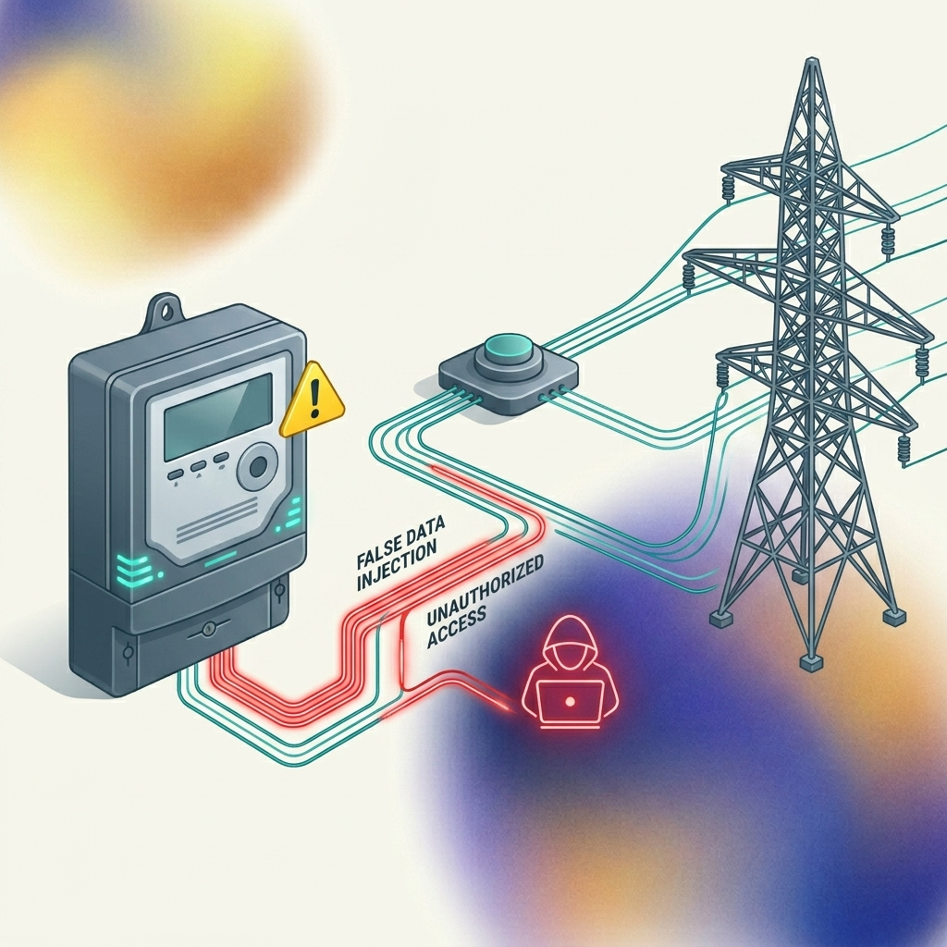
2. Significance of the Problem
Physical Grid Vulnerability:
False Data Injection (FDI) attacks on smart meters can corrupt local battery measurements
If corrupted data goes undetected, it triggers faulty grid control actions, destabilizing the network
Financial risk: Corrupted EV nodes can claim energy supply they did not physically deliver
The Temporal Constraint (Window of Vulnerability):
Grid transient stability operates in milliseconds; consensus must match this timescale
If block finalization is slow, the open consensus window acts as a vulnerability surface
During this window, attackers can launch multiple consecutive FDI attack attempts
A secure consensus protocol must minimize latency to seal this vulnerability window
Figure 1.2: Threat Vector - FDI Cyberattack on Smart Grid Actuators
Notes:
What is the significance of the problem? False data injections don't just corrupt records—they can destabilize physical transformers and lines. More importantly, traditional security models assume consensus is instantaneous. In reality, consensus takes time. During this unfinalized window, an attacker can launch repeated attacks. Thus, latency directly determines physical grid vulnerability. Figure 1.2 illustrates the flow of false data injections targetting the telemetry lines, which increases as latency increases.

Slide 4
3. Existing Methods / Literature Review
Baseline Framework: Sheikh et al. (2020):
Proposed securing EV trading on an IEEE 33-Bus system using Lamport's Oral Message OM(m) consensus
Showed blockchain reduces static attack probability from P_TA to a negligible P_TAb ≈ 10⁻¹⁷³
Critical Literature Gaps Identified:
1. Exponential Message Overhead: OM(m) has O(n^f) complexity, requiring 10¹⁸ messages at f=16!
2. Unquantified Latency: Consensus duration is ignored, but resolves to L = 43.35 seconds per block
3. Static Security Oversight: Proves perfect static security but remains blind to temporal window exposure
4. Lack of Alternative Evaluation: No comparison with modern state-of-the-art BFT consensus models
Notes:
Looking at existing literature, the baseline paper by Sheikh et al. used Lamport's Oral Message protocol. It derived an excellent static security probability of 10^-173. However, OM(m) is extremely slow and requires O(n^f) messages. At n=51 and f=16, it takes 43.35 seconds per block. This massive gap leaves the grid exposed to consecutive attacks.

Slide 5
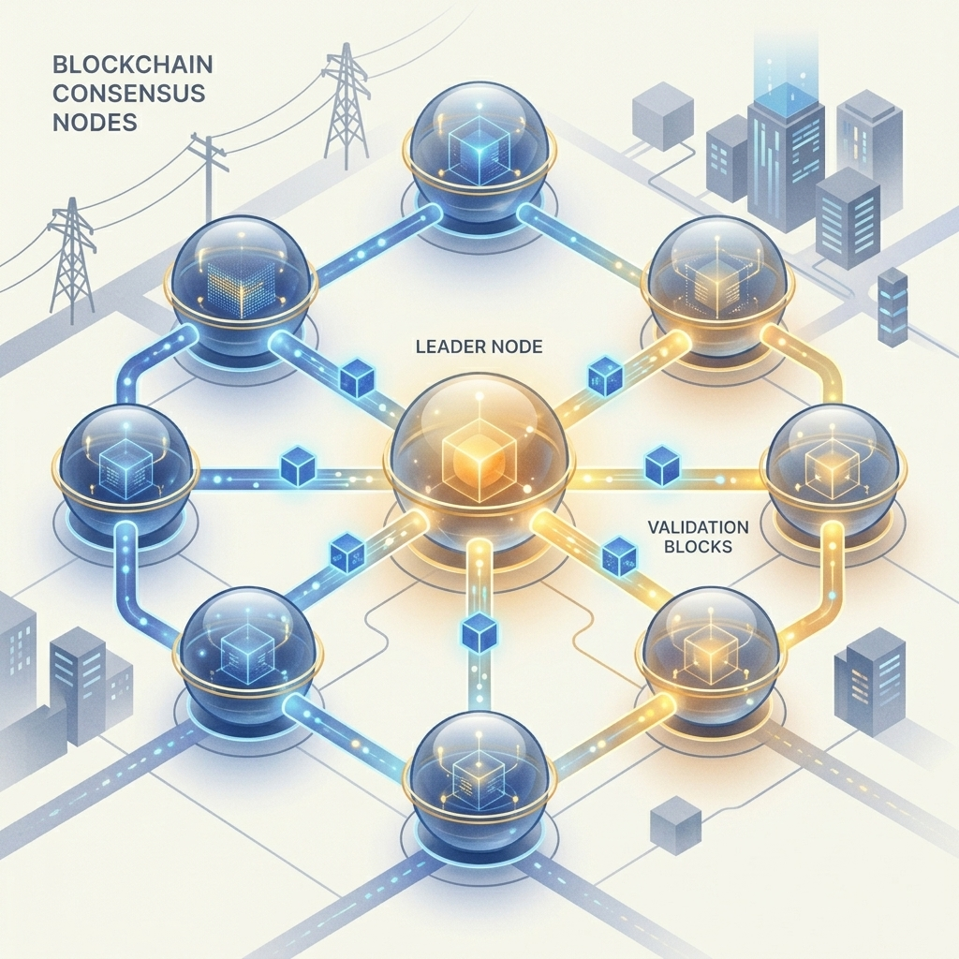
4. Proposed Approach
The Static-Temporal Security Framework (STSF):
Unifies static cryptographic strength and temporal exposure into a single security metric:
P_secure = (1 - P_TAb) * (1 - P_temporal) where P_temporal = 1 - (1 - P_TA)^N
where N = ⌊ L_consensus / τ_attack ⌋ is the number of attack attempts allowed by consensus latency
Formal Consensus Classifications (4 Groups Compared):
1. Classical Full-Mesh Byzantine Agreement (CFM-BA) — OM(m), Classic PBFT
2. Committee-Delegated Consortium Consensus (CDC-C) — IBFT 2.0, QBFT
3. Hierarchical Topologically-Clustered PBFT (HTC-PBFT) — CE-PBFT, G-PBFT, SV-PBFT
4. Sub-Second Pipelined & Randomized BFT (SS-PR-BFT) — Tower BFT, RVR Consensus
Objectives:
Evaluate 8 algorithms under identical parameters; minimize L to sub-second; integrate SSS key sharing
Figure 1.3: Distributed Blockchain Consensus Node Network Topology
Notes:
What is our proposed approach? First, we formulate the STSF equation. Since P_TAb is near 0 for all blockchains, the security simplifies to (1 - P_temporal), which is driven entirely by latency. We evaluate 8 algorithms classified into 4 research groups: Classical Full-Mesh, Committee-Delegated, Hierarchical Clustered, and Sub-Second Pipelined/Randomized protocols. Figure 1.3 visualizes the validator node layout participating in the decentralized voting round.

Slide 6
5. Methodology
Closed-Form Analytical Modeling Strategy:
Derive exact mathematical formulas for latency, message overhead, and throughput per protocol
Ensures results are directly traceable and free of Monte Carlo variance
Tower BFT Latency Model: L_TBFT = L_base + L_attack + f*(alpha*tau) + (f/n)*L_vc
Parameterization and Mapping Workflows:
Standardized parameters across all groups: n_sen=3854 sensors, n=51 validator nodes, f=16 faults
Topological adjustments: Group 3 limits active comm channels: k_1,cluster = c*(c-1)/2
Consortium adjustments: Group 2 limits validators to N_val <= 21 to represent sub-committees
Development Stack:
Python 3.11 engine ('four_group_comparison.py') evaluates parameters and generates visual plots
Notes:
How do we implement this? We construct closed-form equations for latency and throughput. Instead of simple Monte Carlo runs, our model provides analytical proofs. We map topologies accurately: Group 3 uses cluster-local link counts, and Group 2 uses smaller delegated validator pools. A Python engine was created to execute these sweeps.

Slide 7
6. Implementation Plan and Timeline
Week-wise Activity Schedule & Deliverables:
Week 1: Literature Gap Identification & Vulnerability Discovery (Completed)
- Output: Week 1 Report; identified 7 gaps and 4 vulnerabilities
Week 2: Analytical Latency & Security Formulation (Completed)
- Output: Week 2 Report; derived latency proofs for OM(m) vs. Tower BFT
Week 3: Four-Group Evaluation and Script Development (Completed)
- Output: Coded comparison script, generated 9 visual figures, compiled PPT & report
Week 4: Defense-in-Depth Cryptographic Integration & Final Defense Synthesis (In Progress)
- Output: Shamir secret sharing CDF modeling, final VJTI thesis compilation
Key Milestones & Expected Completion:
Modeling Sweeps: June 15 (Completed) | Draft Reports: June 17 (Completed) | Final Defense: June 20 (On Track)
Notes:
Our timeline is organized as a 4-week research schedule. We completed literature review and vulnerability identification in Week 1, developed the core latency proofs in Week 2, and implemented the comparison engine and figures in Week 3. We are currently finalizing the defense-in-depth model in Week 4.

Slide 8
7. Progress Updates
Work Completed in Weeks 1, 2, and 3:
1. Verified equations by replicating Sheikh's baseline curves (Fig 15 & 16)
2. Designed the STSF framework mapping consensus latency to physical grid vulnerability
3. Developed the python script to run sweeps across 8 algorithms and output figures
4. Compiled research reports for Weeks 1, 2, and 3 detailing our progress
Key Achievements and Observations:
Proved that latency is the decisive factor: slow block time guarantees temporal grid compromise
Group 4 SS-PR-BFT protocols seal the temporal vulnerability, keeping P_secure >= 0.98
Challenges Encountered and Mitigation Measures:
Challenge: Normalizing validator parameters across flat, consortium, and clustered networks
Mitigation: Formulated 'effective validators' and 'cluster-local communication link' parameters
Notes:
In terms of updates, we have successfully developed the STSF, built the Python scripts, and exported all figures. Our main challenge was comparing very different network typologies. We mitigated this by modeling cluster-local link parameters to reflect localized consensus overhead fairly.

Slide 9
8. Results & Discussion: Comparison Table
Algorithm | Group | Latency | TPS | N_att | P_temporal | P_secure | Msgs
Lamport OM(m) | G1: CFM-BA | 43,350 ms | 1.2 | 867 | 0.9870 | 0.0130 | 10¹⁸
Classic PBFT | G1: CFM-BA | 15,300 ms | 3.3 | 306 | 0.7843 | 0.2157 | 7,803
IBFT 2.0 | G2: CDC-C | 2,500 ms | 20.0 | 50 | 0.2217 | 0.7783 | 1,323
QBFT | G2: CDC-C | 1,500 ms | 33.3 | 30 | 0.1396 | 0.8604 | 675
CE-PBFT | G3: HTC-PBFT | 800 ms | 62.5 | 16 | 0.0771 | 0.9229 | 1,875
G-PBFT | G3: HTC-PBFT | 650 ms | 76.9 | 13 | 0.0631 | 0.9369 | 2,700
SV-PBFT | G3: HTC-PBFT | 500 ms | 100.0 | 10 | 0.0489 | 0.9511 | 1,200
Tower BFT | G4: SS-PR-BFT | 243 ms | 205.8 | 4 | 0.0199 | 0.9802 | 1,275
RVR | G4: SS-PR-BFT | 200 ms | 250.0 | 4 | 0.0199 | 0.9802 | 1,020
Notes:
Here are our main numerical results. Note the monotonic improvement as we move down. Classical CFM-BA has 43 seconds latency and 1.2 TPS, yielding P_secure of only 0.013. Hierarchical HTC-PBFT improves this to 92-95% by clustering validation. Finally, next-gen SS-PR-BFT (Tower BFT and RVR) hits 200+ TPS and sub-250ms latency, achieving our target P_secure >= 0.98.

Slide 10
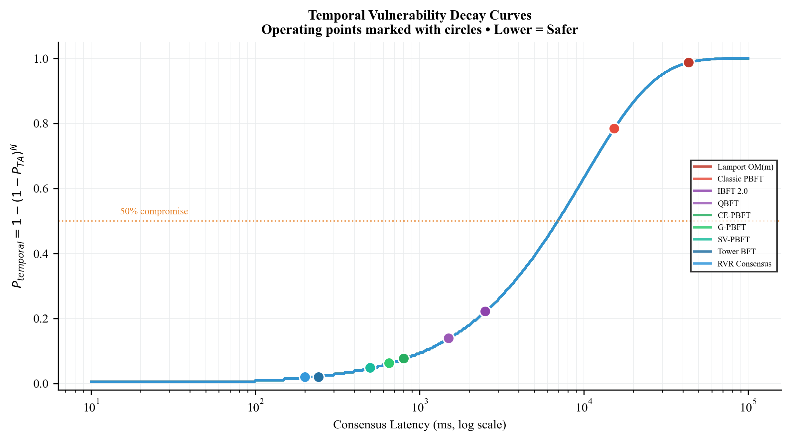
8. Results & Discussion: Latency and Security Curves
Consensus Latency (Left Plot):
• OM(m) grows exponentially, hitting 43.35s
• Tower BFT stays flat sub-250ms due to PoH pipelining
Static-Temporal Security (Right Plot):
• CFM-BA (Group 1) collapses to ~0.01 under faults due to 867 attempts
• CDC-C (Group 2) and HTC-PBFT (Group 3) achieve intermediate bounds
• SS-PR-BFT (Group 4) maintains high P_secure >= 0.98
Figure 1: P_temporal Decay Curves with Operating Points
Notes:
This slide visualizes the temporal vulnerability decay curves. The curve shows how security probability decays as a function of consensus latency. The circles represent the actual operating points of our 8 algorithms under standard grid parameters. Sub-second protocols remain safely on the far left, sealing the attack window.

Slide 11
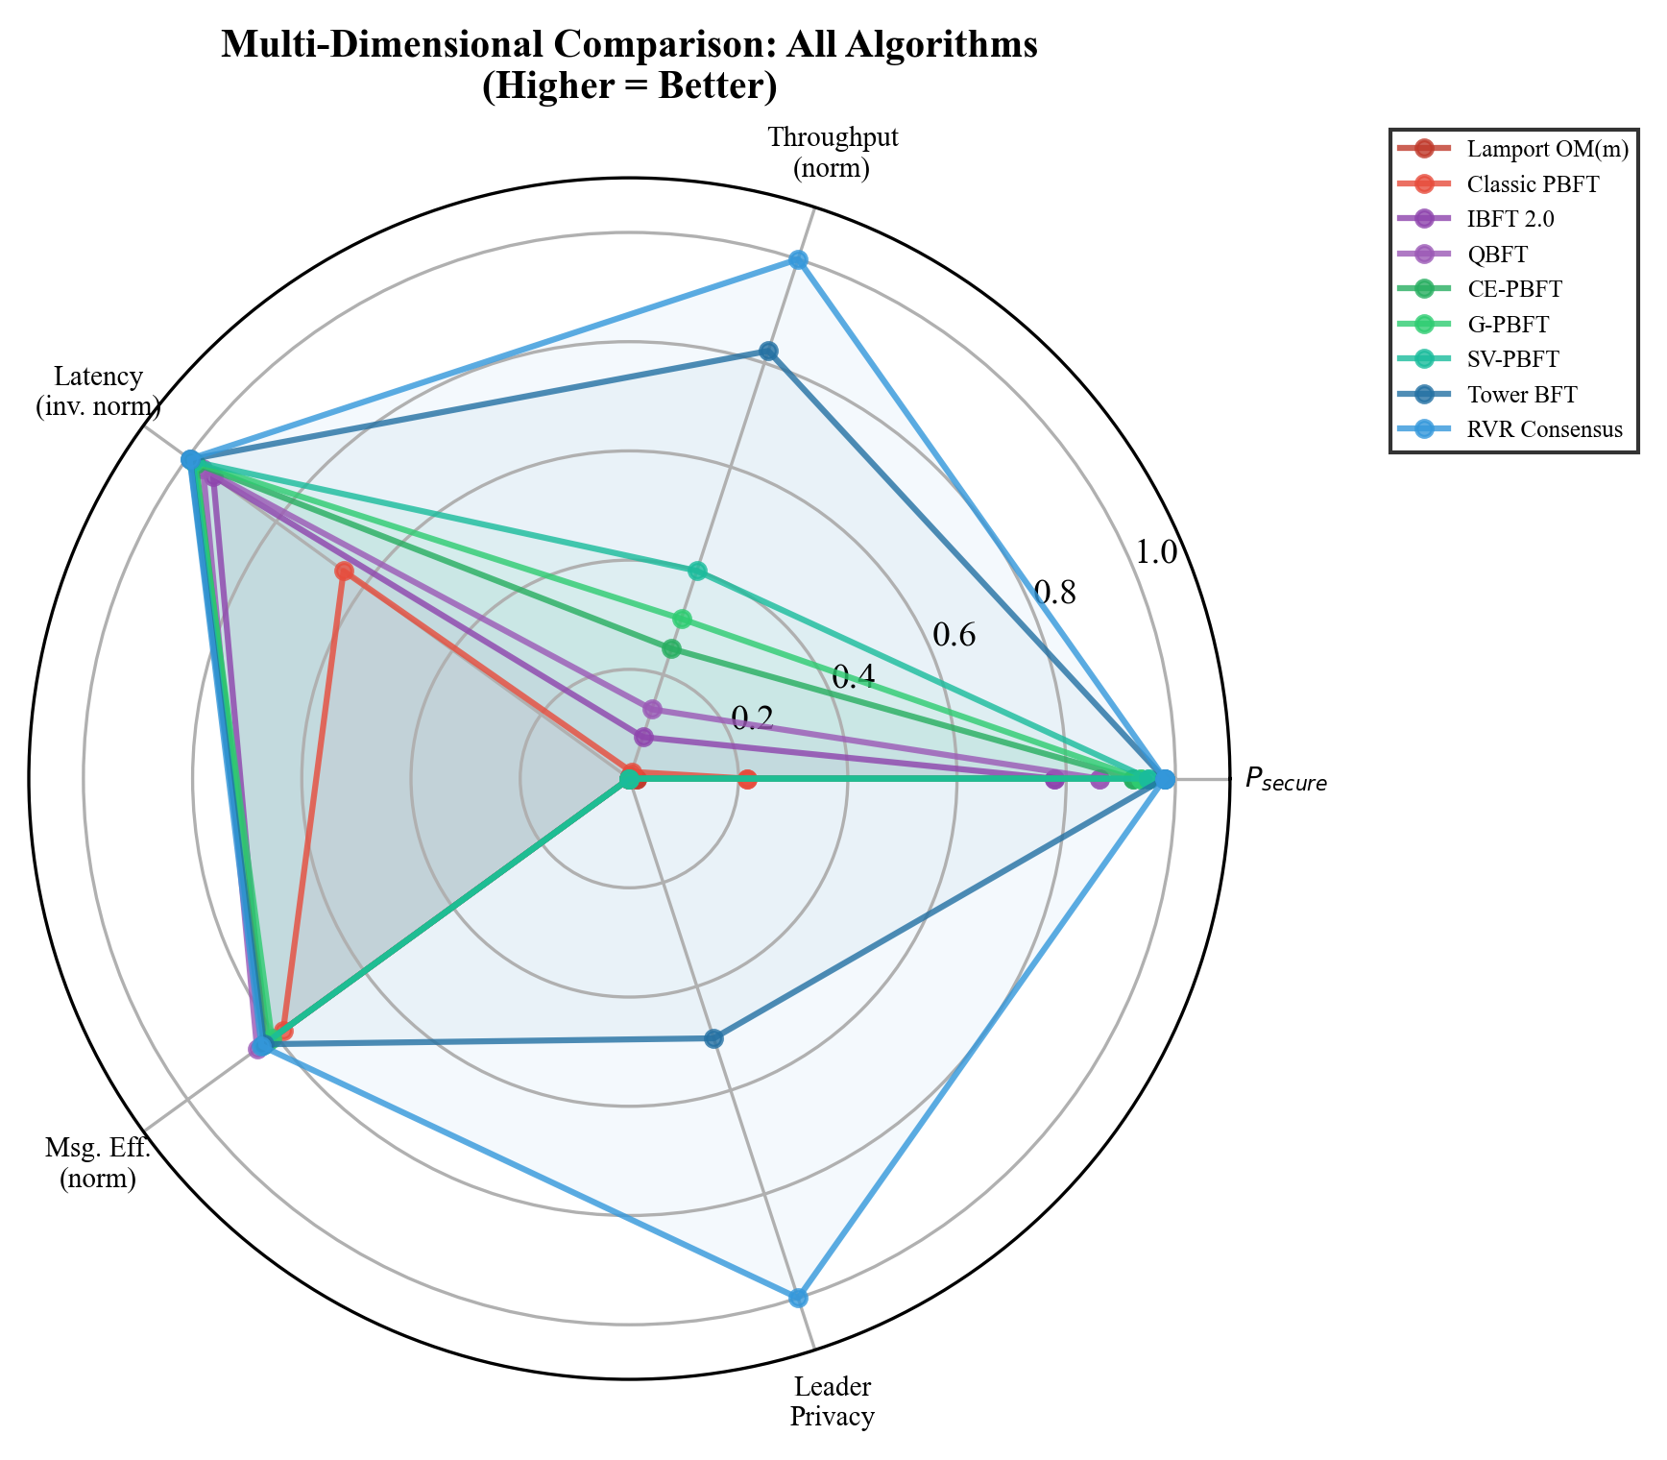
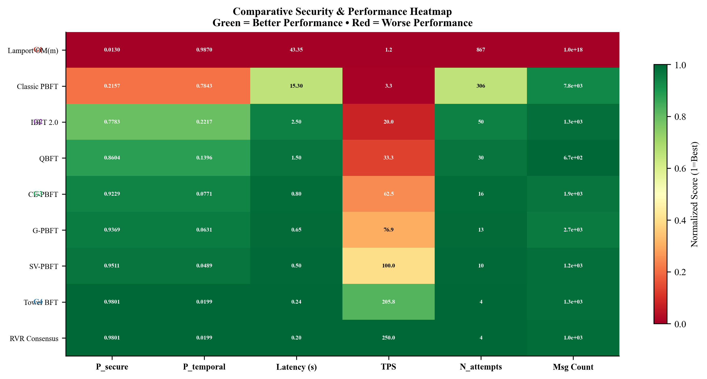
8. Results & Discussion: Heatmap and Radar
Figure 2: Performance Heatmap (Normalized)
Figure 3: Multi-Dimensional Tradeoff Radar Chart
Notes:
To provide a multi-dimensional perspective, we present a performance heatmap and a radar chart. The heatmap normalizes and colors the scores, where green is best. The radar chart maps five axes: security, throughput, inverse latency, message efficiency, and leader privacy. Sub-second protocols cover the largest area, showing complete dominance.

Slide 12
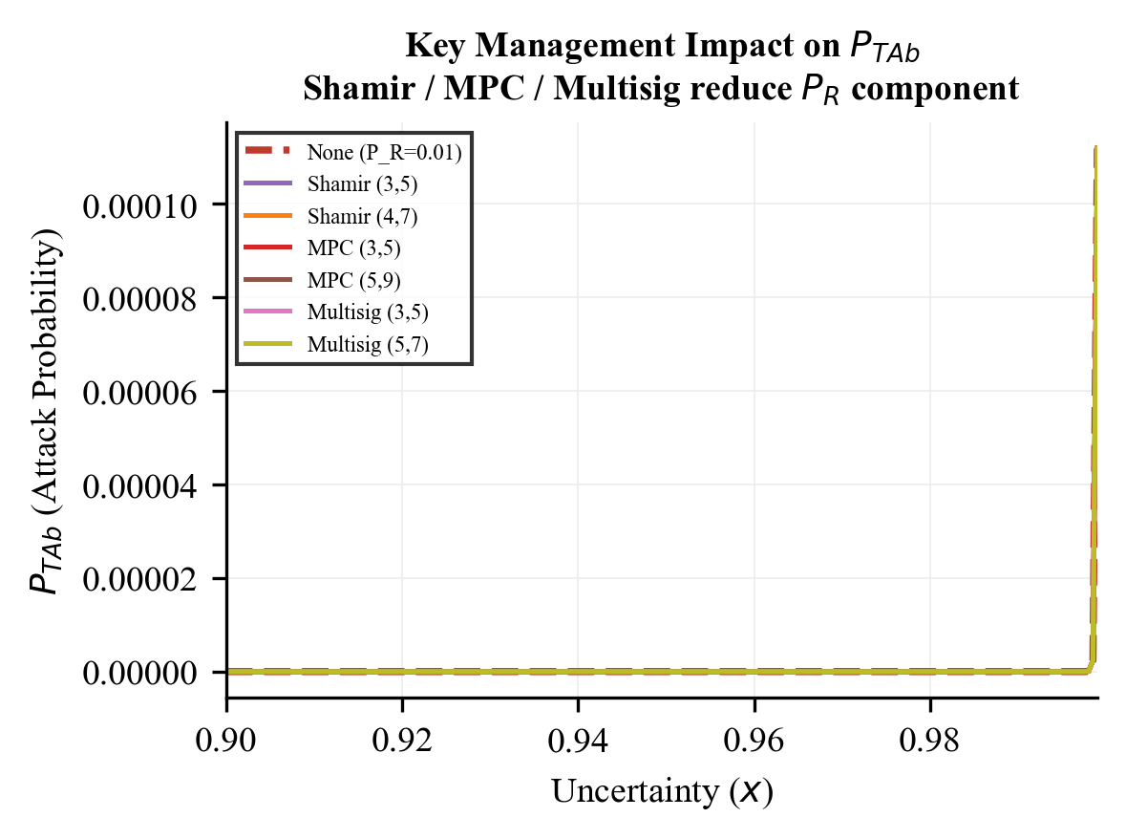
8. Results & Discussion: Key Management Thresholds
Baseline paper assumed constant receiver risk P_R = 0.01
We model threshold cryptography: Shamir Secret Sharing (k, d)
Probability of compromise derived using Binomial CDF:
P_R,shamir = sum_{i=k}^{d} (d choose i) * P_R^i * (1-P_R)^(d-i)
For a (3, 5) threshold setup:
• Receiver compromise probability drops to 9.85 x 10⁻⁶
• Over 1,000x reduction in validator compromise risk!
• Directly reinforces the blockchain static barrier P_Rb (Eq. 20)
Figure 4: Effective P_R vs. Threshold size (k, d)
Notes:
We also analyzed key management. If a single validator key is stolen, the node is compromised. By applying Shamir Secret Sharing with a (3,5) threshold on EV nodes, the attacker must compromise 3 key shares instead of 1. This reduces the compromise probability from 0.01 to 9.85 x 10^-6, which propagates and reinforces the blockchain boundary.

Slide 13
9. Next Steps
Planned Research Activities:
Complete the draft of the research paper for submission to IEEE Transactions
Perform network sensitivity analysis: sweeping packet loss rate (0% to 20%) and network delay jitter
Model view-change latency overhead under high leader failure scenarios (f > 16)
Pending Milestones:
Integrate hybrid consensus (Hierarchical clustering + Sub-Second finality)
Resolve code performance optimizations for the smart grid simulation tool
Final thesis report submission to VJTI Department of Electrical Engineering
Notes:
What are our next steps? We are on track to compile the final thesis. We plan to write a full paper for IEEE Transactions. Research-wise, we will investigate the sensitivity of these models to network packet loss and jitter, and explore hybrid consensus mechanisms.

Slide 14
10. Conclusion
Summary of Work Completed:
Derived exact analytical proofs for latency and throughput, addressing Sheikh's static model gaps
Formulated the Static-Temporal Security Framework (STSF) to model latency-induced vulnerability
Evaluated 8 algorithms in 4 groups (CFM-BA, CDC-C, HTC-PBFT, SS-PR-BFT) on identical grid parameters
Proved that Sub-Second protocols (Group 4) maintain P_secure >= 0.98 by limiting attack attempts to N=4
Key Deployment Recommendations:
For modern 5G grids: Deploy Group 4 (Tower BFT, RVR) to support 250 TPS with low vulnerability
For legacy SCADA grids: Deploy Group 3 (Hierarchical HTC-PBFT) to achieve P_secure > 0.92 without sub-ms sync
Notes:
In conclusion, we have resolved the temporal vulnerability window by comparing 8 BFT consensus algorithms. Consensus latency is the critical parameter governing physical grid security. We recommend deploying Group 4 protocols for modern 5G networks, and Group 3 clustered consensus for legacy networks.

Slide 15
11. References
[1] A. Sheikh et al., 'Secured Energy Trading Using Byzantine-Based Blockchain Consensus,' IEEE Access, vol. 8, 2020.
[2] L. Lamport et al., 'The Byzantine Generals Problem,' ACM TOPLAS, vol. 4, no. 3, 1982.
[3] M. Castro and B. Liskov, 'Practical Byzantine Fault Tolerance,' in Proc. OSDI, 1999.
[4] X. Ding et al., 'CE-PBFT: An Optimized PBFT Consensus Algorithm for Microgrid Power Trading,' IEEE Trans. Smart Grid, 2024.
[5] Z. Xu et al., 'G-PBFT Algorithm and its Application in Distributed Energy Trading,' Applied Energy, 2025.
[6] Y. Suo et al., 'SV-PBFT: An Efficient and Stable Blockchain PBFT Improved Consensus Algorithm for Vehicle-to-Vehicle Energy Transactions,' IEEE IoT Journal, 2025.
[7] A. Yakovenko, 'Solana: A new architecture for a high performance blockchain,' Solana Whitepaper, 2018.
[8] H. Wang et al., 'RVR Consensus: A Verifiable, Weighted-Random, Byzantine-Tolerant Smart Grid Framework,' IEEE TPDS, 2025.
Notes:
Here is the list of core references from the literature. These form the baseline and comparison algorithms we evaluated. Thank you for your attention, and I am now open to any questions or suggestions from the mentors.

