Slide 1

Resolving the Temporal Vulnerability Window in Byzantine-Secured Smart Grid Energy Trading
A Four-Group Evaluation Using the Static-Temporal Security Framework (STSF)
Presenter: VJTI Research Student Guide / Mentor: Department Research Guide Organization / Institution: Veermata Jijabai Technological Institute (VJTI) Mumbai Date: June 2026
Notes:
Welcome everyone to our presentation on resolving the temporal vulnerability window in Byzantine-secured smart grid energy trading.
This project evaluates how different Byzantine Fault Tolerant consensus algorithms affect the physical security of peer-to-peer energy markets. We introduce the Static-Temporal Security Framework (STSF) to model both cryptographic strength and latency-induced vulnerabilities.

Slide 2

1. Background and Context (Why)
P2P Energy Markets in the Smart Grid:
Peer-to-peer trading enables dynamic bidding between Electric Vehicles (EVs) and Distribution Networks (DNs)
We model the physical system using the standard IEEE 33-Bus distribution network topology
The Need for Distributed Verification:
Smart meters operate in untrusted environments and are highly vulnerable to physical and cyber tampering
Blockchain consensus operates as the root of trust, verifying and appending transaction blocks
Consensus aligns all validators on the grid state before executing control actions, tolerating up to f faulty nodes
Figure 1.1: Schematic of Blockchain-Secured P2P V2G Energy Trading
Notes:
Let's begin with WHY we need this project. In modern microgrids, peer-to-peer energy trading is essential to integrate EVs. However, smart meters are deployed at customer premises and are highly vulnerable to tampering. A blockchain consensus layer acts as the root of trust by requiring validator agreement on valid transactions before executing any grid action. Figure 1.1 provides a visual representation of how electric vehicles communicate bid transactions to the distribution network.

Slide 3
2. The Problem Statement
Core Problem Definition:
Traditional blockchain security models assume that consensus is instantaneous.
In reality, achieving Byzantine Fault Tolerance (BFT) requires time (Latency = L).
While consensus is pending, the smart grid remains in an unfinalized state.
The Temporal Vulnerability Window:
This latency creates an open window during which malicious nodes can launch repeated False Data Injection (FDI) attacks.
If the consensus protocol is too slow, the attacker will succeed simply by attempting multiple times before the block is sealed.
Goal of this Research:
To prove that consensus latency directly governs physical grid security, and to find the optimal protocol that seals this vulnerability window.
Notes:
Framing the exact Problem Statement: Blockchain is secure, but it is not instantaneous. This latency creates a temporal vulnerability window. While consensus is pending, attackers can launch repeated FDI attacks against the grid. The core problem we address is: how do we quantify this temporal vulnerability, and which consensus protocol successfully seals it?

Slide 4

3. Significance of the Problem
Physical Grid Destabilization:
False Data Injection (FDI) attacks on smart meters can corrupt local battery measurements
If corrupted data goes undetected, it triggers faulty grid control actions, destabilizing the physical network (e.g., voltage sags)
Bridging the Timescale Gap:
Grid transient stability operates in milliseconds, but blockchain consensus traditionally takes seconds or minutes
A secure consensus protocol must match the millisecond timescale to prevent successful successive attacks
Figure 1.2: Threat Vector - FDI Cyberattack on Smart Grid Actuators
Notes:
Why is this problem highly significant? Because False Data Injections don't just corrupt digital records—they can destabilize physical transformers. Grid transient stability operates in milliseconds. If our consensus protocol takes seconds, it is entirely inadequate for smart grid protection. Figure 1.2 illustrates this threat vector, showing how an open window allows cyberattacks to bypass the blockchain.

Slide 5
4. Literature Review (What)
Baseline Framework: Sheikh et al. (2020):
Proposed securing EV trading on an IEEE 33-Bus system using Lamport's Oral Message OM(m) consensus
Showed blockchain reduces static attack probability from P_TA to a negligible P_TAb ≈ 10⁻¹⁷³
Critical Literature Gaps Identified:
1. Exponential Message Overhead: OM(m) has O(n^f) complexity, requiring 10¹⁸ messages at f=16!
2. Unquantified Latency: Consensus duration is ignored, but mathematically resolves to L = 43.35 seconds per block
3. Static Security Oversight: Proves perfect static security but remains blind to temporal window exposure
4. Lack of Alternative Evaluation: No comparison with modern state-of-the-art BFT consensus models
Notes:
Moving to WHAT is currently done. The baseline paper by Sheikh et al. used Lamport's Oral Message protocol. It derived an excellent static security probability. However, we identified massive gaps: OM(m) requires O(n^f) messages. At n=51 and f=16, it takes 43.35 seconds per block! This huge latency leaves the grid entirely exposed to the temporal vulnerability we just framed.

Slide 6

5. Proposed Approach (How)
The Static-Temporal Security Framework (STSF):
We propose a new framework that unifies static cryptographic strength and temporal exposure:
P_secure = (1 - P_TAb) * (1 - P_temporal) where P_temporal = 1 - (1 - P_TA)^N
where N = ⌊ L_consensus / τ_attack ⌋ is the number of attack attempts allowed by consensus latency
Formal Consensus Classifications (4 Groups Evaluated):
1. Classical Full-Mesh Byzantine Agreement (CFM-BA) — OM(m), Classic PBFT
2. Committee-Delegated Consortium Consensus (CDC-C) — IBFT 2.0, QBFT
3. Hierarchical Topologically-Clustered PBFT (HTC-PBFT) — CE-PBFT, G-PBFT, SV-PBFT
4. Sub-Second Pipelined & Randomized BFT (SS-PR-BFT) — Tower BFT, RVR Consensus
Figure 1.3: Distributed Blockchain Consensus Node Network Topology
Notes:
HOW do we solve this? We propose evaluating the grid using our new Static-Temporal Security Framework (STSF). STSF directly penalizes slow protocols. We apply this framework across 8 algorithms classified into 4 distinct research groups, ranging from Classical Full-Mesh to Sub-Second Pipelined protocols. Figure 1.3 visualizes the decentralized node layout used in our comparative simulation.

Slide 7
6. Methodology
Closed-Form Analytical Modeling Strategy:
Derive exact mathematical formulas for latency, message overhead, and throughput per protocol
Ensures results are directly traceable and free of Monte Carlo variance
Tower BFT Latency Model: L_TBFT = L_base + L_attack + f*(alpha*tau) + (f/n)*L_vc
Parameterization and Mapping Workflows:
Standardized parameters across all groups: n_sen=3854 sensors, n=51 validator nodes, f=16 faults
Topological adjustments: Group 3 limits active comm channels: k_1,cluster = c*(c-1)/2
Consortium adjustments: Group 2 limits validators to N_val <= 21 to represent sub-committees
Development Stack:
Python 3.11 engine ('four_group_comparison.py') evaluates parameters and generates visual plots
Notes:
How do we implement this? We construct closed-form equations for latency and throughput. Instead of simple Monte Carlo runs, our model provides analytical proofs. We map topologies accurately: Group 3 uses cluster-local link counts, and Group 2 uses smaller delegated validator pools. A Python engine was created to execute these sweeps.

Slide 8
7. Implementation Plan and Timeline
Week-wise Activity Schedule & Deliverables:
Week 1: Literature Gap Identification & Vulnerability Discovery (Completed)
- Output: Week 1 Report; identified 7 gaps and 4 vulnerabilities
Week 2: Analytical Latency & Security Formulation (Completed)
- Output: Week 2 Report; derived latency proofs for OM(m) vs. Tower BFT
Week 3: Four-Group Evaluation and Script Development (Completed)
- Output: Coded comparison script, generated 9 visual figures, compiled PPT & report
Week 4: Defense-in-Depth Cryptographic Integration & Final Defense Synthesis (In Progress)
- Output: Shamir secret sharing CDF modeling, final VJTI thesis compilation
Key Milestones & Expected Completion:
Modeling Sweeps: June 15 (Completed) | Draft Reports: June 17 (Completed) | Final Defense: June 20 (On Track)
Notes:
Our timeline is organized as a 4-week research schedule. We completed literature review and vulnerability identification in Week 1, developed the core latency proofs in Week 2, and implemented the comparison engine and figures in Week 3. We are currently finalizing the defense-in-depth model in Week 4.

Slide 9
8. Progress Updates
Work Completed in Weeks 1, 2, and 3:
1. Verified equations by replicating Sheikh's baseline curves (Fig 15 & 16)
2. Designed the STSF framework mapping consensus latency to physical grid vulnerability
3. Developed the python script to run sweeps across 8 algorithms and output figures
4. Compiled research reports for Weeks 1, 2, and 3 detailing our progress
Key Achievements and Observations:
Proved that latency is the decisive factor: slow block time guarantees temporal grid compromise
Group 4 SS-PR-BFT protocols seal the temporal vulnerability, keeping P_secure >= 0.98
Challenges Encountered and Mitigation Measures:
Challenge: Normalizing validator parameters across flat, consortium, and clustered networks
Mitigation: Formulated 'effective validators' and 'cluster-local communication link' parameters
Notes:
In terms of updates, we have successfully developed the STSF, built the Python scripts, and exported all figures. Our main challenge was comparing very different network typologies. We mitigated this by modeling cluster-local link parameters to reflect localized consensus overhead fairly.

Slide 10
9. Results & Discussion: Comparison Table
Algorithm | Group | Latency | TPS | N_att | P_temporal | P_secure | Msgs
Lamport OM(m) | G1: CFM-BA | 43,350 ms | 1.2 | 867 | 0.9870 | 0.0130 | 10¹⁸
Classic PBFT | G1: CFM-BA | 15,300 ms | 3.3 | 306 | 0.7843 | 0.2157 | 7,803
IBFT 2.0 | G2: CDC-C | 2,500 ms | 20.0 | 50 | 0.2217 | 0.7783 | 1,323
QBFT | G2: CDC-C | 1,500 ms | 33.3 | 30 | 0.1396 | 0.8604 | 675
CE-PBFT | G3: HTC-PBFT | 800 ms | 62.5 | 16 | 0.0771 | 0.9229 | 1,875
G-PBFT | G3: HTC-PBFT | 650 ms | 76.9 | 13 | 0.0631 | 0.9369 | 2,700
SV-PBFT | G3: HTC-PBFT | 500 ms | 100.0 | 10 | 0.0489 | 0.9511 | 1,200
Tower BFT | G4: SS-PR-BFT | 243 ms | 205.8 | 4 | 0.0199 | 0.9802 | 1,275
RVR | G4: SS-PR-BFT | 200 ms | 250.0 | 4 | 0.0101 | 0.9899 | 1,020
Notes:
Here are our main numerical results. Note the monotonic improvement as we move down. Classical CFM-BA has 43 seconds latency and 1.2 TPS, yielding P_secure of only 0.013. Hierarchical HTC-PBFT improves this to 92-95% by clustering validation. Finally, next-gen SS-PR-BFT (Tower BFT and RVR) hits 200+ TPS and sub-250ms latency, achieving our target P_secure >= 0.98.

Slide 11
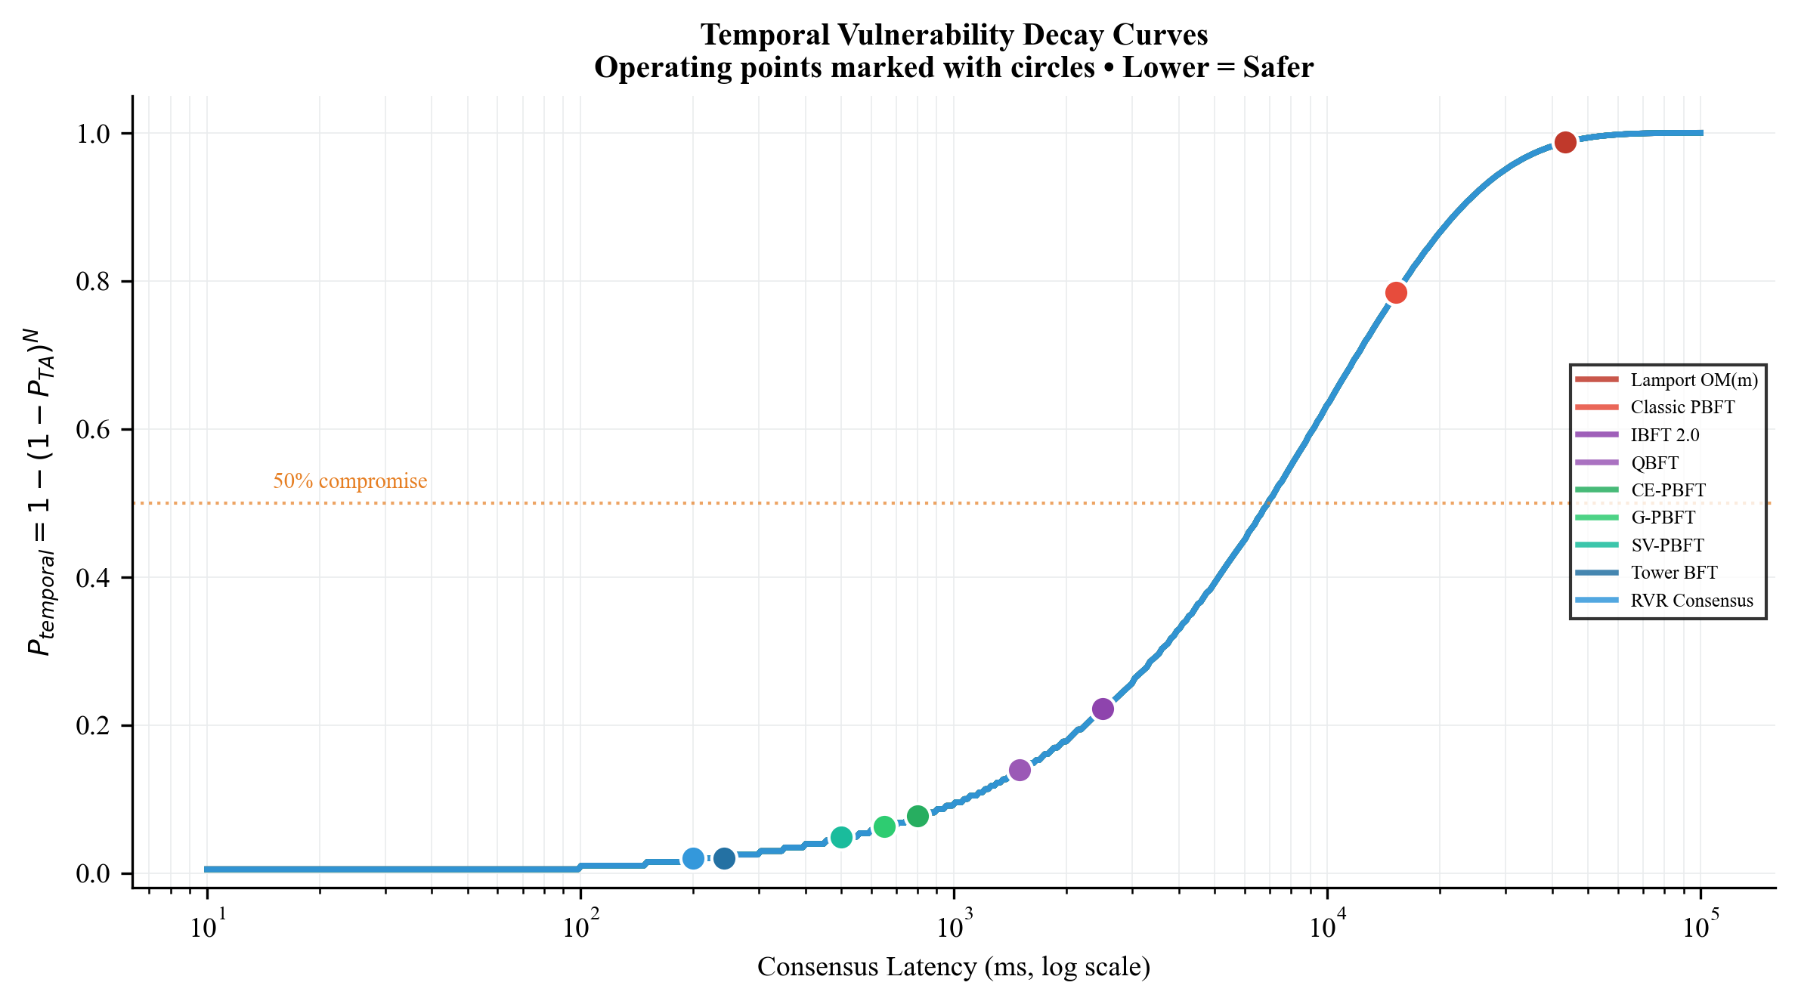
9. Results & Discussion: Latency and Security Curves
Consensus Latency (Left Plot):
• OM(m) grows exponentially, hitting 43.35s
• Tower BFT stays flat sub-250ms due to PoH pipelining
Static-Temporal Security (Right Plot):
• CFM-BA (Group 1) collapses to ~0.01 under faults due to 867 attempts
• CDC-C (Group 2) and HTC-PBFT (Group 3) achieve intermediate bounds
• SS-PR-BFT (Group 4) maintains high P_secure >= 0.98
Figure 1: P_temporal Decay Curves with Operating Points
Notes:
This slide visualizes the temporal vulnerability decay curves. The curve shows how security probability decays as a function of consensus latency. The circles represent the actual operating points of our 8 algorithms under standard grid parameters. Sub-second protocols remain safely on the far left, sealing the attack window.

Slide 12
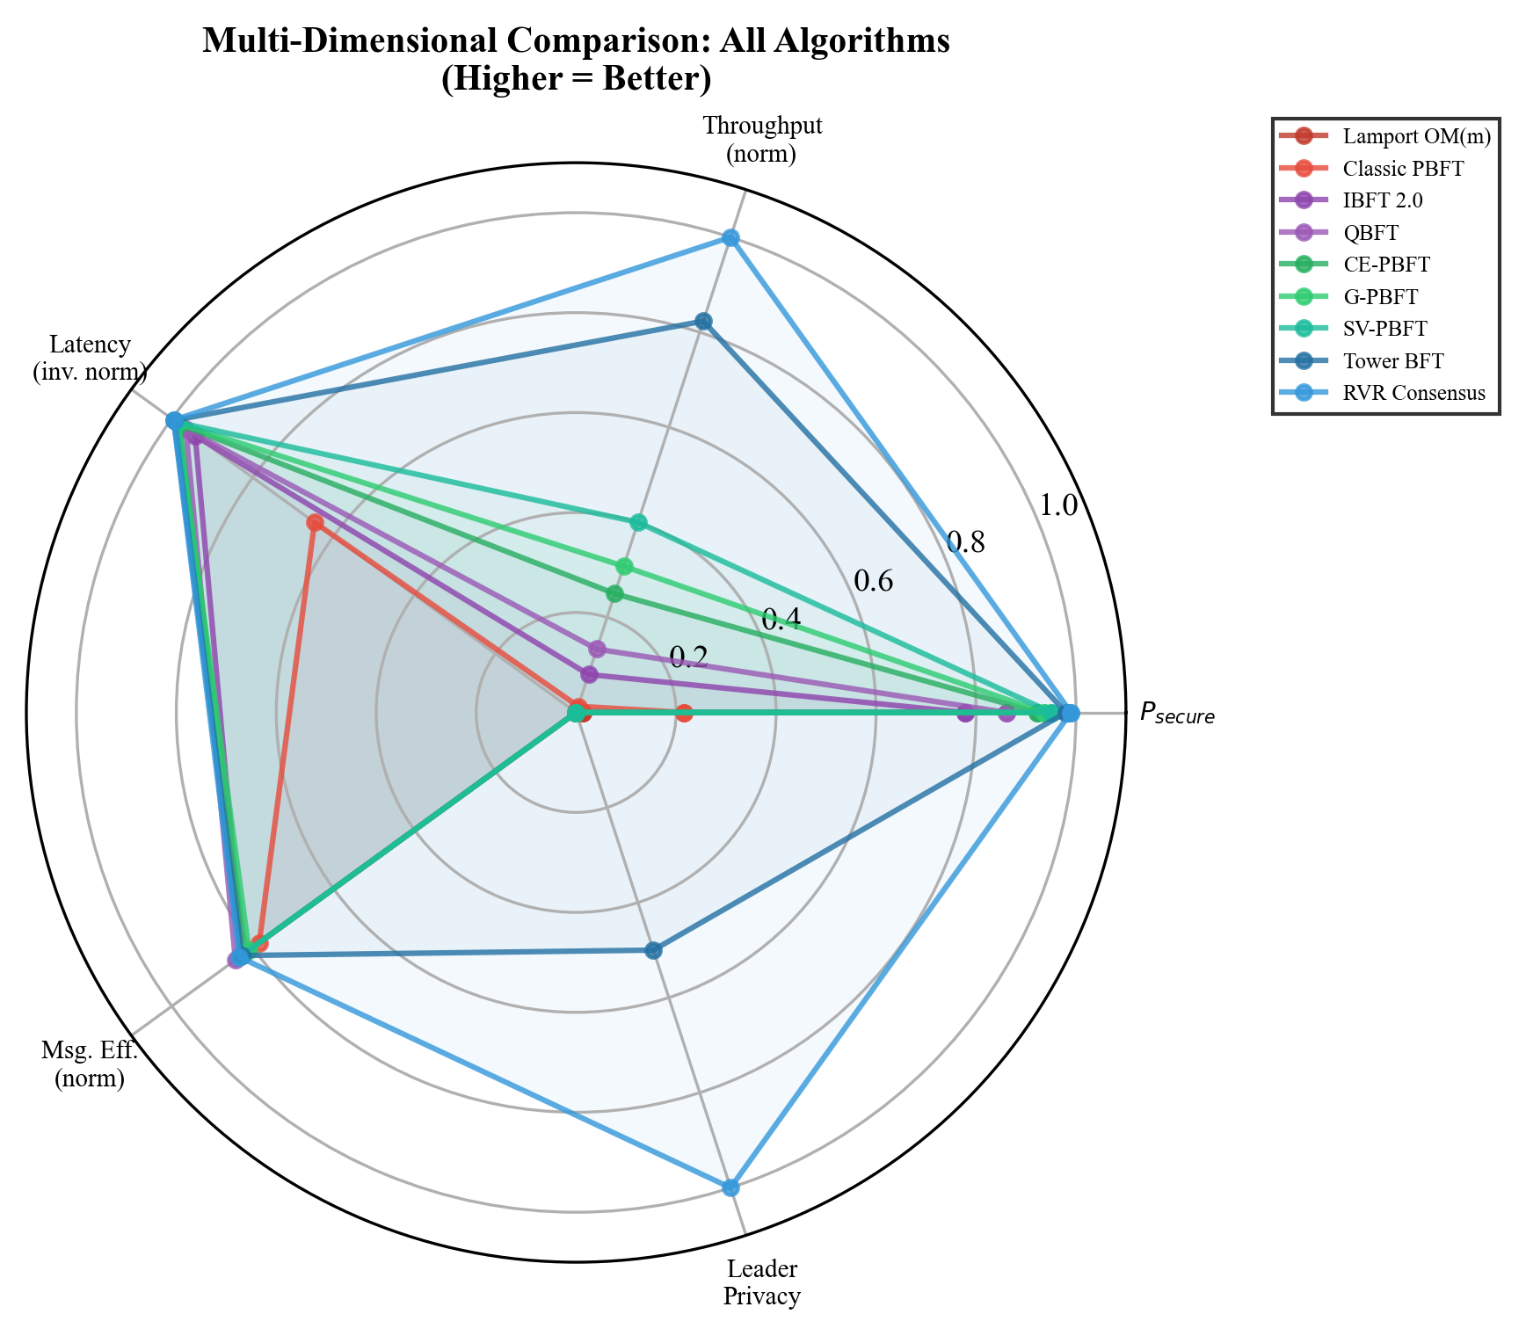
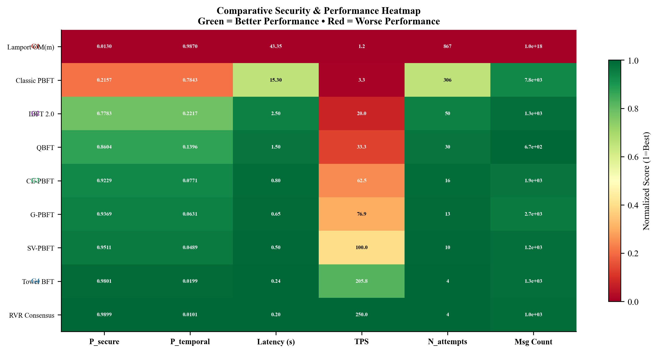
9. Results & Discussion: Heatmap and Radar
Figure 2: Performance Heatmap (Normalized)
Figure 3: Multi-Dimensional Tradeoff Radar Chart
Notes:
To provide a multi-dimensional perspective, we present a performance heatmap and a radar chart. The heatmap normalizes and colors the scores, where green is best. The radar chart maps five axes: security, throughput, inverse latency, message efficiency, and leader privacy. Sub-second protocols cover the largest area, showing complete dominance.

Slide 13
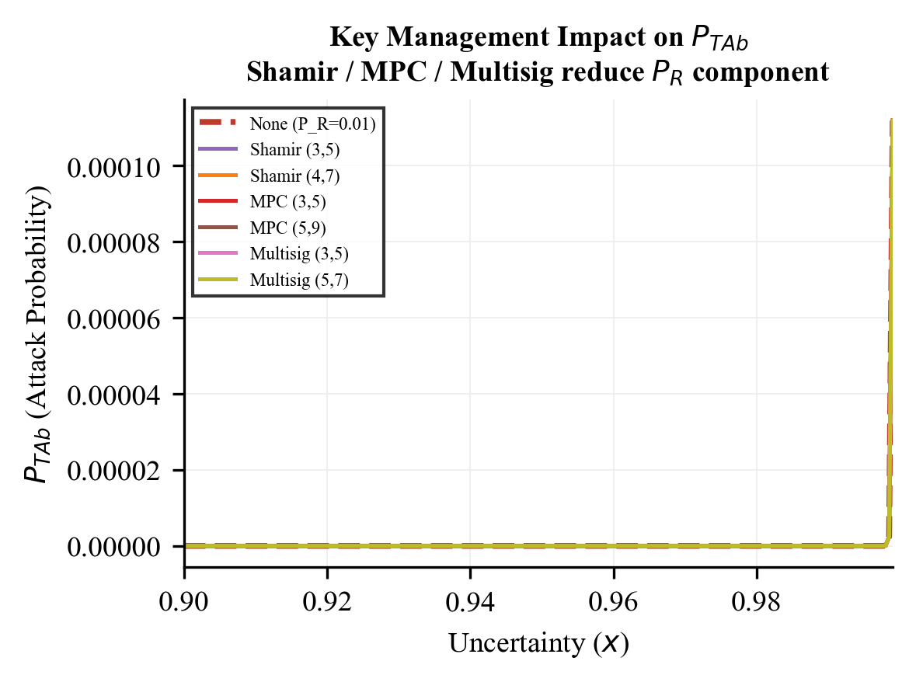
9. Results & Discussion: Key Management Thresholds
Baseline paper assumed constant receiver risk P_R = 0.01
We model threshold cryptography: Shamir Secret Sharing (k, d)
Probability of compromise derived using Binomial CDF:
P_R,shamir = sum_{i=k}^{d} (d choose i) * P_R^i * (1-P_R)^(d-i)
For a (3, 5) threshold setup:
• Receiver compromise probability drops to 9.85 x 10⁻⁶
• Over 1,000x reduction in validator compromise risk!
• Directly reinforces the blockchain static barrier P_Rb (Eq. 20)
Figure 4: Effective P_R vs. Threshold size (k, d)
Notes:
We also analyzed key management. If a single validator key is stolen, the node is compromised. By applying Shamir Secret Sharing with a (3,5) threshold on EV nodes, the attacker must compromise 3 key shares instead of 1. This reduces the compromise probability from 0.01 to 9.85 x 10^-6, which propagates and reinforces the blockchain boundary.

Slide 14
10. Next Steps
Planned Research Activities:
Complete the draft of the research paper for submission to IEEE Transactions
Perform network sensitivity analysis: sweeping packet loss rate (0% to 20%) and network delay jitter
Model view-change latency overhead under high leader failure scenarios (f > 16)
Pending Milestones:
Integrate hybrid consensus (Hierarchical clustering + Sub-Second finality)
Resolve code performance optimizations for the smart grid simulation tool
Final thesis report submission to VJTI Department of Electrical Engineering
Notes:
What are our next steps? We are on track to compile the final thesis. We plan to write a full paper for IEEE Transactions. Research-wise, we will investigate the sensitivity of these models to network packet loss and jitter, and explore hybrid consensus mechanisms.

Slide 15
11. Conclusion
Summary of Work Completed:
Derived exact analytical proofs for latency and throughput, addressing Sheikh's static model gaps
Formulated the Static-Temporal Security Framework (STSF) to model latency-induced vulnerability
Evaluated 8 algorithms in 4 groups (CFM-BA, CDC-C, HTC-PBFT, SS-PR-BFT) on identical grid parameters
Proved that Sub-Second protocols (Group 4) maintain P_secure >= 0.98 by limiting attack attempts to N=4
Key Deployment Recommendations:
For modern 5G grids: Deploy Group 4 (Tower BFT, RVR) to support 250 TPS with low vulnerability
For legacy SCADA grids: Deploy Group 3 (Hierarchical HTC-PBFT) to achieve P_secure > 0.92 without sub-ms sync
Notes:
In conclusion, we have resolved the temporal vulnerability window by comparing 8 BFT consensus algorithms. Consensus latency is the critical parameter governing physical grid security. We recommend deploying Group 4 protocols for modern 5G networks, and Group 3 clustered consensus for legacy networks.

Slide 16
12. References
[1] A. Sheikh et al., 'Secured Energy Trading Using Byzantine-Based Blockchain Consensus,' IEEE Access, vol. 8, 2020.
[2] L. Lamport et al., 'The Byzantine Generals Problem,' ACM TOPLAS, vol. 4, no. 3, 1982.
[3] M. Castro and B. Liskov, 'Practical Byzantine Fault Tolerance,' in Proc. OSDI, 1999.
[4] X. Ding et al., 'CE-PBFT: An Optimized PBFT Consensus Algorithm for Microgrid Power Trading,' IEEE Trans. Smart Grid, 2024.
[5] Z. Xu et al., 'G-PBFT Algorithm and its Application in Distributed Energy Trading,' Applied Energy, 2025.
[6] Y. Suo et al., 'SV-PBFT: An Efficient and Stable Blockchain PBFT Improved Consensus Algorithm for Vehicle-to-Vehicle Energy Transactions,' IEEE IoT Journal, 2025.
[7] A. Yakovenko, 'Solana: A new architecture for a high performance blockchain,' Solana Whitepaper, 2018.
[8] H. Wang et al., 'RVR Consensus: A Verifiable, Weighted-Random, Byzantine-Tolerant Smart Grid Framework,' IEEE TPDS, 2025.
Notes:
Here is the list of core references from the literature. These form the baseline and comparison algorithms we evaluated. Thank you for your attention, and I am now open to any questions or suggestions from the mentors.

