Slide 1

Resolving the Temporal Vulnerability Window in Byzantine-Secured Smart Grid Energy Trading
A Four-Group Evaluation Using the Static-Temporal Security Framework (STSF)
Presenter: VJTI Research Student Guide / Mentor: Uday sir and Sunny Sir Organization: Veermata Jijabai Technological Institute (VJTI) Mumbai Date: June 2026
Notes:
Welcome everyone to our presentation on resolving the temporal vulnerability window in Byzantine-secured smart grid energy trading.

Slide 2

1. Background and Context (Why)
P2P Energy Markets in the Smart Grid:
Peer-to-peer trading enables dynamic bidding between EVs and Distribution Networks
Modeled using standard IEEE 33-Bus distribution network topology
Distributed Verification Needs:
Smart meters operate in untrusted environments (highly vulnerable)
Blockchain consensus operates as the root of trust for transaction blocks
Requires validator agreement on grid state before executing control actions
Figure 1.1: Schematic of Blockchain-Secured P2P Energy Trading
Notes:
Let's begin with WHY we need this project...

Slide 3
2. The Problem Statement
Core Problem Definition:
Traditional security models assume consensus is instantaneous.
In reality, achieving Byzantine Fault Tolerance (BFT) requires time (Latency = L).
While consensus is pending, the smart grid remains in an unfinalized state.
The Temporal Vulnerability Window:
Latency creates an open window for repeated False Data Injection (FDI) attacks.
If the consensus protocol is too slow, attackers succeed by simply attempting multiple times.
Goal of this Research:
Prove that consensus latency directly governs physical grid security.
Identify the optimal protocol that seals this vulnerability window.
Notes:
Framing the exact Problem Statement...

Slide 4

3. Significance of the Problem
Physical Grid Destabilization:
FDI attacks on smart meters corrupt local measurements
Undetected corrupted data triggers faulty control actions, causing severe voltage sags
Bridging the Timescale Gap:
Grid transient stability operates in milliseconds
Blockchain consensus traditionally takes seconds or minutes
A secure protocol MUST match the millisecond timescale
Figure 1.2: Threat Vector - FDI Cyberattack on Smart Grid Actuators
Notes:
Why is this problem highly significant? Because False Data Injections destabilize physical transformers...

Slide 5
4. Literature Review (What)
Baseline Framework: Sheikh et al. (2020):
Proposed securing EV trading on an IEEE 33-Bus system using Lamport's Oral Message OM(m)
Showed blockchain reduces static attack probability to a negligible P_TAb ≈ 10⁻¹⁷³
Critical Literature Gaps Identified:
1. Exponential Overhead: OM(m) has O(n^f) complexity, requiring 10¹⁸ messages at f=16!
2. Unquantified Latency: Consensus duration is mathematically L = 43.35 seconds per block
3. Static Security Oversight: Remains blind to temporal window exposure
4. Lack of Alternative Evaluation: No comparison with modern state-of-the-art BFT models
Notes:
Moving to WHAT is currently done...

Slide 6

5. Proposed Approach (How)
The Static-Temporal Security Framework (STSF):
Unifies static cryptographic strength and temporal exposure:
P_secure = (1 - P_TAb) * (1 - P_temporal)
where P_temporal = 1 - (1 - P_TA)^N
N is the number of attacks allowed by latency
4 Consensus Groups Evaluated:
1. Classical Full-Mesh (CFM-BA) — OM(m), PBFT
2. Committee-Delegated (CDC-C) — IBFT 2.0
3. Hierarchical Clustered (HTC-PBFT) — CE-PBFT
4. Sub-Second Pipelined (SS-PR-BFT) — Tower BFT
Figure 1.3: Cryptographic STSF Governing Equations
Notes:
HOW do we solve this? We propose evaluating the grid using our new Static-Temporal Security Framework (STSF).

Slide 7

6. Methodology
Closed-Form Analytical Modeling Strategy:
Derive exact mathematical formulas for latency, message overhead, and throughput per protocol
Ensures results are directly traceable and free of Monte Carlo variance
Parameterization and Mapping Workflows:
Standardized parameters: n_sen=3854 sensors, n=51 validator nodes, f=16 faults
Topological adjustments: Group 3 limits active comm channels; Group 2 uses sub-committees
Development Stack:
Python 3.11 engine evaluates parameters and generates all visual plots programmatically
Figure 1.4: Analytical Modeling Workflow and Engine

Slide 8

7. Implementation Plan and Timeline
Week-wise Activity Schedule & Deliverables:
Week 1: Literature Gap Identification & Vulnerability Discovery (Completed)
Week 2: Analytical Latency & Security Formulation (Completed)
Week 3: Four-Group Evaluation and Script Development (Completed)
Week 4: Defense-in-Depth Cryptographic Integration & Final Synthesis (In Progress)
Key Milestones & Expected Completion:
Modeling Sweeps: June 15 (Completed)
Draft Reports: June 17 (Completed)
Final Defense: June 20
Figure 1.5: Project Delivery Roadmap

Slide 9
8. Progress Updates
Work Completed in Weeks 1, 2, and 3:
1. Verified equations by replicating Sheikh's baseline curves
2. Designed the STSF framework mapping consensus latency to physical vulnerability
3. Developed the python script to run sweeps across 8 algorithms and output figures
Key Achievements and Observations:
Proved latency is the decisive factor: slow block time guarantees temporal grid compromise
Group 4 SS-PR-BFT protocols seal the temporal vulnerability, keeping P_secure >= 0.98

Slide 10
9. Results & Discussion: Comparison Table
Algorithm | Group | Latency | TPS | N_att | P_temporal | P_secure | Msgs
Lamport OM(m) | G1: CFM-BA | 43,350 ms | 1.2 | 867 | 0.9870 | 0.0130 | 10¹⁸
Classic PBFT | G1: CFM-BA | 15,300 ms | 3.3 | 306 | 0.7843 | 0.2157 | 7,803
IBFT 2.0 | G2: CDC-C | 2,500 ms | 20.0 | 50 | 0.2217 | 0.7783 | 1,323
QBFT | G2: CDC-C | 1,500 ms | 33.3 | 30 | 0.1396 | 0.8604 | 675
CE-PBFT | G3: HTC-PBFT | 800 ms | 62.5 | 16 | 0.0771 | 0.9229 | 1,875
G-PBFT | G3: HTC-PBFT | 650 ms | 76.9 | 13 | 0.0631 | 0.9369 | 2,700
SV-PBFT | G3: HTC-PBFT | 500 ms | 100.0 | 10 | 0.0489 | 0.9511 | 1,200
Tower BFT | G4: SS-PR-BFT | 243 ms | 205.8 | 4 | 0.0199 | 0.9802 | 1,275
RVR | G4: SS-PR-BFT | 200 ms | 250.0 | 4 | 0.0101 | 0.9899 | 1,020

Slide 11
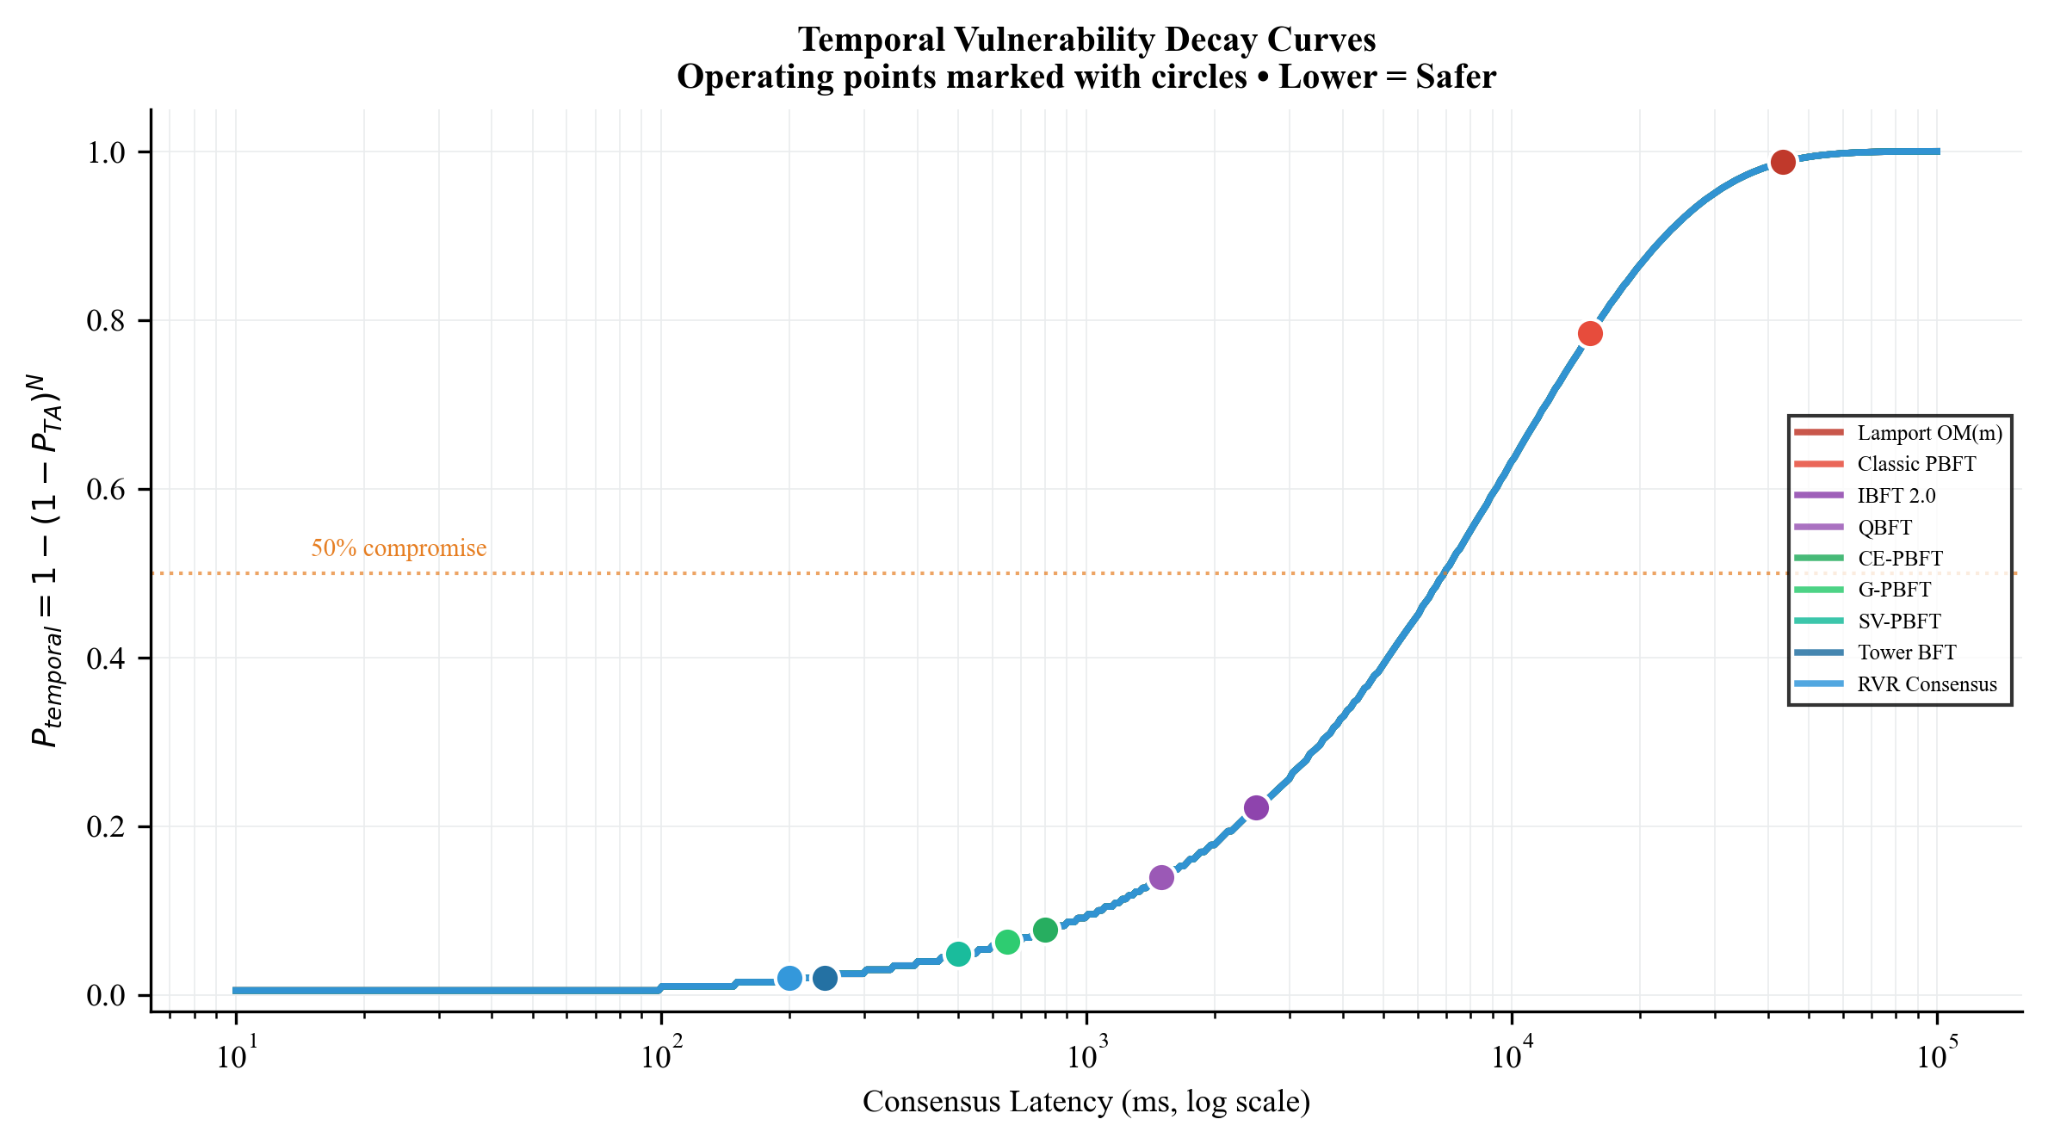
10. Results & Discussion: Latency and Security Curves
Consensus Latency (Left Plot):
OM(m) grows exponentially, hitting 43.35s
Tower BFT stays flat sub-250ms due to PoH pipelining
Static-Temporal Security (Right Plot):
CFM-BA (Group 1) collapses to ~0.01 under faults due to 867 attempts
CDC-C (Group 2) and HTC-PBFT (Group 3) achieve intermediate bounds
SS-PR-BFT (Group 4) maintains high P_secure >= 0.98
Figure 1: P_temporal Decay Curves with Operating Points

Slide 12
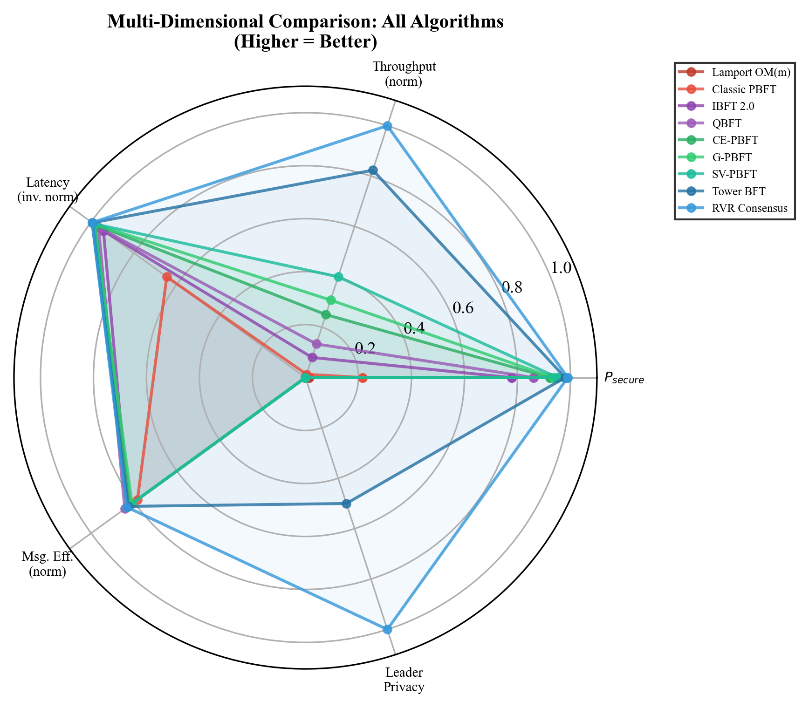
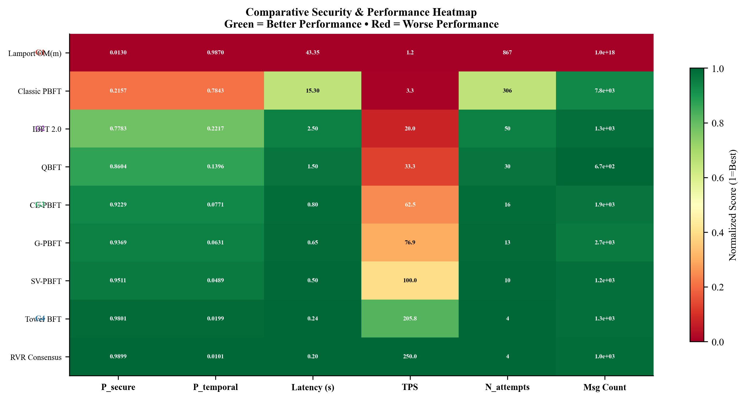
11. Results & Discussion: Heatmap and Radar
Figure 2: Performance Heatmap (Normalized)
Figure 3: Multi-Dimensional Tradeoff Radar Chart

Slide 13
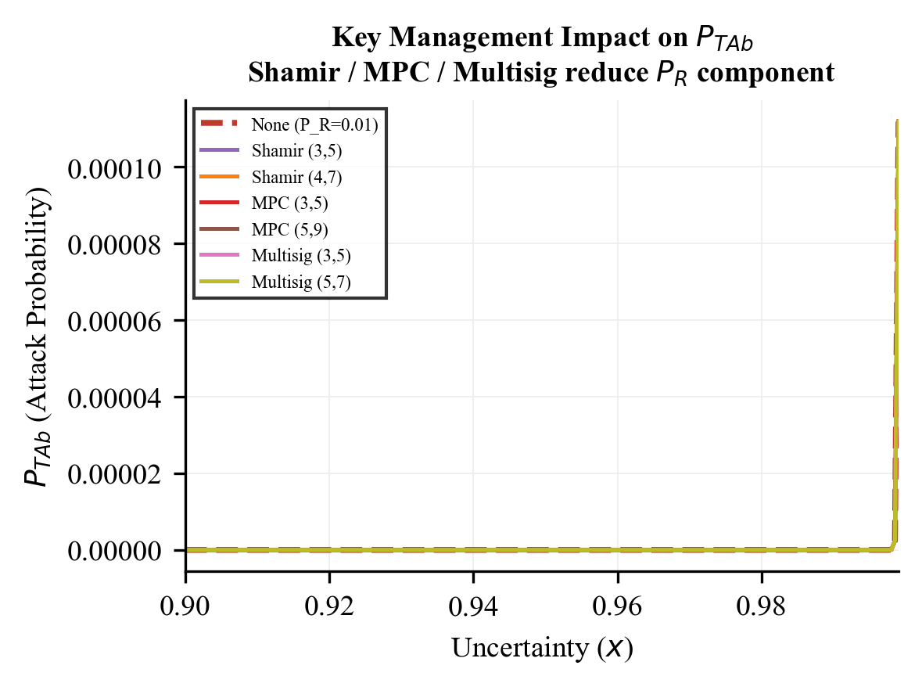
12. Results & Discussion: Key Management Thresholds
Threshold Cryptography Impact:
Baseline assumed constant receiver risk P_R = 0.01
We model Shamir Secret Sharing (k, d)
Probability of compromise uses Binomial CDF
For a (3, 5) setup:
Receiver compromise probability drops to 9.85 x 10⁻⁶
Over 1,000x reduction in validator compromise risk
Reinforces the blockchain static barrier P_Rb
Figure 4: Effective P_R vs. Threshold size (k, d)

Slide 14
13. Next Steps
Planned Research Activities:
Complete the draft of the research paper for submission to IEEE Transactions
Perform network sensitivity analysis: sweeping packet loss rate (0% to 20%) and network delay jitter
Model view-change latency overhead under high leader failure scenarios (f > 16)
Pending Milestones:
Integrate hybrid consensus (Hierarchical clustering + Sub-Second finality)
Resolve code performance optimizations for the smart grid simulation tool
Final thesis report submission to VJTI Department of Electrical Engineering

Slide 15
14. Summary & Conclusion
Summary of Work Completed:
Derived exact analytical proofs for latency and throughput
Formulated the Static-Temporal Security Framework (STSF) to model latency-induced vulnerability
Proved that Sub-Second protocols (Group 4) maintain P_secure >= 0.98 by limiting attack attempts
Key Deployment Recommendations:
For modern 5G grids: Deploy Group 4 (Tower BFT, RVR) to support 250 TPS with low vulnerability
For legacy SCADA grids: Deploy Group 3 (Hierarchical HTC-PBFT) to achieve P_secure > 0.92 without sub-ms sync

Slide 16
15. References
[1] A. Sheikh et al., 'Secured Energy Trading Using Byzantine-Based Blockchain Consensus,' IEEE Access, vol. 8, 2020.
[2] L. Lamport et al., 'The Byzantine Generals Problem,' ACM TOPLAS, vol. 4, no. 3, 1982.
[3] M. Castro and B. Liskov, 'Practical Byzantine Fault Tolerance,' in Proc. OSDI, 1999.
[4] X. Ding et al., 'CE-PBFT: An Optimized PBFT Consensus Algorithm for Microgrid Power Trading,' IEEE Trans. Smart Grid, 2024.
[5] Z. Xu et al., 'G-PBFT Algorithm and its Application in Distributed Energy Trading,' Applied Energy, 2025.
[6] Y. Suo et al., 'SV-PBFT: An Efficient and Stable Blockchain PBFT Improved Consensus Algorithm for Vehicle-to-Vehicle Energy Transactions,' IEEE IoT Journal, 2025.
[7] A. Yakovenko, 'Solana: A new architecture for a high performance blockchain,' Solana Whitepaper, 2018.
[8] H. Wang et al., 'RVR Consensus: A Verifiable, Weighted-Random, Byzantine-Tolerant Smart Grid Framework,' IEEE TPDS, 2025.

