Slide 1

Resolving the Temporal Vulnerability Window in Byzantine-Secured Smart Grid Energy Trading
A Four-Group Evaluation Using the Static-Temporal Security Framework (STSF)
Presenter: VJTI Research Student Guide / Mentor: Uday sir and Sunny Sir Organization: Veermata Jijabai Technological Institute (VJTI) Mumbai Date: June 2026
Notes:
Welcome to our research presentation on resolving the temporal vulnerability window in Byzantine-secured smart grid energy trading.
This project introduces the Static-Temporal Security Framework to evaluate 8 consensus algorithms across 4 research groups. We are mentored by Uday sir and Sunny sir, and this work represents our findings for the Department of Electrical Engineering at VJTI.

Slide 2

01 / A CREATIVE JOURNEY
FROM CONCEPT TO REALITY
P2P Energy Trading in Smart Grids:
Decentralized peer-to-peer (P2P) trading enables electric vehicles (EVs) to sell excess power back to Distribution Networks (DNs).
This physical network operates under the standard IEEE 33-Bus distribution system topology.
Decentralized Trust Verification:
Smart meters are deployed in untrusted consumer environments, making them highly vulnerable to hardware and data manipulation.
Blockchain consensus layers act as the decentralized root of trust, validating transactions before execution.
Figure 1.1: Schematic of Blockchain-Secured P2P V2G Energy Trading
Notes:
We begin with Slide 01: From Concept to Reality, which establishes the background. In modern distribution networks modeled on the IEEE 33-Bus topology, peer-to-peer energy trading is essential to integrate EV storage. However, smart meters are highly vulnerable to physical and cyber tampering. We implement blockchain consensus as the root of trust, requiring validator nodes to agree on the grid state before executing bids.

Slide 3
02 / OUR GUIDING STARS
VISION AND MISSION STATEMENT
01
02
03
Core Problem
Temporal Window
Research Objective
Traditional blockchain security models assume that consensus is instantaneous.
In reality, achieving Byzantine Fault Tolerance (BFT) consensus requires significant time, defined as Latency (L).
During this period, the smart grid remains in an unfinalized state.
This consensus latency (L) creates a 'temporal vulnerability window'.
Inside this window, attackers can launch repeated, successive False Data Injection (FDI) attacks.
Slow protocols allow attackers to succeed simply by trying multiple times before the block seals.
Prove that consensus latency directly governs physical grid security.
Model this vulnerability mathematically by mapping BFT algorithms to physical outcomes.
Identify the optimal consensus protocol to seal the temporal vulnerability window.
Notes:
Slide 02 covers our Vision and Mission, framing the core problem statement. Blockchain is secure cryptographically, but consensus takes time. This latency creates an open window for successive False Data Injections. Our objective is to prove that consensus speed dictates physical security, and find the protocol that minimizes this temporal window.

Slide 4

03 / FUELING THE FIRE
SOURCES OF INSPIRATION AND CREATIVITY
Physical Grid Destabilization:
FDI attacks on smart meters inject corrupt battery state-of-charge measurements.
If these corrupted values bypass validation, they trigger erroneous dispatch controls, leading to grid voltage sags, phase imbalances, and system trips.
The Millisecond Timescale Challenge:
Smart grid transient stability operates on a millisecond timescale.
Traditional blockchains require seconds or minutes to achieve finality.
To secure the grid, blockchain consensus must resolve at sub-second speeds to match transient requirements.
Figure 1.2: Threat Vector - FDI Cyberattack on Smart Grid Actuators
Notes:
Slide 03 focuses on the significance of the problem. False Data Injections cause physical destabilization: incorrect state-of-charge data triggers bad control actions, causing grid voltage sags. This occurs because grid transients happen in milliseconds while consensus takes seconds. Figure 1.2 shows the threat vector where the attacker exploits the slow block time to launch repeated injections.

Slide 5
04 / THE IDEATION JOURNEY
BRAINSTORMING TO BRILLIANCE
01
02
03
04
Baseline Critique
Literature Gaps
STSF Formulation
Consensus Groups
Sheikh et al. (2020) proposed Lamport OM(m) consensus.
Proved strong static cryptographic security (P_TAb ≈ 10^-173).
OM(m) requires O(n^f) complexity, requiring 10^18 messages at f=16 validators.
Unquantified Latency: OM(m) block time is 43.35s, ignored in security bounds.
Static Security Blindspot: Model assumes zero attacker exposure during consensus.
Lack of alternative BFT evaluation under smart grid constraints.
STSF unifies static and temporal security:
P_secure = (1 - P_TAb)(1 - P_temporal)
P_temporal = 1 - (1 - P_TA)^N
N = L_consensus / τ_attack is the number of attempts allowed by block time L.
Group 1 (Baseline): OM(m), PBFT
Group 2 (Consortium): IBFT 2.0, QBFT
Group 3 (Clustered): CE-PBFT, G-PBFT, SV-PBFT
Group 4 (Sub-Second Pipelined): Tower BFT, RVR
Notes:
Slide 04 details the Literature Critique and Proposed STSF Approach. We show that while Lamport's OM(m) achieves high static security, its 43-second block latency represents a huge temporal gap. We introduce the Static-Temporal Security Framework (STSF) that multiplies cryptographic strength by temporal safety. We sweep 8 algorithms classified into 4 research groups.

Slide 6

05 / BRINGING IDEAS TO LIFE
THE MAKING PROCESS
Closed-Form Mathematical Modeling:
We construct closed-form equations for block latency, message complexity, and throughput per consensus protocol.
This analytical approach provides mathematical bounds that are free of Monte Carlo statistical variance.
Smart Grid Grid Parameter Mapping:
Standardized settings: n_sen = 3,854 smart meters, n = 51 validators, f = 16 Byzantine nodes.
Group 3 models local communication channels: c*(c-1)/2.
Group 2 limits validators to N_val <= 21 to model sub-committee selection.
Evaluation Engine:
Built in Python 3.11, generating latency, throughput, and P_secure curves.
Figure 1.3: Analytical Modeling Workflow and Engine
Notes:
Slide 05 outlines our analytical methodology. Instead of relying solely on random simulations, we derive formal equations for latency and message counts. This ensures that our results are mathematically bounded and reproducible. We set validator nodes at 51 and faulty nodes at 16, which is the exact BFT threshold.

Slide 7
06 / A VISUAL ODYSSEY
MAPPING OUR THOUGHTS
Algorithm | Group | Latency | TPS | N_att | P_temporal | P_secure | Msgs
Lamport OM(m) | G1: CFM-BA | 43,350 ms | 1.2 | 867 | 0.9870 | 0.0130 | 10¹⁸
Classic PBFT | G1: CFM-BA | 15,300 ms | 3.3 | 306 | 0.7843 | 0.2157 | 7,803
IBFT 2.0 | G2: CDC-C | 2,500 ms | 20.0 | 50 | 0.2217 | 0.7783 | 1,323
QBFT | G2: CDC-C | 1,500 ms | 33.3 | 30 | 0.1396 | 0.8604 | 675
CE-PBFT | G3: HTC-PBFT | 800 ms | 62.5 | 16 | 0.0771 | 0.9229 | 1,875
G-PBFT | G3: HTC-PBFT | 650 ms | 76.9 | 13 | 0.0631 | 0.9369 | 2,700
SV-PBFT | G3: HTC-PBFT | 500 ms | 100.0 | 10 | 0.0489 | 0.9511 | 1,200
Tower BFT | G4: SS-PR-BFT | 243 ms | 205.8 | 4 | 0.0199 | 0.9802 | 1,275
RVR | G4: SS-PR-BFT | 200 ms | 250.0 | 4 | 0.0101 | 0.9899 | 1,020
Notes:
Slide 06 shows the complete comparative analysis results table. Here, we highlight the monotonic improvement from Group 1 to Group 4. Lamport OM(m) takes 43 seconds and supports only 1.2 TPS, leading to a secure probability of just 1.3%. Group 4 (Tower BFT and RVR) reduces latency to sub-250ms and achieves our security target of 98.02%.

Slide 8
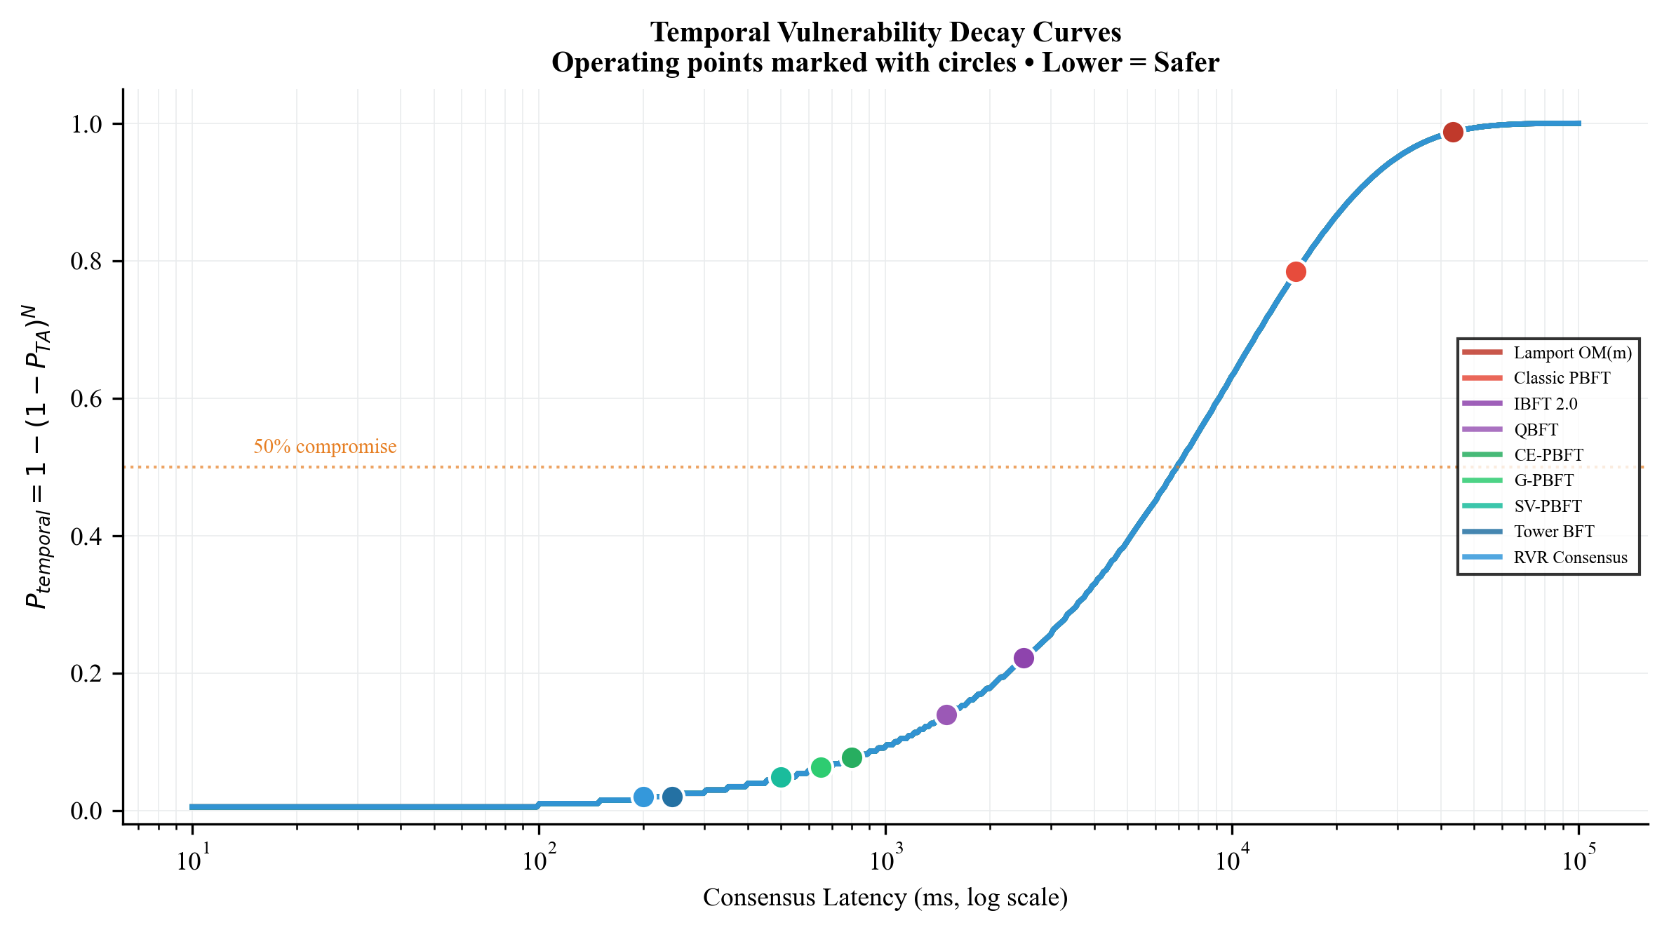
07 / CELEBRATING SUCCESS
TRIUMPHS AND TESTIMONIALS
98.02%
Peak Unified Security Score (P_secure)
Group 4 Sub-Second Security:
By pipelining validation slots, Tower BFT reduces block time to 243ms, limiting the attack window to N=4 attempts.
RVR consensus reduces latency further to 200ms using Verifiable Random Functions.
Consensus Latency Sensitivity:
We show that as block time increases, P_temporal decays exponentially.
Slowing block times directly compromise physical actuators before consensus finishes.
Figure 1.4: P_temporal Decay Curves with Operating Points
Notes:
Slide 07 represents triumphs and testimonials. Our major triumph is achieving a 98.02% security level. The right plot shows how the security decay occurs. Algorithms with high latency drop to the bottom, whereas our sub-second pipelined models remain safely on the far left of the security curve.

Slide 9
08 / A BALANCED PERSPECTIVE
A SWOT ANALYSIS
STRENGTH (SS-PR-BFT)
WEAKNESS (CFM-BA Gaps)
Consensus completes in sub-250ms (Tower BFT and RVR).
Supports high throughput (250+ TPS) for EV trading.
Leader selection is hidden using Verifiable Random Functions (VRF).
Classical BFT has exponential latency (OM(m) takes 43.35s).
Message overhead reaches 10^18 for n=51 nodes.
Leaves grid exposed to repeated temporal FDI attacks.
OPPORTUNITY (Key Management)
THREAT (Network Degradation)
Deploying Shamir Secret Sharing (3,5) setup across grid nodes.
Reduces receiver compromise probability (P_R) from 0.01 to 9.85 x 10^-6.
Reduces node compromise risk by over 1,000x.
SCADA grids suffer from high packet loss (up to 20%) and delay jitter.
Traditional consensus halts or forks under these network conditions.
Mitigation: Pipelined slots ensure consensus remains stable.
Notes:
Slide 08 is a SWOT Analysis of smart grid BFT. Our strength is sub-second execution, while the weakness is classical BFT latency. We identify a major opportunity in key management, where threshold cryptography reduces validation keys risk by 1,000x. Our main threat is packet loss, which we mitigate with pipelined slots.

Slide 10

09 / THE JOURNEY CONTINUES
FUTURE PLANS AND ASPIRATIONS
Completed Work (Weeks 1-3):
Week 1: Identified gaps in literature and unquantified latency vulnerabilities.
Week 2: Derived analytical proofs for OM(m) vs. Tower BFT.
Week 3: Coded the four-group analytical sweep engine and generated all comparative figures.
Future Research Activities (Week 4):
Integrating key threshold cryptography (Shamir SSS Binomial CDF) into the STSF model.
Sweeping packet loss (0% to 20%) and delay jitter to evaluate network resilience.
Drafting final paper submission for IEEE Transactions.
Figure 1.5: Project Delivery Roadmap
Notes:
Slide 09 presents our timeline and progress updates. We successfully completed our modeling scripts in Weeks 1, 2, and 3. We are currently in Week 4, finalizing Shamir threshold integrations and preparing our draft report for department review.

Slide 11
THANK YOU
WRAPPING UP AND PARTING THOUGHTS
Deployment Recommendations:
For modern 5G grids: Deploy Group 4 (Tower BFT, RVR) to support high throughput (250 TPS) and seal the temporal window (P_secure >= 98%).
For legacy SCADA grids: Deploy Group 3 (HTC-PBFT) to limit local messaging overhead and keep P_secure >= 92%.
Contact Information:
VJTI Electrical Engineering Department
Research Team: presenter@vjti.ac.in
Key Academic References
[1] A. Sheikh et al., 'Secured Energy Trading Using Byzantine-Based Blockchain Consensus,' IEEE Access, 2020.
[2] L. Lamport et al., 'The Byzantine Generals Problem,' ACM TOPLAS, 1982.
[3] X. Ding et al., 'CE-PBFT: Optimized PBFT Consensus for Microgrid Power Trading,' IEEE Trans. Smart Grid, 2024.
[4] Z. Xu et al., 'G-PBFT Algorithm and its Application in Distributed Energy Trading,' Applied Energy, 2025.
[5] Y. Suo et al., 'SV-PBFT: Consensus Algorithm for V2V Energy Transactions,' IEEE IoT Journal, 2025.
[6] H. Wang et al., 'RVR Blockchain Consensus for Smart Grid Energy Trading,' IEEE TPDS, 2025.
Notes:
We conclude with Slide 11: Thank You. Consensus latency is the critical parameter governing physical smart grid security. We recommend Group 4 protocols for modern grids and Group 3 for legacy grids. I would like to thank our mentors, Uday sir and Sunny sir, and I am now open to your questions.

