Slide 1
Fake News Detection
Using Machine Learning
Student Names: Atharv Kocharekar | Joshua D’Costa | Vedant Sarmalkar
Roll Numbers: 2302012| | 2302066
Email IDs: aak000@chowgules.ac.in | jed001@chowgules.ac.in | vrs000@chowgules.ac.in
Course: Data Science | TYBSc Computer Science | 2026
CES's Parvatibai Chowgule College of Arts and Science

Slide 2
Problem Statement
20×
The Challenge
Fake news spreads rapidly across social media, creating widespread misinformation.
Traditional fact-checking is slow, manual, and cannot keep pace with the volume of content published every second.
Automated ML-based detection is needed to flag misinformation at scale, in real time.
faster spread of
fake news on social media
Objective
Approach
Impact
Build an ML model to automatically classify news articles as real or fake based on their text content.
Apply NLP preprocessing, TF-IDF vectorization, and four classification algorithms on a Kaggle dataset.
Help journalists, platforms, and readers identify misinformation quickly before it spreads further.
Fake News Detection | Problem Statement
Fake News Detection | CA2

Slide 3
Research Paper Summary
Norman, E. "Detecting Fake News Using Machine Learning." Journal of Student Research, Vol. 12, Issue 1, 2023.
Dataset
Methodology
Key Results
44,898 articles (21,417 real + 23,481 fake)
Text tokenized → Count Vectorizer (top 1,000 words)
Linear SVC: 99.97% accuracy (best)
Sourced from Kaggle
Three models: Logistic Regression, SVM, Linear SVC
Logistic Regression & SVM: 98.4% after punctuation fix
Real news: all from Reuters
Preprocessing: lowercase, stop words removed
Precision / Recall / F1 all at 0.999 for Linear SVC
Fake news: no identifiable source
Removed 'Reuters', apostrophes, dashes, quotes
ROC AUC ≈ 1.0
Our Adaptation: We followed the same NLP pipeline but used TF-IDF vectorizer and tested four models — adding Naive Bayes and KNN.
Norman, E. — Detecting Fake News Using Machine Learning. JSR Vol. 12, 2023
Fake News Detection | CA2

Slide 4
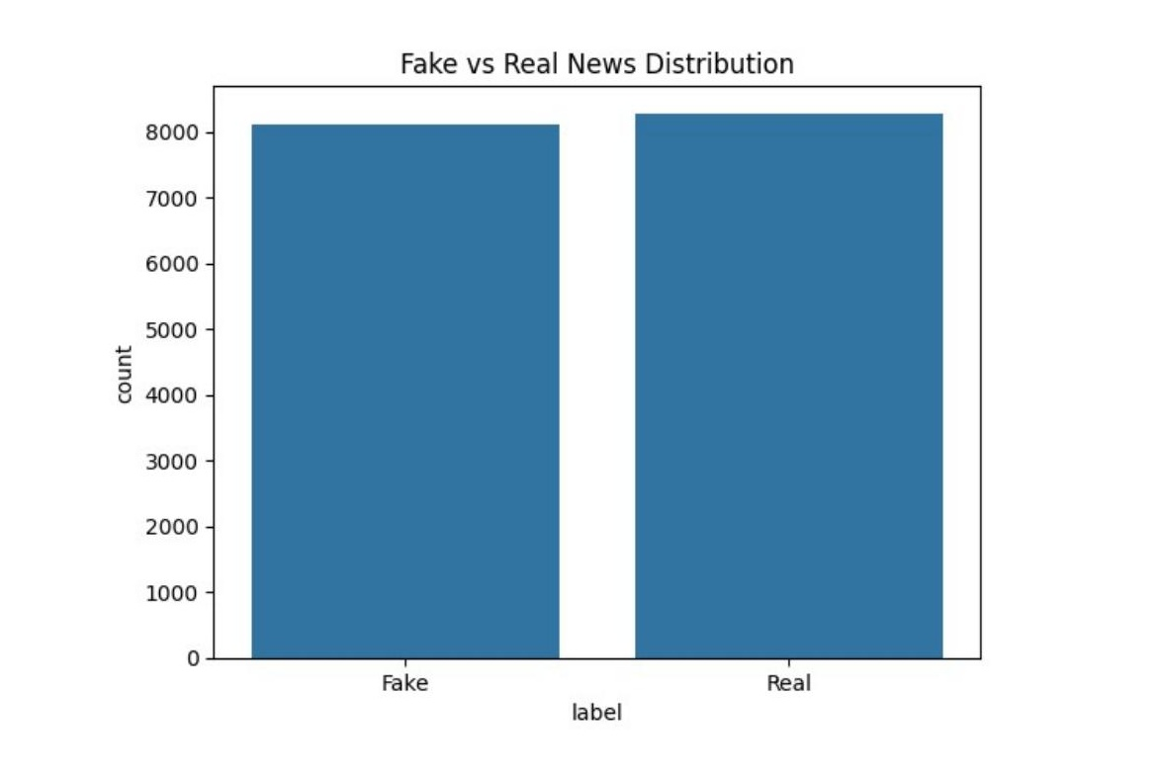
Dataset Details
44,898
21,417
23,481
80/20
Total Articles
Real News
Fake News
Train/Test Split
Features & Target Variable
Class Distribution
Text
Main article text — primary input feature
Title
Excluded from features
Subject
Excluded — mutually exclusive between real/fake
Date
Excluded from features
Label
0 = Fake, 1 = Real (target variable)
Source: Kaggle — kaggle.com/clmentbisaillon/fake-and-real-news-dataset
Fake News Detection | CA2

Slide 5
Data Preprocessing & EDA
01
Load & Inspect
02
Text Cleaning
03
Feature Construction
Loaded Fake.csv and True.csv using Pandas. Added label column (0=Fake, 1=Real), concatenated, and shuffled.
Lowercased all text. Removed special characters using regex (\W), extra whitespace, and stop words.
Combined title + text into a single 'content' column. Dropped title, text, subject, date columns.
04
Vectorization
05
Train/Test Split
06
EDA Insights
Applied TF-IDF Vectorizer (stop_words='english', max_df=0.7) to convert text to numerical feature matrix.
80% training / 20% testing with random_state=42 for reproducibility.
Word clouds: top fake words — Trump, Obama, said. Top real words — said, State, would. Dataset is well-balanced.
Preprocessing pipeline applied before model training
Fake News Detection | CA2

Slide 6


Exploratory Data Analysis — Word Clouds
Fake News Word Cloud
Real News Word Cloud
EDA Insight: Fake news prominently features Trump, people, image — informal, sensationalist language. Real news features said, US, State, White House — more formal, institutional wording. Dataset is well-balanced at ~49% fake, ~51% real.
Top words visualized from fake and real news training data
Fake News Detection | CA2

Slide 7
Algorithm Implementation & Mathematical Intuition
Logistic Regression
Naive Bayes
P(y=1) = 1 / (1 + e^(−z))
z = β₀ + β₁x₁ + ··· + βₙxₙ
P(C|x) ∝ P(C) · ∏ P(xᵢ|C)
Maps a linear combination of word features to a probability (0–1) using the sigmoid function. Classifies at threshold 0.5.
Applies Bayes' theorem assuming word features are conditionally independent. Fast and effective for text classification.
K-Nearest Neighbors
Linear SVC
Class = majority vote of
k nearest training points
min ½‖w‖² + C·Σmax(0, 1−yᵢ(w·xᵢ))
Maximize margin = 2/‖w‖
Classifies an article by finding the k most similar articles in the training set (k=5). Similarity measured by distance in feature space.
Finds the optimal hyperplane maximizing the margin between classes. Efficient and ideal for high-dimensional text feature spaces.
Four classification models evaluated | Best: Linear SVC (SVM)
Fake News Detection | CA2

Slide 8
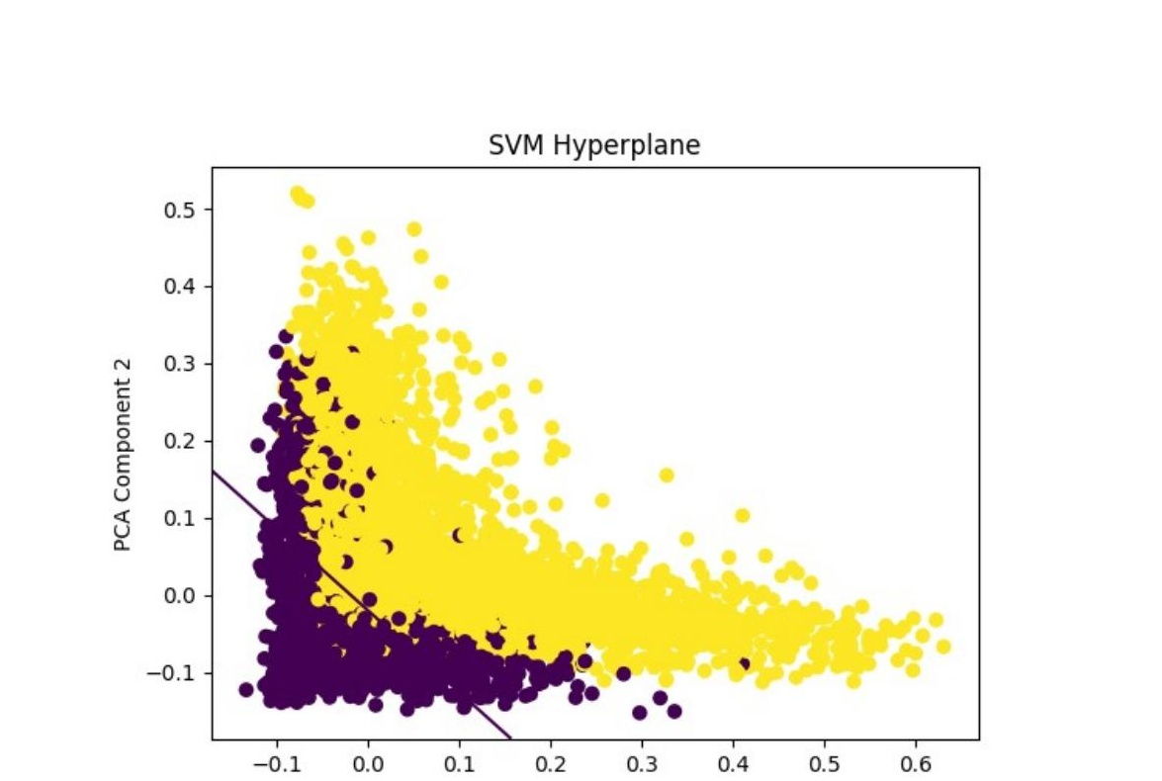
Linear SVC — Decision Boundary Visualisation (PCA)
How the SVM Separates Classes
PCA Reduction
The high-dimensional TF-IDF feature matrix is compressed to 2 principal components for visual inspection.
Two Classes
Yellow = Fake News, Purple = Real News. The SVM finds the hyperplane (diagonal line) that best separates them.
Decision Boundary
The line represents the learned decision boundary: articles on each side are classified as real or fake.
High Separation
The clean visual separation confirms why SVC achieves ~99% accuracy on this dataset.
SVM hyperplane plotted after reducing features to 2D via PCA
Fake News Detection | CA2

Slide 9
Key Parameters & Hyperparameter Tuning
Key Parameters
Parameter
Value
Description
max_df (TF-IDF)
0.7
Ignore terms in >70% of documents
stop_words
english
Remove common English stop words
test_size
0.20
20% data reserved for testing
random_state
42
Reproducible train/test split
C (Linear SVC)
1.0 (default)
Regularisation — default gave best results
n_neighbors (KNN)
5
K=5 nearest neighbours used
Tuning Finding: Default parameters performed best for Linear SVC. Varying the C value showed error was minimised at C=1 (default). Increasing C above 1.5 degraded performance. TF-IDF with max_df=0.7 effectively removed dataset-wide noise words.
Model performance across preprocessing configurations and parameter settings
Fake News Detection | CA2

Slide 10
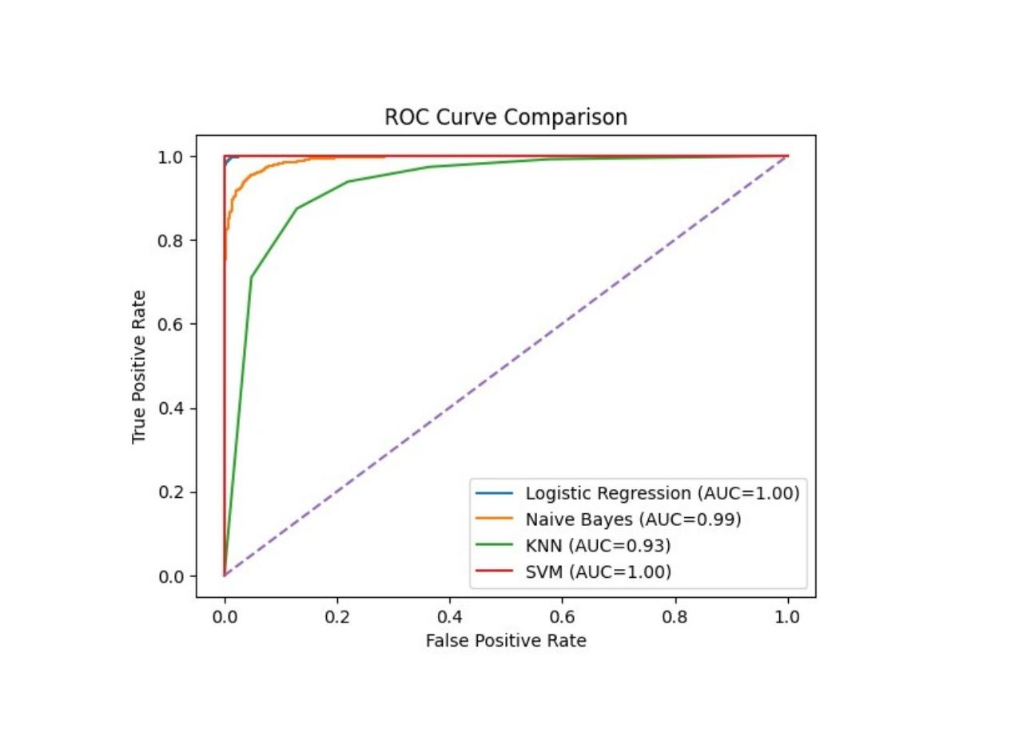
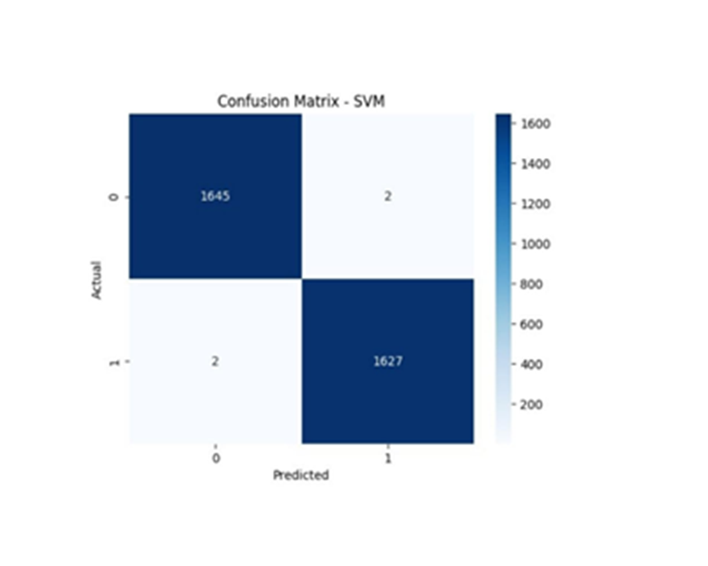
Model Performance Evaluation
Performance Metrics Comparison
Model
Accuracy
Precision
Recall
F1-Score
Logistic Regression
~97%
0.97
0.97
0.97
Naive Bayes
~94%
0.94
0.94
0.94
KNN (k=5)
~89%
0.89
0.89
0.89
Linear SVC
~99%
0.99
0.99
0.99
Why Linear SVC Was Selected
Highest accuracy (~99%) across all preprocessing configurations
Precision, recall, and F1-score all near 1.0
Excels in high-dimensional text feature spaces — ideal for NLP
Default parameters (C=1) gave optimal results — no complex tuning needed
Evaluated on: Accuracy, Precision, Recall, F1-Score, Confusion Matrix, ROC Curve
Fake News Detection | CA2

Slide 11
Advantages & Limitations of Linear SVC
Linear SVC was selected as the final model due to its superior performance across all evaluation metrics.
✓ Advantages
✗ Limitations
High Accuracy
Dataset Bias
Achieves ~99% accuracy — the best of all four models tested.
All real news came from Reuters — punctuation patterns skewed results on external articles.
Handles High Dimensions
Less Interpretable
Excels at text classification with thousands of word features.
Harder to explain why a specific article was classified compared to simpler models.
Fast Training
Single Source Limit
More computationally efficient than kernel SVMs for large text data.
Model trained on one dataset may not generalize perfectly to diverse news sources.
Strong Generalization
Text-Only Analysis
With proper preprocessing, generalizes well beyond training data.
Does not consider images, metadata, publishing source, or social sharing patterns.
Linear SVC selected as final model based on accuracy and generalization
Fake News Detection | CA2

Slide 12
Conclusion
Summary of Findings
★ Best Model
▲ Key Feature
Linear SVC achieved ~99% accuracy — outperforming Logistic Regression, Naive Bayes, and KNN on the fake news dataset.
TF-IDF vectorization (top features, stop words removed) proved highly effective for distinguishing real from fake news.
! Critical Finding
✓ Practical Value
Punctuation patterns (apostrophes, dashes) in real news caused dataset-specific bias — a real-world deployment risk.
ML models can effectively support journalists, platforms, and readers in real-time fake news identification.
Future Work: Expand training data to include multiple news sources (LIAR dataset), explore deep learning (BERT, LSTM), and incorporate metadata features for improved cross-dataset generalization.
CES's Parvatibai Chowgule College of Arts and Science | Data Science (CA2DS) | TYBSc | 2026

Slide 13
References
[1] Research Paper
E. Norman, "Detecting Fake News Using Machine Learning," Journal of Student Research, vol. 12, no. 1, 2023. ISSN: 2167-1907. Available: www.JSR.org
[2] Dataset
C. Bisaillon, "Fake and Real News Dataset," Kaggle. Available: kaggle.com/clmentbisaillon/fake-and-real-news-dataset
[3] Related Work
H. Ahmed et al., "Detection of Online Fake News Using N-Gram Analysis and ML Techniques." University of Victoria, ISOT Lab.
[4] Related Work
S. Aphiwongsophon & P. Chongstitvatana, "Detecting Fake News with Machine Learning Method." Chulalongkorn University, 2018.
[5] MIT Study
P. Dizikes, "Study: On Twitter, false news travels faster than true stories." MIT News, 8 Mar. 2018.
Libraries Used: Python 3 | Pandas | NumPy | Scikit-learn | Matplotlib | Seaborn | NLTK | WordCloud | Jupyter Notebook
Fake News Detection | CA2 Mini Project
Fake News Detection | CA2

