Slide 1
Enhancing Classifier Performance with Evolutionary Weighting
and Priority-Based Aggregation
Under the Supervision of Professor Debjani Chakraborty
Atharv Bajaj

Slide 2
Classification Problem
Applications-
Email Spam Detection
Healthcare
Sentiment Analysis
Finance
Customer Relationship Management
Image Recognition
Existing Models-
Logistic Regression
Decision Trees
Random Forest
Support Vector Machines (SVM)
k-Nearest Neighbours (k-NN)
Neural Networks

Slide 3
What if we could harness the collective power of multiple models to achieve a heightened level of accuracy?
While current models exhibit acceptable performance levels, there's undeniable potential for enhancement. How might we push these boundaries further?

Slide 4
Ensemble Learning
Constructing an ensemble system involves two primary challenges:
learning a diverse collection of base classifiers
devising an effective technique for combining their outputs.
Generation of a diverse set of classifiers can either be done :
Using single base learning classifier with different parameters
Using varied set of classifiers

Slide 5
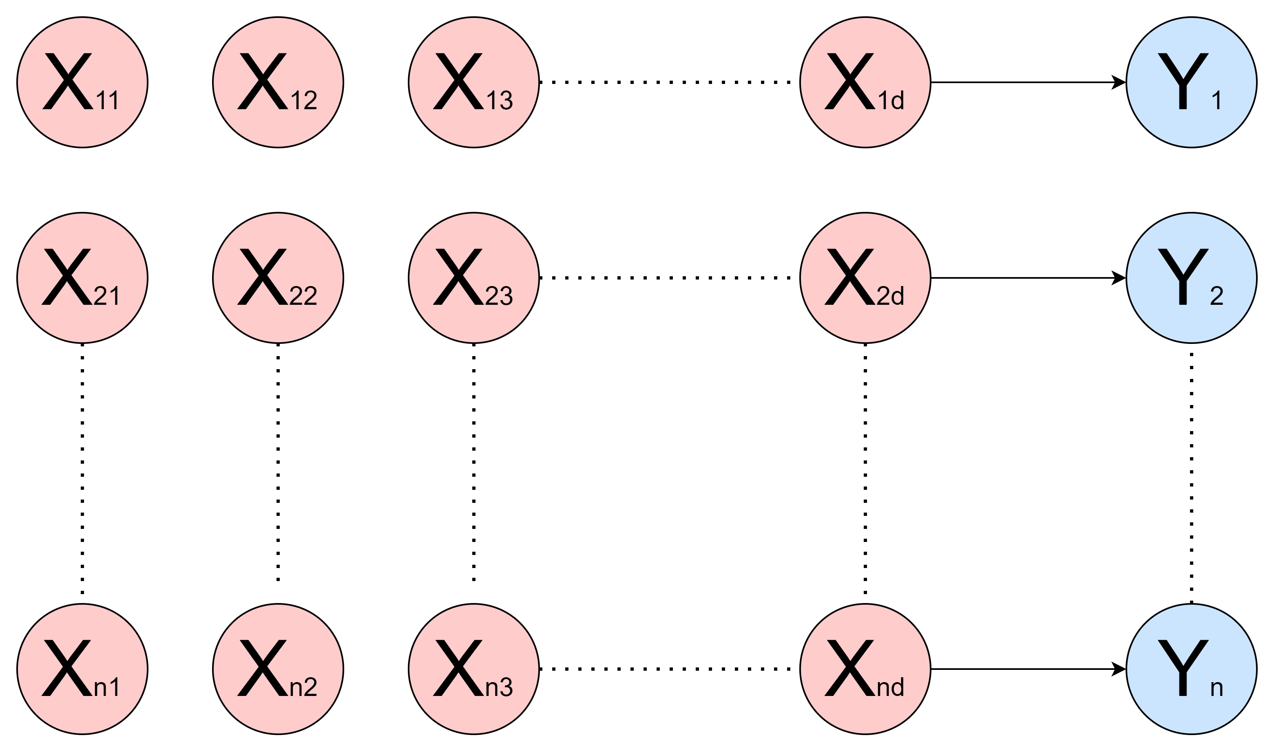
Let X denote the feature space and Y represent the label space, where each x ∈ X is
associated with a label y ∈ Y . Consider a training dataset comprising a finite sequence of examples, S = {(x1, y1), . . . , (xN , yN )}, where yi denotes the label corresponding to the
xi having d features. Consequently, a classifier, represented by the function h: X→Y, aims to predict an output 𝑦 from a given input 𝑥, where X represents the input space and Y represents the output space.

Slide 6

This study first considers the problem of the generation of multiple classifiers using a single base classifier (Neural Network).
intuitive ideology-
manipulate the training examples
To manipulate the training examples effectively, weightings can be assigned to individual features before inputting them into the base learning classifier to get multiple classifiers.

Slide 7
to enhance the model's adaptability and performance, it is highly essential to assign appropriate and optimized weights.
Proposing a methodology to assign optimal weightings to features inputted to the classifier is imperative.
The weight space is vast, presenting a challenge in determining the most effective weightings.
Several methods exist to address this challenge, including
hill climbing,
simulated annealing, and
Evolutionary algorithms (genetic algorithms ).

Slide 8
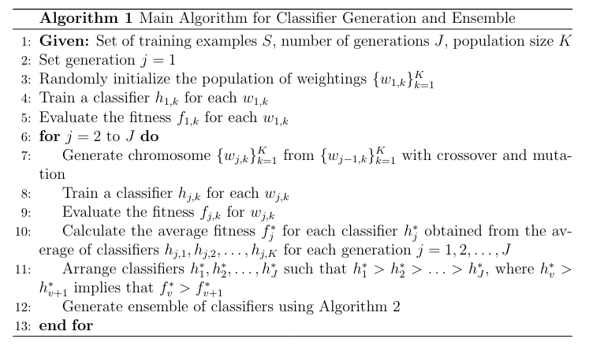
Evolutionary Algorithm(genetic algorithm)

Slide 9
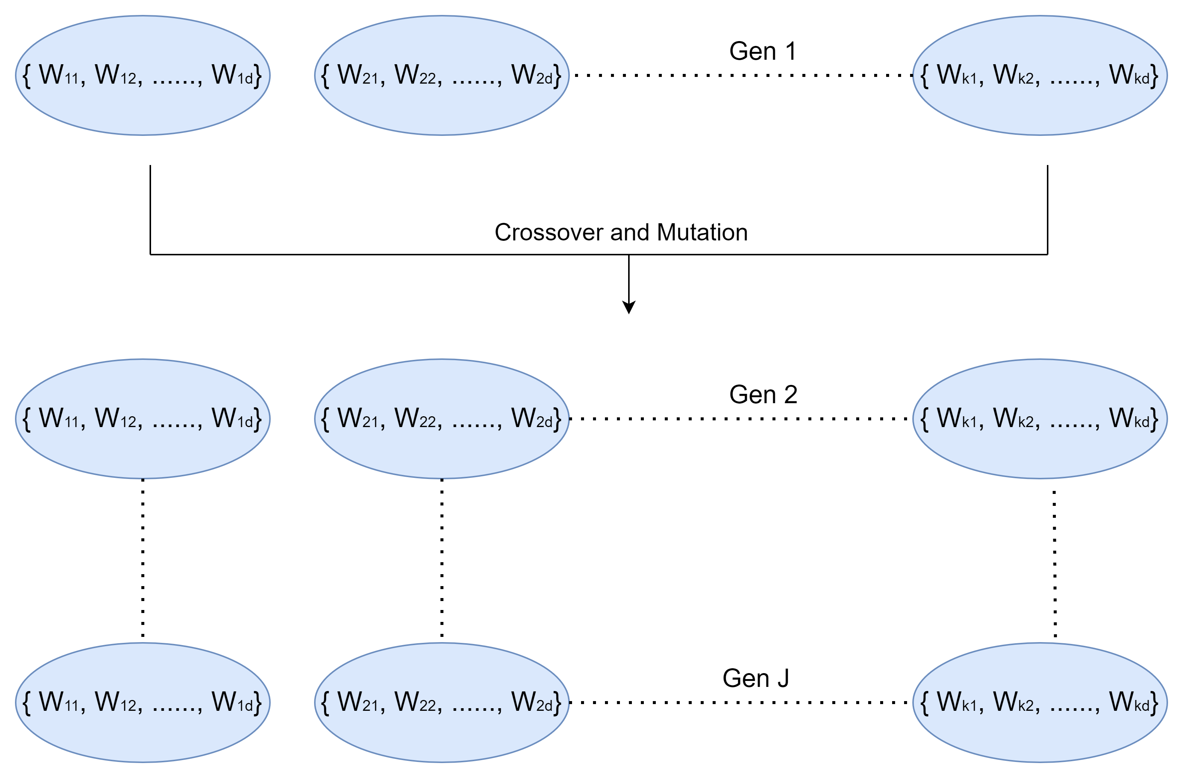

Slide 10
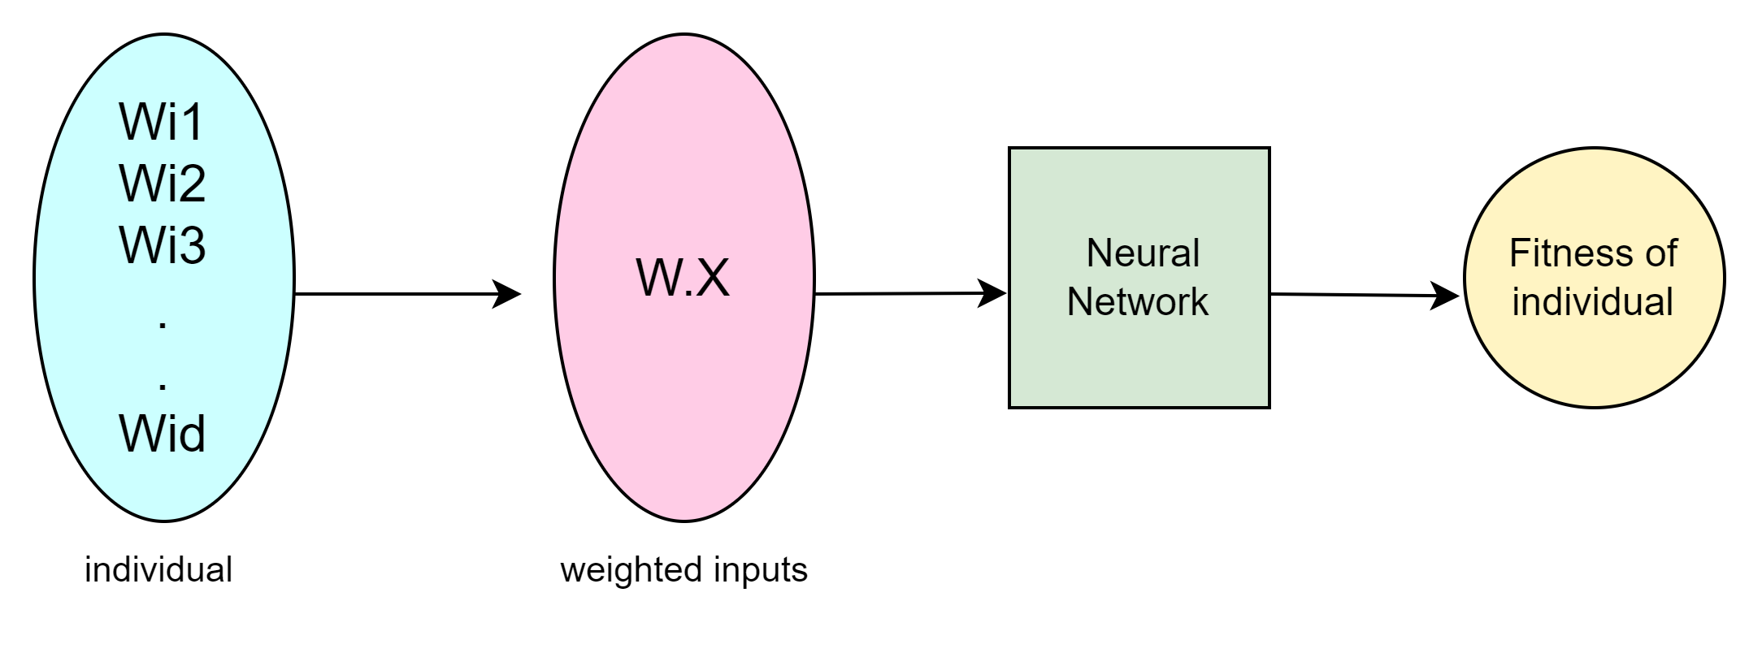

Slide 11
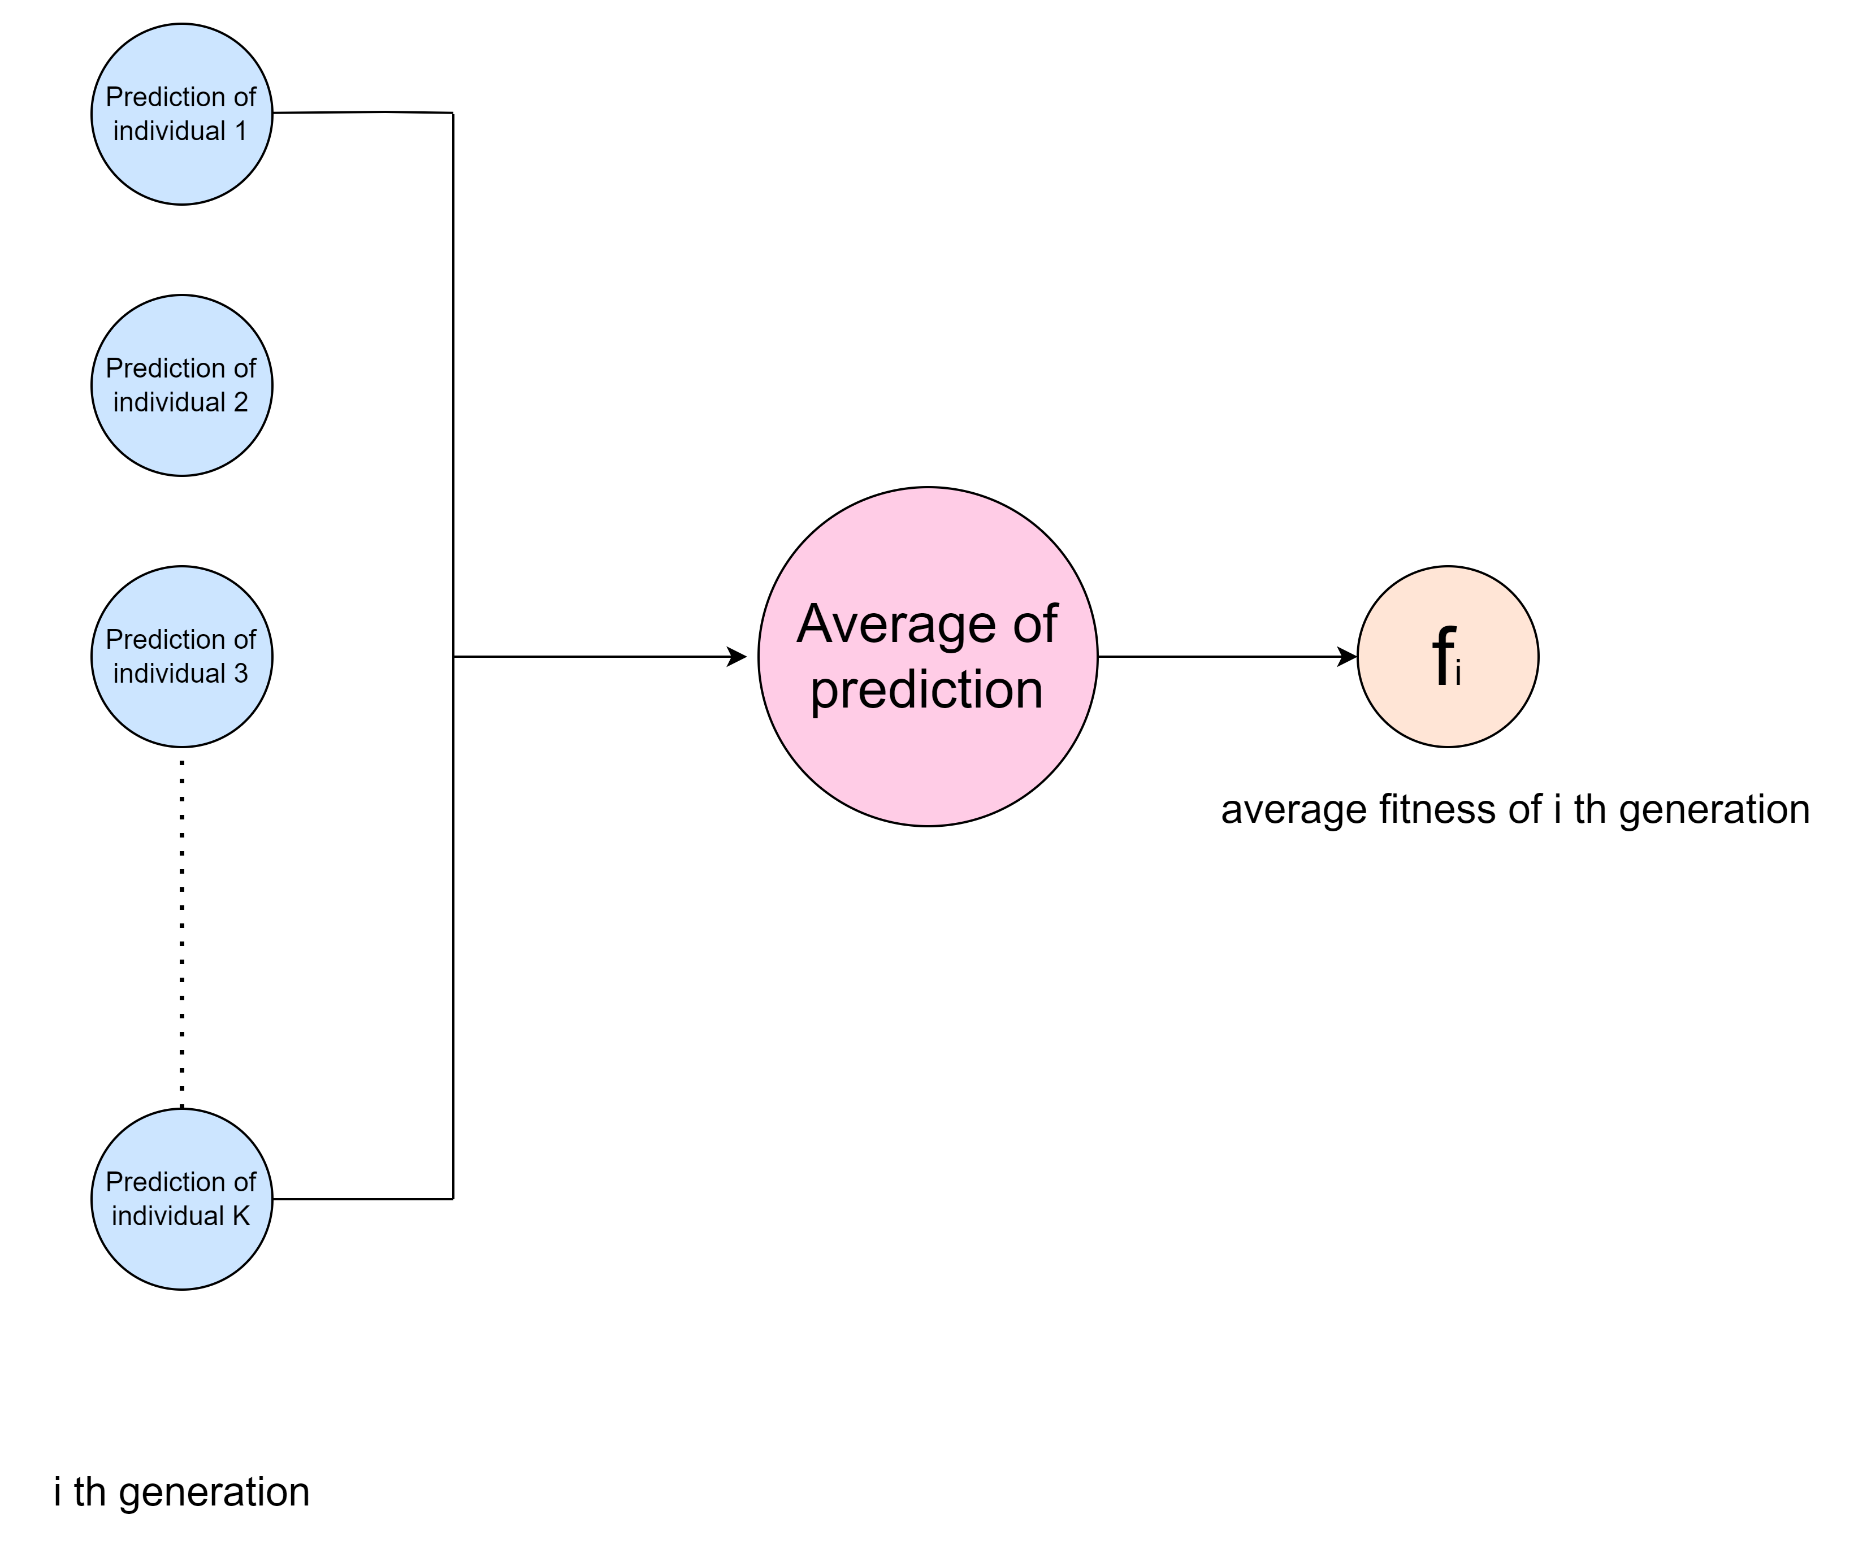

Slide 12
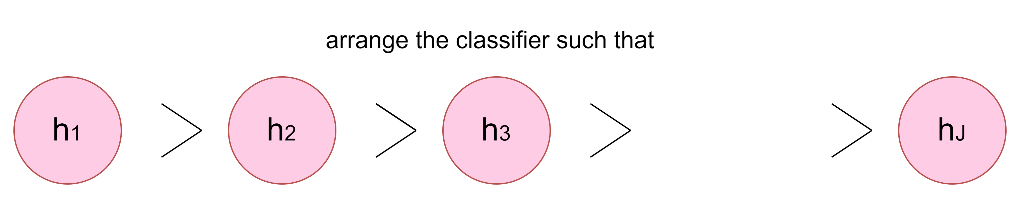

Slide 13
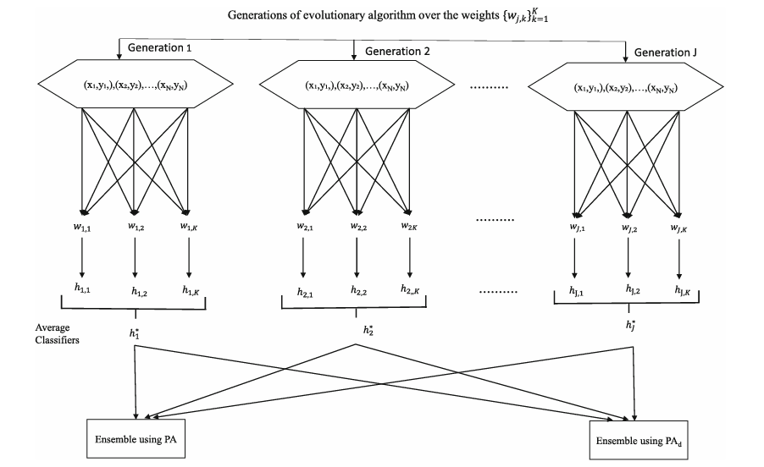

Slide 14
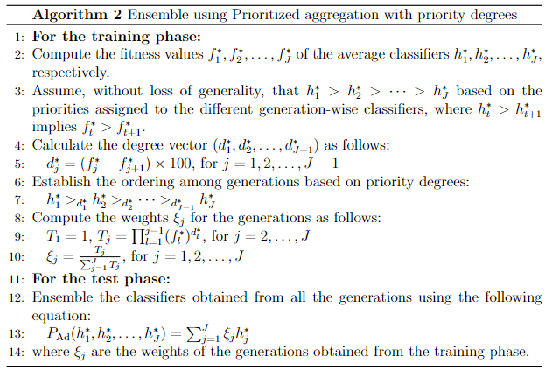

Slide 15

Next, we combine all the classifiers
We will demonstrate how to accomplish this using a technique known as the prioritized averaging operator with priority degree.
evaluate the priority degrees as follows:
$$d_{1}^{∗}=\frac{f_{1}^{∗}−f_{2}^{∗}}{f_{2}^{∗}}×100$$
$$d_{2}^{∗}=\frac{f_{2}^{∗}−f_{3}^{∗}}{f_{3}^{∗}}×100$$
.
.
.
$d_{J−1}^{∗}=\frac{f_{J−1}^{∗}−f_{J}^{∗}}{f_{J}^{∗}}×100$
where, $d_{t}^{∗}$indicates by how much percent the fitness of $h_{t}^{∗}$ is better than the fitness of $h_{t+1}^{∗}$

Slide 16


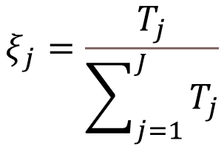
Thus, we have
These fitness values and priority degrees are used to calculate the weights $ξ_{j}$ for each generation j = 1, . . . , J. The formula for $ξ_{j}$is given by:
for j = 1, 2………., J
Where $T_{1}=1 and$ for j = 2, 3 ……………., J
$h_{1}^{∗}>d_{1}^{∗}h_{2}^{∗}$ $>d_{2}^{∗}h_{3}^{∗}> ………..>d_{J−1}^{∗}h_{J}^{∗}$
$$ξ_{j}=\frac{T_{j}}{\sum_{j=1}^{J}{T_{j}}}$$
$${ T}_{j}=\prod_{l=1}^{j−1}{{\left(f_{l}^{∗}\right)}^{d_{l}^{∗}}}$$

Slide 17
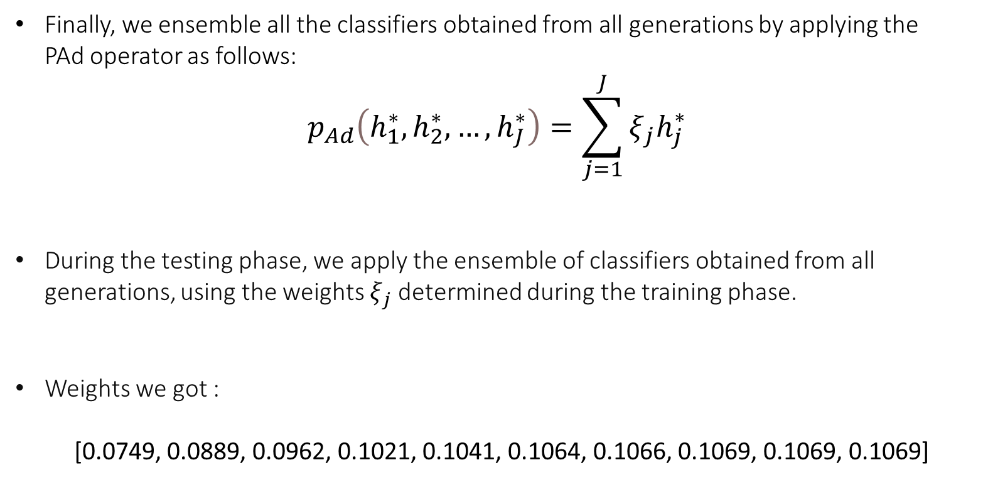
Finally, we ensemble all the classifiers obtained from all generations by applying the PAd operator as follows:
$$p_{Ad}\left(h_{1}^{∗},h_{2}^{∗},…,h_{J}^{∗}\right)=\sum_{j=1}^{J}{ξ_{j}h_{j}^{∗}}$$
During the testing phase, we apply the ensemble of classifiers obtained from all generations, using the weights $ξ_{j}$determined during the training phase.
Weights we got :
[0.0749, 0.0889, 0.0962, 0.1021, 0.1041, 0.1064, 0.1066, 0.1069, 0.1069, 0.1069]

Slide 18
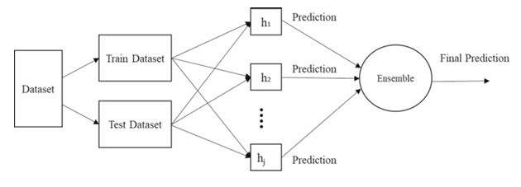

Slide 19
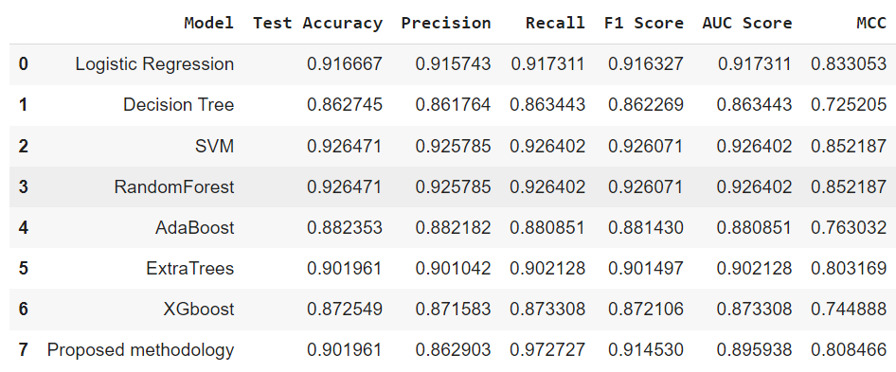

Slide 20
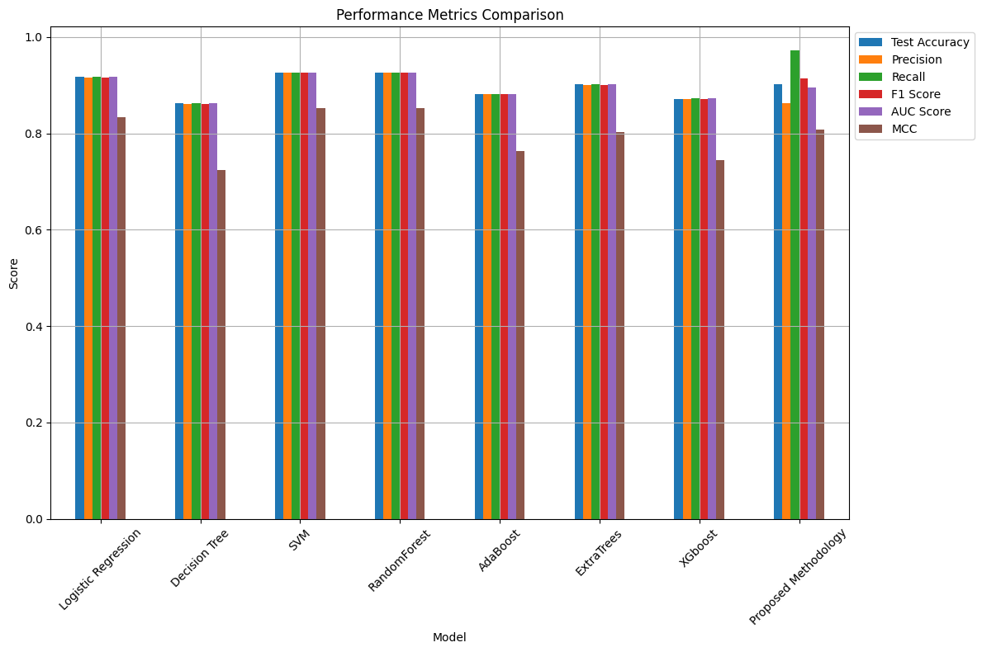

Slide 21
Shapely Values
SHAP values are a common way of capturing a consistent and objective explanation of how each feature impacts the model's prediction.
assigns contributions to each feature in a model. These values capture how the inclusion of each feature influences the model’s output relative to its absence.
The interpretation of the Shapley value for feature value j is: The value of the j-th feature contributed 𝜙𝑗 to the prediction of this particular instance compared to the average prediction for the dataset.

Slide 22

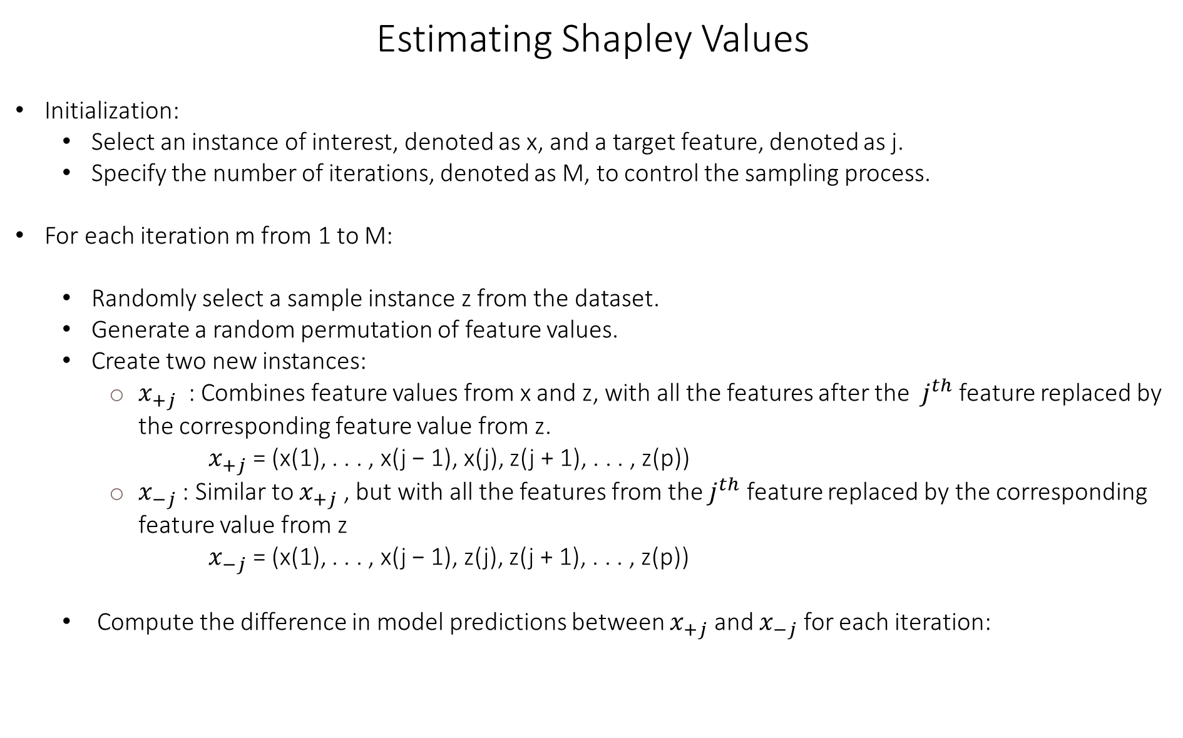
Estimating Shapley Values
Initialization:
Select an instance of interest, denoted as x, and a target feature, denoted as j.
Specify the number of iterations, denoted as M, to control the sampling process.
For each iteration m from 1 to M:
Randomly select a sample instance z from the dataset.
Generate a random permutation of feature values.
Create two new instances:
$x_{+j}$ : Combines feature values from x and z, with all the features after the $j^{th}$ feature replaced by the corresponding feature value from z.
$x_{+j}$ = (x(1), . . . , x(j − 1), x(j), z(j + 1), . . . , z(p))
$x_{−j}$ : Similar to $x_{+j}$ , but with all the features from the $j^{th}$ feature replaced by the corresponding feature value from z
$x_{−j}$ = (x(1), . . . , x(j − 1), z(j), z(j + 1), . . . , z(p))
Compute the difference in model predictions between $x_{+j}$ and $x_{−j}$ for each iteration:
$$φ_{j}^{m}=\hat{f}\left(x_{+j}^{m}\right)−\hat{f}\left(x_{−j}^{m}\right)$$

Slide 23
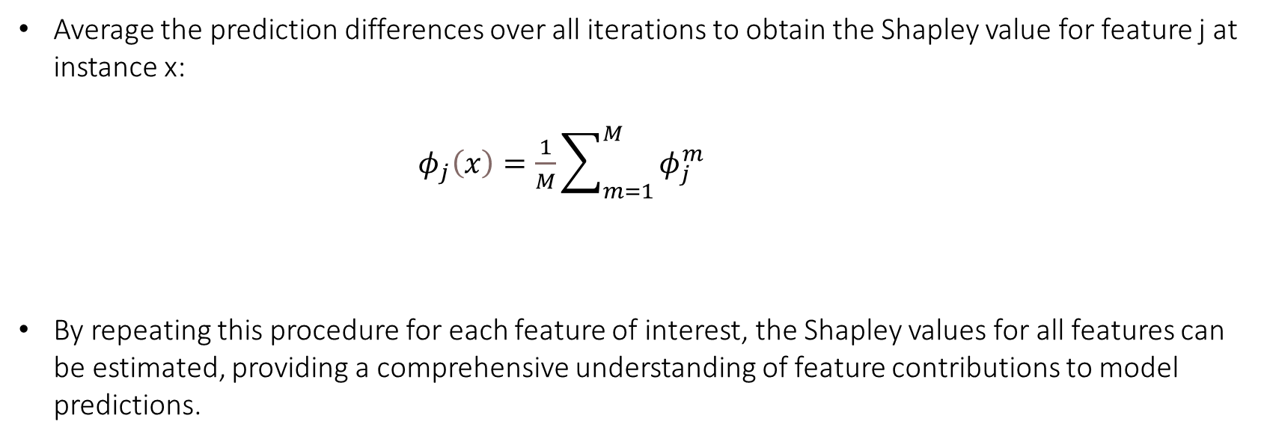
Average the prediction differences over all iterations to obtain the Shapley value for feature j at instance x:
$φ_{j}\left(x\right)=\frac{1}{M}\sum_{m=1}^{M}{φ_{j}^{m}}$
By repeating this procedure for each feature of interest, the Shapley values for all features can be estimated, providing a comprehensive understanding of feature contributions to model predictions.

Slide 24
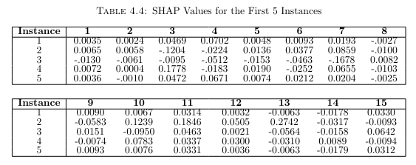

Slide 25
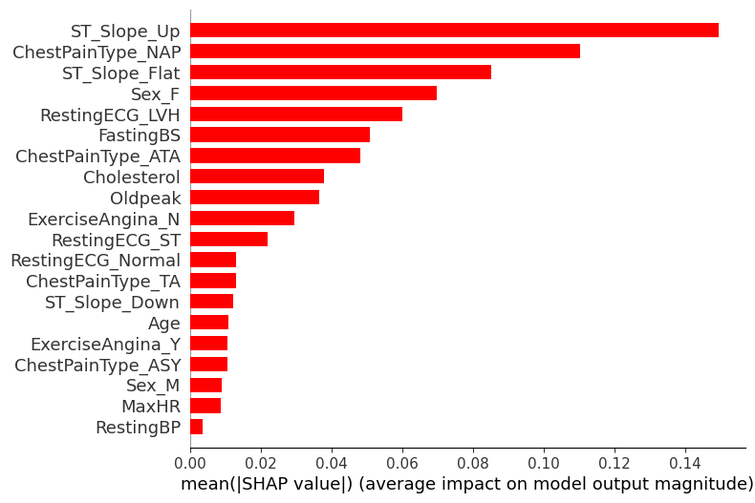

Slide 26
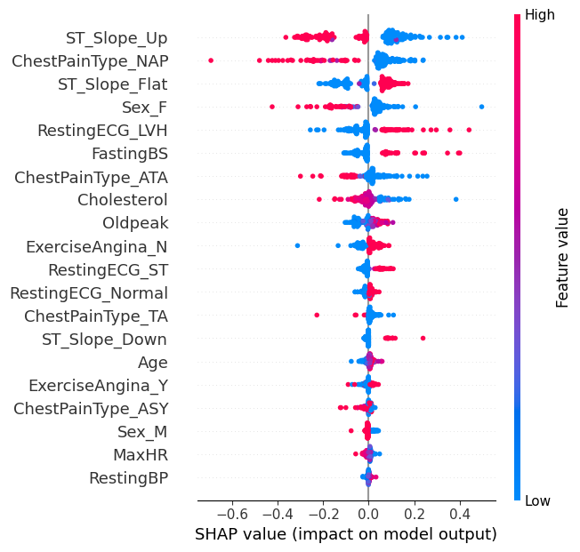

Slide 27
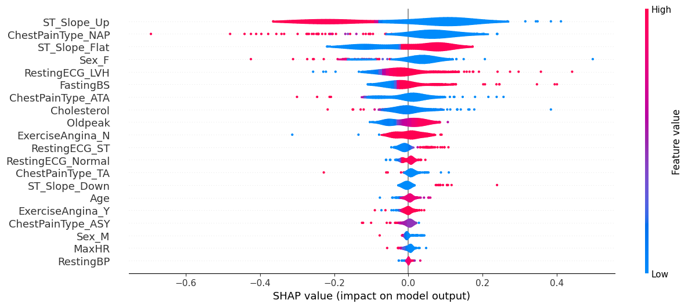

Slide 28
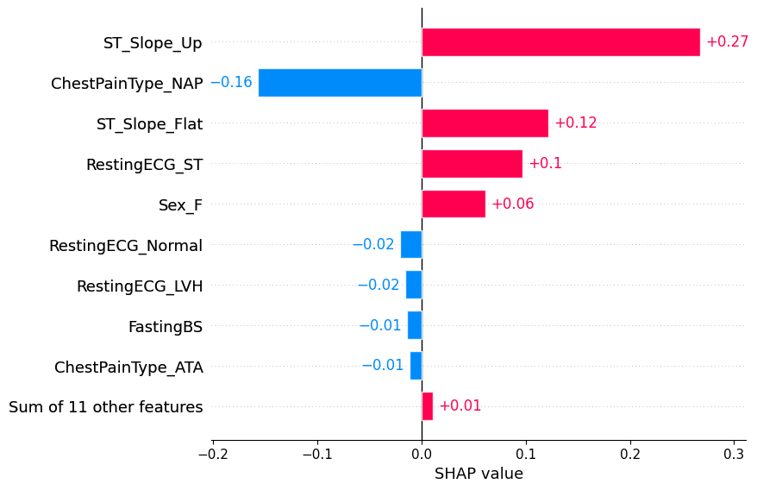

Slide 29
Limitations - Computational complexity for the proposed algorithm is high.
However, leveraging SHAP values allows us to identify and potentially ignore features with negligible or zero SHAP values.
By excluding features with low SHAP values, we can streamline the algorithm and improve efficiency without compromising accuracy.
This approach enhances the scalability and performance of the proposed algorithm, making it more suitable for large-scale datasets and complex models.

Slide 30
Thanks

Slide 31





• True Positive (TP): Model predicts positive, and actual observation is positive.
• True Negative (TN): Model predicts negative, and actual observation is negative.
• False Positive (FP): Model predicts positive, but actual observation is negative.
• False Negative (FN): Model predicts negative, but actual observation is positive.

Slide 32
Not all features in a dataset contribute equally to the predictive power of a model. By assigning weights to features, we can prioritize the most informative ones, allowing the model to focus on relevant information while disregarding noise or irrelevant features.
In high-dimensional datasets, assigning weights to features can effectively reduce the dimensionality of the input space by emphasizing important features and downplaying less relevant ones. This simplification can lead to improved model generalization and performance.
By assigning appropriate weights to features, we can prevent overfitting and improve the model's ability to generalize to unseen data. Weighted feature selection ensures that the model learns a more robust representation of the underlying data distribution, resulting in better performance on both training and test datasets.

