Slide 1
PROJECT DELIVERABLE 2
GROUP 3
Yu Yen Liu cl4202
Xiaoyi Zhou xz3126
Yolanda Zhu xz3013
Divya Tadimeti dt2760
Atharva Kulkarni ak5070

Slide 2
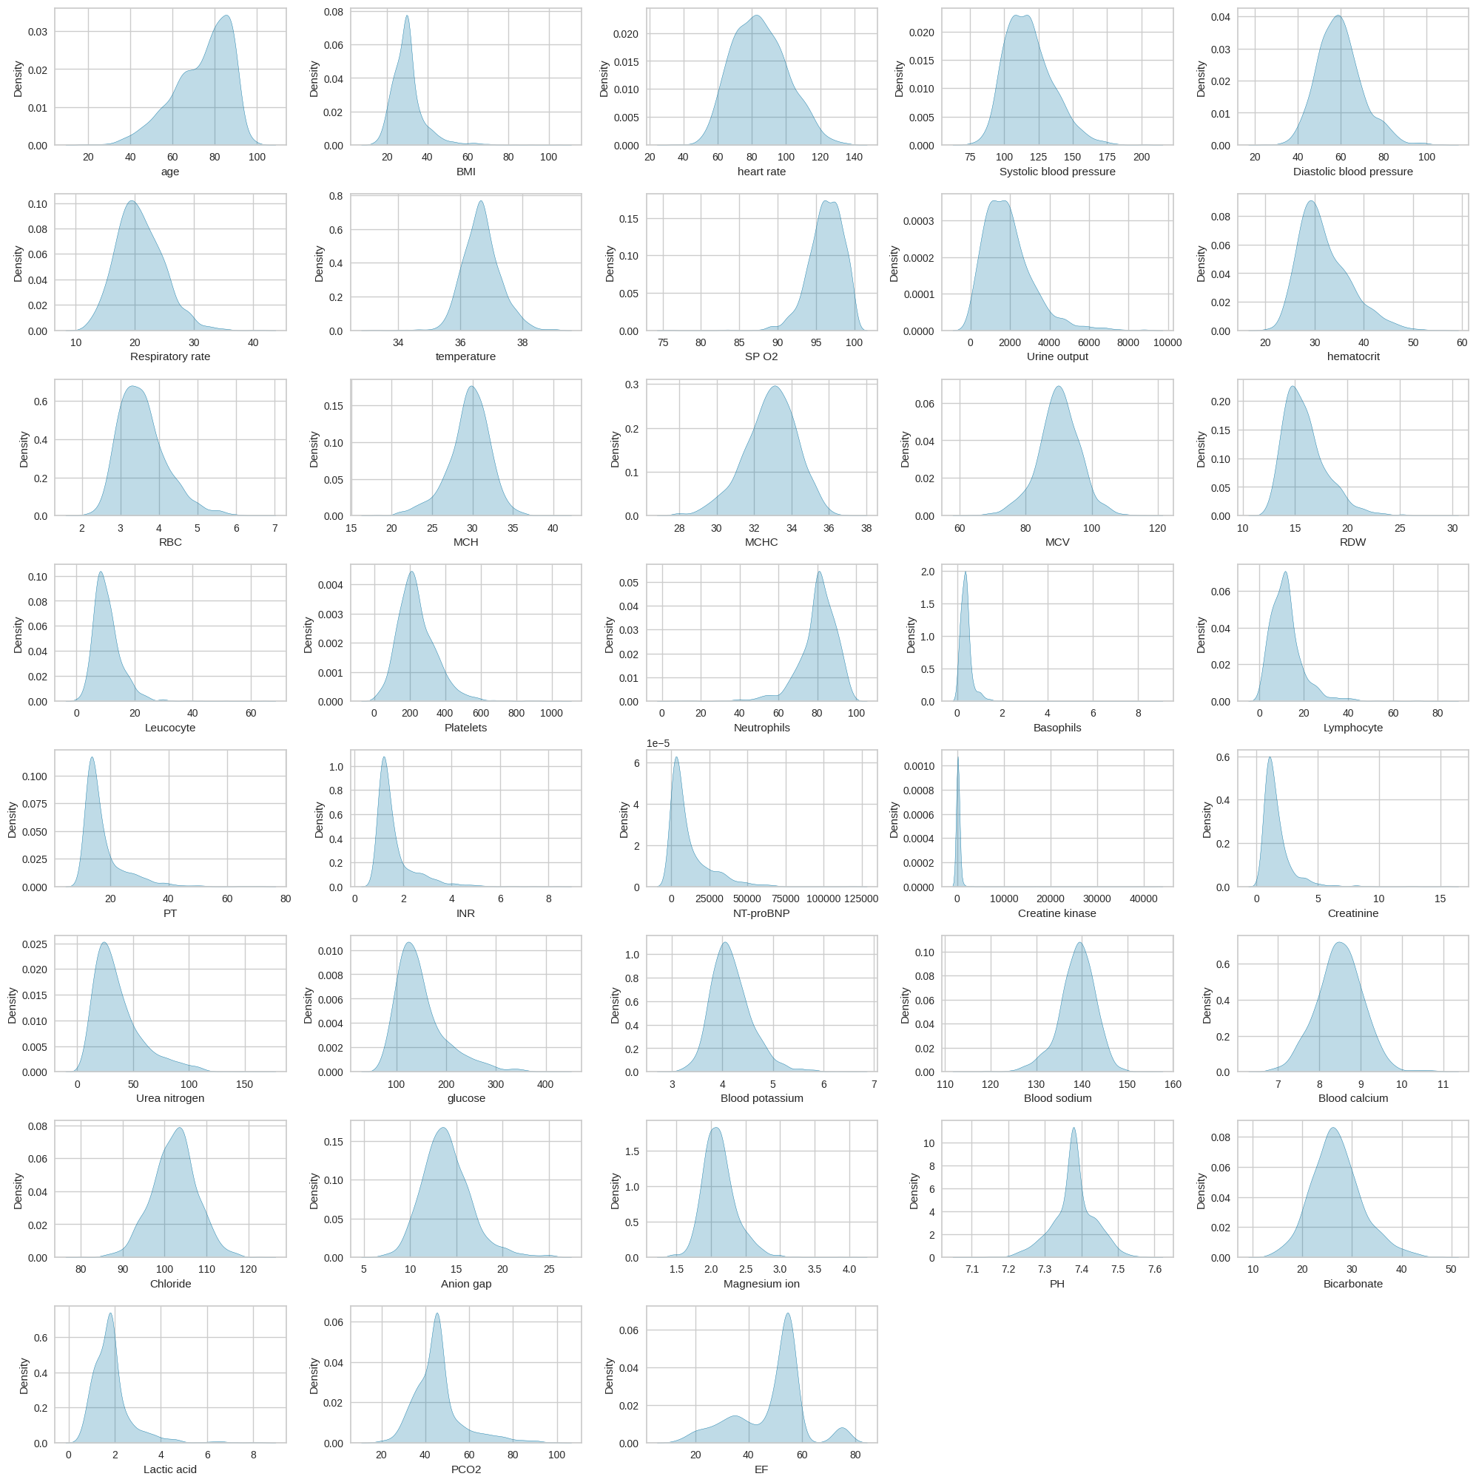
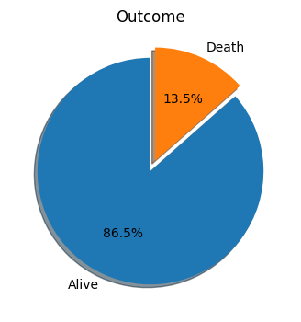
Initial Data Exploration
The 'Alive' category takes the vast majority.
Significant class imbalance between the categories.
All features are asymptotically normally distributed.
Notes:
The pie chart shows our target variable is highly imbalanced since the proportion of ‘Death’ is far below ‘Alive’.
The features in the dataset are almost normally distributed seen from the distribution plots.

Slide 3
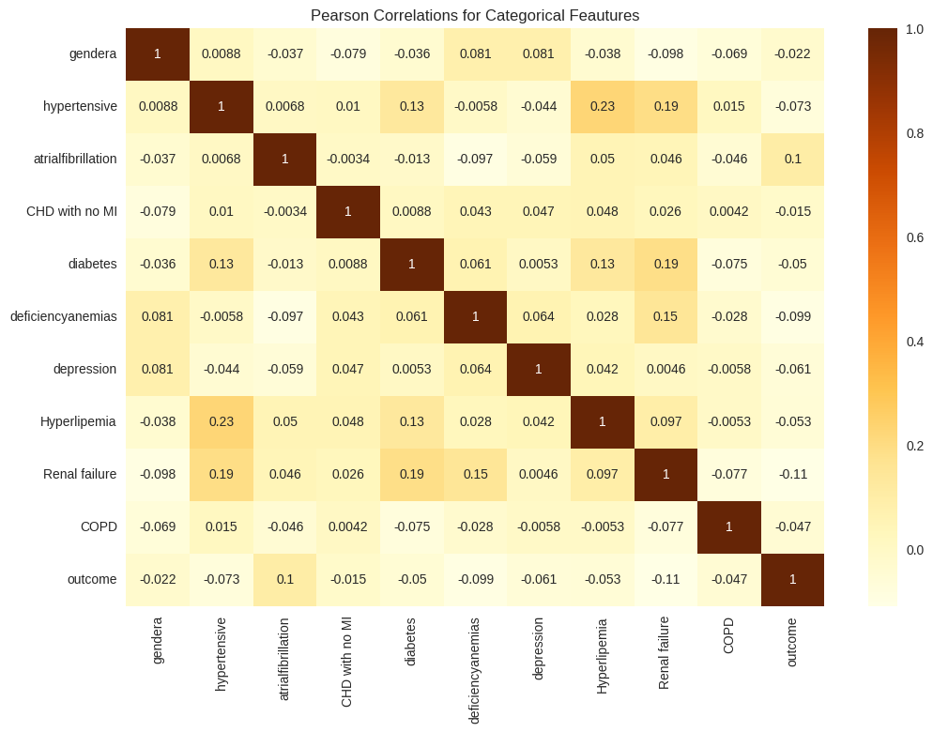
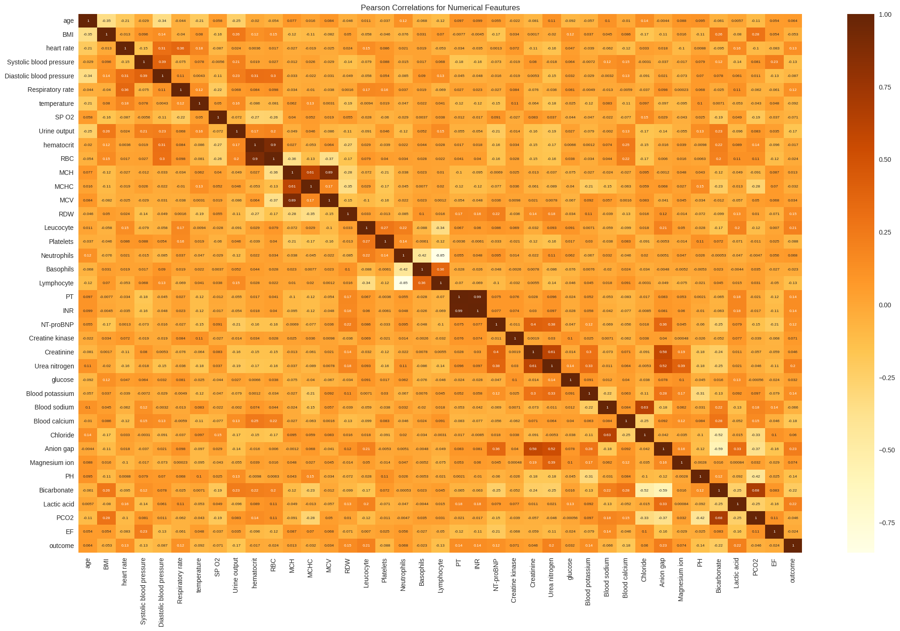
Initial Data Exploration
Relatively weak correlations for categorical variables. No variable should be dropped.
High correlations in some numerical variables. Use Spearman correlation matrix for further analysis.
Notes:
We can see relatively weak correlations for categorical variables, as there are no variables that display very strong correlations (values close to 1 or -1) with each other.
The correlations between some numerical variables are high (abs>0.8), we will check the Spearman correlation as well and decide to drop some features.

Slide 4
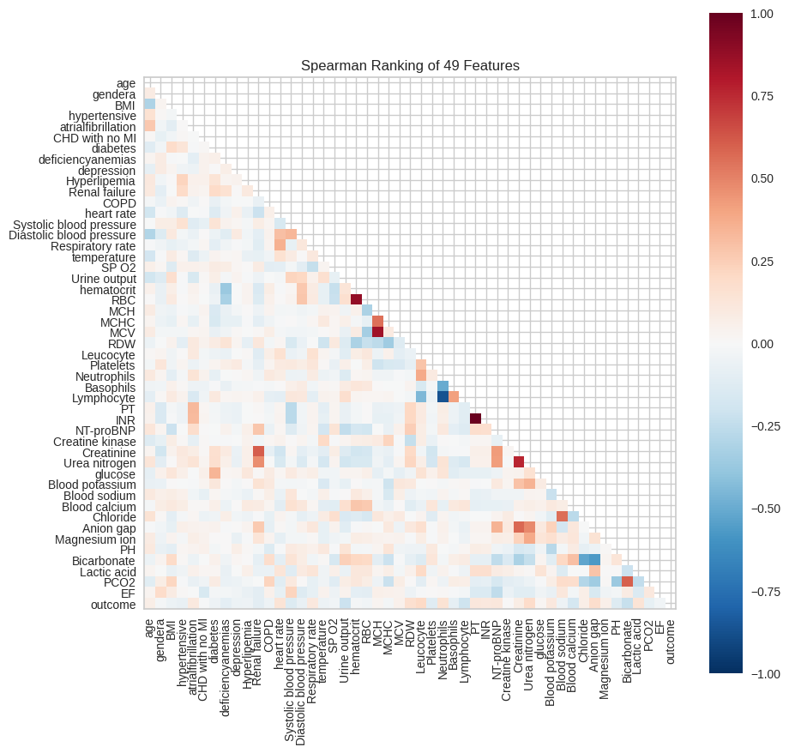
Initial Data Exploration
Almost same to the Pearson Correlation coefficients.
MCH (Mean Corpuscular Hemoglobin) and MCV (Mean Corpuscular Volume) are both important indicators of anemia, they represent almost the same characteristics of RBC, so MCV should be dropped.
Lymphocyte and Neutrophils are two important components of WBC (Leucocyte), and they are balanced negatively correlated with each other, So lymphocyte is removed.
PT is calculated from INR in medicine, so they are highly correlated,we drooped INR.
Hematocrit is a measure of the volume of red blood cells in the blood, so the strong correlation between hematocrit and RBC count is clinically expected, we just keep RBC for following analysis.

Slide 5
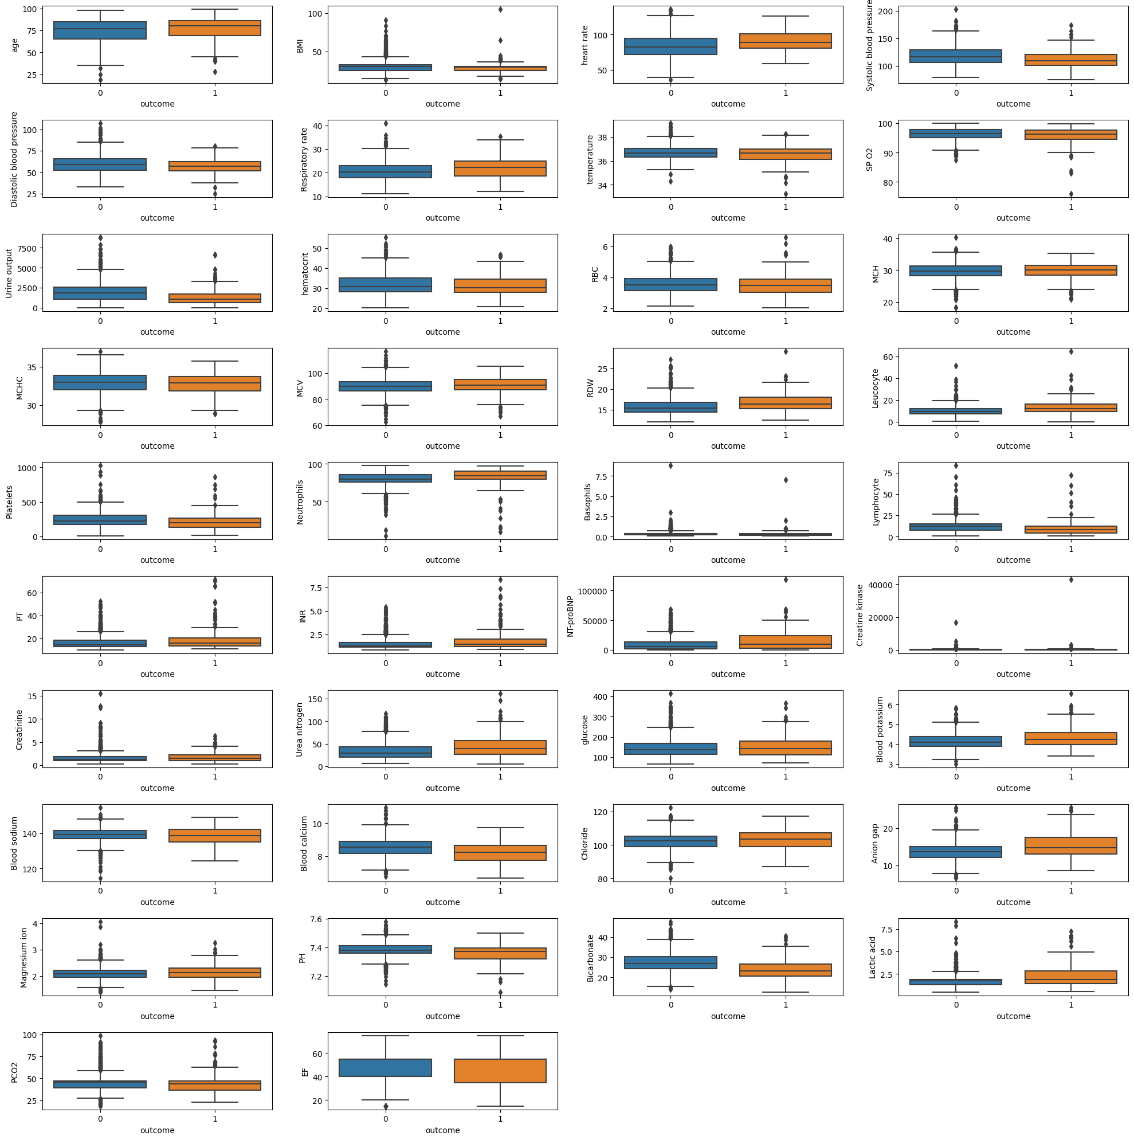
Initial Data Exploration
We use these boxplots to further understand the distribution of the features and observe any outliers
The following features have the some of the most notable outliers:
BMI
RDW
Basophils
Creatine kinase
We can consider some of the following techniques to reduce their effect:
Data trimming (remove outliers)
Feature engineering (e.g. using log-transformed versions of some features)
Standard scaling
Notes:
The provided image shows a collection of boxplots, which are used to visualize the distribution of various features in relation to two outcomes (labeled as 0 and 1). Boxplots for features such as BMI, RDW (Red Cell Distribution Width), Basophils, and Creatine kinase are highlighted as having notable outliers. Outliers are data points that deviate significantly from the rest of the data, and they can potentially skew the analysis. To address the issue of outliers, we consider techniques such as data trimming to remove outliers, feature engineering (possibly involving transformations like logarithmic scaling to reduce skewness and variance), and standard scaling (normalizing or standardizing features so that they have a mean of 0 and a standard deviation of 1). Such preprocessing steps are crucial for improving the performance of machine learning models by ensuring that the feature values have a more normalized distribution and are on a similar scale.

Slide 6
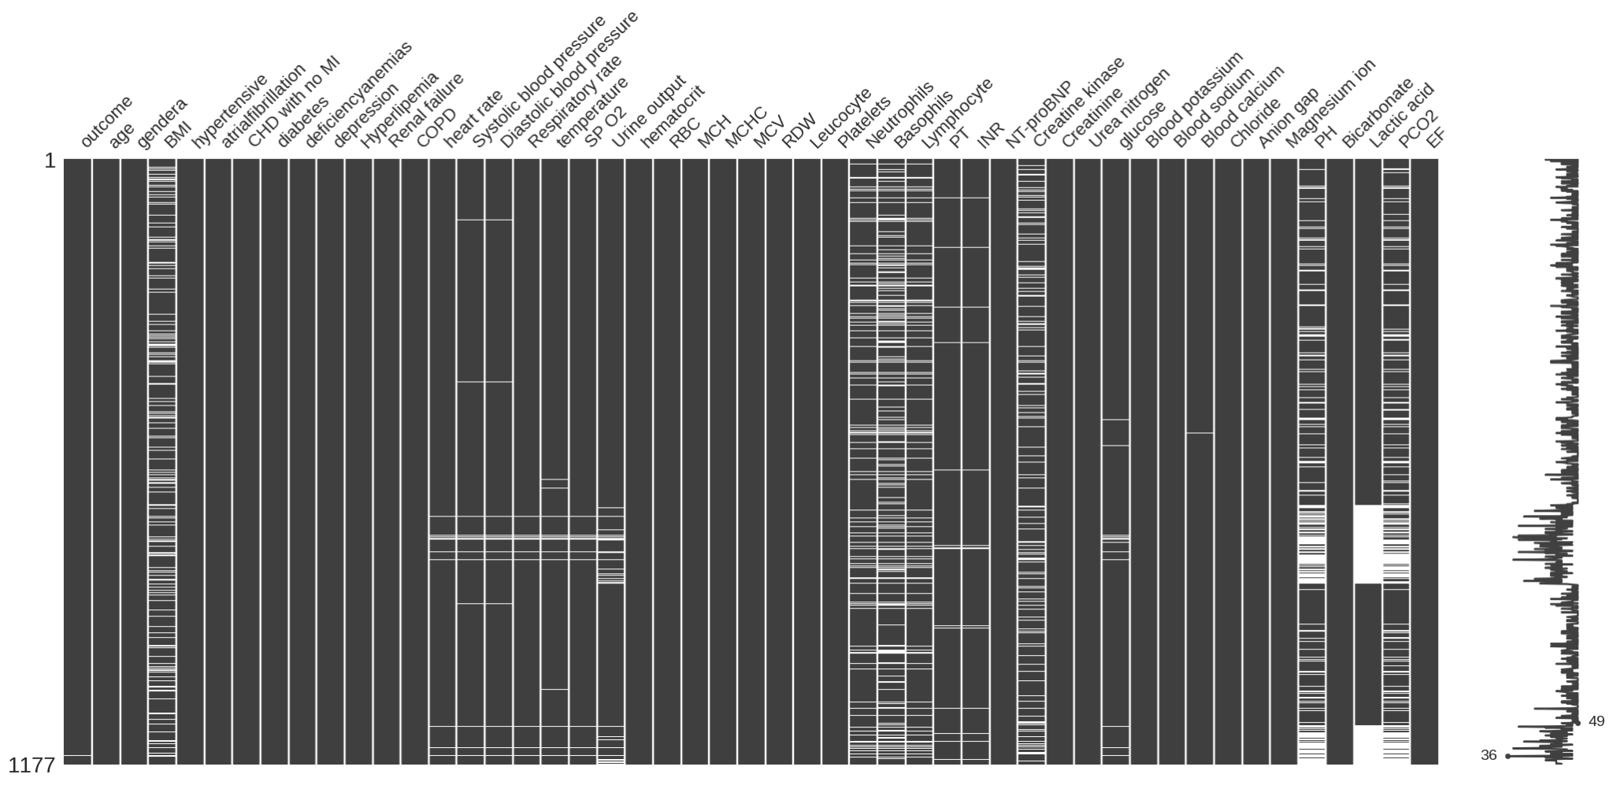
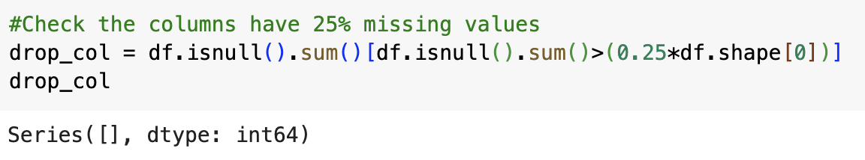
Cleaning and Sampling
All categorical features are complete
Some numerical features seem to exhibit a significant amount of missing data
Use the following code to check if the proportion of missing value exceeds 25% for each feature
The empty array shows we do not need to drop any features since no one exceeds 25%
Notes:
We plot a missing value matrix for our dataset. We observe that features such as "outcome," "gender," and "hypertensive" are mostly complete with very few missing entries, as indicated by the predominance of dark black and minimal white lines. On the contrary, some features exhibit a significant amount of missing data, denoted by the large white section towards the right of the matrix. So we need to calculate the proportion of missing values to determine which features need to be dropped, from the output of the code snippet, no variable shows more than 25% null value, so we can keep all of them for next step.

Slide 7
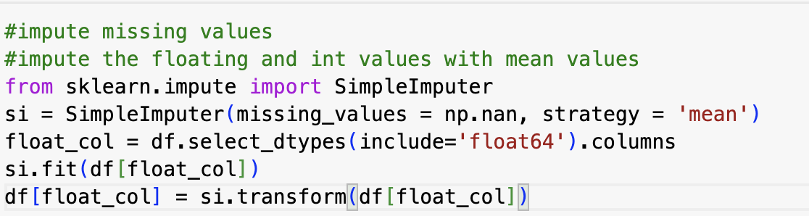
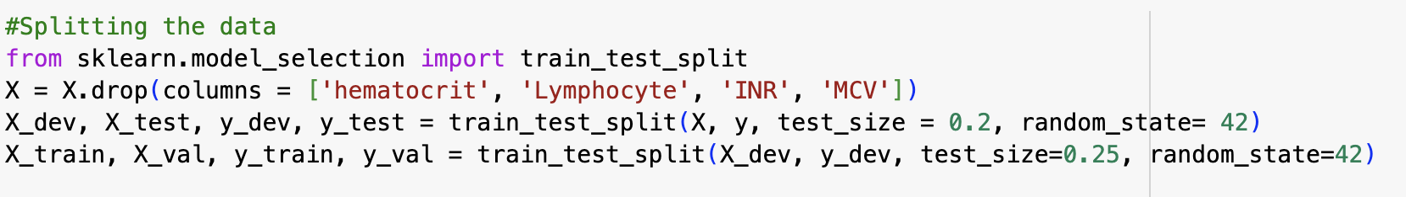
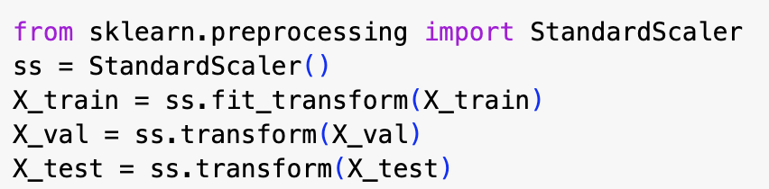
Cleaning and Sampling
Impute the missing values:
For numerical features, use their mean values to impute the NaNs
For the only one missing values in target variable, we use mode to impute that
Drop the highly correlated features mentioned in the initial data exploration part
Split the dataset into train, validation and test sets
Since almost all features are normally distributed, use standard scaler to scale the features to reduce the effect caused by outliers
Notes:
In this slide, we illustrate a section of a data preprocessing workflow of cleaning and sampling. Missing values within the dataset are imputed using two strategies: the mean value for floating-point features (using SimpleImputer with the mean strategy in scikit-learn), and the most frequent value for the target variable (most_frequent strategy). This is a common practice to handle missing data in machine learning to prevent errors during model training. Additionally, the dataset undergoes feature selection by dropping highly correlated features to reduce redundancy and potential multicollinearity, as noted from initial data exploration. The data is then split into training, validation, and test sets, ensuring separate data subsets for model training, hyperparameter tuning, and final evaluation, respectively. The split proportions are 20% for the initial split (to create a development and test set), and then 25% of the development set is further split to create a validation set. Finally, feature scaling is applied using a StandardScaler to standardize the feature values to have a mean of zero and a standard deviation of one, which helps to mitigate the influence of outliers and ensures that all features contribute equally to the model's performance. This process exemplifies careful preparation of data to facilitate effective machine learning model development.

Slide 8
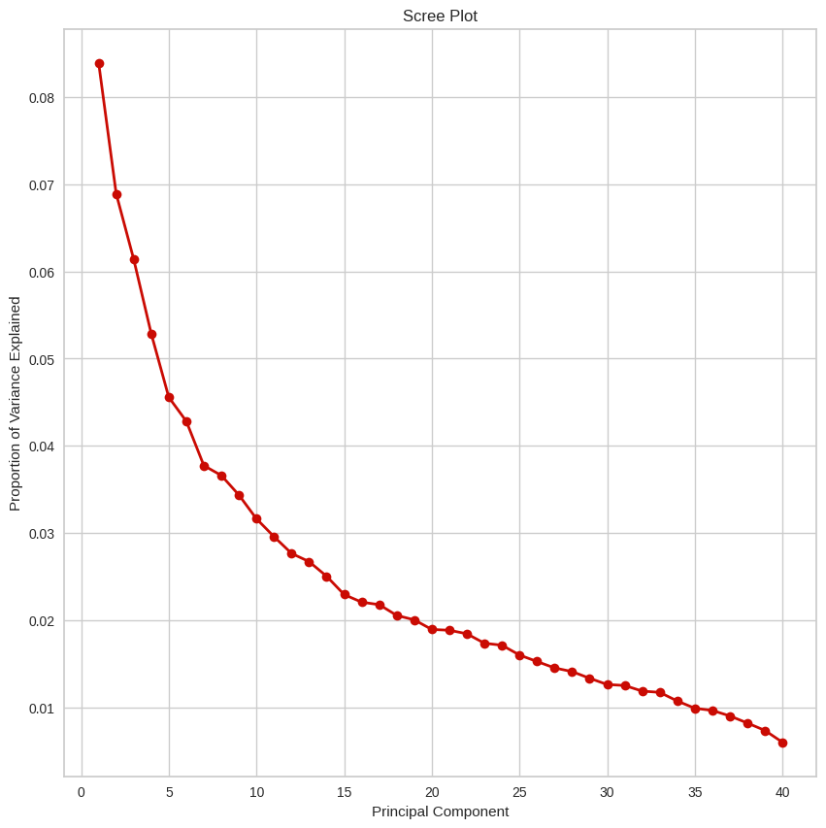
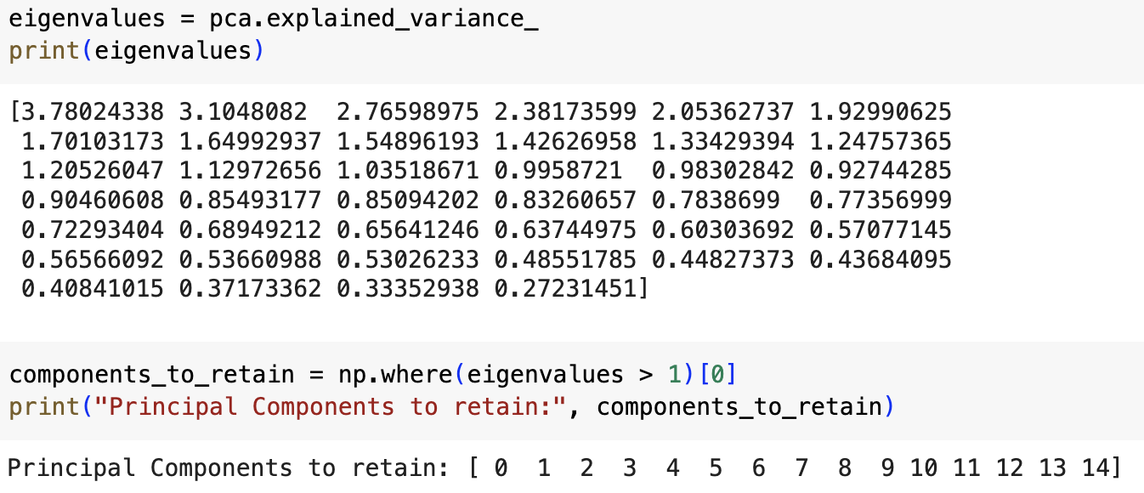
PCA
Draw the scree plot to determine the optimal number of components to keep.
Around the 15th component, as this is where the rate of decrease in variance explained begins to less steep (elbow).
Moreover, from the perspective of eigenvalues, only top 15th eigenvalues > 1, so we need to keep 15 Principal Components for subsequent analysis.
Notes:
The Scree Plot shows the proportion of variance explained by each principal component in PCA. From the plot, we can observe a steep decline in the explained variance with the initial few components, followed by a gradual plateau as we move to higher numbered components. The first component explains the highest variance, and subsequent components explain progressively less. This trend continues past the 15th principal component, after which the decrease in variance explained by each additional component becomes less steep. Typically, the elbow of the plot is used to determine the optimal number of components to keep, which in this case could be around the 15th component, as this is where the rate of decrease in variance explained begins to less steep.
We will use this PCA analysis to reduce the dimensionality of our features in future steps of the project.

Slide 9
Insights from Data Exploration
Imbalanced target variable: 'Death' is significantly lower than 'Alive'.
Numerical features exhibit near-normal distribution.
Weak correlations among categorical features; high correlations among some numerical features.
Feature reduction: Eliminate redundant features like MCV, Lymphocyte, and INR
Minimal missing data: Impute missing values with means for numerical features and mode for the target variable.
Retain the first 15 principal components in PCA based on Scree Plot for dimensionality reduction (use X_train_PCA dataset instead of entire X_train; reducing from 40-50 features to ~15) .

Slide 10
Proposed Machine Learning Algos/Techniques
Synthetic Minority Over-sampling Technique (SMOTE): Crucial for addressing the significant data imbalance in patient outcomes.
Logistic Regression: Useful for binary classification of patient outcomes (live or die). It's interpretable, which can help in understanding the impact of features on the prediction. Additionally, it handles imbalanced data effectively when coupled with techniques like class-weight balancing or threshold adjustment.
Random Forest: Well-suited for predicting patient outcomes, as it can capture complex relationships in the dataset, which may be essential in medical contexts. It also handles imbalanced data through bootstrapping and aggregating multiple decision trees, reducing the risk of overfitting.
Gradient Boosting (e.g., XGBoost): Valuable for predicting patient outcomes as it excels in handling imbalanced data by giving more weight to misclassified instances, focusing on the minority class, and providing better predictive performance.
Notes:
SMOTE generates synthetic samples for the minority class, allowing machine learning algorithms to better recognize the minority class and reduce bias towards the majority class, thus improving prediction accuracy in cases of imbalanced data.

