Slide 1
Optimizing Real Estate Investments
A Data-Driven Solution
Atharva M Kulkarni
MS in Data Science, Columbia University
atharva.kulkarni@columbia.edu

Slide 2
Table of Content
Introduction
Problem Statement
Key Performance Indicator (KPIs)
Assessment of Consultant's Model
New Model Development
Data Exploration
Feature Engineering and Selection
Pre-modeling
Modeling
Conclusion and Takeaways
Future Work

Slide 3
Introduction
The Real Estate team aims to identify properties to invest in to maximize the returns and minimize risk
Historically, consultants were hired to work on this task and the decisions were based on a 3rd party vendor providing success probabilities for each property
Successful Property: $ 1M Unsuccessful Property : $ 3M

Slide 4
Problem Statement
Goal: Develop an in-house predictive model to enable property investment decisions, replacing the 3rd party vendor's service
Objective: From business perspective, the solution must
Mitigate Financial Risk
Maximize Returns
Enhance Decision Confidence
Notes:
Minimize financial loss by reducing false positives (unprofitable investments) and also the model should identify successful properties.
Highlight that the decision can only be binary.

Slide 5
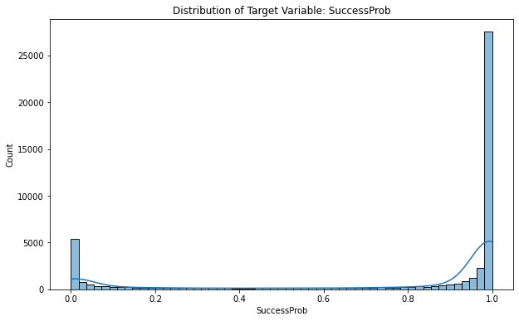
Regression or Classification?
For predicting property investment outcomes, there are 2 potential modeling approaches:
Beta Regression
Suitable for continuous variable between 0 and 1, preserves the values
Difficult to interpret (bimodal) and does not align with binary nature of investment decisions
Binary Classification
More appropriate for making business decisions, directly addressing the yes/no nature of investment choices
Invest: 1
Success Probability
Don't Invest: 0
Fig. 1 : Distribution of Target Variable

Slide 6
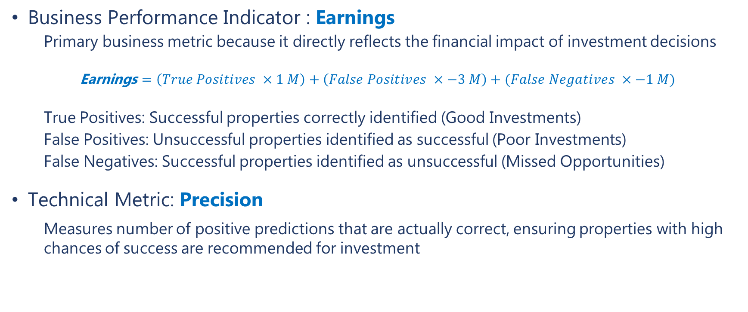
Key Performance Indicators (KPIs)
Business Performance Indicator : Earnings
Primary business metric because it directly reflects the financial impact of investment decisions
Earnings $=\left(True Positives ×1 M\right)+\left(False Positives ×−3 M\right)+(False Negatives ×−1 M)$
True Positives: Successful properties correctly identified (Good Investments)
False Positives: Unsuccessful properties identified as successful (Poor Investments)
False Negatives: Successful properties identified as unsuccessful (Missed Opportunities)
Technical Metric: Precision
Measures number of positive predictions that are actually correct, ensuring properties with high chances of success are recommended for investment
The new in-house model achieves a boost of at least 170% in Earnings & ~ 7-8% increase in model performance
Notes:
Precision : reduces the # of poor investments and maximizes the good investments.

Slide 7
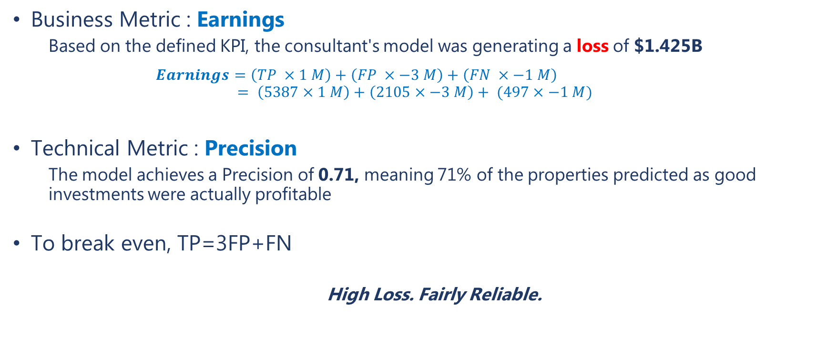
Assessment of Consultant's Model
Business Metric : Earnings
Based on the defined KPI, the consultant's model was generating a loss of $1.425B
$Earnings=\left(TP ×1 M\right)+\left(FP ×−3 M\right)+\left(FN ×−1 M\right)$
$$= \left(5387×1 M\right)+\left(2105×−3 M\right)+ (497×−1 M)$$
Technical Metric : Precision
The model achieves a Precision of 0.71, meaning 71% of the properties predicted as good investments were actually profitable
To break even, TP=3FP+FN
High Loss. Fairly Reliable.
Notes:
FPs show room for improvement to further reduce unprofitable investments.

Slide 8
New Model Development
Real Estate Investment Data Overview
Census Data
Demographic, Economic & Environmental stats at state level (Population, Median Income, Rent, Rainfall, Snowfall, etc.)
No Null Values and Duplicates 15 rows x 12 columns Numeric features
Property Data
Property Attributes: Physical, Financial and Operational Details (Building Count, Area, Value, Expenses, SuccessProb)
7 features with missing values, No duplicates 48,019 rows x 21 columns 18 numerical, 3 categorical features
Census Data + Property Data
(merged on StateCode)

Slide 9
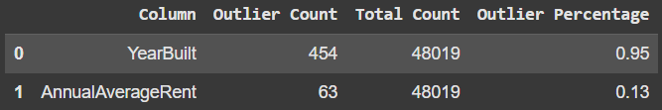
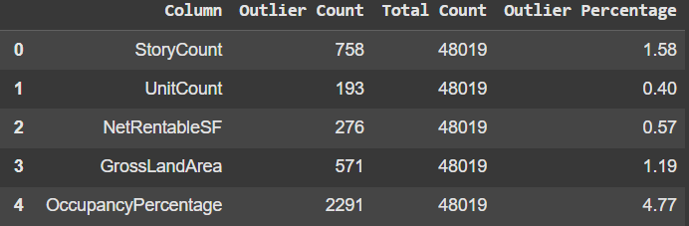
Data Exploration: Outlier Detection
Z- score based
YearBuilt, AnnualAverageRent
IQR based
StoryCount, UnitCount, NetRentableSF,
GrossLandArea,OccupancyPercentage
Table 1: Z-score based Outliers
Table 2: IQR based Outliers
No treatment undertaken
Notes:
FPs show room for improvement to further reduce unprofitable investments.

Slide 10
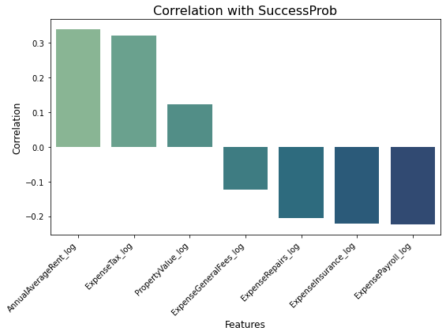
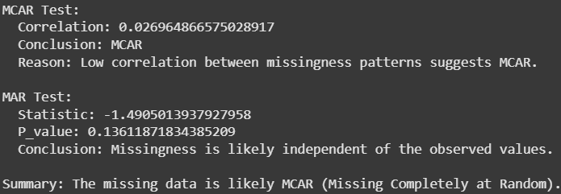
Data Exploration: Missing Value Analysis
d.
5 features namely ExpenseTax, ExpenseRepairs, ExpenseInsurance, ExpensePayroll, have ~ 95% missing records
Unlikely Investment Drivers, Insufficient data for reliable imputation
AnnualAverageRent (74%) and PropertyValue (52%) are likely important for the prediction
Possible methods: SimpleImputer, kNNImputer
Fig 2: Missing Value Features Correlation with Target Variable

Slide 11
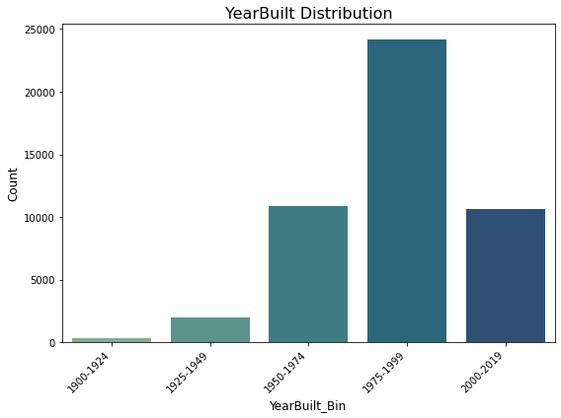
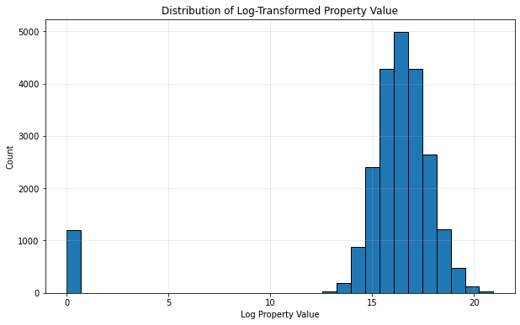
Feature Engineering
Binning YearBuilt into 5 bins
Numerical to Categorical
Property Value
~ 1200 properties with 0 value
Fig 3: YearBuilt Bins Distribution
Fig. 4: log Property Values Distribution

Slide 12
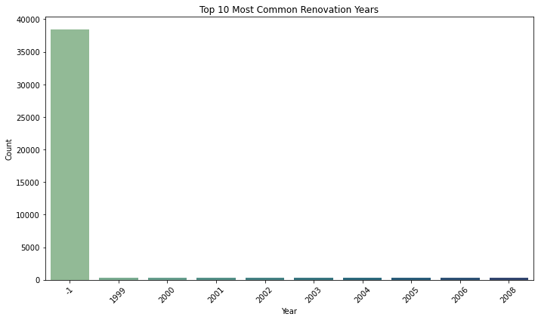
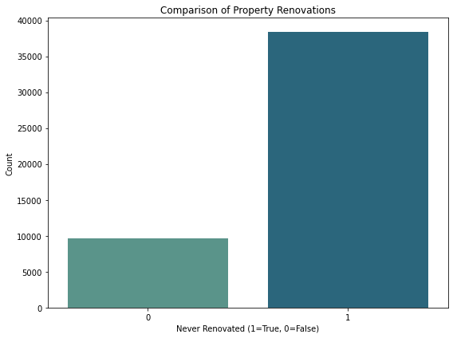
Feature Engineering
YearLastRenovated NeverRenovated
~39,000 rows with placeholder value (-1) Binary Variable ( 0 or 1)
Fig. 5: Count of Placeholder Values vs Actual Values
Fig. 6: Count of Renovations vs No Renovations

Slide 13
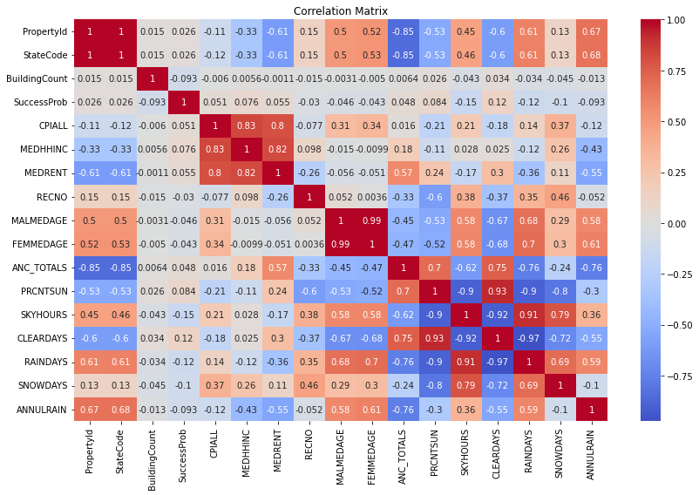
Feature Selection
Feature Selection based on correlation with SuccessProb
High Correlation (>0.8)
SKYHOURS, FEMMEDAGE, CPIALL
Minimal Predictive Value (<0.03)
RECNO, PropertyID, StateCode
PropertyType
No variability (Single value: Multifamily)
Fig. 7: Correlation Matrix

Slide 14
Pre-modeling
Encoding:
One Hot Encoding (ParkingRatio, PropertySubType, YearBuilt_Bin)
Split:
80:20 Train – test split
Scaling:
StandardScaler
Normally distributed features (UnitCount, NetRentableSF)
RobustScaler
Irregular distribution with outliers (BuildingCount, ANC_TOTALS)
MinMax Scaler
Percentage based or bounded features (OccupancyPercentage, PRCNTSUN)

Slide 15
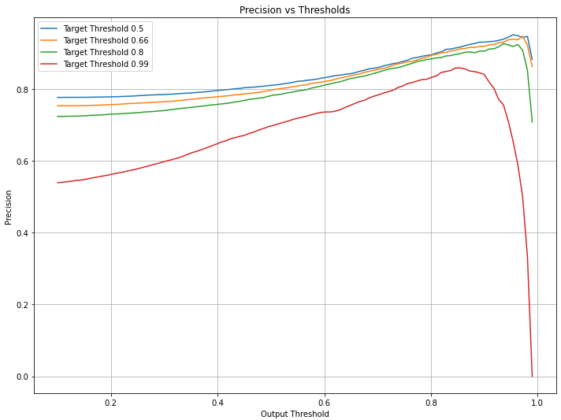
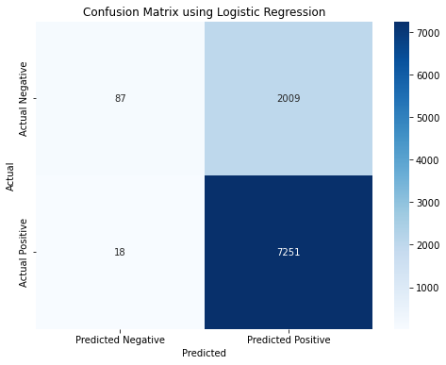
Modeling
Logistic Regression
Threshold Optimization Approach:
Nested thresholds: outer loop for target thresholds [0.5, 0.66, 0.8, 0.99] to binarize the probability scores
Inner loop tries 100 different output thresholds (0.1 to 0.99) on predicted probabilities
Optimal balance between target threshold and prediction threshold
Fig. 8: Precision across Thresholds
Earnings = $ 1.206 B Profit
Precision = 0.78
Substantially Profitable. Reliably Accurate.
Fig. 9: Confusion Matrix

Slide 16
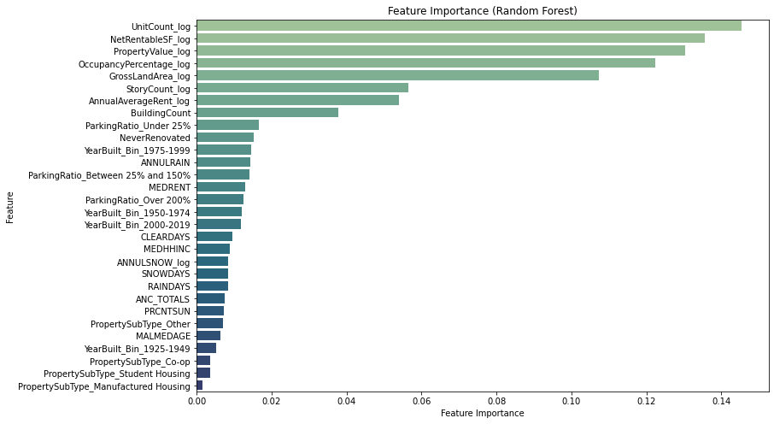
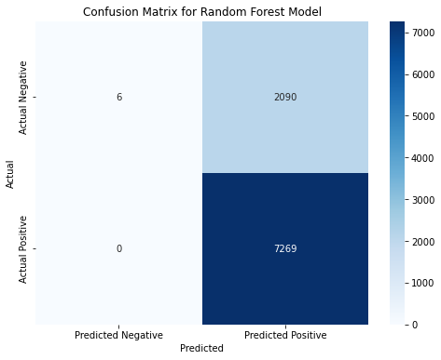
Modeling
Random Forest
Plain Version. No HP.
More conservative in terms of missing opportunities, but ends up making more poor investment decisions (FP).
Fig. 11: Feature Importance
Earnings = $ 0.99 B Profit
Precision = 0.77
Fairly Profitable. Reliably Accurate.
Fig. 10: Confusion Matrix

Slide 17
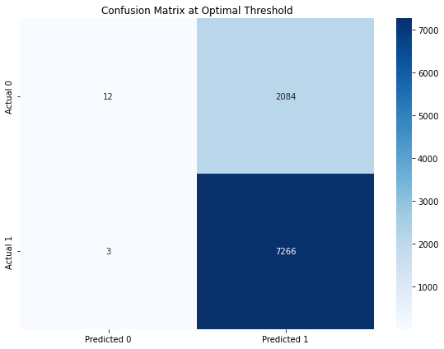
Modeling
XGBoost
Hyperparameters:
n_estimators, learning_rate, max_depth
More conservative in terms of missing opportunities, but ends up making more poor investment decisions (FP).
Fig. 12: Confusion Matrix
Earnings = $ 1.01 B Profit
Precision = 0.77
Moderately Profitable. Reliably Accurate.

Slide 18
Conclusion & Key Learnings
Developed an in-house model delivering 185% higher earnings and 8% improved accuracy, outperforming consultant's model
Logistic Regression optimized with nested thresholds proved the best balance of profitability ($1.206B earnings) and precision (78% profit precision)
Balancing business KPIs with technical metrics is key
It's crucial to understand the data in the context of the use case, features critical to business outcomes should be prioritized and not overlooked.

Slide 19
Future Work
Advanced Imputation (MICE, ML- based) for critical features
Extensive Modeling: Hyperparameter Tuning, Cross Validation
Explainability: SHAP or LIME to further understand key investment drivers and trends
Explore the possibility of Beta Regression (Unlikely, but experimentation could be done!)

Slide 20
THANK YOU!

