Slide 1
DATALYZE AI
ATHARVA PERFORMANCE PACK
Automated Executive Presentation • Compiled on 2026-07-04

Slide 2
DATA HEALTH & INGESTION PROFILE
Dataset Ingestion Diagnostics
• Health Index Score: 100.0/100
• Total Dataset Rows: 23
• Total Data Columns: 5
• Missing Data Cells: 0 (0.0%)
• Duplicate Row Count: 0 (0.0%)
AI Data Doctor Ingest Recommendations
🤖 No actions required for dataset validation.
🤖 Dataset is in perfect health.
🤖 No corrections needed.

Slide 3
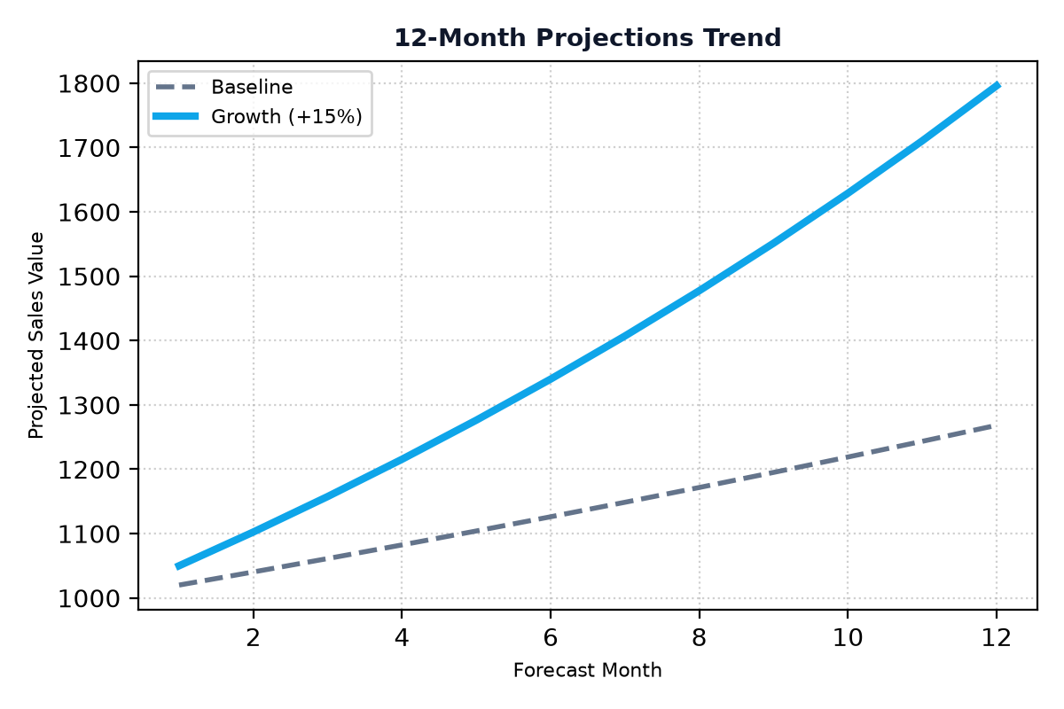
WHAT-IF SIMULATION FORECAST PROJECTIONS
Revenue Projection Model
Here's a 2-sentence executive summary: "Run-time forecasting trend simulation enables organizations to optimize revenue growth by accurately predicting and adapting to changing market conditions, customer behavior, and competitor activity, ultimately driving increased revenue and market share. By leveraging growth and churn optimization, companies can make data-driven decisions to allocate resources effectively, mitigate risk, and capitalize on new opportunities, resulting in sustained revenue growth and improved profitability."

Slide 4
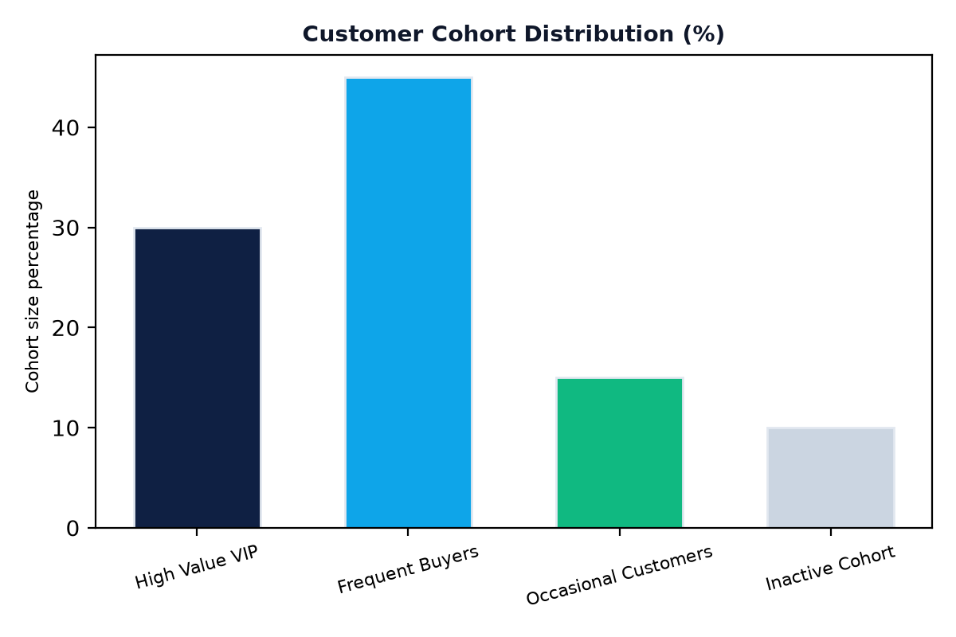
CUSTOMER COHORTS & MARKET SEGMENTS
Segmentation Insights
Visual clustering helps executive teams identify distinct customer groups, enabling targeted product campaigns that resonate with specific cohorts and drive business growth. By visualizing customer behavior, teams can develop tailored strategies to engage and retain high-value customers.

