Slide 1

DIP Tutorial: 1
By,
Atharva Kadethankar
Course Instructor,
Prof. Neelam Sinha

Slide 2
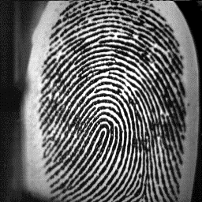
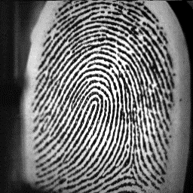
Problem Statement & Discussion:
Start
Input scanned fingerprint image
Extract features
Match/ compare features of given two fingerprints
Fingerprint recognition
End

Slide 3
Extract Features:
Morphological operations :
Erosion: it erodes away the boundaries of foreground object (Always try to keep foreground in white)
Dilation: it increases the white region in the image or size of foreground object increases
Opening: Erosion followed by Dilation
Closing: Dilation followed by Erosion
Edge Detection
Canny edge detection
Corner Detection
Harris corner detection
Key-points detection
SIFT, SURF

Slide 4
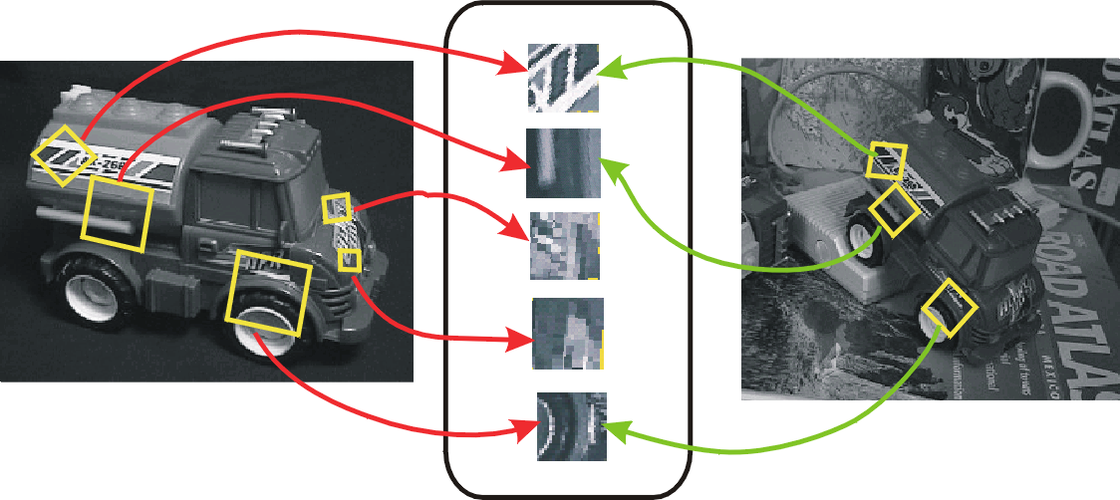
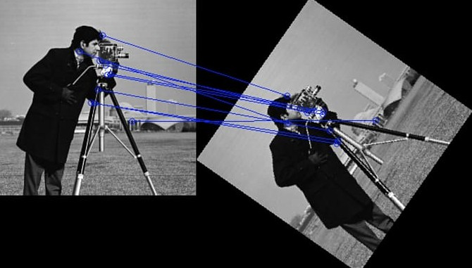
SIFT (Scale-invariant feature transform) :
Matching features across different images to identify similarity in images
When all images are similar in nature (same scale, orientation, etc) corner detector can work
But when you have images of different scales and rotations, you need to use the Scale Invariant Feature Transform

Slide 5
Thank You!
Atharva Kadethankar
atharva.kadethankar@iiitb.org

