Slide 1
The Whole and Its Parts:
History of Ideas about the Brain
BT6270: Introduction to Computational Neuroscience
V. S. Chakravarthy
Department of Biotechnology
IIT, Madras.

Slide 2
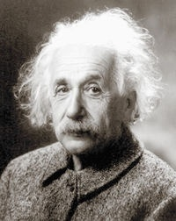
WHY IS HE SO SMART?
or
What are the neural substrates of Intelligence?

Slide 3
The “Life After Death” Saga of Einstein’s Brain
Einstein's brain was removed within 7 hours of his death.
It was dissected into roughly 240 blocks of about 10cm³ each
The blocks were encased in a plastic-like material called celloidin.
Experts then looked for significant anatomical and cytological differences from normal brains

Slide 4
Brain Basics
Frontal lobe: planning for future action, movement control, “civilized” behavior
Parietal lobe: somatic sensation, body image, spatial skills
Occipital lobe: vision
Temporal lobe: hearing, memory consolidation, emotion.

Slide 5
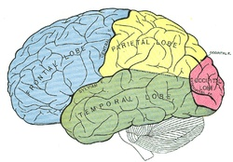

Slide 6
Study by a team at McMaster University
Einstein's parietal operculum region was missing.
  The operculum is part of the inferior frontal gyrus of the frontal lobe in the brain. The inferior frontal gyrus borders the lateral sulcus (Sylvian fissure)
The Sylvian fissure was partially absent
The inferior parietal lobe was 15 percent wider than normal
  The inferior parietal region is responsible for mathematical thought, visuospatial cognition, and imagery of movement.
Einstein's brain also contained 73 percent more glial cells than the average brain in the left inferior parietal area
(http://en.wikipedia.org/wiki/Albert_Einstein's_brain)

Slide 7
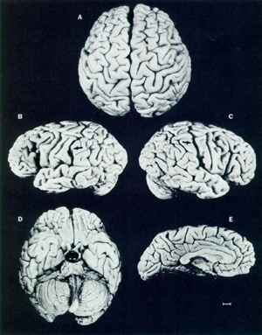
Einstein’s Brain
It is different from a
Normal brain;
but nothing dramatic.

Slide 8
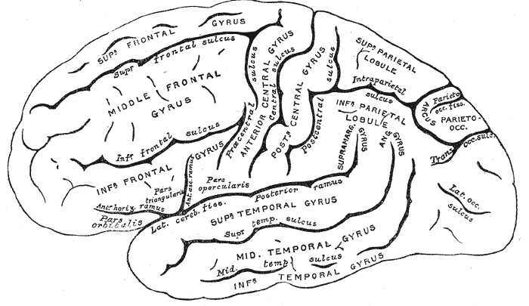

Slide 9
Back to the Past…

Slide 10
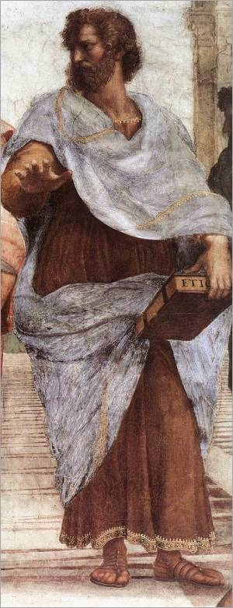
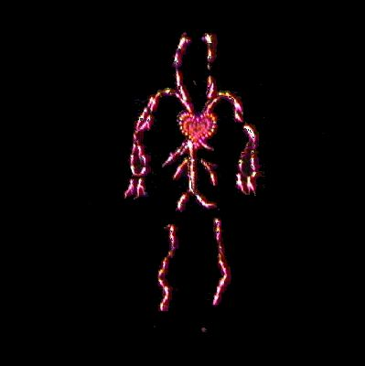
Aristotle:
Heart is the seat of the Soul, not the Brain
(335 BC)

Slide 11
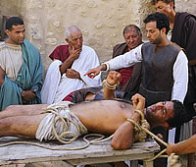
Herophilus (335 BC)
Father of experimental method in medicine
Ventricles are the seat of the Soul

Slide 12
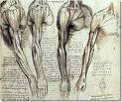
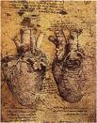
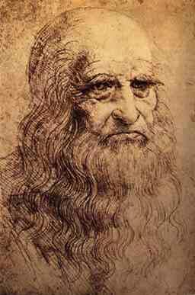
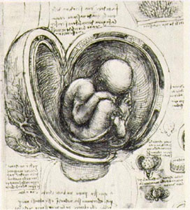

Leonardo –the Anatomist

Slide 13
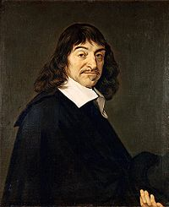
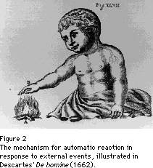
Des Cartes: I think, therefore I am.
…external motions affect the peripheral ends of the nerve fibrils, which in turn displace the central ends. As the central ends are displaced, the pattern of interfibrillar space is rearranged and the flow of animal spirits is thereby directed into the appropriate nerves.
http://serendip.brynmawr.edu/Mind/Descartes.html

Slide 14
Phrenology
Franz Joseph Gall: Austrian physician and neuroanatomist
1.The brain is the organ of the mind.
2. The mind is composed of multiple, distinct faculties.
3. Each faculty has a separate organ in the brain.
4. The size of the organ is a measure of its power.
5. Sizes of various organs determine the shape of the brain
6. Shape of the brain determine the shape of the skull
7. The surface of the skull is an accurate index of psychological aptitudes and tendencies.
(Other names: anatomical personology, bumpology)

Slide 15
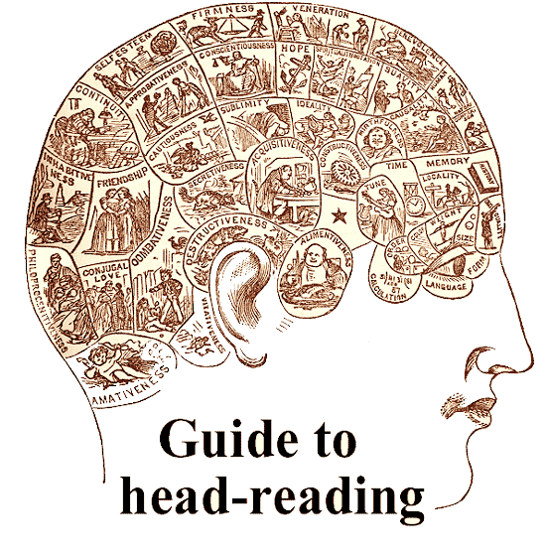
Phrenology

Slide 16
Applying the Scientific Method to Brain Science

Slide 17
The Tributaries
Amalgamation of 7 sciences:
Anatomy
Embryology
Physiology
Pharmacology
Psychology
Diagnostic Tools
Computing

Slide 18
Ideas about Anatomy

Slide 19
“Fluid” Ideas
Fluids, fluids everywhere…
Heat, light, void (“ether”) – all fluids
Galen: nerves are ducts conveying fluid secreted by the brain and spinal cord to the periphery of the body.

Slide 20
The Fluid starts drying up…
Before the invention of microscope in 18th century there was:
Reticular theory:
  nervous system as a syncytial network
  of nerve fibers which were continuous with each other
  brain as a fused mass of cells sharing a common cytoplasm

Slide 21
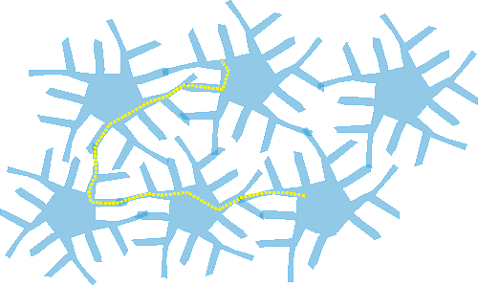
What is a syncytial network?
Cells connected such that there is a continuous path
from one cell to another
http://synapses.clm.utexas.edu/anatomy/astrocyte/astrocyt2.stm

Slide 22
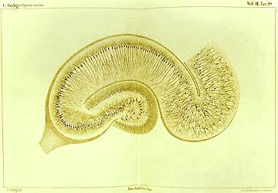
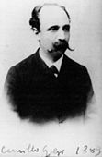
Camillo Golgi
Golgi’s silver impregnation method:
  allowed visualization of the anatomy of the whole neuron - the cell body, axon and dendrites.

Slide 23
Ramon y Cajal
Used this staining technique and showed that nervous system is not a syncytium but an intricate network of discrete cells.
Neuron doctrine: nervous system is made of individual signaling elements, the neurons, which contact one another only at specialized points of interaction called synapses.

Slide 24
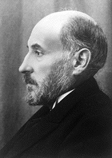
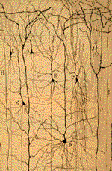
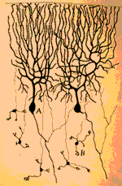
Ramon y Cajal
Father of Neuroscience
Pyramidal cells
Purkinje Cells

Slide 25
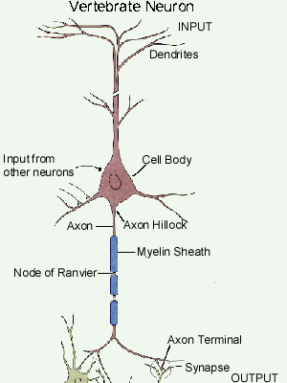

Slide 26
Ideas about functional organization

Slide 27
Phrenology
Franz Joseph Gall: Austrian physician and neuroanatomist
1.The brain is the organ of the mind.
2. The mind is composed of multiple distinct, innate faculties.
3. Because they are distinct, each faculty must have a separate seat or "organ" in the brain.
4. The size of an organ, other things being equal, is a measure of its power.
5.The shape of the brain is determined by the development of the various organs.
6.As the skull takes its shape from the brain, the surface of the skull can be read as an accurate index of psychological aptitudes and tendencies.
Other names: anatomical personology, bumpology

Slide 28
Phrenology

Slide 29
Jean Pierre Flourens
Gall did NOT use the scientific method.
The Academy of Sciences of Paris, acting on order of the emperor Napoleon, asked Flourens to fix the mess
Approach:
  remove various portions of the brains of experimental animals.
  Study their contribution to behavior
Conclusions: mental functions are not localized. All regions in the brain participate in all mental function.
The Aggregate Field View

Slide 30
A case for localization
J. Hughlings Jackson - British neurologist
Clinical studies of focal epilepsy – Jacksonian seizures
Convulsions begin in one part of the body and gradually spread.
The spreading pattern is always the same

Slide 31
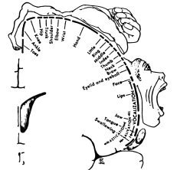
Motor Homunculus
Jackson’s Conclusion:
Specific parts of the body have specific “seat” in the brain.
Since spreading pattern in the body is constant,
brain’s organization is also constant.

Slide 32
Broca’s Aphasia
Pierre Paul Broca - French neurologist (1861)
A patient who could understand language but could not speak
No conventional motor deficits of the tongue, mouth or vocal cords
He could utter isolated words and sing a melody;
Could not speak grammatically or full sentences
“Son ... University ... Smart ... Boy ... Good ... Good ... “
Postmorten showed lesion in – Broca’s area
This led Broca to announce in 1864: “Nous parlons avec l’hemisphere gauche!” (We speak with the left hemisphere!)

Slide 33
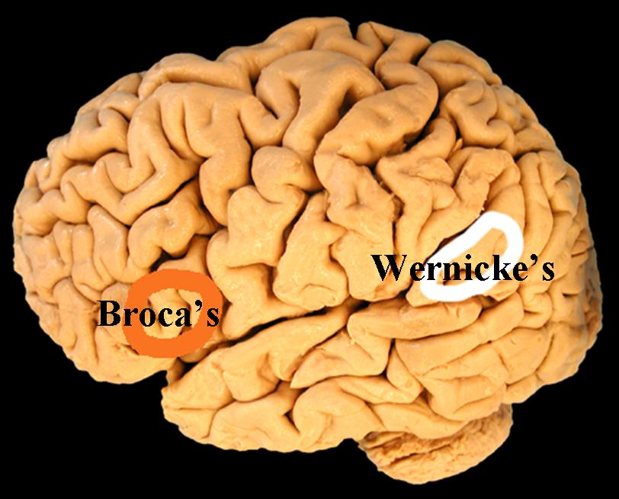
Language Areas
Arcuate Fasciculus

Slide 34
Wernicke’s Aphasia
Carl Wernicke - 1876 (at the age of 26)
Whereas Broca’s patients could understand but could not speak
cortical lesion in the posterior part of the temporal lobe
“I called my mother on the television and did not understand the door. It was too breakfast, but they came from far to near. My mother is not too old for me to be young.”

Slide 35
Conduction Aphasia
Connection between Broca’s and Wernicke’s areas – arcuate fasciculus – is destroyed.
Patients can understand words that are heard and seen but cannot repeat simple phrases.
Although they speak fluently, they cannot speak correctly
Omit parts of words and substitute incorrect sounds in the words

Slide 36
Wernicke’s Summary
Most basic mental functions, those concerned with simple perceptual and motor activities, are localized to single cortical regions; interconnections between these functional sites make more complex intellectual functions possible.
Parallel and distributed processing

Slide 37
Aggregate Field View strikes back
Karl Lashley: 1890–1958
“The ‘ideal’ architectonic map is nearly worthless…The areal subdivisions are in large part anatomically meaningless, and…misleading as to the presumptive functional divisions of the cortex.”
Approach: effect of brain lesions on maze learning in rats
Observation: found that severity of the learning deficit produced by brain lesions depend on the extent of the damage, not on its precise location.
Conclusion: Learning doesn’t have a special locus in the brain.

Slide 38
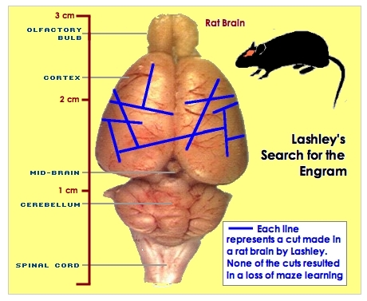
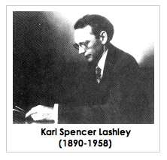

Slide 39
Lashley’s Principles for the Nervous System
Rejected the notion of localized learning. Rather he proposed two principles:
Equipotentiality: All parts of the cortex contribute equally to learning; one part can substitute for another part.
Mass Action: The cortex works as a whole; performance improves when more of the cortex is involved.

Slide 40
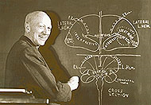
Localization again – Penfield’s work
Stimulated brains of awake patients under anesthesia
Stimulation at specific sites produced specific responses

Slide 41
More recent data from Imaging
Reading: response is produced in both primary visual cortex and visual association cortex
Hearing: temporal cortex and junction of temporal-parietal cortex.
Speaking: Subjects repeat words either spoken through headphones or displayed on screen
  Supplementary motor area and Broca’s area are activated
Thinking: subjects are asked to reflect on the meaning or words given. (associate a verb to a noun, eg brain and think)
  Anterior inferior frontal cortex is active.

Slide 42
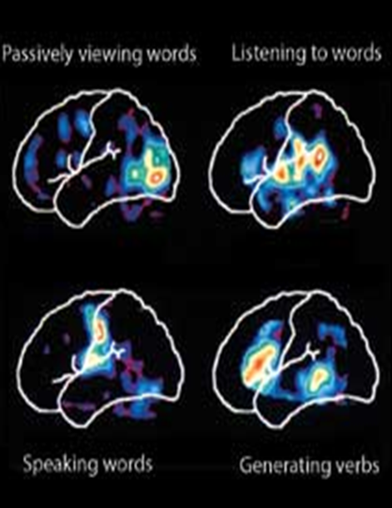

Slide 43
Functional organization of the Brain
Brain is a network of modules
Module➔ mass of neurons
Interconnections ➔ neural pathways
A given behavioral function is mediated by several modules and interconnections.
Objective: map behavior onto components of this network
Connectionist view – neural networks
Parallel and distributed processing

Slide 44
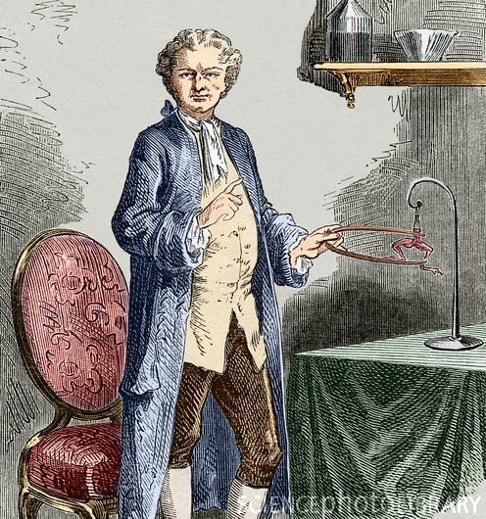
Beginnings of Neurophysiology
Luigi Galvani
Discovered that
muscles produce
electricity
Touching a frog’s nerve
with an electrostatically
charged rod produced
muscular contraction

Slide 45
19th & 20th century Electrophysiology
Emil DuBois-Reymond:
  Discovered the action potential
  Taught that muscle consists of “electric molecules”
Hans Berger (1924): Electroencephalogram (EEG)
Hodgkin-Huxley (Nobel Prize 1963)
  Model of Electrical signal Conduction in squid axon (1mm dia)

Slide 46
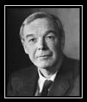
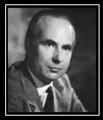
Hodgkin, Huxley, and the Giant Squid Axon
Hodgkin
Huxley

Slide 47
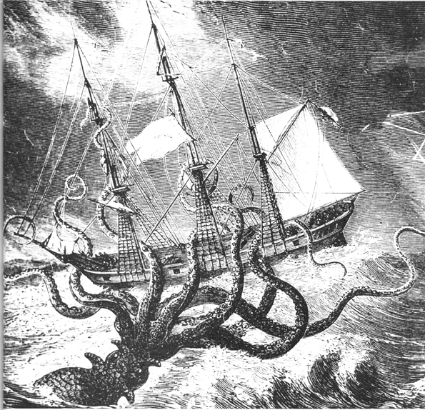
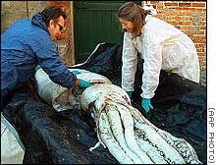
The
Giant Squid

Slide 48
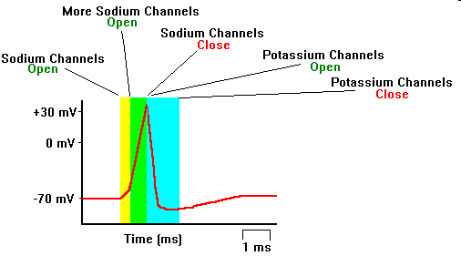
The Action Potential
Action Potential is a voltage spike
that propagates along a nerve fiber
Hodgkin and Huxley found the electrical basis of the
Action Potential

Slide 49
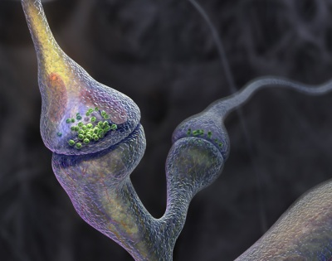
Pharmacology
Claude Bernard, Paul Ehrlich, John Langley: (end of 19th century)
  Demonstrated that drugs interact with specific receptors on neurons.
  Became the basis of the modern study of chemical synaptic transmission.
How does the neural signal
Jump across the synapse?

Slide 50
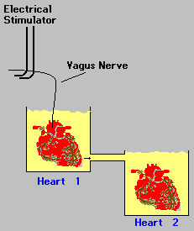
Lewi’s Experiment
Two frog hearts in a beaker
When the vagus nerve of the first heart was stimulated:
  The first heart slowed down
  The second heart also
  slowed down after a delay
Something was transferred from:
vagus nerve of heart 1 → medium 1
medium 2.
That something must be a chemical.

Slide 51
Chemical Transmission
Sir Henry Hallett Dale and Otto Loewi share the Nobel Prize for their discoveries relating to chemical transmission impulses (1936)
Synaptic transmission - John Eccles (shared the Nobel Prize for Medicine with Hodgkin-Huxley, 1963)

Slide 52

Psychology
Charles Darwin’s investigations on evolution paved way to a scientific study of behavior.
-Experimental psychology:
  study of behavior in lab; quantify behavior
  Treat the animal/brain as an input/output system
  Define relationship between inputs and outputs
Behaviorism

Slide 53
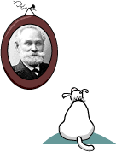
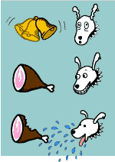
Pavlov & his Dog

Slide 54
Diagnostic Technology
EEG – Hans Berger (1924)
Imaging: CAT, PET, MRI,…
Voltage clamp, Patch Clamp etc

Slide 55
Computing Technology
Neural Network paradigm
Mathematical models of brain
Computational models of the brain

Slide 56
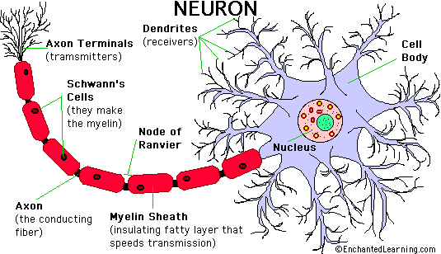
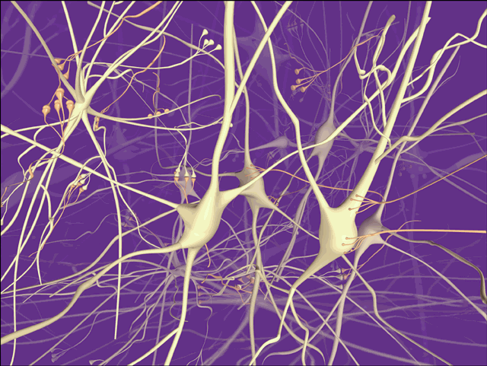

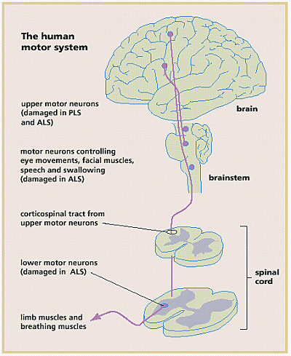

Slide 57
Course Outline
Basics
Math preliminaries
Single neuron Models
Network models

Slide 58
Basics
Introduction to Neuroscience
Basics of the Neuron
Basics of the Nervous system

Slide 59
Math Preliminaries
Linear Algebra review (recorded video)
Dynamical systems
Limit Cycles (oscillators)

Slide 60
Single Neuron Modeling
Biophysical Modeling
Dendritic Processing
Axonal Processing
Synaptic Transmission
More
Detailed
Hodgkin-Huxley Model
Simplified Neuron Models
FitzHugh-Nagumo model
Morris-Lecar Model
Izhikevich Models
Integrate and fire neuron
McCulloch-Pitts neuron
Less
Detailed

Slide 61
Network Models
Oscillator Networks
Deep Networks
Hopfield Networks and memories
Self-Organizing Maps

Slide 62
Modeling Systems
Visual system
Basal Ganglia
Hippocampus

Slide 63

References
BT6270: NPTEL notes
Steven Strogatz, Nonlinear Dynamics and Chaos
Christof Koch, Biophysics of Computation.
Satish Kumar, Neural Networks
Neuroscience:
Kandel and Schwatz, Principles of Neural Science
VSC, Demystifying the Brain.

