Slide 1
Basics of Neural Signaling
BT6270: Introduction to Computational
Neuroscience

Slide 2
Brain’s cells
Two main cell types
  Neurons
  Glia

Slide 3
Neuron
Electrically active cell
Arboreal projections
Number in human brain: 100 billion
  in Aplysia nervous system = 18,000-20,000
  in each segmental ganglia in the leech = 350
  C. Elegans = 302
Size:
  4 micron (granule cell) to 100 micron (motor neuron in cord)

Slide 4
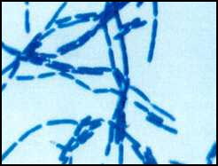
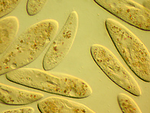
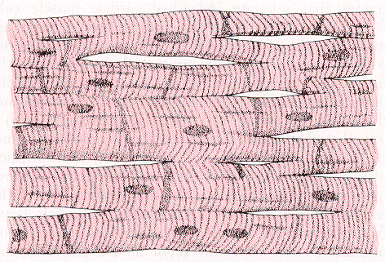
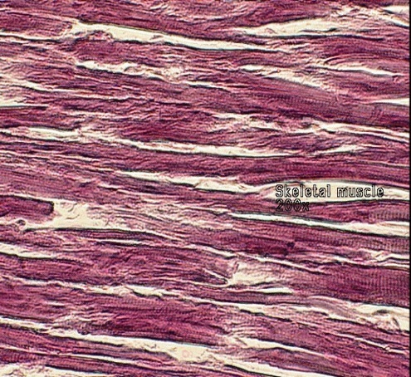

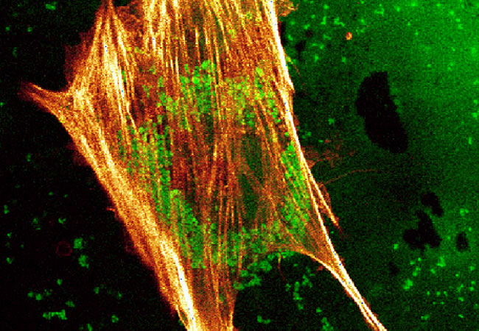
Other cells
Bacilus
Paramecium
Cardiac cells
Skeletal Muscle
RBC
Bone marrow
www.uic.edu/classes/bios/bio100

Slide 5
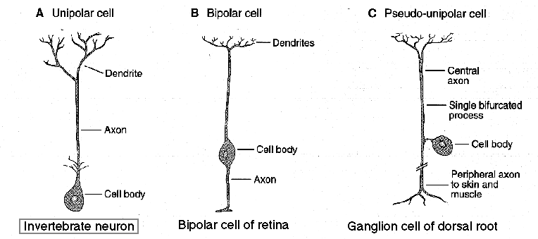
Neuron Morphologies
Average number of connections per neuron = 1000-10,000

Slide 6
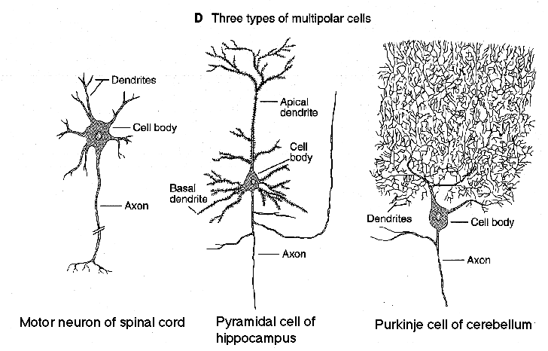
Neuron Morphologies
<200,000 connections

Slide 7
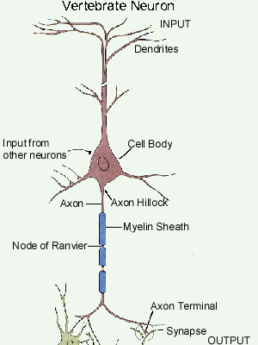

Slide 8
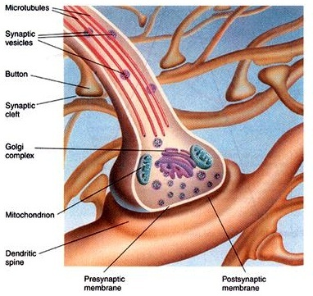
Synapse

Slide 9
Neurons are electrically active cells
-
+
+
+
-
-
-
-
+
+
-
-
+
+
-
+
-ve inside
Vm = -70 mV
+
+
-
-
-
+
+
-
-
+
+

Slide 10
Vm
Neural signals are
electrical waves
+
+
+
+
+
+
-
-
-
-
-
-
-
-
-
-
-
Vm
+
+
+
+
+
+
-
-
-
-
-
-
-
-
-
-
-

Slide 11
Wave propagation over a neuron
The nature of wave propagation is different in different parts of the neuron
  Propagation over dendrites is usually lossy
  Propagation over axons is non-lossy

Slide 12
Wave propagation over a dendrite
Vm
As the wave propagates down the dendrite:
It loses amplitude
- It spreads in time

Slide 13
Inject Current, I(t)
Measure Voltage, V_{m}(t)

Slide 14
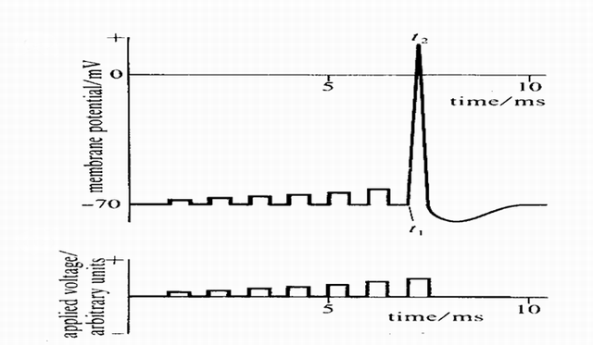
Action Potential generation at the Soma (axon hillock)
All-or-none Response
http://www.codeproject.com/cs/algorithms/NeuralNetwork_1.asp?print=true

Slide 15
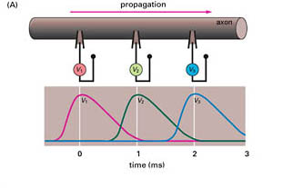
Wave propagation over an axon
Action
Potential
As the wave propagates down the axon:
No loss of amplitude
- No spreading

Slide 16
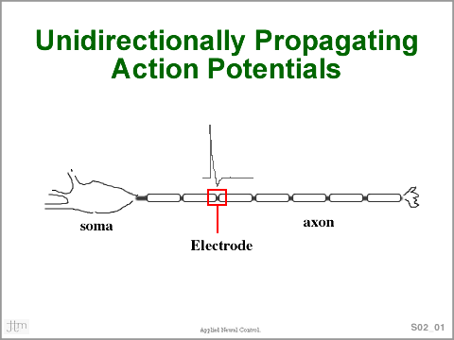
http://www.cwru.edu/groups/ANCL/pages/02/s02_01ttl.gif

Slide 17
Across the synapse
Action Potentials on the
“pre-synaptic” terminal
Get converted into
“Post-synaptic Potentials (PSPs)” on the “Post-synaptic” terminal
Neurotransmission
A chemical step

Slide 18
Neurotransmission
Action
Potential
Synapse
PSP
Post-synaptic
Terminal
Pre-synaptic
Terminal

Slide 19
Post-Synaptic Potentials are of Two kinds
EPSP: excitatory post-synaptic potential
  post-synaptic cell temporarily depolarizes
IPSP: inhibitory post-synaptic potential
  post-synaptic cell temporarily hyperpolarizes

Slide 20
EPSP/IPSP
EPSP
IPSP

Slide 21
EPSPs and IPSPs are graded potentials
Unlike the all-or-none action potential, PSPs are graded potentials
  They come in all shapes and sizes

Slide 22
Types of Synapses
Excitatory synapses: those that produce EPSPs
Inhibitory synapses: those that produce IPSPs
Depends on the “chemistry” of the synapse

Slide 23
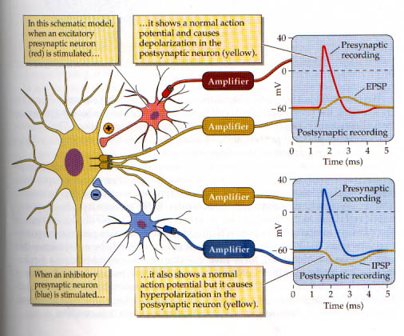

Slide 24
EPSPs and IPSPs summate
Two kinds of summation:
  Spatial summation - inputs from several neurons add together
  Temporal summation - inputs add up over time, perhaps even from the same spatial location

Slide 25
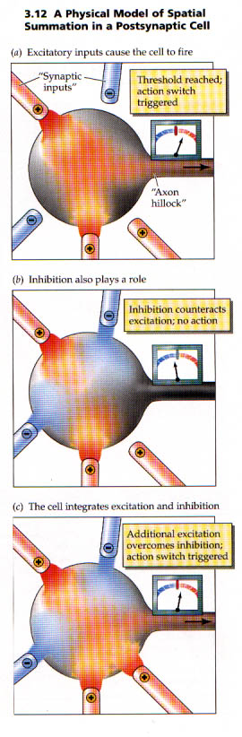

Slide 28
EPSPs and IPSPs summate
Spatial summation - inputs from several neurons add together
Temporal summation - inputs add up over time, perhaps even from the same spatial location

Slide 29
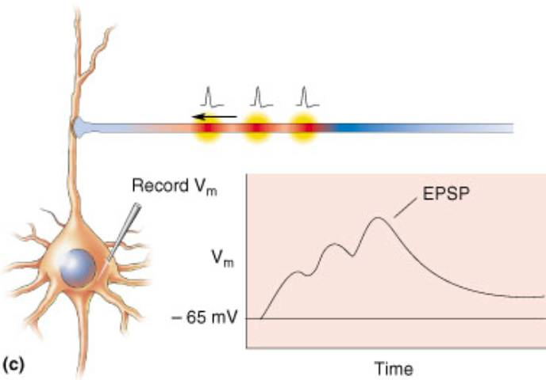

Slide 30
Neuron as an Input-Output System
Axon
Neuron
Axon
Collaterals
Dendrites
Inputs from
Other neurons
Outputs to
Other neurons

Slide 31
Signaling inside a neuron – 4 components
3) Sig. prop. along Axon
Neuron
Dendrites
1) Signal
propagation
along dendrites
4. Signaling
across
Synapse
2) Signal summation
in cell body

Slide 32
Condition for Neural Firing
If the net effect of inputs < threshold
no APs (no firing)
Axon
Soma
(cell body)
Dendrites

Slide 33
Condition for Neural Firing
If the net effect of inputs > threshold
APs are generated
Axon
Soma
(cell body)
Dendrites

