Slide 1
Organization of Nervous system

Slide 2
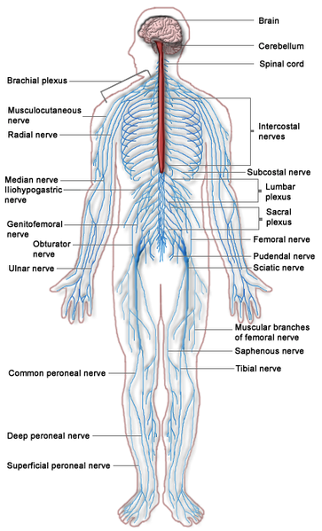
The nervous system can be broadly classified into two major categories
Central Nervous System (CNS) and
Peripheral Nervous System (PNS)

Slide 3
Central Nervous System
Brain The brain consists of the cerebrum, cerebellum and brain stem (containing the midbrain, pons and medulla oblongata).
Spinal Cord The spinal cord is a long, thin, tubular bundle of nervous tissue and support cells that extends from the brain (the medulla oblongata specifically).
The brain and spinal cord together make up the central nervous system (CNS).

Slide 4
Peripheral Nervous System
The peripheral nervous system is divided into two parts –
Somatic nervous system and
Autonomic nervous system.

Slide 5
Somatic Nervous System
The somatic nervous system performs two major functions – sensory and motor.
The sensory nerves innervate skin, muscles and joints, and provide information about muscle and limb position, etc
It is majorly composed of 12 cranial nerves and 33 spinal nerves.

Slide 6
Autonomic Nervous System
The autonomic nervous system can be classified into two major parts –
Sympathetic Nervous system
Parasympathetic Nervous systems.
Enteric Nervous system

Slide 7
Autonomic Nervous System
The sympathetic system participates in the body’s reaction to stress, and helps in reacting to an emergency (“fight or flight”) situation.
The parasympathetic system conserves body resources and maintains homeostasis. About 75% of all parasympathetic nerve fibres are in the vagus nerve.
Example – Sympathetic nerves control the sudden increase in heart rate during a stressful situation, whereas the parasympathetic nerves participate in lowering the heart rate during rest.

Slide 8
Autonomic Nervous System
A third part of the autonomic nervous system, called the enteric system, specifically controls the smooth muscles in the intestine.

Slide 9
Nerves
A nerve is an enclosed, cable-like bundle of axons (the long, slender projections of neurons) in the peripheral nervous system.
A nerve provides a common pathway for the electrochemical nerve impulses that are transmitted along each of the axons.

Slide 10
Types of Nerves
There are three major types of nerves –
Afferent nerves
conduct signals from sensory neurons to the central nervous system, for example from the mechanoreceptors in skin.
Efferent nerves
conduct signals from the central nervous system along motor neurons to their target muscles and glands.
Mixed nerves
contain both afferent and efferent axons, and thus conduct both incoming sensory information and outgoing muscle commands in the same bundle.

Slide 11
Types of Nerves
Nerve fibres may also be classified into various categories based on the speed at which they conduct electrical impulses.
Type A – Large, myelinated fibres (~120 m/s conduction velocity)
Type C – Small, unmyelinated fibres (~0.5 m/s)
Myelin sheath – A sheath which may cover nerve fibres; it helps in faster conduction of electrical impulses.

Slide 12
Central Nervous System

Slide 13
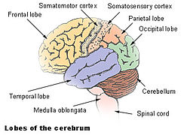
Cerebrum
The cerebrum consists of two hemispheres, joined by a large bundle of axons called the corpus callosum.
The hemispheres are also connected by a smaller bundle of fibres called the anterior commisure.

Slide 14
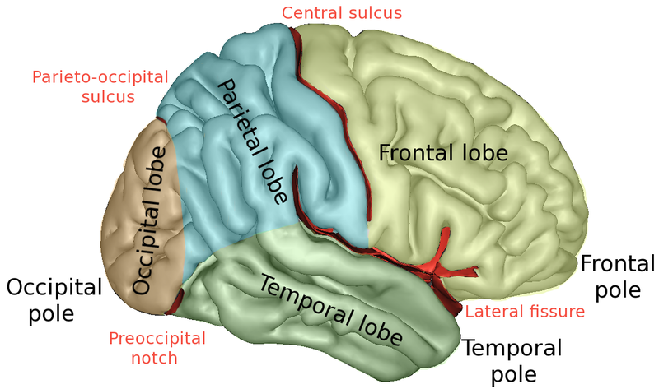
Lobes of Cerebrum: Frontal lobe
The frontal lobe is in the front of each cerebral.
It is separated from the parietal lobe by a vertical gap called central sulcus, and from the temporal lobe by a deep fold called the lateral (Sylvian) sulcus.

Slide 15
Frontal lobe
Primary motor cortex, which controls voluntary movements of the body is located in the precentral gyrus, forming the posterior border of the frontal lobe.
Prefrontal cortex - The prefrontal cortex (P.F.C.) is the anterior part of the frontal lobes of the brain, lying in front of the motor and premotor areas.
This brain region has been implicated in planning complex cognitive behavior, personality expression, decision making and moderating social behavior – a whole range of activities that are summarily described as executive function.

Slide 16
Lobes of Cerebrum: Parietal lobe
Parietal Lobe - The parietal lobe is above the occipital lobe and behind the frontal lobe.
It consists of the somatosensory cortex located at the anterior extreme, in the postcentral gyrus. The somatosensory cortex processes touch information coming from mechanoreceptors located in the skin, muscles and joints.

Slide 17
Parietal lobe
Inferior parietal lobe consists of areas that process higher aspects of vision like spatial sense.
By virtue of its strategic location amidst three primary sensory cortices – somatosensory cortex, visual cortex and auditory cortex, - inferior parietal lobe as sensory association areas which integrate information from the three sensory modalities and extract abstract concepts.

Slide 18
Lobes of Cerebrum: Temporal lobe
The temporal lobe is located beneath the Sylvian fissure, a shared border between the temporal and frontal lobes.
Primary auditory cortex, involved in auditory processing, is located in the superior part of temporal lobe, bordering on the sylvian fissure.
The temporal lobe contains a deep structure called hippocampus, whose functions include spatial navigation, declarative memory, and memory consolidation.

Slide 19
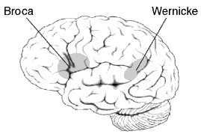
Temporal lobe
Wernicke's area, which spans the region between temporal and parietal lobes, plays a key role, in language understanding, while Broca's area, which is in the frontal lobe, is responsible for language production
The inferior part of temporal lobe has cortical areas that are responsible for recognizing complex visual objects, like for example, faces.

Slide 20
Lobes of Cerebrum: Occipital lobe
The occipital lobe has primary and higher areas of the visual cortex.
The primary visual cortex is commonly called V1 (visual one). It is partly located in the medial side of occipital lobe and partly in the posterior pole of the occipital lobel.
V1 is often also called striate cortex because it can be identified by a large stripe of myelin, the Stria of Gennari. Visually driven regions outside V1 are called extrastriate cortex.

Slide 21
Occipital lobe
There are many extrastriate regions, and these are specialized for different visual tasks, such as visuospatial processing, color discrimination and motion perception
Secondary and higher visual cortical areas extend from the occipital lobe and are spread over the neighboring parietal lobe.

Slide 22
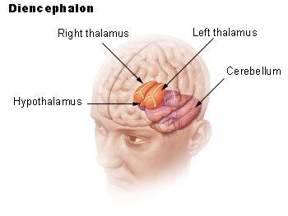
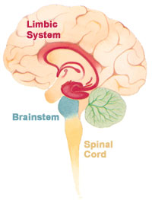
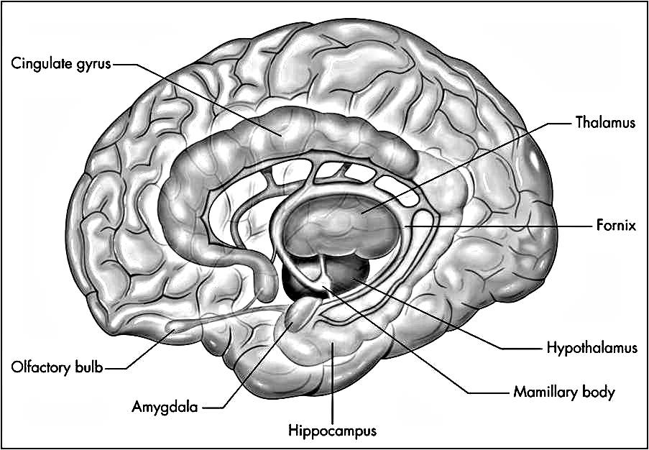
Deep Brain Structures

Slide 23
Thalamus and Hypothalamus
The thalamus is located between the cerebral cortex and midbrain. It is an important hub through which most sensory information reaches the sensory cortex.
It is involved in regulation of consciousness, sleep, and alertness
The hypothalamus is an important structure controlling our autonomous function. It links the nervous system to the endocrine system via the pituitary gland.
The hypothalamus controls body temperature, hunger, thirst, fatigue, sleep, and circadian cycles

Slide 24
Limbic System and RAS
The reticular activating system (RAS) is an area of the brain responsible for regulating arousal and sleep-wake transitions.
The limbic system is a set of brain structures involved in processing emotions, and is closely related to autonomous function.
This system includes the hippocampus, amygdala, anterior thalamic nuclei, septum, limbic cortex and fornix

Slide 25
Amygdala and Basal Ganglia
Amygdala is an almond-shaped structure is located bilaterally in the medial temporal lobes of the brain.
A part of the limbic system, this structure is involved in fear conditioning.
The basal ganglia (or basal nuclei) are a deep brain circuit consisting of 6 or 7 nuclei.
This circuit receives inputs from the cortex and projects back to the cortex
It has key functions like reward processing, action selection, working memory etc

Slide 26
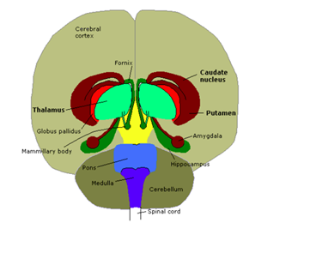
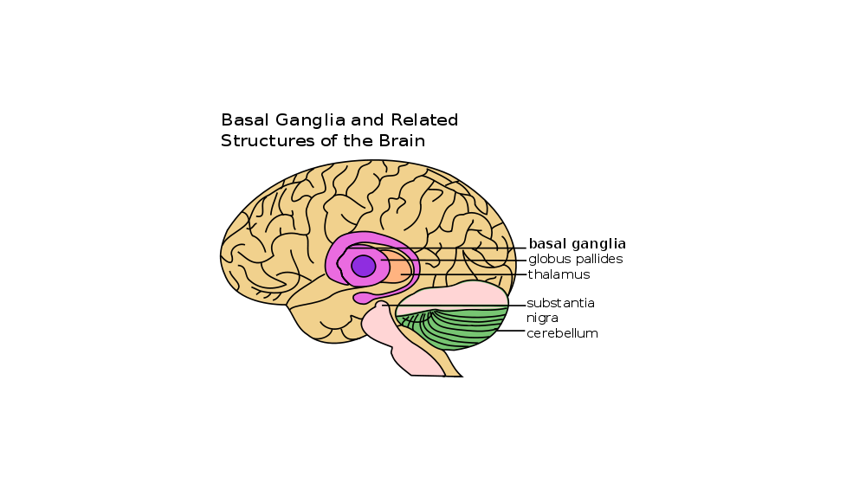
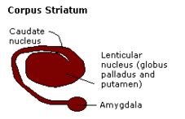
Diencephalon and Rhomencephalon

Slide 27
Brain Stem
The brain stem is a sort of a bridge area between the cerebrum and the spinal cord. It comprises of three regions: midbrain, medulla oblongata and pons.
It consists of a lot of important control centers and anatomical features.
Centers for controlling cardiac and respiratory function; for regulating sleep and arousal; for controlling eating and drinking are located here.

Slide 28
Medulla and Pons
Medulla is a direct rostral (“towards nose”) extension of the spinal cord. Its primary functions include: regulation of blood pressure and respiration.
The pons is a a part of the brain stem, located below the midbrain and above medulla oblongata.
It consists of wiring that carries:
1) motor signals from the cerebrum down to the cerebellum and medulla, and
2) sensory signals from the body into the thalamus.

Slide 29
Cerebellum
The cerebellum (Latin for little brain) is a distinct structure located posteriorly under the hemispheres.
It is generally thought of as a motor control unit, though its role in cognitive and affective function is well-established.
It is involved in control of fine movement, equilibrium, posture, and motor learning.

Slide 30
Spinal Cord
The spinal cord is a long, tail-like bundle of nerve fibers that extends from the brain (the medulla oblongata specifically) along the spine. It has three key functions:
Carrying motor signals from the brain to the muscle
Carrying sensory information in the reverse direction
Coordinating reflexes

