Slide 1
Bases of
Neural Signaling

Slide 2
NEURAL SIGNALING

Slide 3
Neural signaling is electrical and chemical
It is mediated by:
  spreading voltage waves
  release of chemicals
What is the basis of NEURAL ELECTICITY?

Slide 4
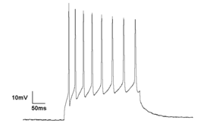
Neuron in
Resting Condition
Neuron Firing
Cytosol
V_{m}=-70 mV
Cytosol
V_{m}(t)mV
0 volts
0 volts
What is the basis of this voltage?

Slide 5
What is the basis of membrane potential?
Like any cell, the interior and exterior of a neuron are permeated by an ionic medium
Key ions: Na+, K+, Cl-, Ca2+
Differences in distribution of these ions between inside and outside produce membrane voltage

Slide 6
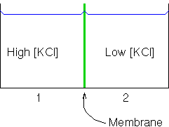
Equilibrium Potential
If the membrane is permeable to both K+ and Cl-, both the ionic
species will cross the membrane from left to right until the
concentrations on both sides become equal.

Slide 7
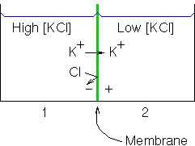
Equilibrium Potential
(semi-permeable membrane)
If the membrane is permeable only to K+, then only K+
will cross the membrane from left to right which introduces
a charge gradient (potential difference) opposing the flow.
The process will continue until the potential difference and
chemical gradient cancel each other.

Slide 8
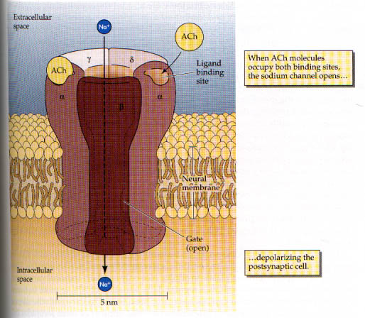
The Cell membrane is semi-permeable because:
Ion channels are selective to ions

Slide 9
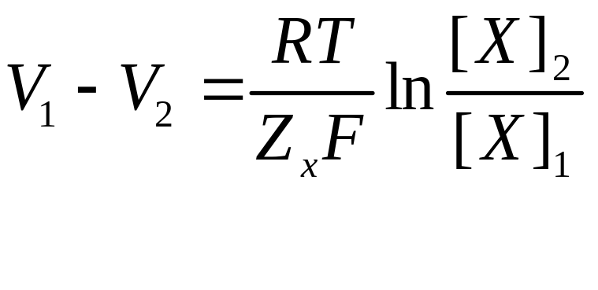
Nernst Potential
V1-V2 - Nernst potential for ion ‘X’
[X]_{1,2} – concentrations of ‘X’
Z_{x} – Valence of ‘X’
R – Ideal gas constant
T – Absolute temperature
F – Faradays’ constant
RT/F = 26 mV at T=25ºC (Z_{x} = +1)

Slide 10
Equivalent circuit of an ion channel
(Outside neuron)
0 (volts)
g_{channel}
0
E_{Nernst}
channel conductance
(g_{channel} )
(Inside neuron)
E_{Nernst} (volts)

Slide 11
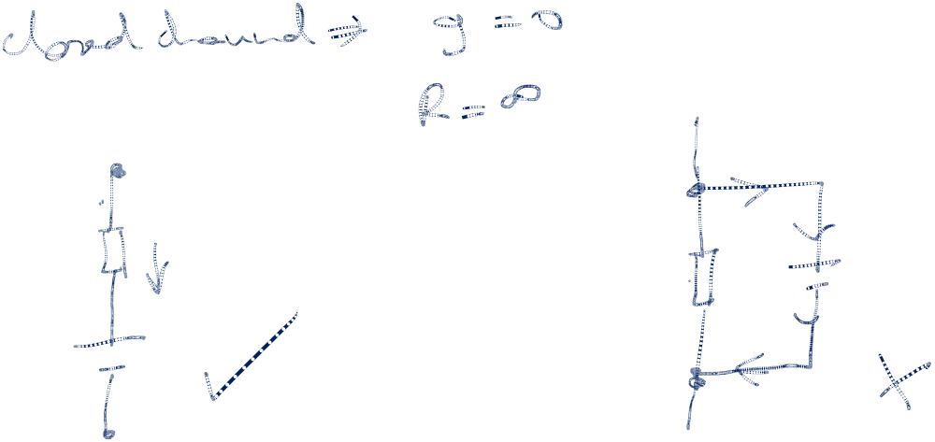

Slide 12
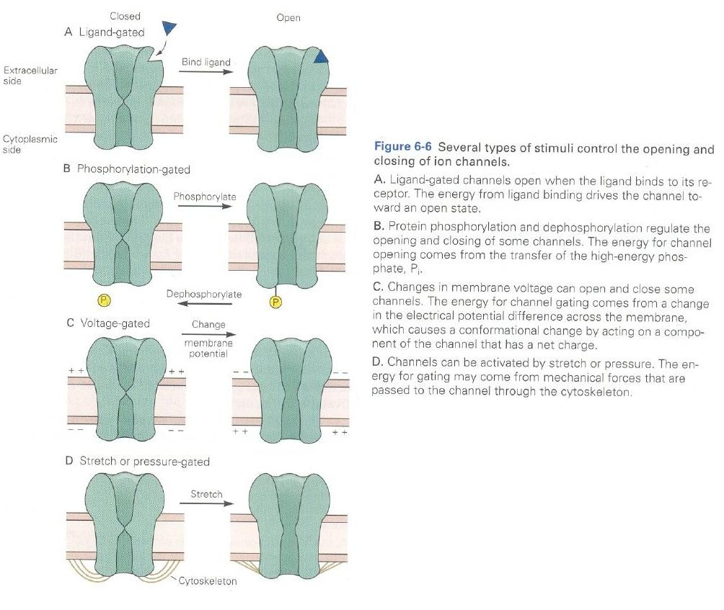
Channel gating:
Channels are modifiable
Voltage-
Gating is
crucial for
AP generation

Slide 13

Equivalent circuit of a voltage-dependent ion channel
(Outside neuron)
0 (volts)
Conductance varies with time
g_{channel}
0
E_{Nernst}
channel
conductance
(g_{channel} )
(Inside neuron)
E_{Nernst} (volts)
*The arrow
represents
variability

Slide 14
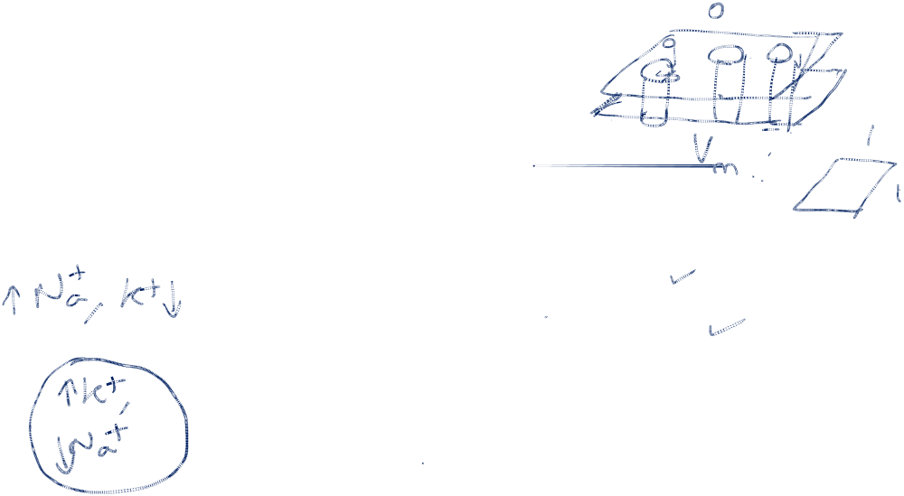
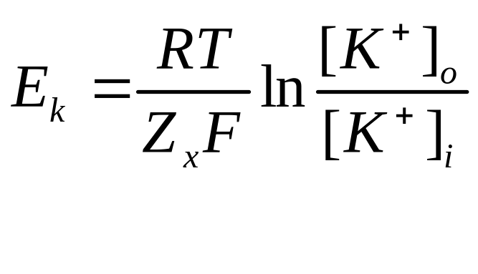
Nernst Potentials of K+
[K+]_{o} = 20 mM
[K+]_{i} = 400 mM
E_{k} = -77 mV
g_{k}=36mS/cm²
(under resting conditions)

Slide 15

K+ Equivalent circuit
Under resting conditions:
  E_{k} = -77mv
  g_{k} = 36 mS/cm²
g_{k}
E_{k}
Voltage-dependent K+ channel

Slide 16
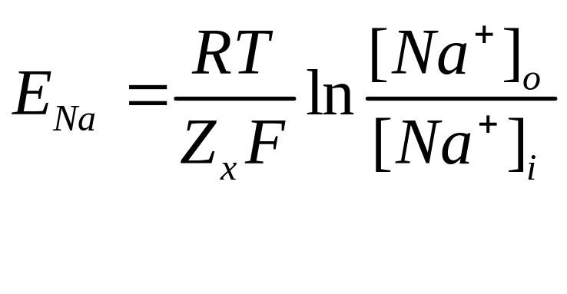
Nernst Potentials of Na+
[Na+]_{o} = 440 mM
[Na+]_{i} = 60 mM
E_{Na} = 50 mV
g_{Na} = 120 mS/cm²
(under resting conditions)

Slide 17
Na+ Equivalent circuit
Under resting conditions Na+ ions are more concentrated outside the cell
  E_{Na} = 55mv
  g_{Na} = 120 mS/cm²
Equivalent circuit of
Na+ channel and
Na+ Nernst Potential
g_{Na}
E_{Na}
Voltage-dependent Na+ channel

Slide 18

Leakage channels
Channels that are independent of membrane voltage
The Na+ and K+ channels seen before are voltage dependent (therefore nonlinear!)
Using Thevenin’s theorem (of elec ckts), all voltage-independent channels can be combined into one “leakage” branch….

Slide 19
Equivalent ckt of leakage channels
g_{a}
g_{b}
g_{L}
+
+…
=
E_{a}
E_{b}
E_{L}
E_{L} = 10.6 mV
g_{L} = 0.3mS/cm²

Slide 20


Cell membrane
- A double layer (bilayer) of lipid molecules
- An insulating double layer
- A parallel plate capacitor

Slide 21
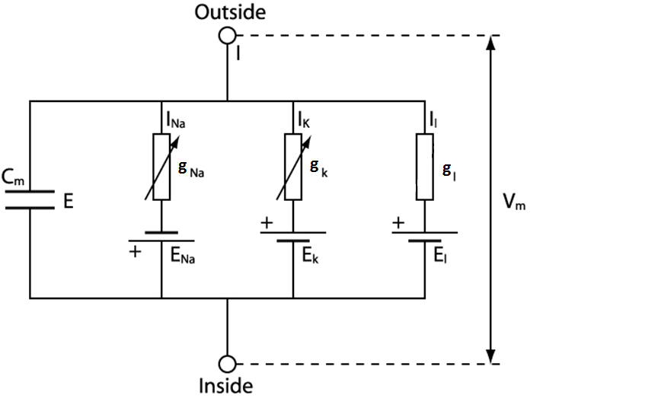
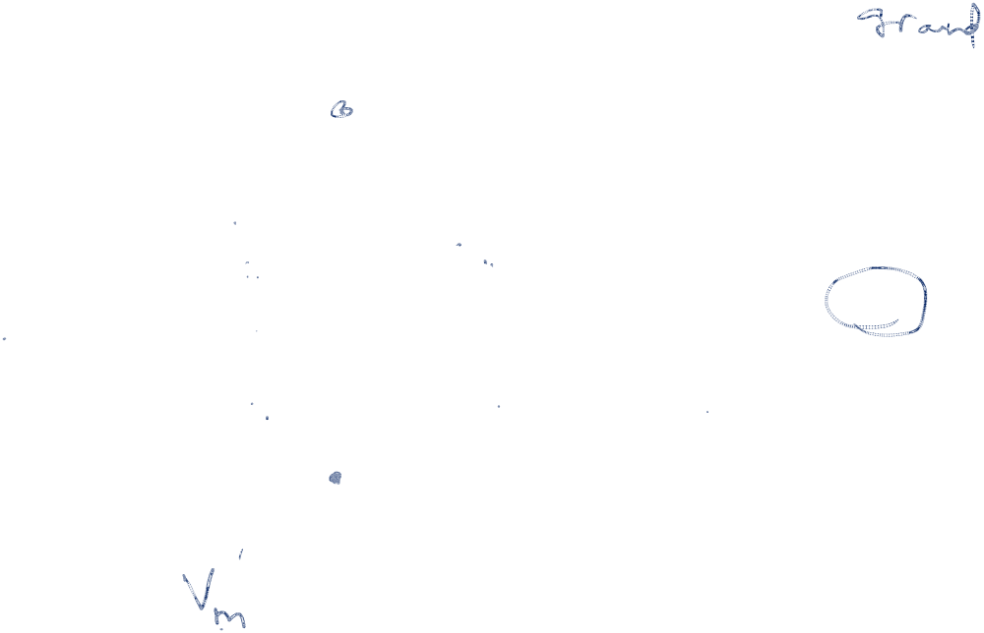
Equivalent ckt for the membrane

Slide 22
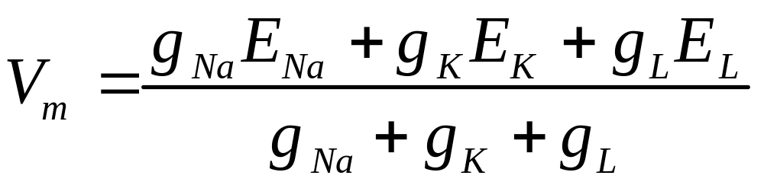
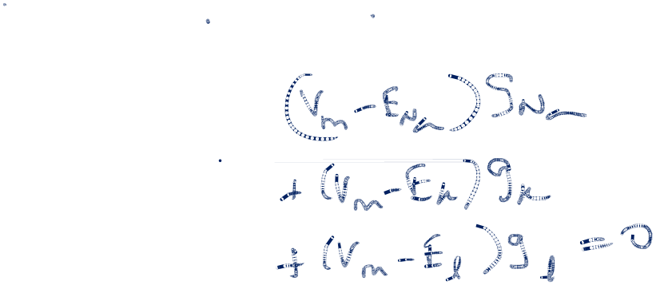
Membrane Potential in steady-state conditions
In steady state conditions,
current through the capacitor is 0.
V_{m} = -70 mV

Slide 23
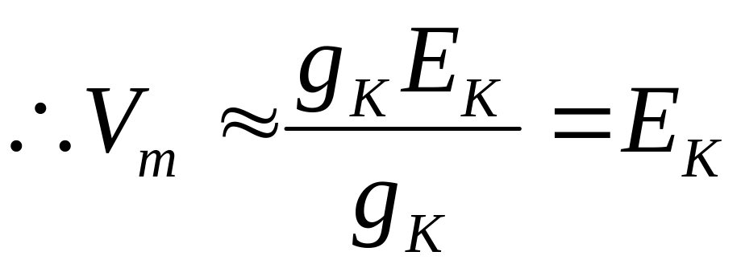
Membrane Potential when the neuron is in resting state
K+ channels are open;
Na+ channels are closed
g_{Na} << g_{K} ; g_{l} << g_{K}
V_{m} = -70 mV
(close to E_{K})

Slide 24

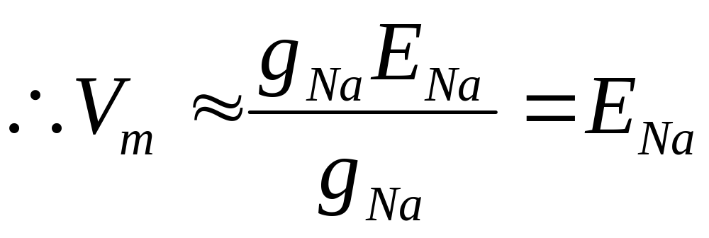
Membrane Potential when the neuron is in resting state
K+ channels are closed;
Na+ channels are open
g_{K} << g_{Na} ; g_{l} << g_{Na}
V_{m} is about 30 mV (closer to E_{Na})

Slide 25
Na+ and K+ channels are used as knobs to turn V_{m} up and down
  To increase V_{m} → open more Na+ channels
  To decrease V_{m} → open more K+ channels

Slide 26
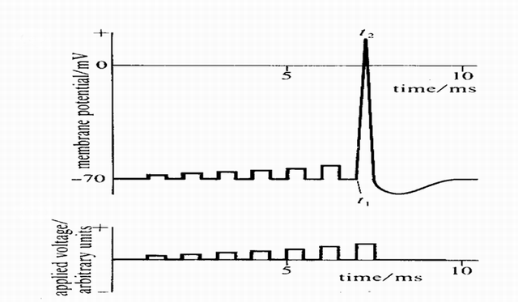

Action Potential generation at the Soma (axon hillock)
All-or-none Response
http://www.codeproject.com/cs/algorithms/NeuralNetwork_1.asp?print=true

Slide 27
Why is AP generated at axon hillock?
AP is a nonlinear response. It suddenly appears when the input crosses a threshold.
Axon hillock has a high density of voltage-dependent Na+ and K+ channels
Voltage-dependent channels are nonlinear conductances
Therefore, AP is generated at the axon hillock

Slide 28
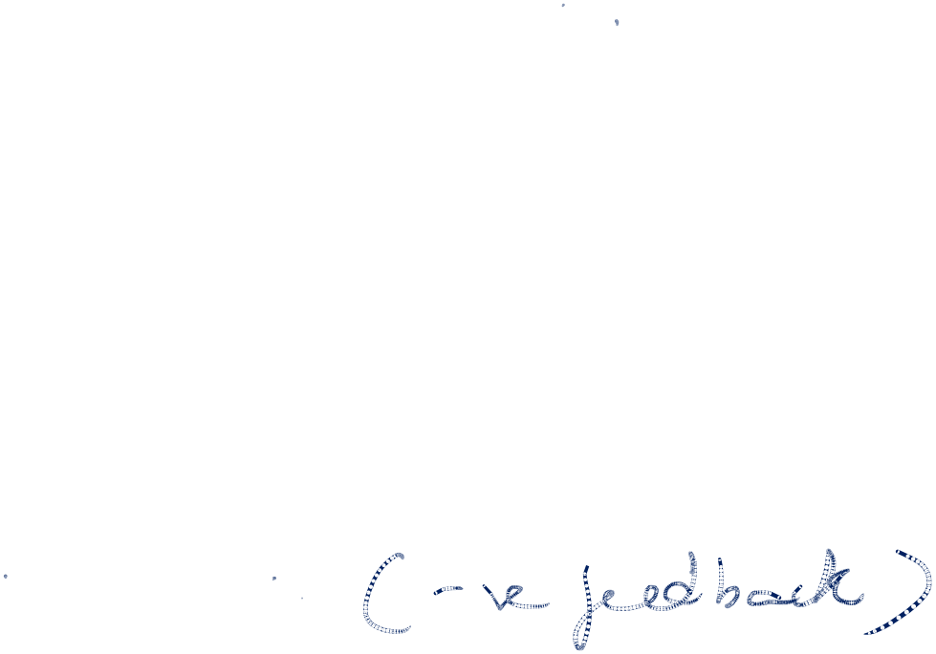
How is AP generated?
When current is injected in soma, the local membrane voltage increases
Increased voltage opens Na+ channels (due to voltage-dependence)
Opening Na+ channels further increase membrane voltage (positive feedback!!!)
But Na+ channels close on their own after sometime (reducing Vm)
K+ channels open after some time (further reducing Vm)

Slide 29
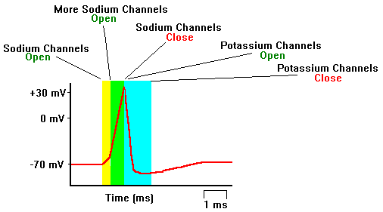
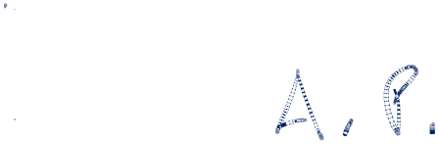

Slide 30
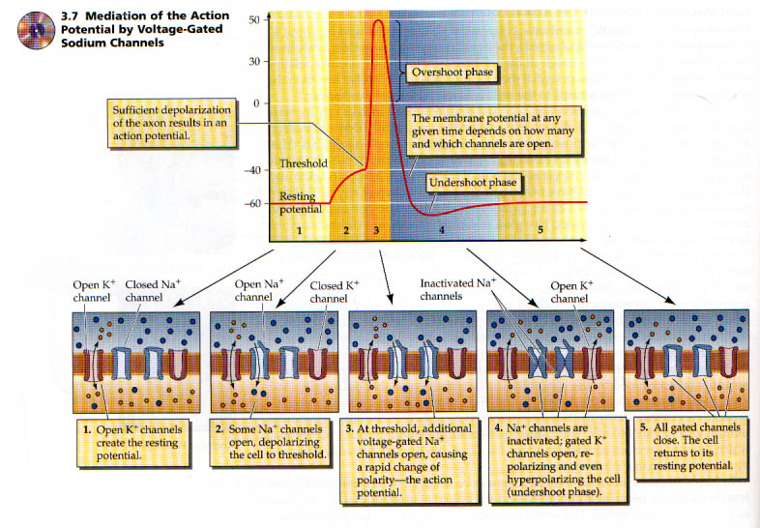

Slide 31
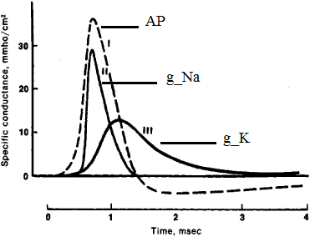
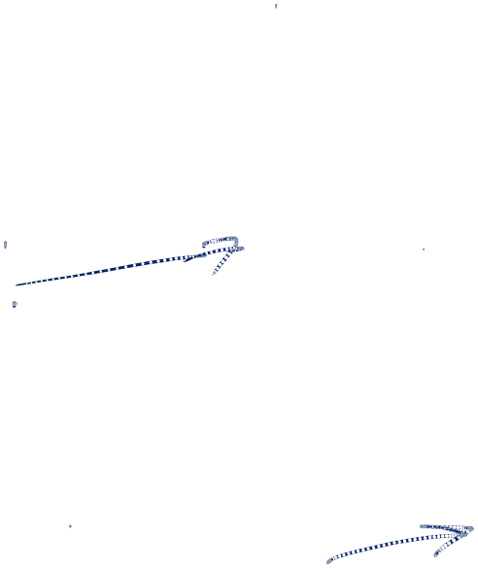
AP and Na+, K+ Conductances

Slide 32
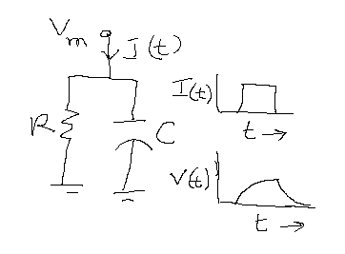
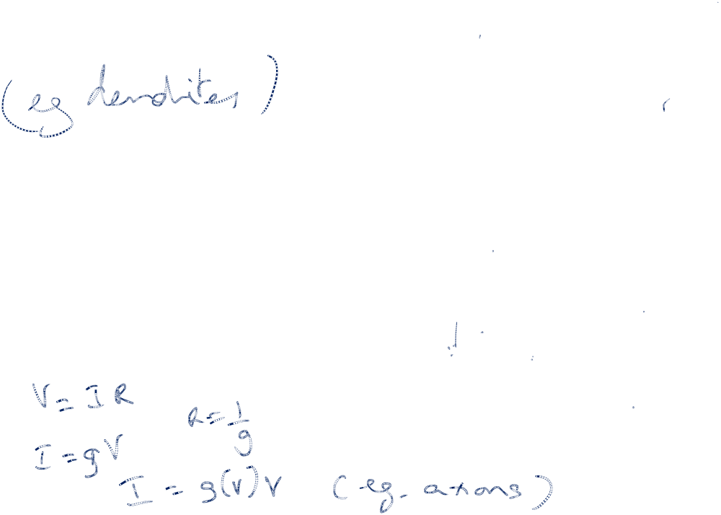
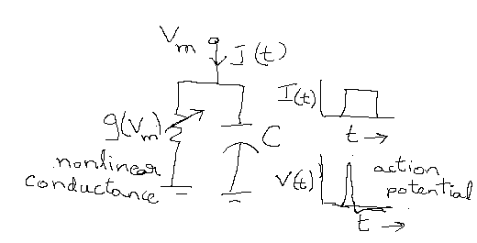
Membrane voltage
Response in case of
Linear, passive, RC ckt
Membrane voltage
Response in case of
Nonlinear, active, RC ckt

Slide 33
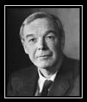
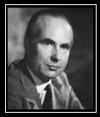
Hodgkin, Huxley, and the Giant Squid Axon
Hodgkin
Huxley
Nobel Prize 1963

Slide 34
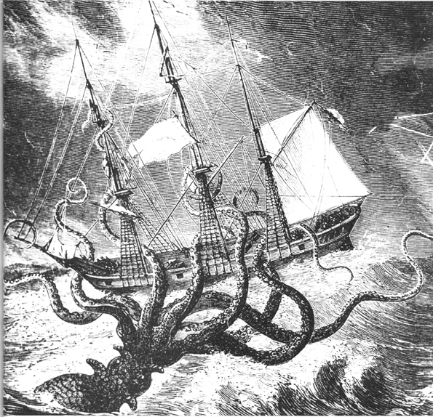

Slide 35
Axonal propagation
Axon also has voltage-dependent Na+ and K+ channels
Therefore APs propagate without loss of amplitude along the axon

Slide 36
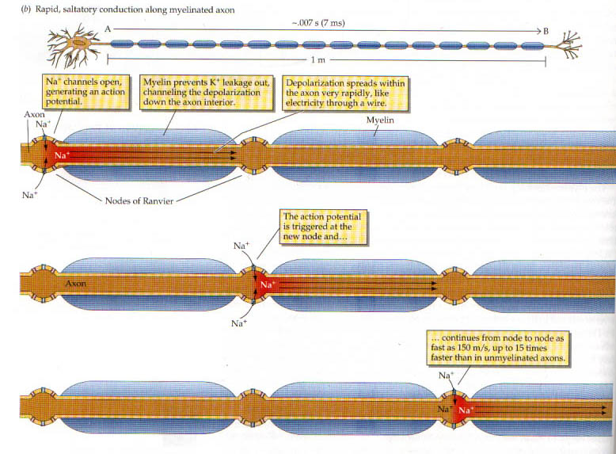


Slide 37

Saltatory Conduction
Action potential jumps from node to node
Propogation of action potential is faster in a myelinated axon:
  unmyelinated axons: .2 to 2 meters/sec
  myelinated axons: 12 to 120 meters/sec

Slide 38
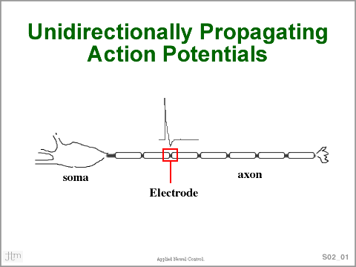
http://www.cwru.edu/groups/ANCL/pages/02/s02_01ttl.gif

Slide 39
Dendritic Propagation
Dendrites usually DO NOT have voltage-dependent ion channels
Therefore, propagation along dendrites is passive/lossy

Slide 40
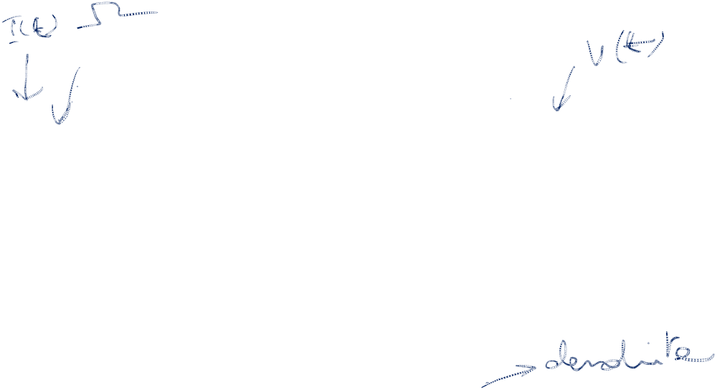
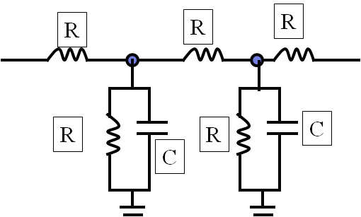
Circuit Equivalent
R
R
R
R
R
C
C

Slide 41
In the dendritic tree
Electrical signal propagates passively like in an Electrical cable along a dendrite
- Amplitude of the voltage wave decreases with distance
Width of the voltage wave increases with distance

Slide 42
Wave propagation over a dendrite
Vm
As the wave propagates down the dendrite:
It loses amplitude
It spreads in time

Slide 43
Across the synapse
Action Potentials on the
“pre-synaptic” terminal
Get converted into
“Post-synaptic Potentials (PSPs)” on the “Post-synaptic” terminal
Neurotransmission
A chemical step

Slide 44

Neurotransmission
Action
Potential
Synapse
PSP
Post-synaptic
Terminal
Pre-synaptic
Terminal

Slide 45
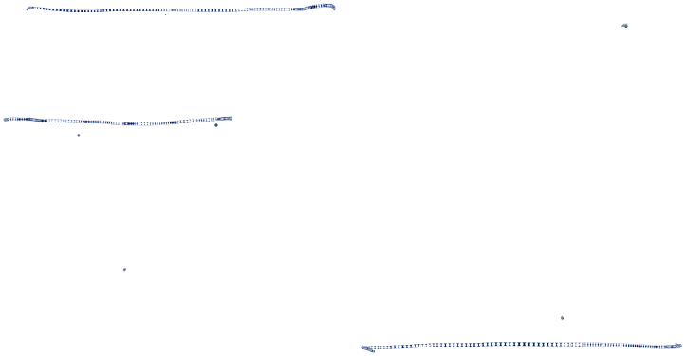
What happens at the synapse?
The presynaptic terminal releases a substance called neurotransmitter (NTS)
NTS binds with a Receptor on the post-synaptic side
The receptor opens/closes an ion channel

Slide 46
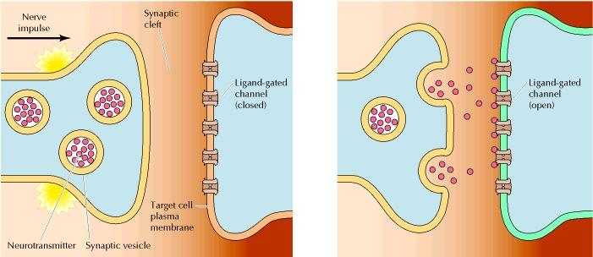
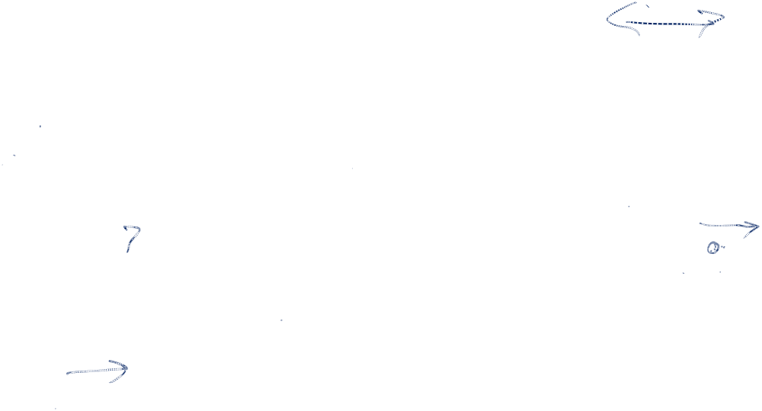

Slide 47
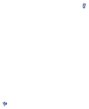
Neurotransmission
Key Players:
  Neurotransmitter
  Receptor
  Ion Channel

Slide 48
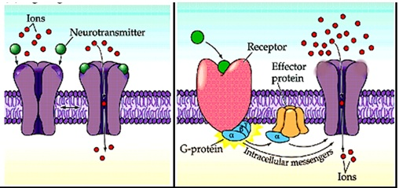

Neurotransmitter – Receptor – Ion Channel
Ionotropic receptor
Metabotropic receptor

Slide 49
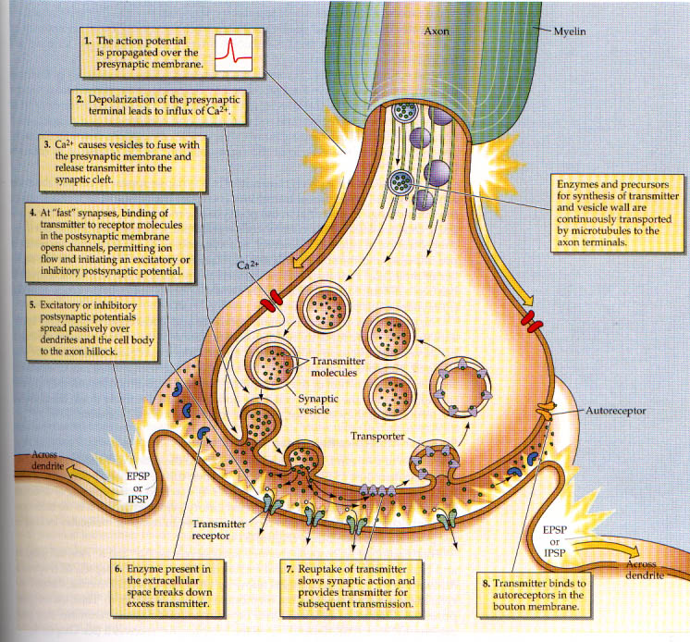

Slide 50
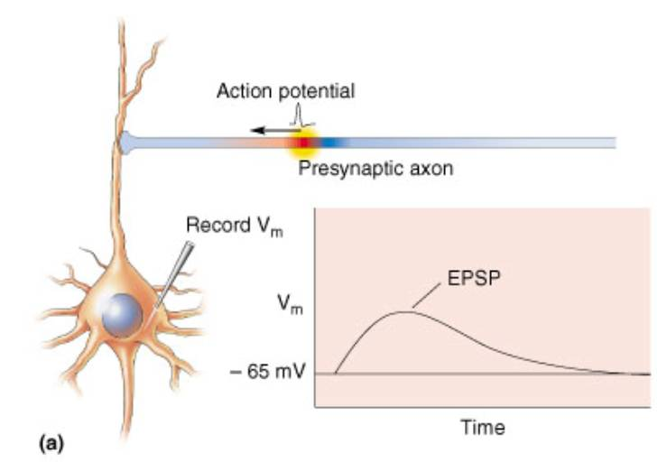

Slide 51
Post-Synaptic Potentials are of Two kinds
EPSP: excitatory post-synaptic potential
  post-synaptic cell temporarily depolarizes
IPSP: inhibitory post-synaptic potential
  post-synaptic cell temporarily hyperpolarizes

Slide 52
Excitatory synapses
EPSP
If the NTS-Receptor binding event opens a Na+ channel, post-synaptic potential increases ➔ EPSP

Slide 53
Inhibitory synapses
IPSP
If the NTS-Receptor binding event opens K+ channels, (or Cl- channels), post-synaptic potential decreases ➔ IPSP

Slide 54
Synaptic Strength
Action
Potential
Synapse
PSP
Post-synaptic
Terminal
Pre-synaptic
Terminal
Synaptic strength:
= average PSP produced in response to
an AP on the presynaptic side.

Slide 55

Neurotransmitter | Type | Receptor(s) | Ion Channel
Glutamate | Excit | AMPA NMDA Kainate | Na+
GABA (Gamma-amino Butyric acid) | Inhib | GABA_A, GABA_B | Cl-

Slide 56
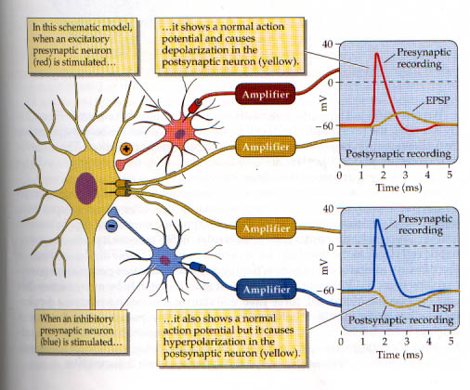

Slide 57

Condition for Neural Firing
If the net effect of inputs < threshold
no APs (no firing)
Axon
Soma
(cell body)
Dendrites

Slide 58
Condition for Neural Firing
If the net effect of inputs > threshold
APs are generated
Axon
Soma
(cell body)
Dendrites

Slide 59
Neuron as a thresholding device
idealization
Step
function
Firing
rate
Firing
rate
Net input
(@ axon hillock)
Net input
(@ axon hillock)
This simplification/idealization forms the basis for
construction of large network models

