Slide 1


Prof. Srinivasa Chakravarthy V
Dept: Biotechnology
IIT-Madras
schakra@ee.iit.ac.in

Slide 2
Eigenvalues & Eigenvectors

Slide 3



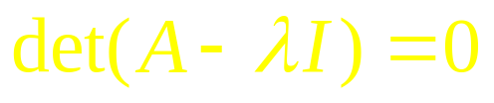
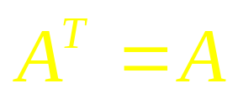

Eigenvalues & Eigenvectors
1. A is a square matrix
(n – Dimensional complex vector)
Let A be a real symmetric matrix
Or
Hermitian matrix
(implies conjugation of all elements)

Slide 4

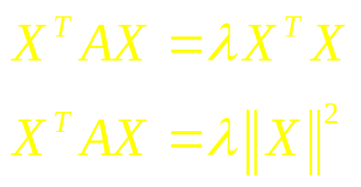


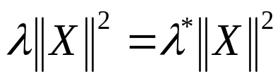

Theorem 1:
The Eigenvalues of a Hermitian matrix are real.
Proof:
is real

Slide 5
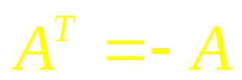

2. A is skew-symmetric
Real Skew-Symmetric
Or
Complex Skew-Hermitian
(implies conjugation
of all elements)

Slide 6
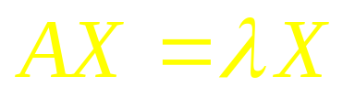
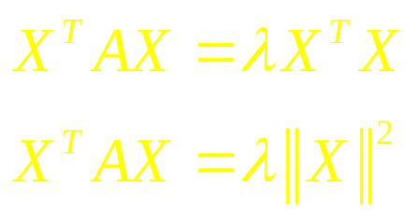

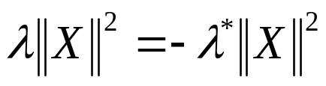

Theorem: Eigenvalues of a skew-symmetric matrix are purely imaginary
is purely imaginary.

Slide 7
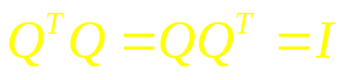
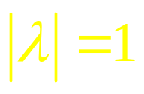
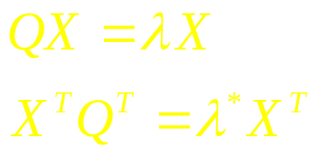
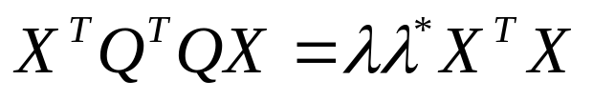

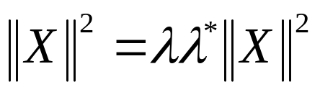
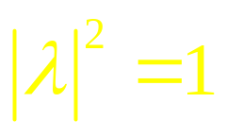

3) The eigenvalues of an orthogonal matrix, Q, are on the unit circle.
Orthogonal matrix:
Proof:

Slide 8
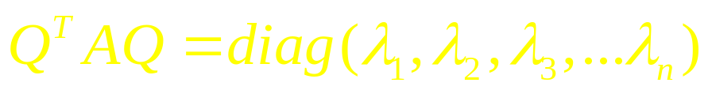
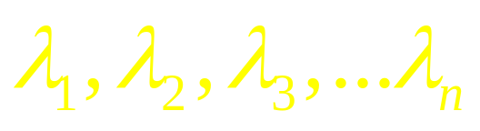
Theorem:
For every symmetric matrix, A, there exists an orthogonal matrix, Q, such that
Where,
are eigenvalues of A.

Slide 9
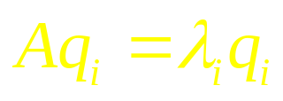
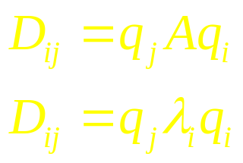


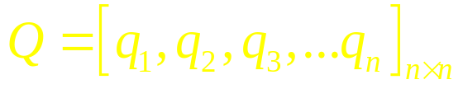
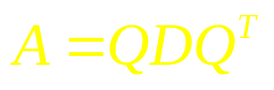

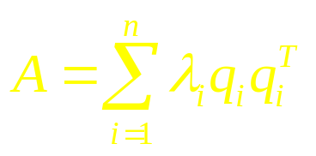
Proof:
Let be the Eigenvector corresponding to
Let D be a matrix where,
Eigen-decomposition of A.

Slide 10
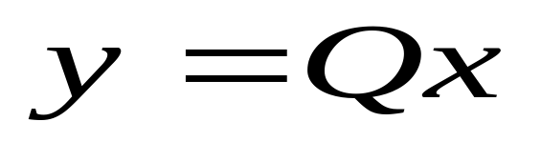
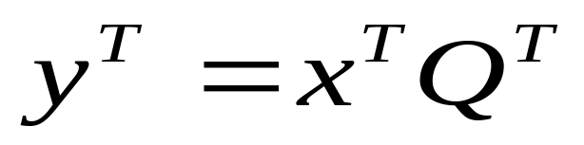
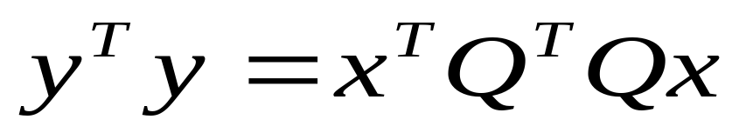
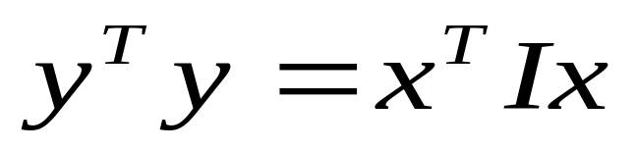
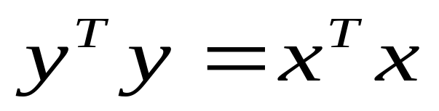
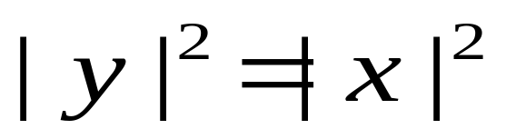
Orthogonal transformation preserves length
Length of x =
Length of y

Slide 11
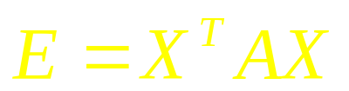
2.0. Quadratic form
A quadratic form is a quadratic function associated with a symmetric matrix, A, and is expressed as:
A discussion of quadratic forms is relevant to study of neural systems since often it is required to minimize an “error function” that depends on a large number of parameters. To be able to do so, we must first define the minimum of a multivariate function.
For a univariate function, the minimum is simply a point where f’=0 and f’’>0.
To define the minimum of a multivariate function, the concepts corresponding to f’ and f’’ must be introduced.

Slide 12
For a multivariate function
First derivative is the Gradient., G =
Second derivative is the Hessian, H.
H is defined more elaborately as,
Since H is a matrix and not a scalar like f’’, we need to
specify how to define a minimum in terms of the Hessian H.
It is here that we need quadratic forms. To understand this
let us expand a multivariate function as a Taylor series:

Slide 13
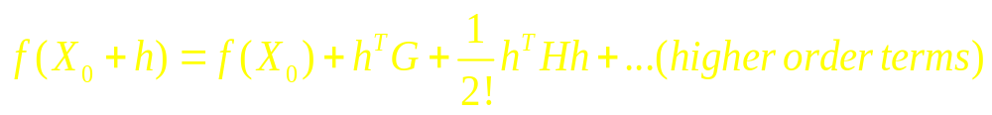
Taylor Series expansion of a multivariate function
f(X₀) is a constant and therefore does not affect the shape of f(X) around X₀.
Since G = 0, we may ignore the linear term
The higher order terms beyond quadratic are too small and may be ignored.
Therefore, the function f(X) has a minimum at X₀, if the
function
has a minimum at h = 0. To verify this, we need to examine
the shape of a quadratic function around the origin (X=0).

Slide 14
It is easier to examine the shape of a quadratic function, in transformed coordinates, Y, obtained by rotating the original coordinates X, so that in the new coordinates the “cross-terms” are eliminated.

Slide 15
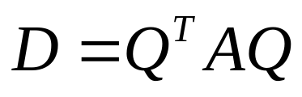
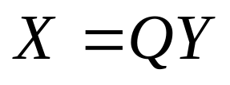
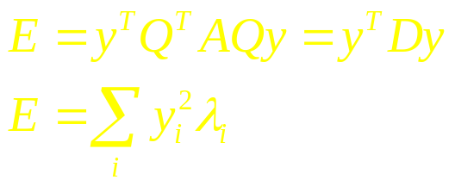
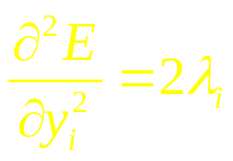
Geometric interpretation of eigenvalues in terms of quadratic forms:
For a real, symmetric matrix, A, let ,
Where Q is the orthogonal matrix of A
Note that D is a diagonal matrix of eigenvalues of A.
Let
Thus in the rotated coordinates, eigenvalues of A are (proportional to) the second derivatives of E.
Or,

Slide 16
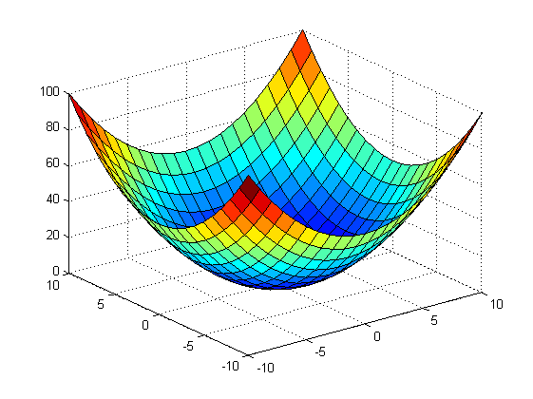
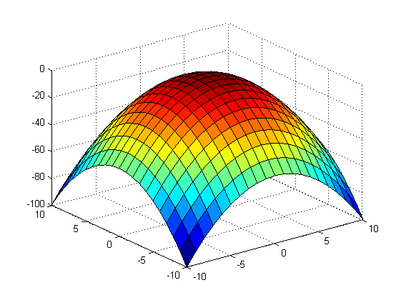
Shape does not change on rotation
Minimum
remains a minimum
Maximum
remains a maximum

Slide 17

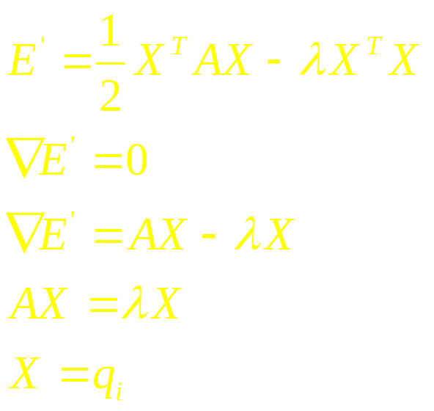
Geometric interpretation of eigenvectors in terms of quadratic forms:
or
Maximize the quadratic form, E, subject to
This can be done using the method of Lagrangian
multipliers as follows. Since there is only one constraint, the Lagrange function may be written as:

Slide 18
Concept of Definiteness
That is, the directions along which E is stationary (∇E’ = 0) under the constraint of is ||X||=1, correspond to the eigenvectors, of the matrix A, to which the quadratic form is associated.
Thus we can see that the shape of a quadratic form at the origin depends on the composition of the eigenvalues of A. Here we come to the notion of definiteness.
There are 5 kinds of definiteness

Slide 19
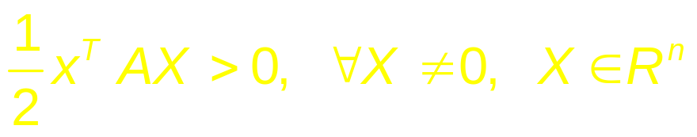
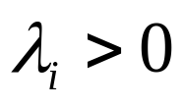
1. Positive definite:
An ‘n x n’ matrix ‘A’ is said to be positive definite if it meets the following condition:
This implies
This case corresponds to the “minimum.” Thus a multivariate function has a minimum at a point X₀,
if the Hessian of the function at X₀, is positive definite.
if the Gradient of the function at X₀, is 0

Slide 20
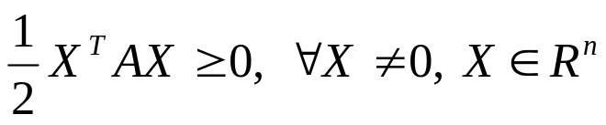

2. Positive semi-definite:
An ‘n x n’ matrix ‘A’ is said to be positive semi-definite if it meets the following condition:
This implies
.

Slide 21
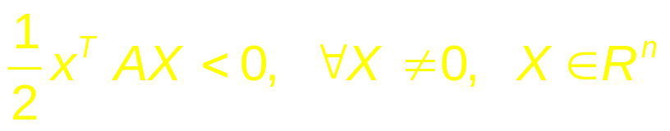

3. Negative definite:
An ‘n x n’ matrix ‘A’ is said to be negative definite if it meets the following condition:
This implies
This case corresponds to the “maximum.” Thus a multivariate function has a maximum at a point X₀,
if the Hessian of the function at X₀, is negative definite.
if the Gradient of the function at X₀, is 0

Slide 22
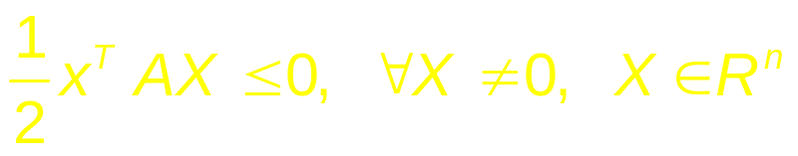

4. Negative semi-definite :
An ‘n x n’ matrix ‘A’ is said to be negative semi-definite if it meets the following condition:
This implies

Slide 23
5. Indefinite:
An ‘n x n’ matrix ‘A’ is said to indefinite if it does not meet any of the above four conditions.
Illustrations of various kinds of definiteness for two-variable functions.

Slide 24
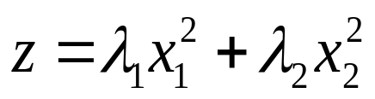



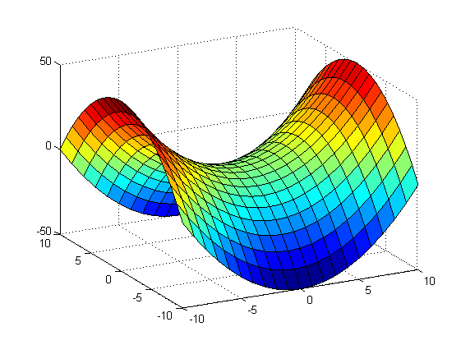
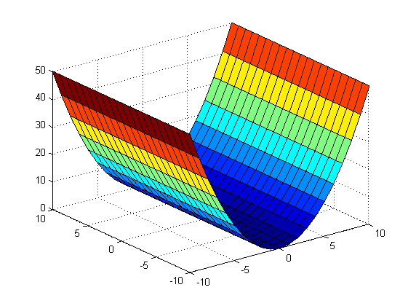
Example:
For n=2, , plot z for all possible values of
Case 1: and are both positive:
Case 2: and are both negative:
Case 3: is positive and is negative
Case 4: is positive and is zero

Slide 25

Thank You

