Slide 1
Hodgkin-Huxley Model
It explains how the dynamics of ion channels (Na+, K+ etc) contribute to the generation of an Action Potential in a neuron.

Slide 3
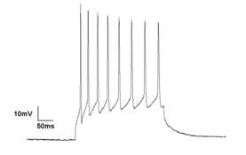
Neuron in
Resting Condition
Neuron Firing
(Action Potential)
Cytosol
V_{m}=-70 mV
Cytosol
V_{m}(t)mV
0 volts
0 volts
What is the basis of this voltage?

Slide 4
The Nonlinearity in Action Potential Generation
An Action Potential is a sharp voltage spike elicited by stimulating a neuron with a current that exceeds a certain threshold value.
The voltage response does not increase proportionally. It shows a sharp, disproportionate increase, as the current amplitude is increased gradually at the threshold point.
Once the membrane voltage reaches a threshold value, it increase further rapidly to maximum value and drops again rapidly to a value that is less than resting value, before returning to the baseline value after a delay.

Slide 5
Understanding Action Potential Generation
Concepts Needed:
(With the introduction on Nernst Potential) A simple ion channel model which expresses how the channel conductance contributes to the membrane potential: In the case of
Voltage Independent Channels
Voltage dependent Channels
Finally the above components placed in a full circuit model of neural membrane (Hodgkin-Huxley model).

Slide 6
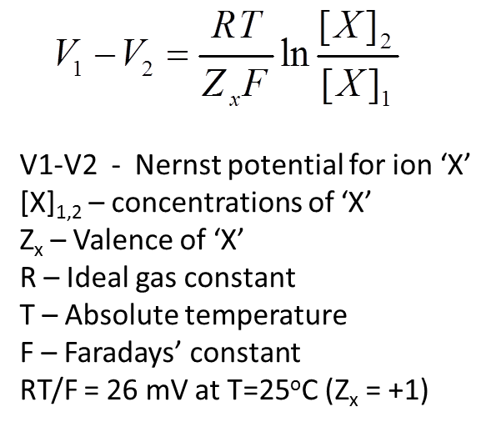
Nernst Potential
Membrane Potential Basis:
Key ions involved: Na+, K+, Cl-, Ca2+
Differences in distribution of these ions between inside and outside produce membrane voltage
In general, Nernst potential is calculated between interior and the exterior of the Neuron, under equilibrium conditions, containing an ion X, as shown in the right.

Slide 7
Equivalent circuit of a voltage-independent ion channel
(Outside neuron)
0 (volts)
g_{channel}
0
E_{Nernst}
channel conductance
(g_{channel} )
(Inside neuron)
E_{Nernst} (volts)

Slide 8
Equivalent circuit of a voltage-dependent ion channel
(Outside neuron)
0 (volts)
Conductance varies with time
g_{channel}
0
E_{Nernst}
channel
conductance
(g_{channel} )
(Inside neuron)
E_{Nernst} (volts)
*The arrow
represents
variability

Slide 9
Nernst Potentials of K+
[K+]_{o} = 20 mM
[K+]_{i} = 400 mM
E_{k} = -77 mV
g_{k}=36mS/cm²
(under resting conditions)

Slide 10
K+ Equivalent circuit
Under resting conditions:
E_{k} = -77mv
g_{k} = 36 mS/cm²
g_{k}
E_{k}

Slide 11
Nernst Potentials of Na+
[Na+]_{o} = 440 mM
[Na+]_{i} = 60 mM
E_{Na} = 50 mV
g_{Na} = 120 mS/cm²
(under resting conditions)

Slide 12
Na+ Equivalent circuit
Under resting conditions Na+ ions are more concentrated outside the cell
E_{Na} = 55mv
g_{Na} = 120 mS/cm²
Equivalent circuit of
Na+ channel and
Na+ Nernst Potential
g_{Na}
E_{Na}

Slide 13
Leakage channels
Channels that are independent of membrane voltage
The Na+ and K+ channels seen before are voltage dependent (therefore nonlinear!)
Using Thevenin’s theorem (of elec ckts), all voltage-independent channels can be combined into one “leakage” branch….

Slide 14
Equivalent ckt of leakage channels
g_{a}
g_{b}
g_{L}
+
+…
=
E_{a}
E_{b}
E_{L}
E_{L} = 10.6 mV
g_{L} = 0.3mS/cm²

Slide 15
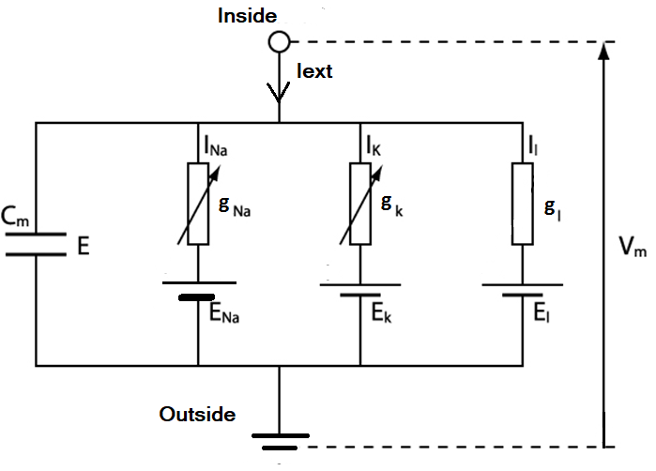

Slide 16
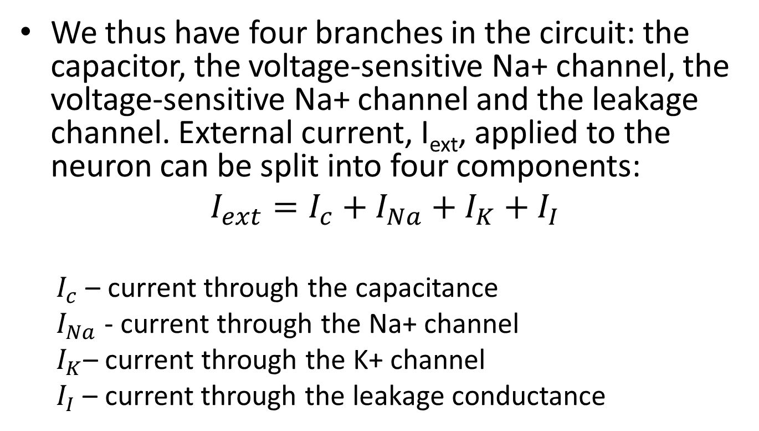
Constructing the Hodgkin-Huxley (HH) model
We thus have four branches in the circuit: the capacitor, the voltage-sensitive Na+ channel, the voltage-sensitive Na+ channel and the leakage channel. External current, I_{ext}, applied to the neuron can be split into four components:
$$I_{ext}=I_{c}+I_{Na}+I_{K}+I_{I}$$
$I_{c}$ – current through the capacitance
$I_{Na}$ - current through the Na+ channel
$I_{K}$– current through the K+ channel
$I_{I}$ – current through the leakage conductance

Slide 17
The above current equation may be expanded as,
(HHV eqn)
g_{Na} and g_{K} are time varying. How to model them?

Slide 19
OPEN/CLOSE states of an ion channel

Slide 20
A model of a voltage-sensitive channel
The mathematical treatment of voltage dependent gating of channels has two parts:
The dynamics of switching between open/close states. This description is kept general, without reference to a specific gating mechanism.
Voltage-gating, or, the manner in which switching dynamics is influenced by membrane voltage.

Slide 21
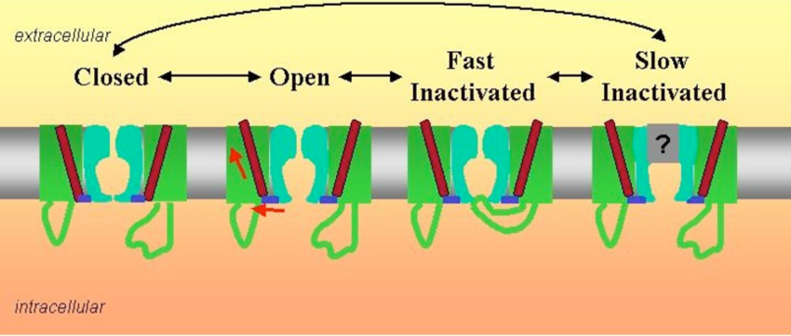
Complex channels with a lot of intermediate states
Complex channels have a large number of intermediate states that are not strictly ‘open’ or ‘closed.’
But for the moment we consider only simple channels with only two states – open and closed.

Slide 22
Channels with 2 States – OPEN/CLOSED
Channel switching can be described as a uni-molecular chemical reaction where a molecule (the channel protein) switches between two states as follows:
where C_{c} and C_{o} denote the channel in open and closed states, and k⁺ and k⁻ are the forward and reverse rate coefficients.
k⁺
C_{c}
C_{o}
k⁻

Slide 23
x :- fraction of the channels in open state, and
(1-x) :- fraction of channels in closed state
Dynamics of state transition may be described as a first order chemical reaction as follows:
---------------(1)

Slide 24
The previous equation can also be written as,
where,
---------------(2)
---------------(3)

Slide 25
Statistical Description of Channel Kinetics
This simple description is applicable for a statistical ensemble of channels.
Since a cell membrane typically has a few thousand ion channels the above description is justified.
Switching behavior in single channels, which can be measured using techniques like patch-clamping, is far more complex.
Since our objective is to study membrane voltage changes it is sufficient to treat channels as an ensemble.

Slide 26
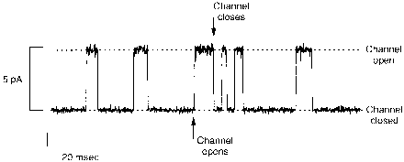
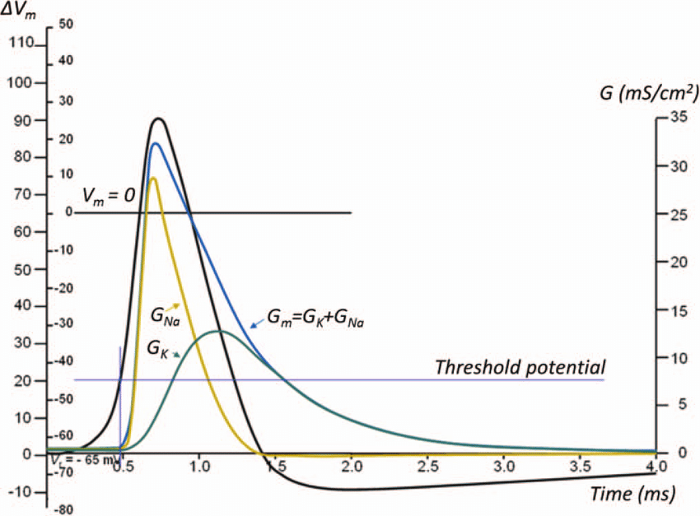
Single Channel kinetics
Conductance variation
of a single
Ion channel is
BINARY
Kinetics of a population of
Ion channels
Conductance variation
Of a population of
Ion channels is
SMOOTH

Slide 27
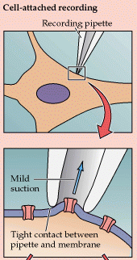
Patch clamp technique
For recording
single channel currents
Inventors of the Patch Clamp:
Sakman and Neher
get a Nobel Prize for Physiology
In 1976.

Slide 29
Where is the Voltage dependency?
Complete solution of eqn. (1) requires knowledge of K⁺ and K ⁻ .
In voltage-sensitive channels these quantities are functions of membrane voltage and that is the mechanism by which membrane voltage controls channel gating.
Since ion channels are proteins which contain charged amino acid side chains, membrane potential can influence the rate of open/close transitions.

Slide 30
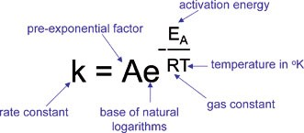
Arrhenius Expression for rate constant

Slide 31
Activation energy is proportional to Membrane Voltage, V
Using Arrhenius expressions, the rate constants can be expressed in terms of the membrane potential as:
and
where and are independent of membrane voltage.

Slide 32
Substituting the previous formulae for K+ and K- in eqn. (1), we have
----(2)
---(3)

Slide 33
Let us define
and
Substituting S₀ and V₀ in equations (2) and (3)

Slide 34
Using hyperbolic functions, the last two expressions can be rewritten as,

Slide 35
If S₀ is positive, channels open with increasing membrane voltages (activation gates)
When S₀ is negative, gates close with increasing membrane voltages (inactivation gates).
V₀ determines the voltage at which the transition from ‘mostly open’ to ‘mostly closed’ takes place.

Slide 36
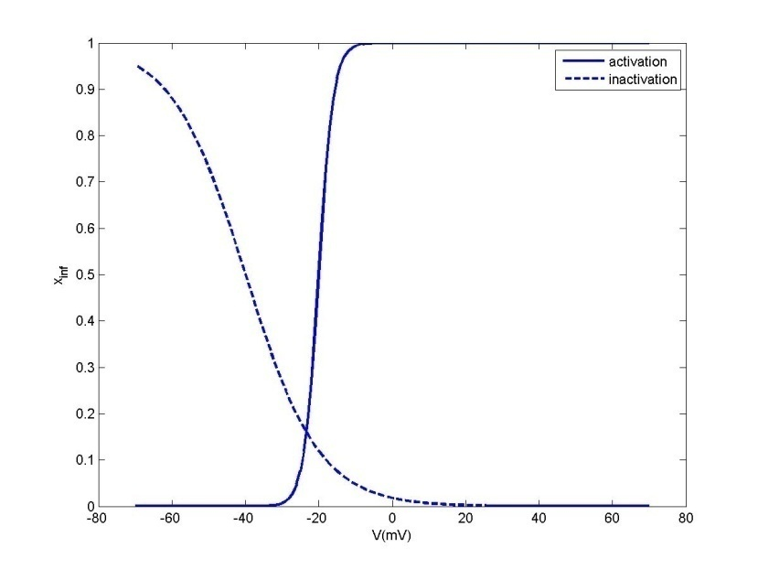
Activation gates (X_inf)
Activation gate (S0>0):
Increased V OPENS gate
The solid line corresponds to an activation gate (S₀ = 2)
Note the smaller the magnitude of S₀, the steeper the curve. V₀ for the activation gate is -20 mV

Slide 37
Inactivation gates (X_inf)
Inactivation gate (S0<0):
Increased V CLOSES gate
Dashed line corresponds to an inactivation gate (S₀ = -10).
Note the smaller the magnitude of S₀, the steeper the curve.
V₀ for inactivation gate is -40 mV

Slide 38
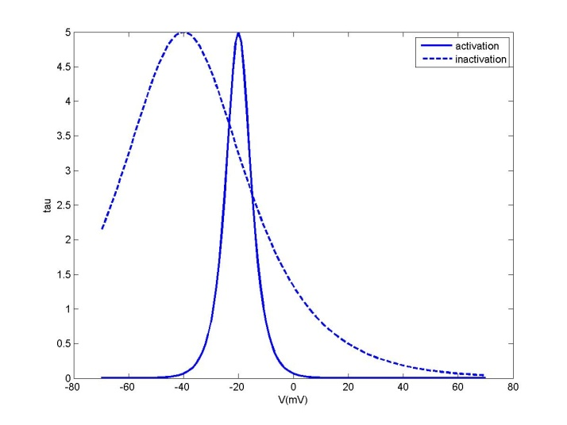
Time constant
In this figure, for the solid line, S₀ = 2; V₀ = -20, whereas for the dotted line, S₀ = 10; V₀ = -40.
Note that the sign of S₀ does not affect t since it is an even function of S₀.
V₀ denotes the voltage at which t is maximum. The magnitude of S₀ determines the sharpness of the peak.

Slide 39
Until now…
Channel opening/closing is described
as if the channel behaves as a single, unitary entity
0
0
CLOSED Channel
OPEN Channel
Dynamics defined by a single variable – X
X = fraction of OPEN Channels

Slide 40
From now on…
We adopt a more complex model of the Channel.
Channel opening/closing is described as if
the channel is a composite entity
with MULTIPLE GATES

Slide 41
Channels with multiple gates:
All gates OPEN
All gates CLOSED
Each GATE has a separate variable – the “gating variable”, X
X = probability of OPEN gate

Slide 42
Multiple Gates in a Channel
Expressing the switching of the whole channel in terms of the component gates: (Gate Kinetics)
Considering only channels with single gates:
Here, ‘x’ now represents the fraction of open gates, which is also interpreted as probability of the gate being in open state (gating variable).
Fraction of open channels = fraction of open gates.

Slide 43
Channels with multiple gates:
If a channel has K gates, with open probabilities of the gates denoted, by x₁, x₂, x_{K}, then the open probability, denoted by x, of the entire channel is given as:
x = x₁* x₂*… x_{K}
since the channel is open only when all the gates are open.

Slide 44
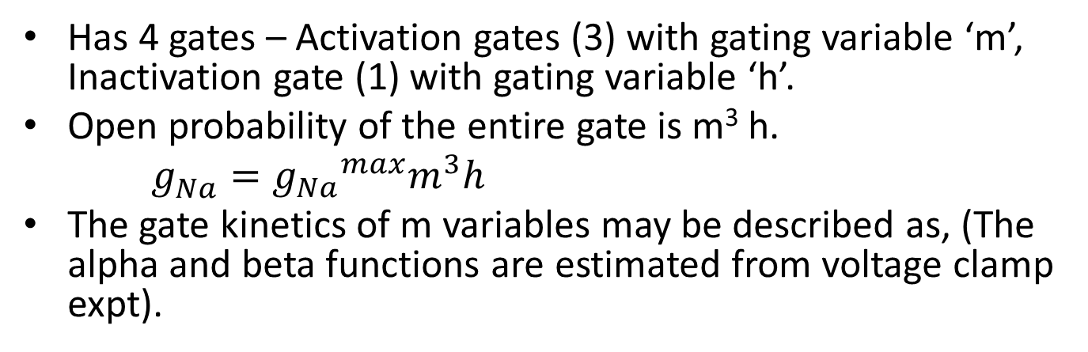
Modeling a voltage-dependent Na+ channel
Has 4 gates – Activation gates (3) with gating variable ‘m’, Inactivation gate (1) with gating variable ‘h’.
Open probability of the entire gate is m³ h.
$g_{Na}^{}={g_{Na}}^{max}m^{3}h$
The gate kinetics of m variables may be described as, (The alpha and beta functions are estimated from voltage clamp expt).

Slide 45
Voltage-dependent Na+ channel
Activation gates - 3 with
gating variable ‘m’
Inactivation gates - 1
gating variable ‘h’

Slide 46
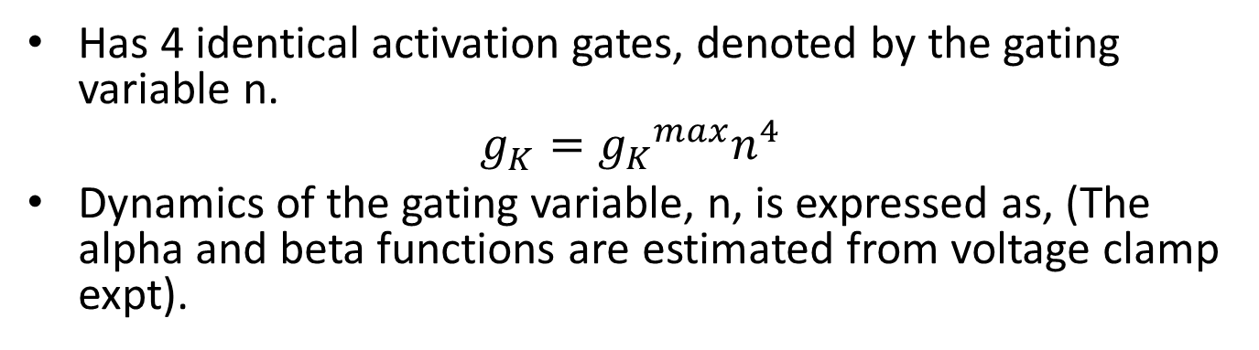
Modeling a voltage-dependent K+ channel
Has 4 identical activation gates, denoted by the gating variable n.
$$g_{K}^{}={g_{K}}^{max}n^{4}$$
Dynamics of the gating variable, n, is expressed as, (The alpha and beta functions are estimated from voltage clamp expt).

Slide 47
Voltage-dependent Na+ channel
Activation gates - 4 with
gating variable ‘n’

Slide 48
Equivalent circuit of a HH model

Slide 49
Constructing the HH model
We thus have four branches in the circuit: the capacitor, the voltage-sensitive Na+ channel, the voltage-sensitive Na+ channel and the leakage channel. External current, I_{ext}, applied to the neuron can be split into four components:
$$I_{ext}=I_{c}+I_{Na}+I_{K}+I_{I}$$
$I_{c}$ – current through the capacitance
$I_{Na}$ - current through the Na+ channel
$I_{K}$– current through the K+ channel
$I_{I}$ – current through the leakage conductance

Slide 50
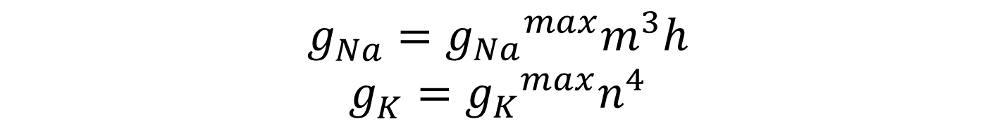
The above current equation may be expanded as,
$$g_{Na}^{}={g_{Na}}^{max}m^{3}h$$
$$g_{K}^{}={g_{K}}^{max}n^{4}$$

Slide 51
The above equation that describes membrane voltage dynamics must be supplemented by the following equations to complete the definition of the Hodgkin-Huxley model.

Slide 53
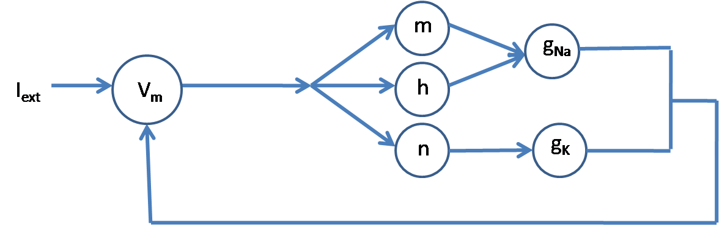
Dependencies among the variables

Slide 54
Voltage vs. time; Conductances vs. time; gating variables vs. time for I = 0.02 µA/mm²

Slide 55
Voltage vs. time; Conductances vs. time; gating variables vs. time for I = 0.023 µA/mm²

Slide 56
Voltage vs. time; Conductances vs. time; gating variables vs. time for I = 0.1 µA/mm²

Slide 57
Voltage vs. time; Conductances vs. time; gating variables vs. time for I = 0.6 µA/mm²

Slide 58
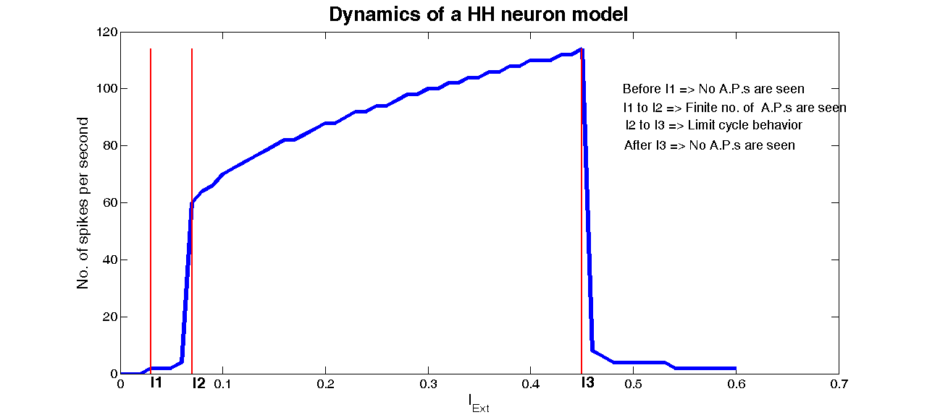
Dynamics of HH neuron model

