Slide 1
Finite Cable
Consider a finite cable of electrotonic length L.
Let X denote the electrotonic distance along the cable,
A general expression for steady state membrane voltage, as a function of X, is given as,
where,
Why hyperbolic functions?

Slide 2
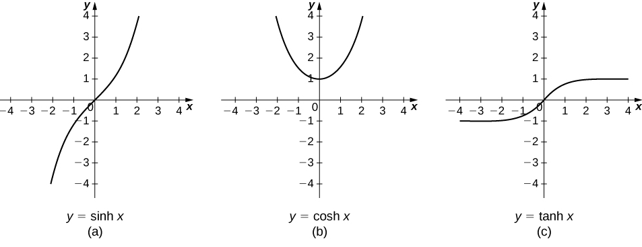
Hyperbolic functions

Slide 3
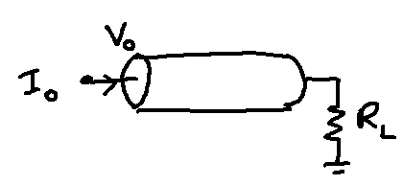
Now we consider three different boundary conditions under which we solve the steady state voltage distribution of a finite length cable:
Sealed end (R_{L} = infinity)
Killed end (R_{L} = 0)
Arbitrary (R_{L} = finite)

Slide 4

Sealed-end Boundary Condition
Sealed End
Physically this refers to the situation when the dendrite is sealed/closed with a membrane patch.
Electrically this is equivalent to loading the circuit of the dendrite at the far end with a resistance equal to that of membrane patch that sealed the dendritic cable.
R_{l}=3000 GΩ

Slide 5
For dendritic cable of diameter, d of 2μm , and R_{m} of 10⁵ Ω.cm², the loading resistance R_{L} is, R_{L} = 3000G Ω.
Since the sealed end has high resistance we can approximate it with an open circuit, implying that axial current, Ii =0 at the sealed end (x=L).

Slide 6
Since the sealed end has high resistance we can approximate it with an open circuit, implying that axial current, I_{i} =0 at the sealed end (x=L).
Therefore, from eqn. (1),

Slide 7
Substituting the above boundary condition in the solution of eqn. (14), we have,
or, B=0. Therefore,
Assuming V₀ is the voltage at the near-end (x=0=X) of the cable at steady state, the solution can be written as,

Slide 8
At X=0, I_{i} is,
(At X = 0)

Slide 9
Killed End Boundary Condition
The previous case of ‘sealed-end boundary condition’ refers to the situation when the far end is an open circuit.
The present case of ‘killed end boundary condition’ the end of the terminal is ‘shorted’ so that the voltage at the far end is zero.
Physically this situation can be created by cutting (“killing”) the far end so that the interior of the dendrite is directly in contact with the extracellular space.

Slide 10
The form of the solution for this case is again,
Boundary conditions:
(14)
at X = L
at X = 0

Slide 11
Input resistance
Calculating Input current:

