Slide 1
Synapse
AP → NTs → PSP.
Modeling the transient increase and return to zero of synaptic conductance g_{syn}(t)
when g_{syn}(t) > 0

Slide 2
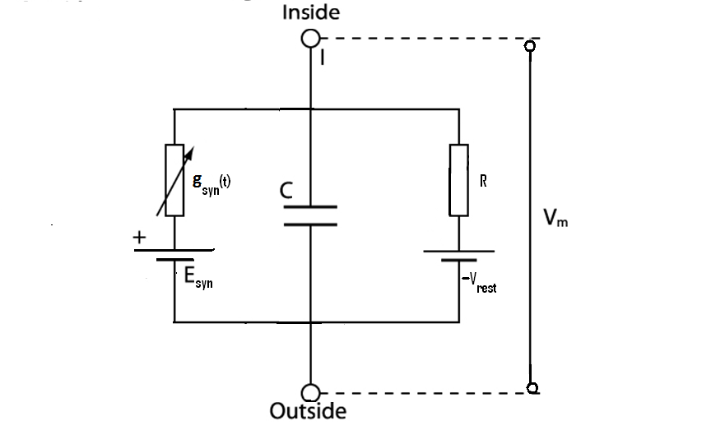
g_{syn}(t) – is the time-varying synaptic conductance (of the ion channel involved in synaptic transmission)
E_{syn} – is the Nernst potential corresponding to the ion channel (involved in synaptic transmission) and the ionic species to which it is permeable
C – membrane capacitance
Vrest – resting membrane potential of the postsynaptic membrane
R – membrane resistance

Slide 3
PSP
Is deviation from the resting potential
(PSP)v = V_{m} – V_{rest}
-- (*)
The direction of change in v can be to 3 cases:
Case 1) Esyn > Vrest
Case 2) Esyn < Vrest
Case 3)

Slide 4
Case 1) Esyn > Vrest
v transiently increases. → EPSP.
Ex: fast, excitatory synapses with AMPA receptors (or non-NMDA type) and glutamate as neurotransmitter.

Slide 5
Case 2) Esyn < Vrest
Current injected is negative, → negative deviation in v, → IPSP
Ex: Some potassium channels with GABA as the neurotransmitter and GABA_B as the receptor.

Slide 6
Case 3)
No current in the synaptic conductance
No apparent effect on the PSP.
Ex: Some Cl channels having GABA synapse with GABA_A receptor.
Although these synapses do not seem to have any effect in isolation, when used in conjunction with excitatory synapses they show an interesting effect.

Slide 7
Case 3 with Excitatory synapses
Here EPSP produced is smaller than what it would be when the excitatory synapse alone is present.
In that sense, the synapse corresponding to
is inhibiting the excitatory synapse. Therefore it is known as a silent or a shunting inhibition.

Slide 8
Excitatory synapses
AMPA type synapses:
Time-scale of opening of this channel is about 1 ms.

Slide 9
NMDA type synapses:
Have more complex dynamics than AMPA type synapses, since they are dual-gated.
Gated by both the NT and V.
Under conditions of normal membrane polarity, extracellular Mg2+ blocks the NMDA associated channels. This block is removed when the membrane potential is depolarized beyond -50 mV.
However the time-scales of opening of this channel is longer (10-100 ms).

Slide 10
Inhibitory Synapses
Can have more complex models of synaptic conductance.
Ex: GABAergic synapses of cerebellar granule cells, postsynaptic current is found to have a fast and a slow component.

