Slide 2
A simplified 2-dimensional model
Three models discussed previously have following common feature,
Resting state for I = 0
Spikes/oscillations/limit cycles for a sufficiently large I.
An N-shaped V-nullcline. The shape of the second nullcine is linear in the FN model, and sigmoidal in ML and INAPK model.
The intersection between the V-nullcine and the second nullcline near the U-shaped, lower arch of the V-nullcline plays a crucial role in neuron dynamics.

Slide 3
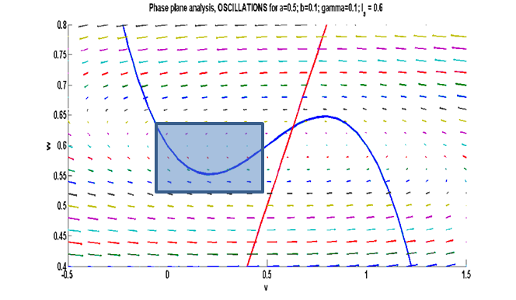
Figure 5.4.1 : Area of interest for the upstroke: Phase plane analysis- Oscillations (FN model) at a=0.5; b = 0.1; r=0.1; I_{a}=0.6

Slide 4
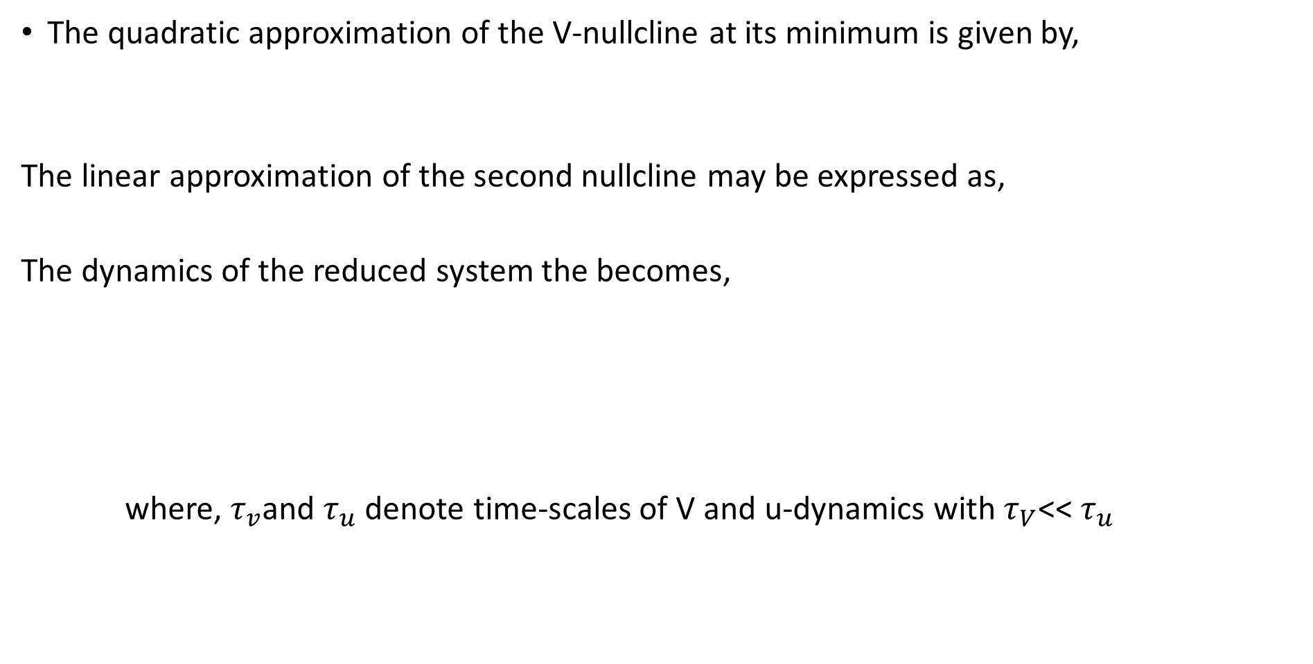
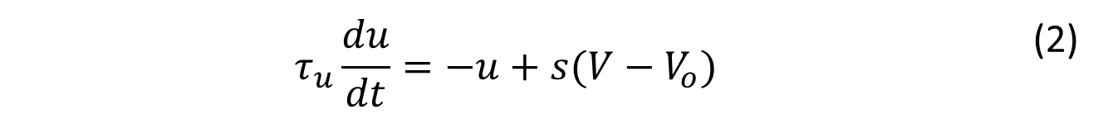
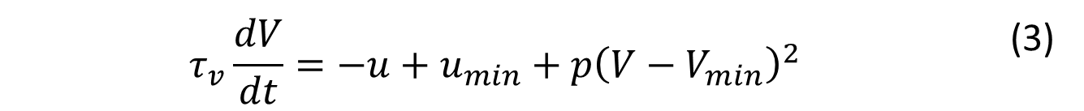
The quadratic approximation of the V-nullcline at its minimum is given by,
The linear approximation of the second nullcline may be expressed as,
The dynamics of the reduced system the becomes,
where, $τ_{v}$and $τ_{u}$ denote time-scales of V and u-dynamics with $τ_{V}$<< $τ_{u}$
$$u=u_{min}+p{(V−V_{min})}^{2}$$ | (1)
$u=s\left(V−V_{o}\right)$ | (2)
$$τ_{v}\frac{dV}{dt}=−u+u_{min}+p{\left(V−V_{min}\right)}^{2}$$ | (3)
$$τ_{u}\frac{du}{dt}=−u+s(V−V_{o})$$ | (2)

Slide 5
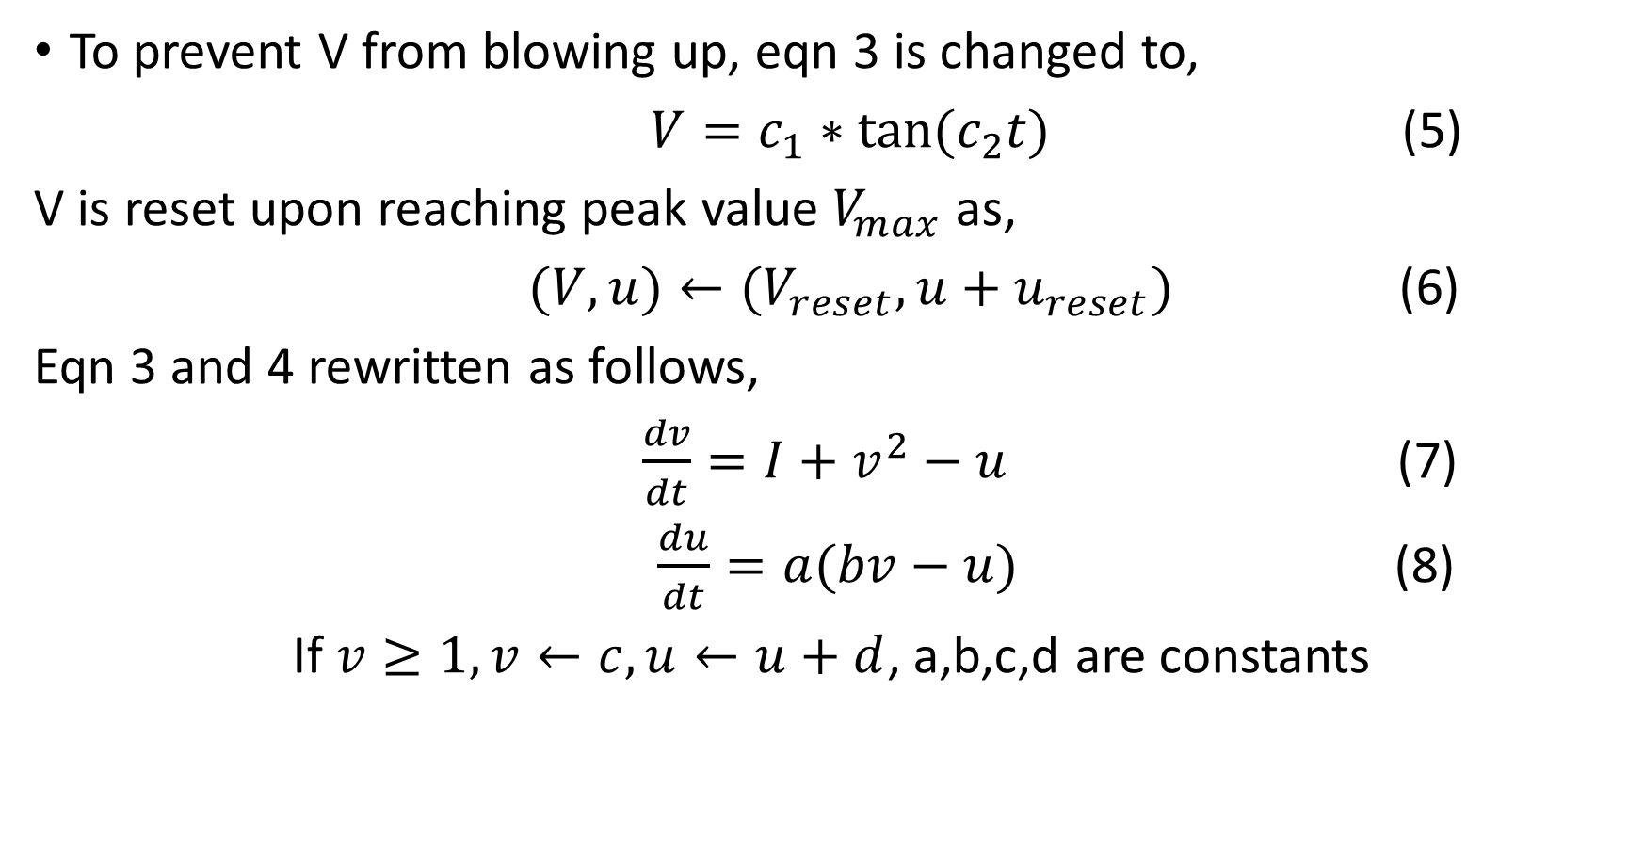
To prevent V from blowing up, eqn 3 is changed to,
$V=c_{1}∗tan⁡(c_{2}t)$ (5)
V is reset upon reaching peak value $V_{max}$as,
$(V,u)←(V_{reset},u+u_{reset})$ (6)
Eqn 3 and 4 rewritten as follows,
$\frac{dv}{dt}=I+v^{2}−u$ (7)
$\frac{du}{dt}=a(bv−u)$ (8)
If $v≥1,v←c,u←u+d$, a,b,c,d are constants

Slide 6
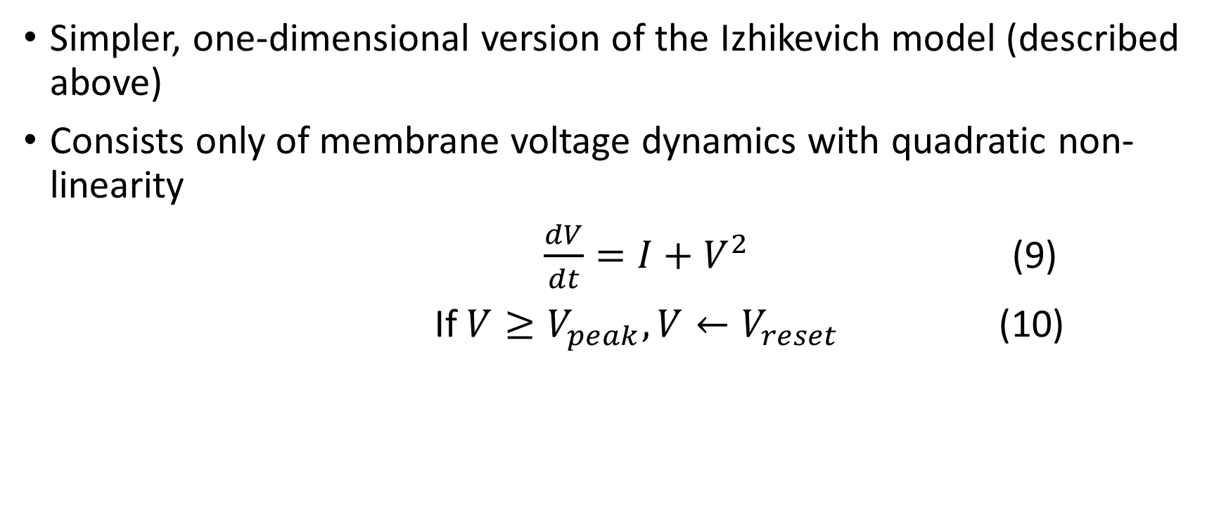
Quadratic Integrate and fire neuron
Simpler, one-dimensional version of the Izhikevich model (described above)
Consists only of membrane voltage dynamics with quadratic non-linearity
$\frac{dV}{dt}=I+V^{2}$ (9)
If $V≥V_{peak},V←V_{reset}$ (10)

Slide 7
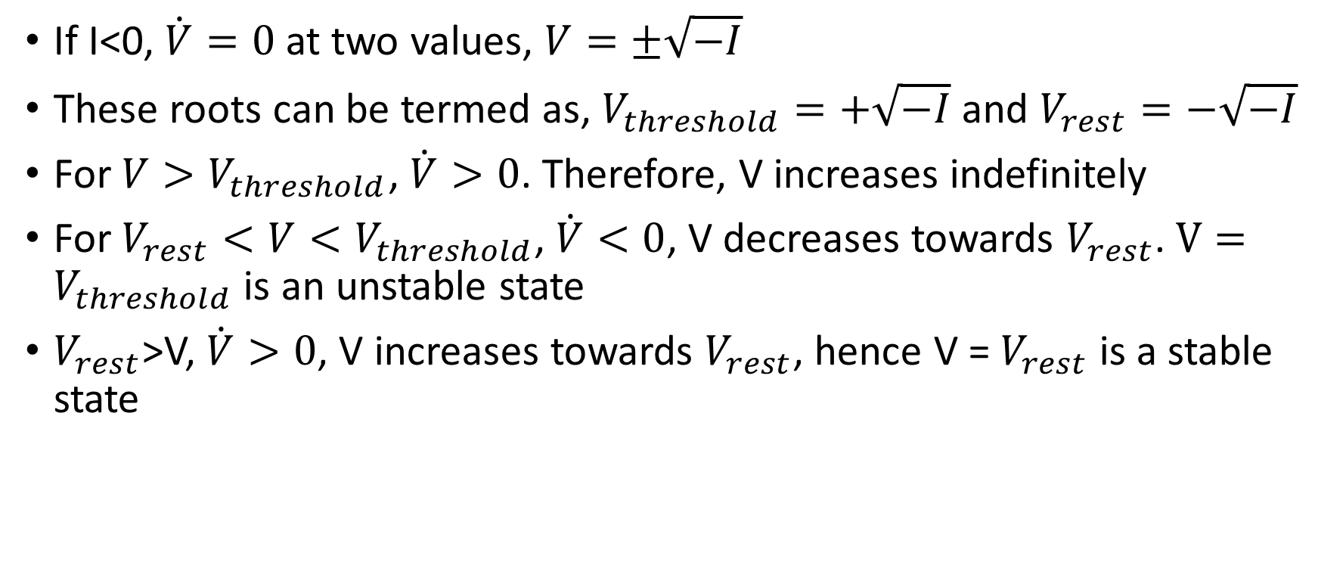
If I<0, $\dot{V}=0$ at two values, $V=±\sqrt{−I}$
These roots can be termed as, $V_{threshold}=+\sqrt{−I}$ and $V_{rest}=−\sqrt{−I}$
For $V>V_{threshold}$, $\dot{V}>0$. Therefore, V increases indefinitely
For $V_{rest}<V<V_{threshold}$, $\dot{V}<0$, V decreases towards $V_{rest}$. $V=V_{threshold}$ is an unstable state
$V_{rest}$>V, $\dot{V}>0$, V increases towards $V_{rest}$, hence V = $V_{rest}$ is a stable state

Slide 8
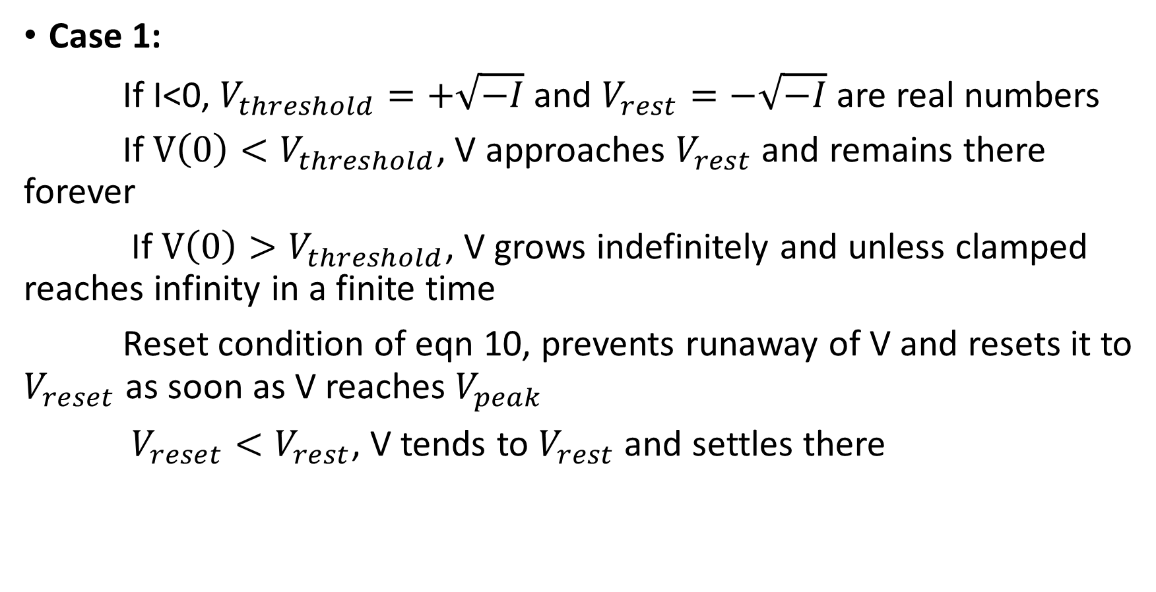
Case 1:
If I<0, $V_{threshold}=+\sqrt{−I}$ and $V_{rest}=−\sqrt{−I}$ are real numbers
If $V\left(0\right)<V_{threshold}$, V approaches $V_{rest}$ and remains there forever
If $V\left(0\right)>V_{threshold}$, V grows indefinitely and unless clamped reaches infinity in a finite time
Reset condition of eqn 10, prevents runaway of V and resets it to $V_{reset}$ as soon as V reaches $V_{peak}$
$V_{reset}<V_{rest}$, V tends to $V_{rest}$ and settles there

Slide 9
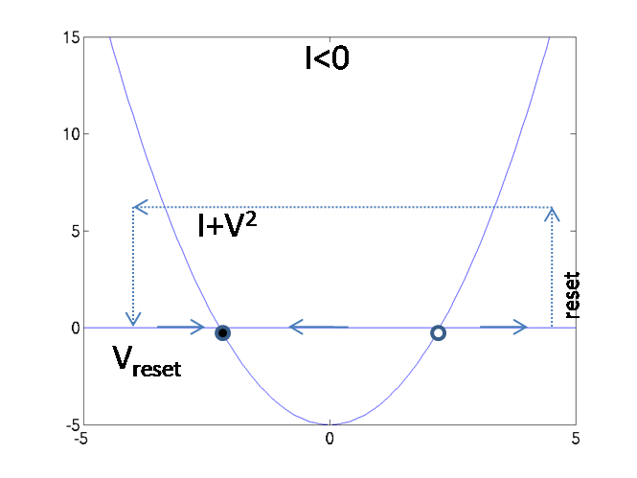
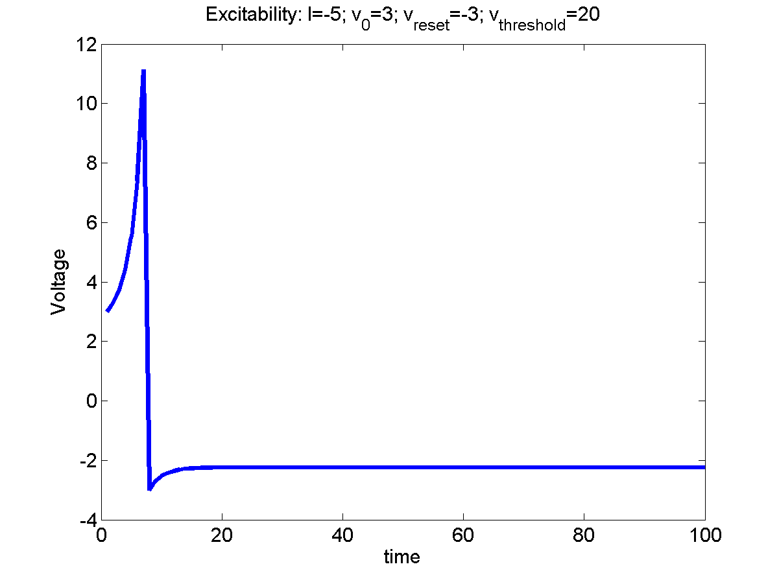
Figure 5.4.1.1: a) Reset condition b) Voltage simulation at I = 5; v_{o} = 3; v_{reset} = -3; v_{threshold} = 20;

Slide 10
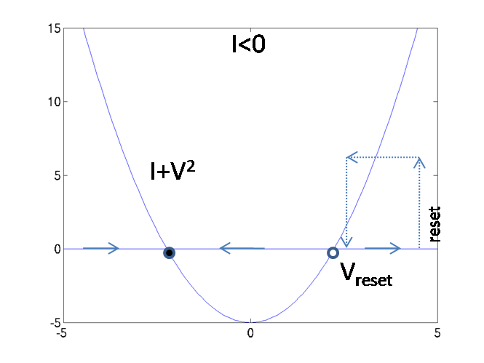
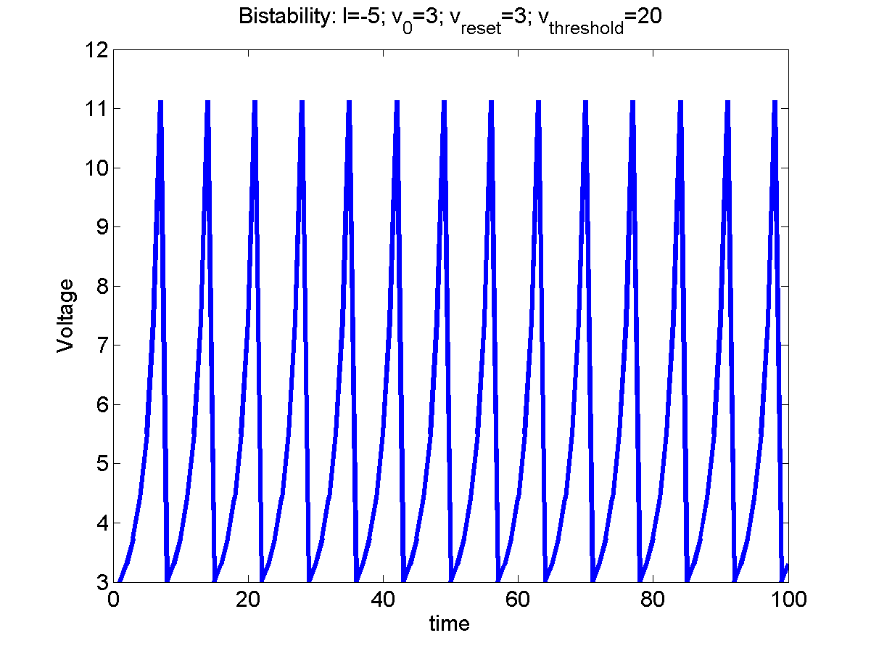

Case 2:
When $V\left(0\right)>V_{threshold}$, V reaches $V_{peak}$ and gets reset to $V_{reset}$
Periodic firing – instead of slow return to $V_{rest}$. Bistability
Figure 5.4.1.2: a) Reset condition b) Voltage simulation at I = -5; v_{o} = 3; v_{reset} = 3; v_{threshold} = 20;

Slide 11
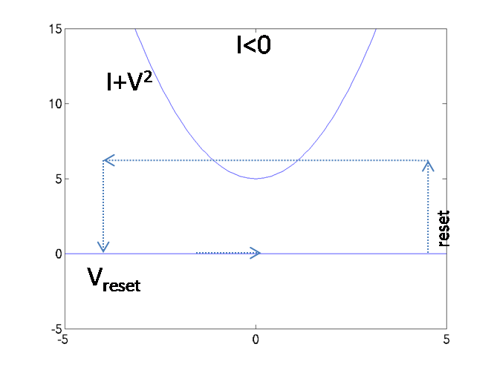
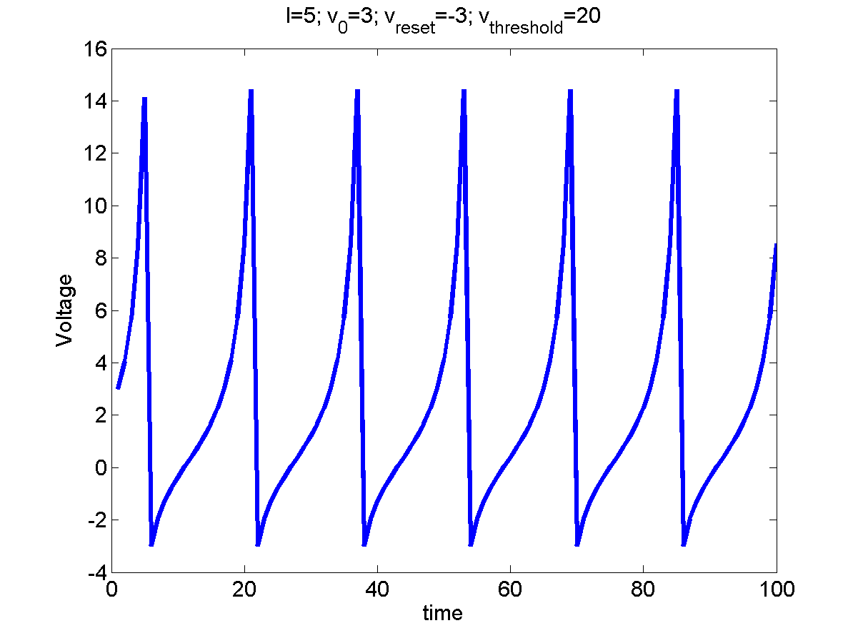

Case 3:
When I>0 and $V_{threshold}=+\sqrt{−I}$ and $V_{rest}=−\sqrt{−I}$ are unreal.
Tonic firing, without excitation
Figure 5.4.1.3: a) Reset condition b) Voltage simulation at I = 5; v_{o} = 3;

Slide 12
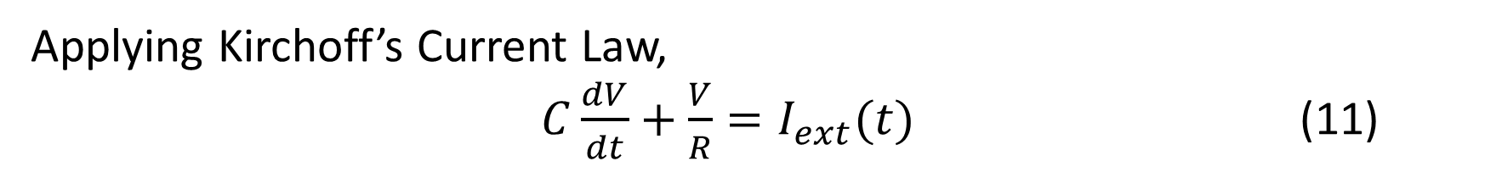
Leaky Integrate and Fire neuron
I_{ext}(t)
V_{th}
R
C
Figure 5.4.2.1: Leaky Integrate and Fire circuit diagram
Applying Kirchoff’s Current Law,
$C\frac{dV}{dt}+\frac{V}{R}=I_{ext}(t)$ (11)

Slide 13
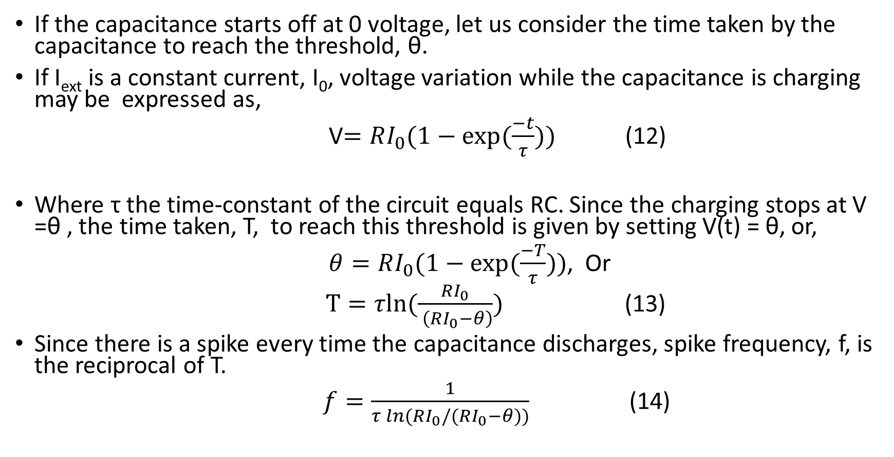
If the capacitance starts off at 0 voltage, let us consider the time taken by the capacitance to reach the threshold, θ.
If I_{ext} is a constant current, I₀, voltage variation while the capacitance is charging may be expressed as,
V$=RI_{0}(1−exp⁡(\frac{−t}{τ}))$ (12)
Where τ the time-constant of the circuit equals RC. Since the charging stops at V =θ , the time taken, T, to reach this threshold is given by setting V(t) = θ, or,
$θ=RI_{0}(1−exp⁡(\frac{−T}{τ}))$, Or
$T=τln⁡(\frac{RI_{0}}{ \left(RI_{0}−θ\right)})$ (13)
Since there is a spike every time the capacitance discharges, spike frequency, f, is the reciprocal of T.
$f=\frac{1}{τ\ln{(}RI_{0}/(RI_{0}−θ))}$ (14)

Slide 14
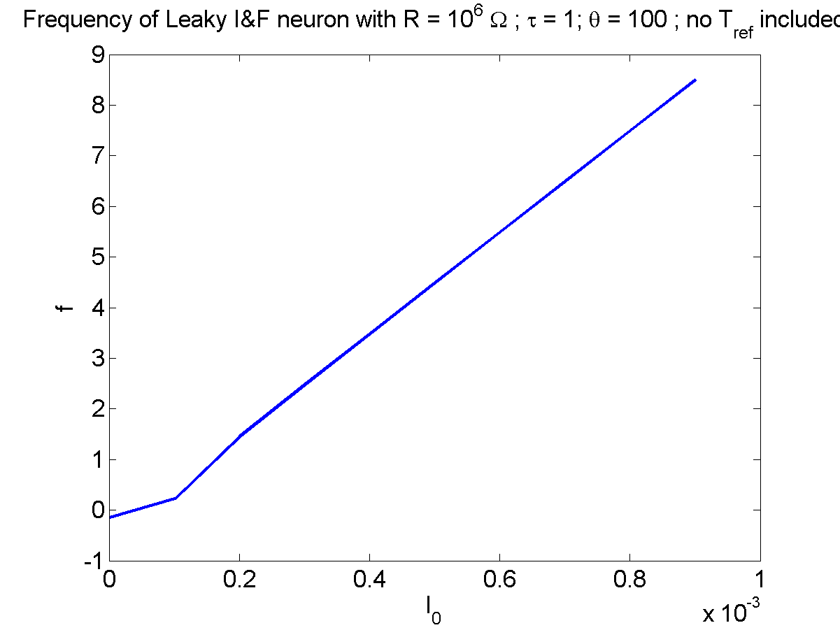
Figure 5.4.2.2: frequency vs I_{o} without inclusion of absolute refractory period

Slide 15
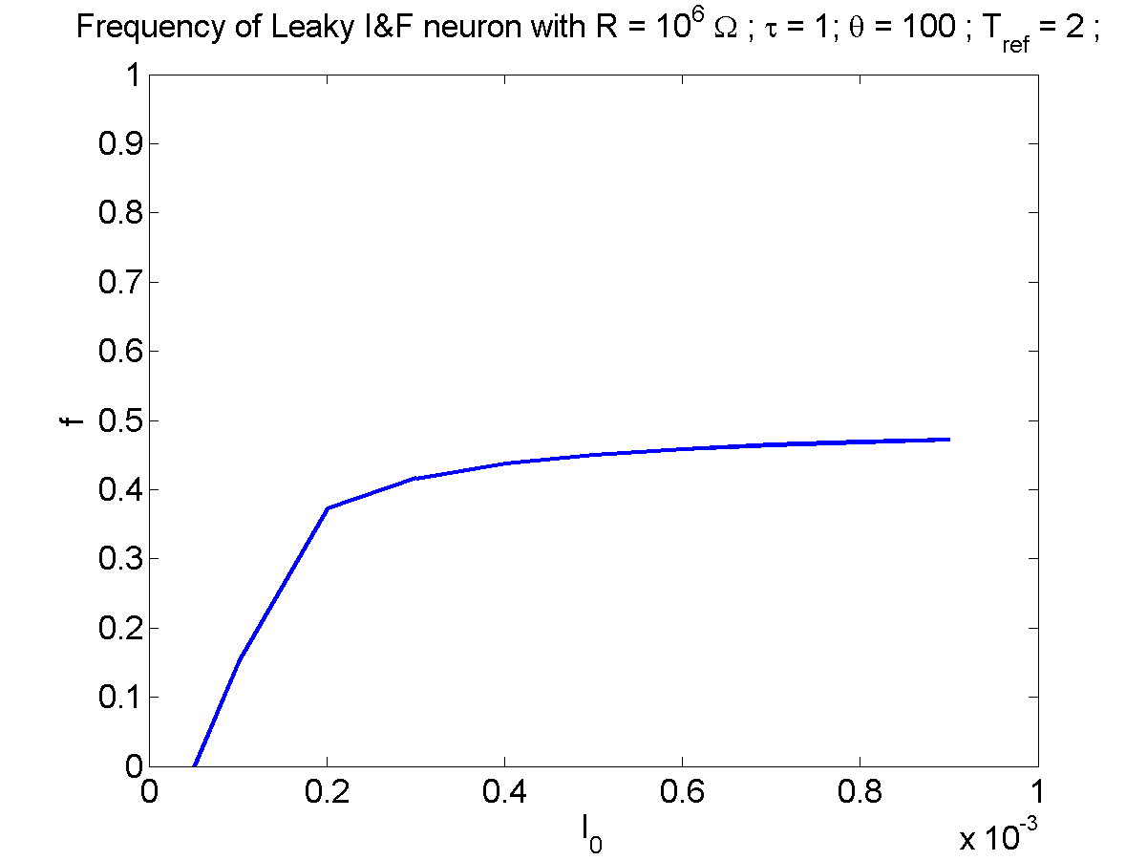

The time taken to charge is incremented as,
$T=τ\ln{(}RI_{0}/(RI_{0}−θ))+​T_{ref}$ (15)
And the new firing rate is,
$f=\frac{1}{τ\ln{(}RI_{0}/(RI_{0}−θ))+T_{ref}}$ (16)
With the inclusion of absolute refractory period, the plot of I₀vs f, shows saturating behavior
Figure 5.4.2.3: frequency vs I_{o} with inclusion of absolute refractory period

Slide 16
Binary Neuron Models
To simplify the single neuron model further, we may consider rate-coded models which represent the neuron state in terms of the spike rate.
These models typically describe neurons as binary elements, with a high (excited state) and a low (resting) state.

Slide 17
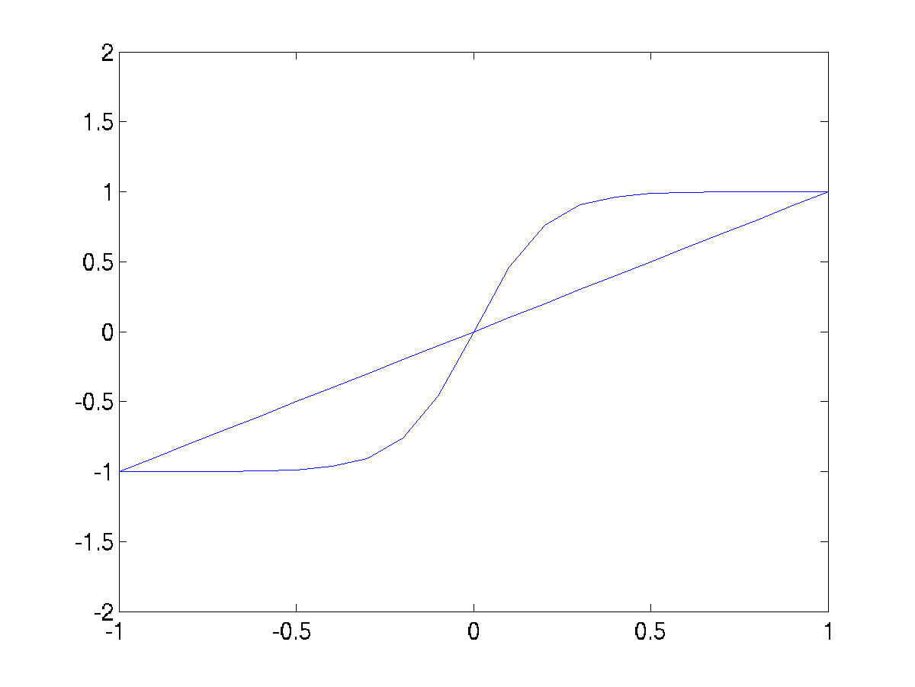

Dynamic Binary Neuron Model
A dynamic version of a binary neuron is a bistableneuron whose dynamics is described as,
$\dot{τu}=−u+V+I$ (17)
$V= \tanh{(λu)}$ (18)
Figure 5.4.3.1.1: u,v nullclines

Slide 18
V is an abstract quantity that denotes if the neuron is excited (V is close to 1) or in the resting state (V is close to -1).
For I = 0 and l> 1, the above system has three fixed points. The fixed point at the origin can be shown to be unstable, while the ones on the flanks can be shown to be stable. When released from a random initial condition, the neuron state, V, settles near +1 or -1.
For I > b, where b = 2.63, and l> 1, Eqn 17 above has only a single, stable fixed point at V close to +1.
For I < -b, and l> 1, eqn 17 above has only a single, stable fixed point at V close to -1.
For –b < I < b, there are again three fixed points, two close to + 1 and -1 respectively, and the third somewhere in the middle, not necessarily at the origin.
The above neuron model also shows hysteresis effect. If I is reduced from a large positive value to a large negative value and back, the points at which V makes transitions from (+1 to -1 and vice versa) are different in the forward pass and the reverse pass.

Slide 19
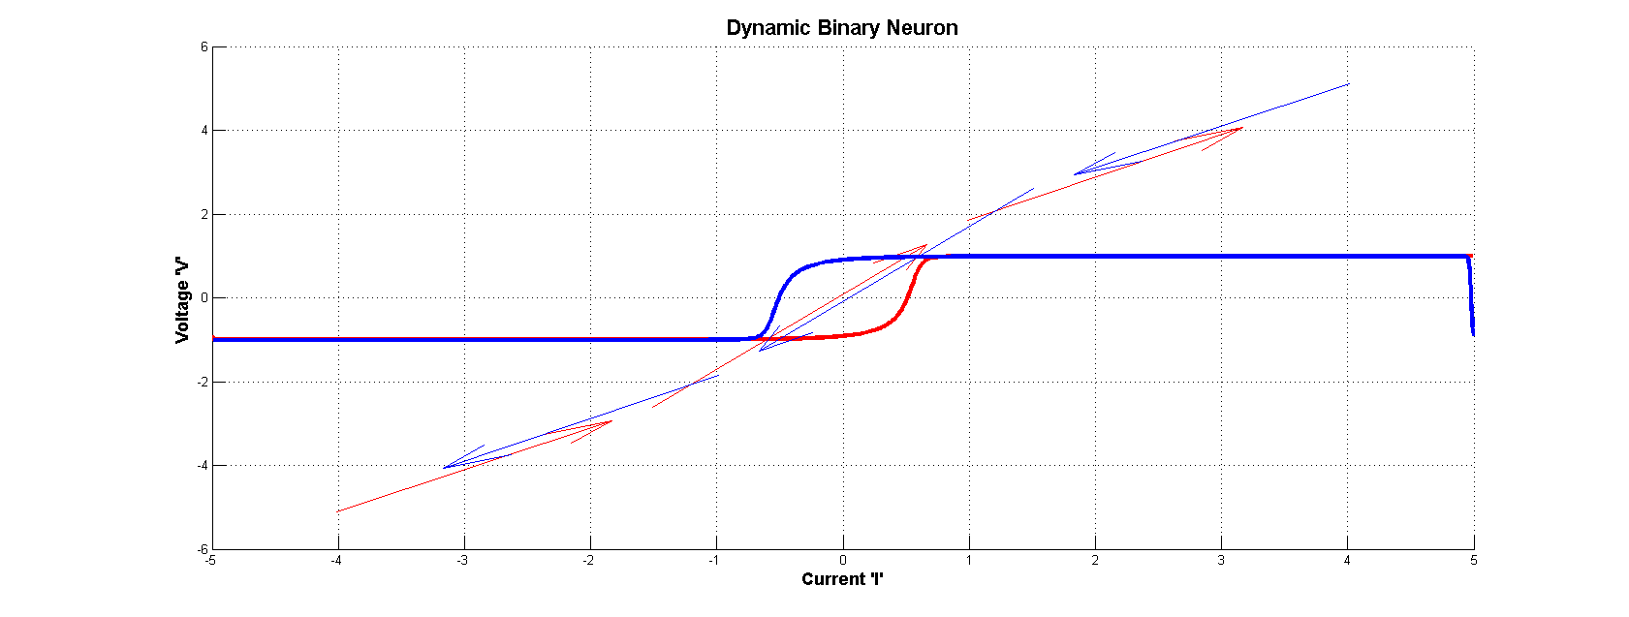
Figure 5.4.3.1.2 : Hysteresis curve for a dynamic binary neuron

Slide 20
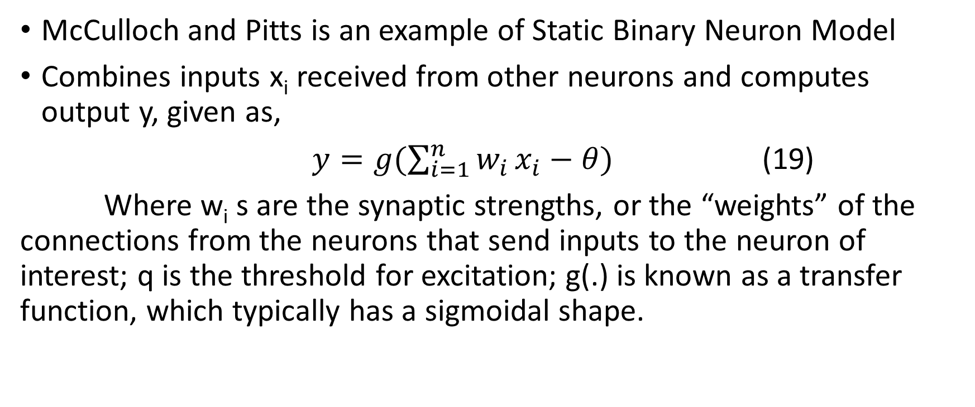
Static Binary Neuron Model
McCulloch and Pitts is an example of Static Binary Neuron Model
Combines inputs x_{i} received from other neurons and computes output y, given as,
$y=g(\sum_{i=1}^{n}{w_{i}}x_{i}−θ)$ (19)
Where w_{i} s are the synaptic strengths, or the “weights” of the connections from the neurons that send inputs to the neuron of interest; q is the threshold for excitation; g(.) is known as a transfer function, which typically has a sigmoidal shape.

Slide 21
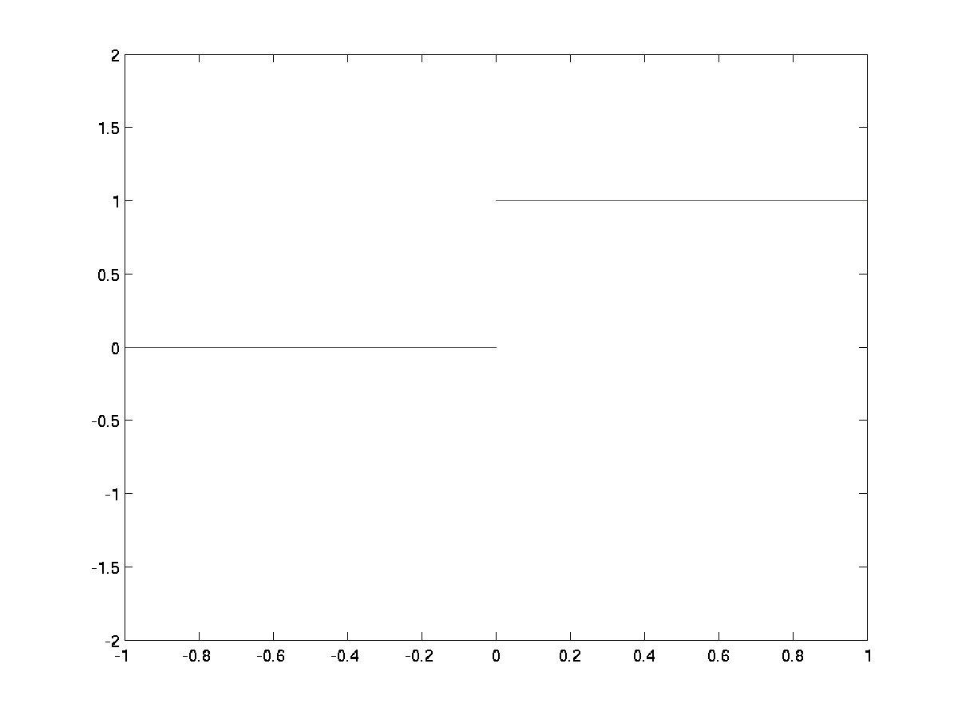
Hardlimiting nonlinearity:
y = 1/0:

Slide 22
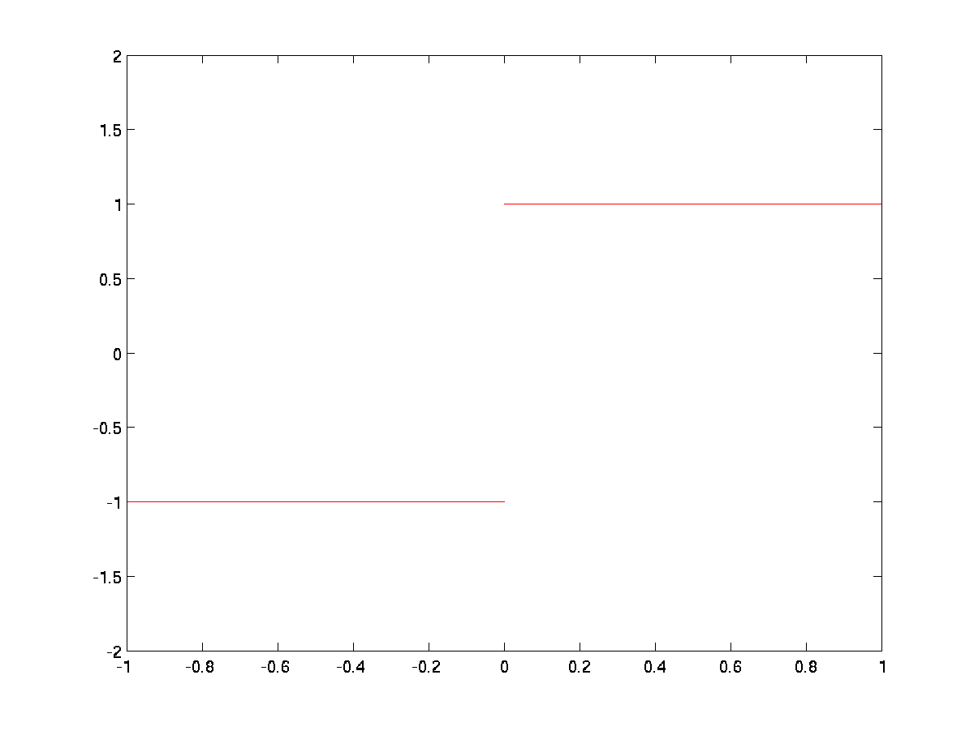
Hardlimiting nonlinearity:
y = +1:

Slide 23
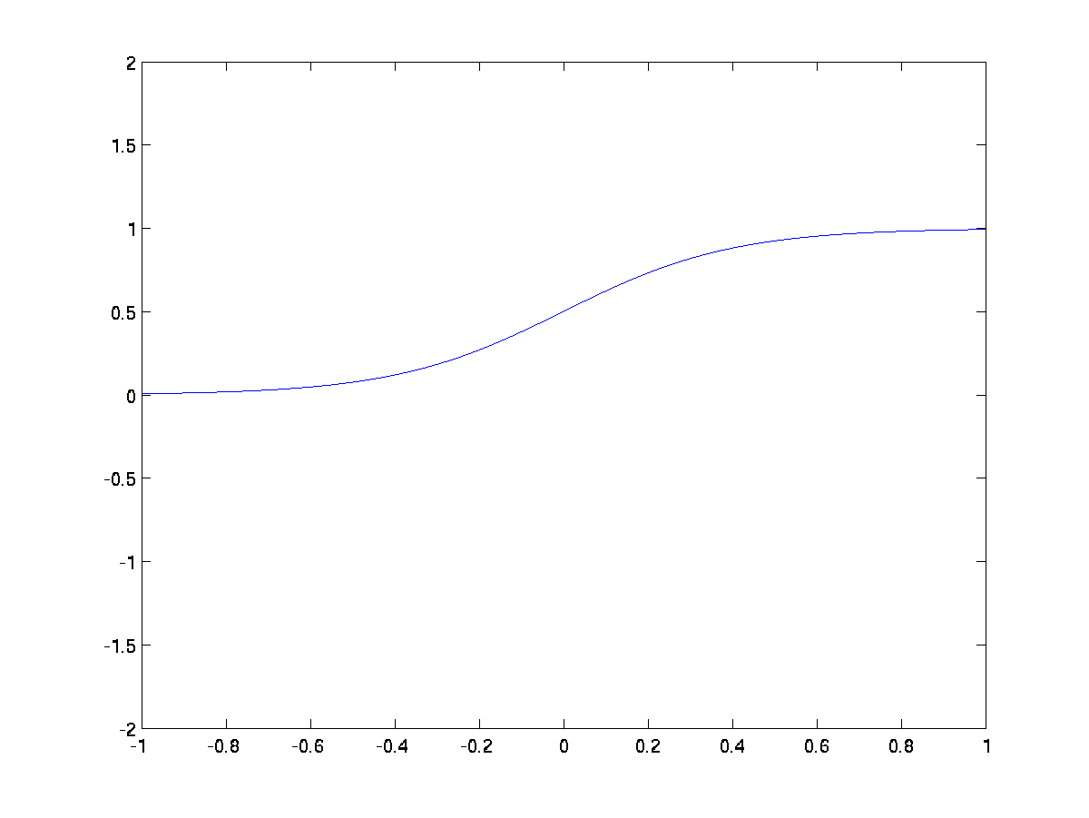
Smooth Sigmoid nonlinearity:
Logistic function, y ϵ (0,1)

Slide 24
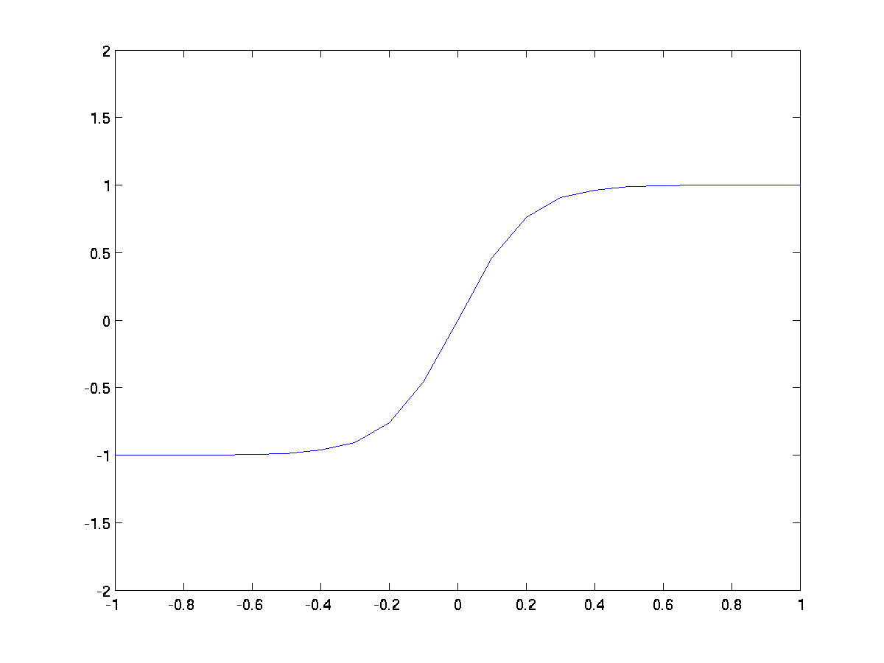
Smooth Sigmoid nonlinearity:
Tanh(.) function, y ϵ (-1,1)

Slide 25
References:
E. M. Izhikevich, J. A. Gally, and G. M. Edelman, “Spike-timing dynamics of neuronal groups,” Cerebral Cortex, vol. 14, pp. 933–944,2004.
E. M. Izhikevich, N. S. Desai, E. C. Walcott, and F. C. Hoppensteadt, “Bursts as a unit of neural information: Selective communication via resonance ,” Trends Neurosci., vol. 26, pp. 161–167, 2003.
E. M. Izhikevich, “Simple model of spiking neurons,” IEEE Trans. Neural Networks, vol. 14, pp. 1569–1572, Nov. 2003.
Latham, P. E., B. J. Richmond, P. G. Nelson, and S. Nirenberg. (2000). "Intrinsic Dynamics in Neuronal Networks. I. Theory.". Journal of Neurophysiology 88 (2): 808–27.

