Slide 1
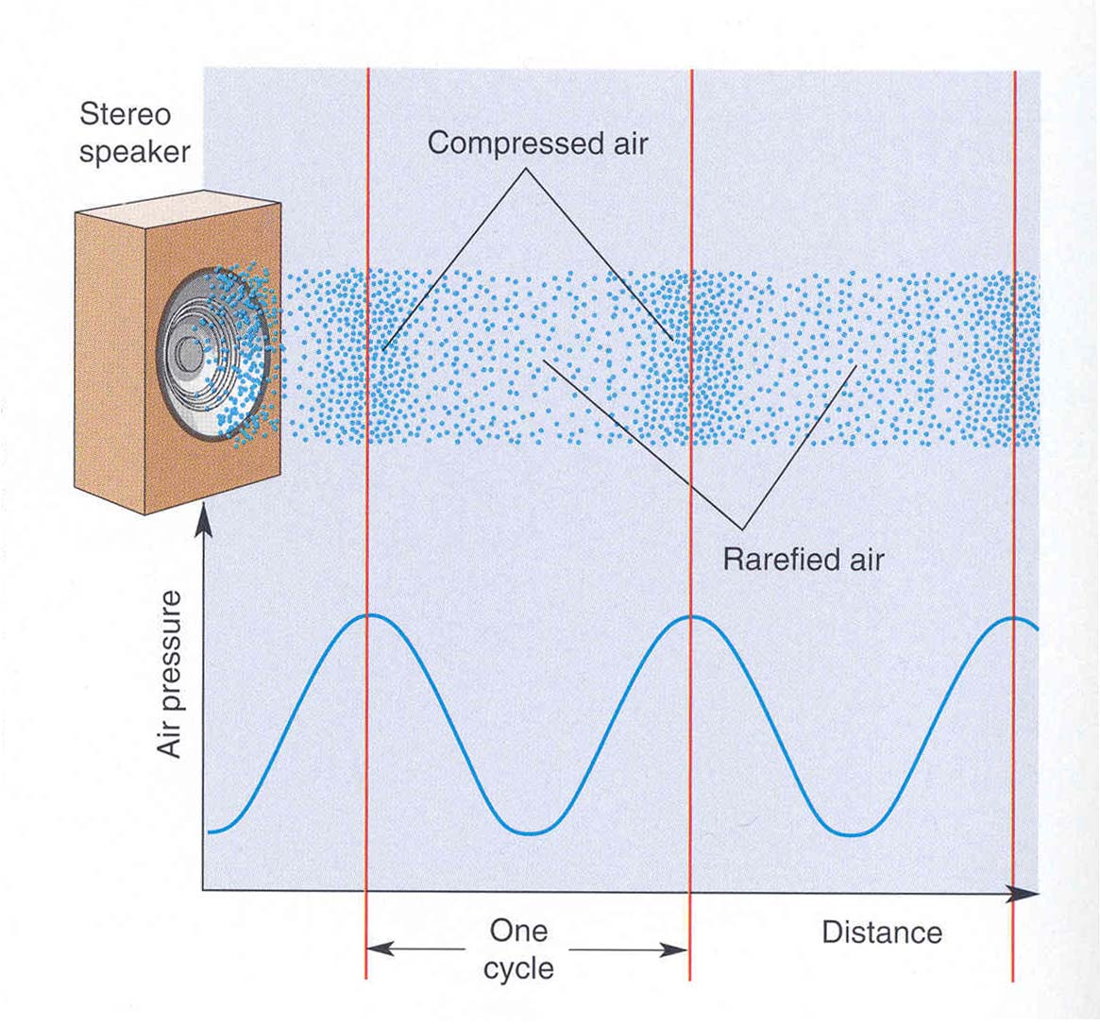
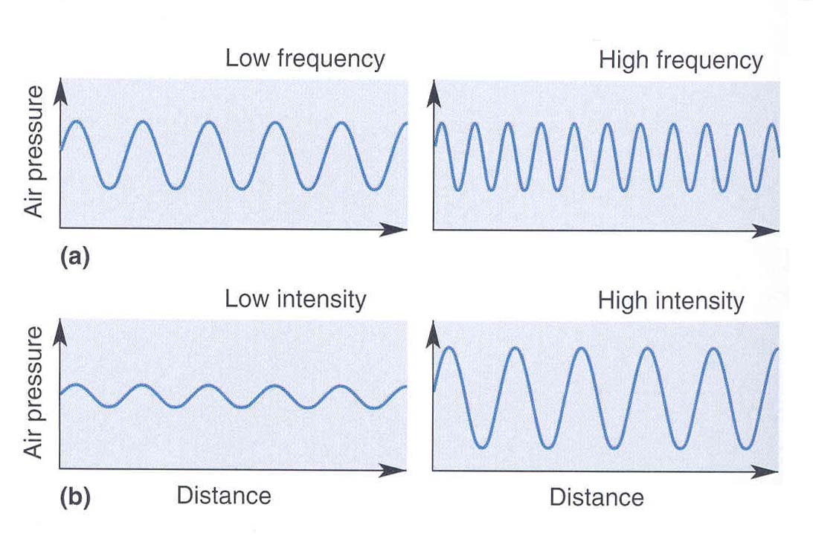
The Auditory System
http://www.med.uottawa.ca/courses/nsc5104/assets/documents/AuditorySystem.ppt
Sound is created by pressure waves in air; these waves are induced by vibrating membranes such as vocal cords. Because the membranes usually vibrate in a regular manner, the pressure waves have a fixed spacing.
Sound has two main characteristics: A. the spacing between waves or period. This can also be thought of in terms of how many wave cycles pass by in one second - that is, the sound’s frequency in Hz=cycles/second.
B. The intensity of amplitude of the sound measured in decibels.
Bear et al.

Slide 2
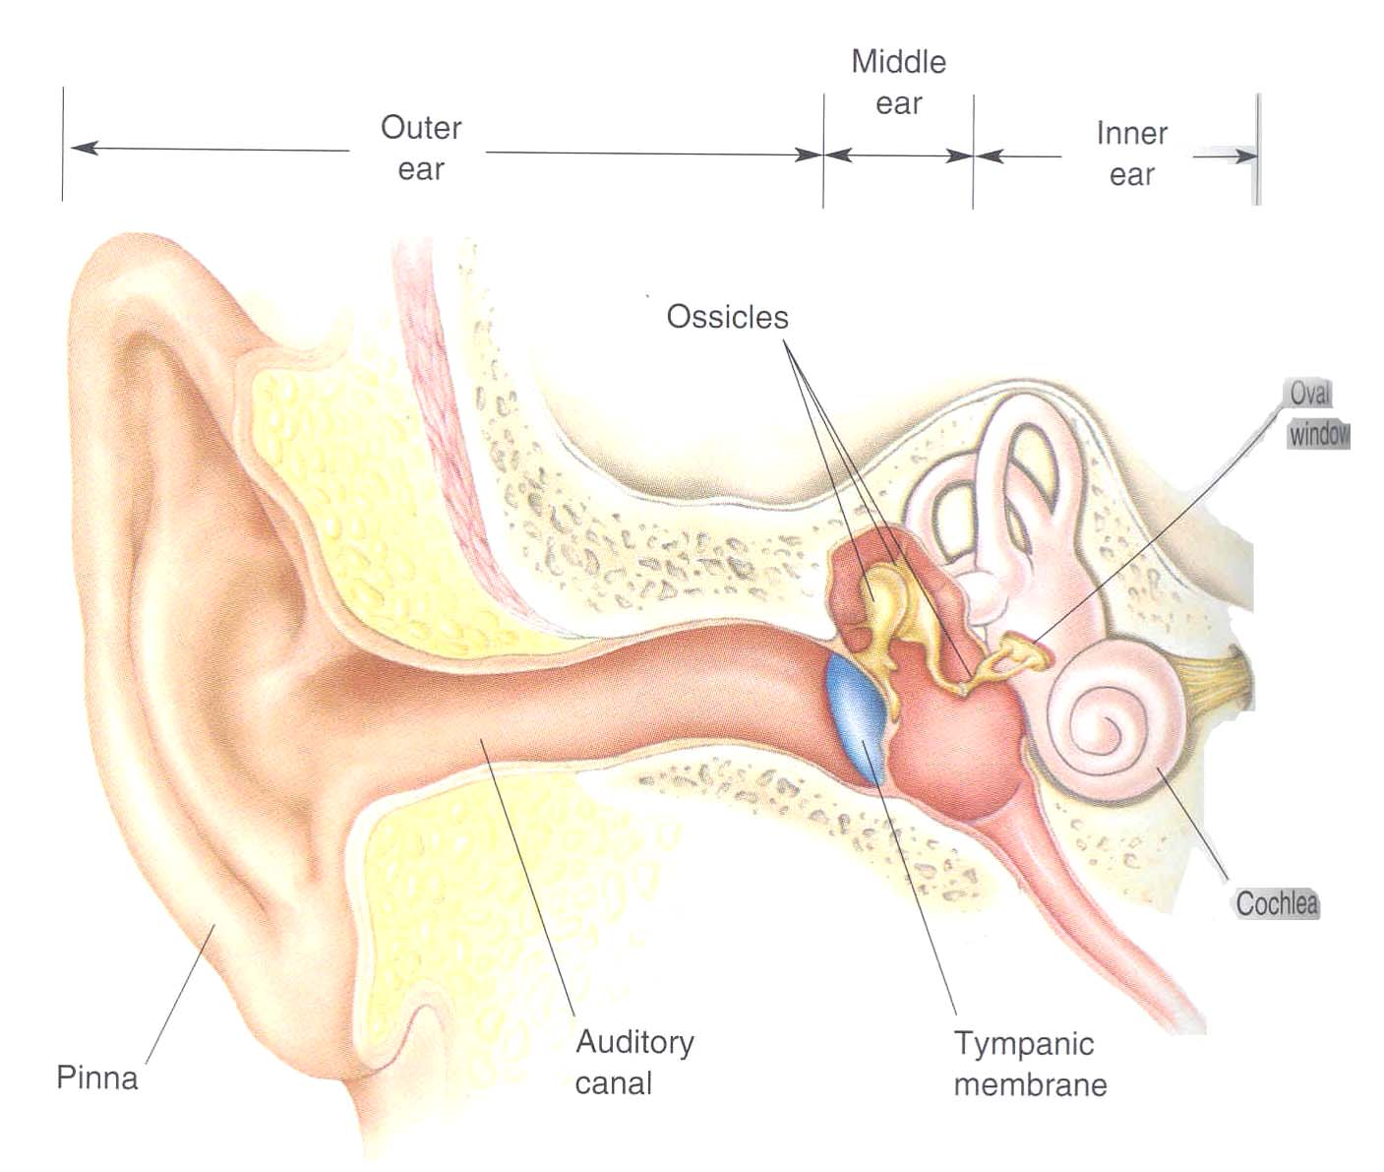
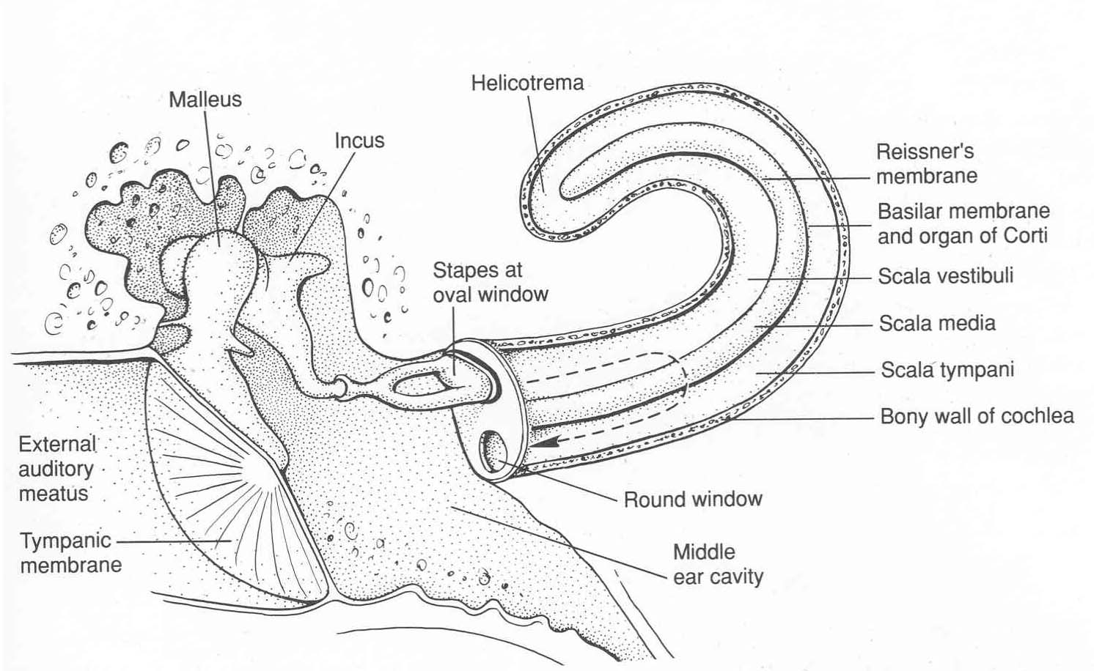
The Auditory Periphery
Bear et al.
Kandel et al.
The outer ear and canal guide and filter sound. The tympanic membrane and ossicles transmit the vibrations to the cochlea itself; the vibrations enter the cochlea via the round window and exit via the round window. As they pass through the endolymph of the scala vestibuli and tympani, sound waves cause the basilar membrane to vibrate. This is the key to auditory function.

Slide 3
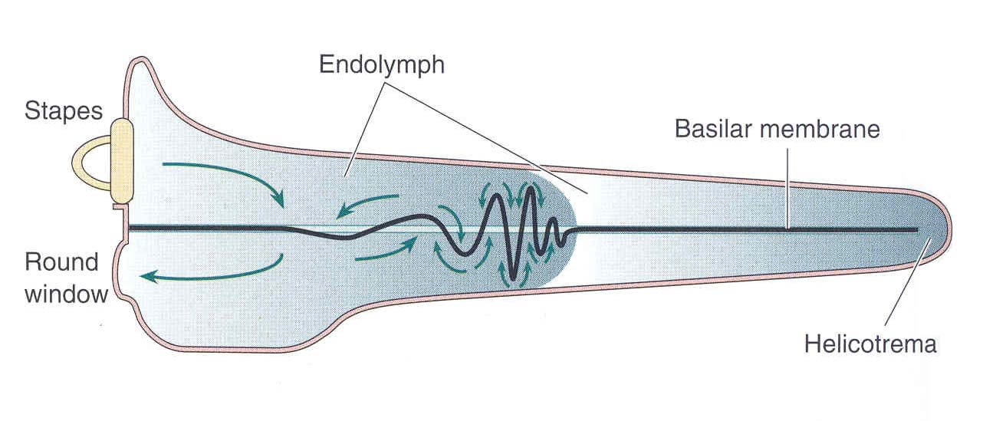
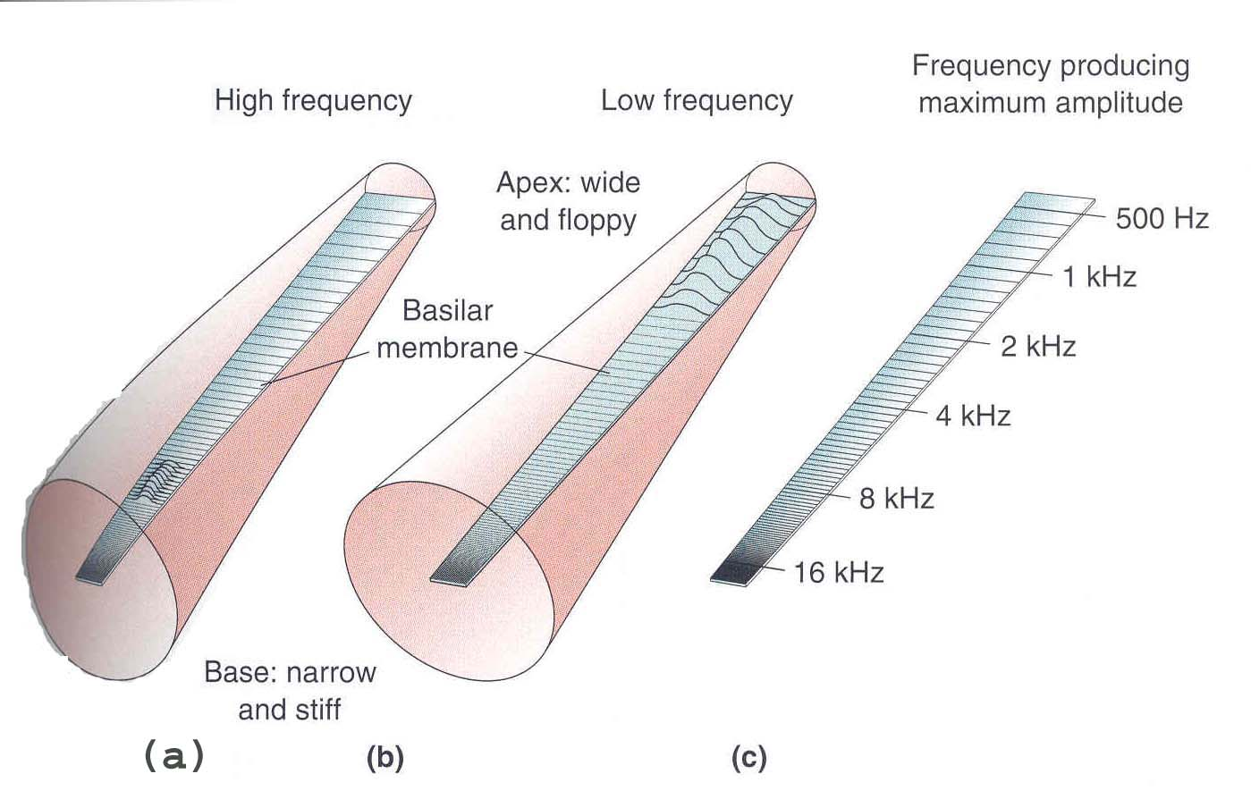
The Cochlea
Sound waves cause the basilar membrane to vibrate.
The basilar membrane is stiff at its base and loose at its apex. Just like a guitar string, this causes it to resonate to high frequencies at its base and low frequencies at its apex. There is therefore a tonotopic map- a location code- formed on the cochlea.This is a fundamental feature of auditory coding and is preserved right up to cortex.
Note that this is a separate code from synchronization.
Bear et al.

Slide 4
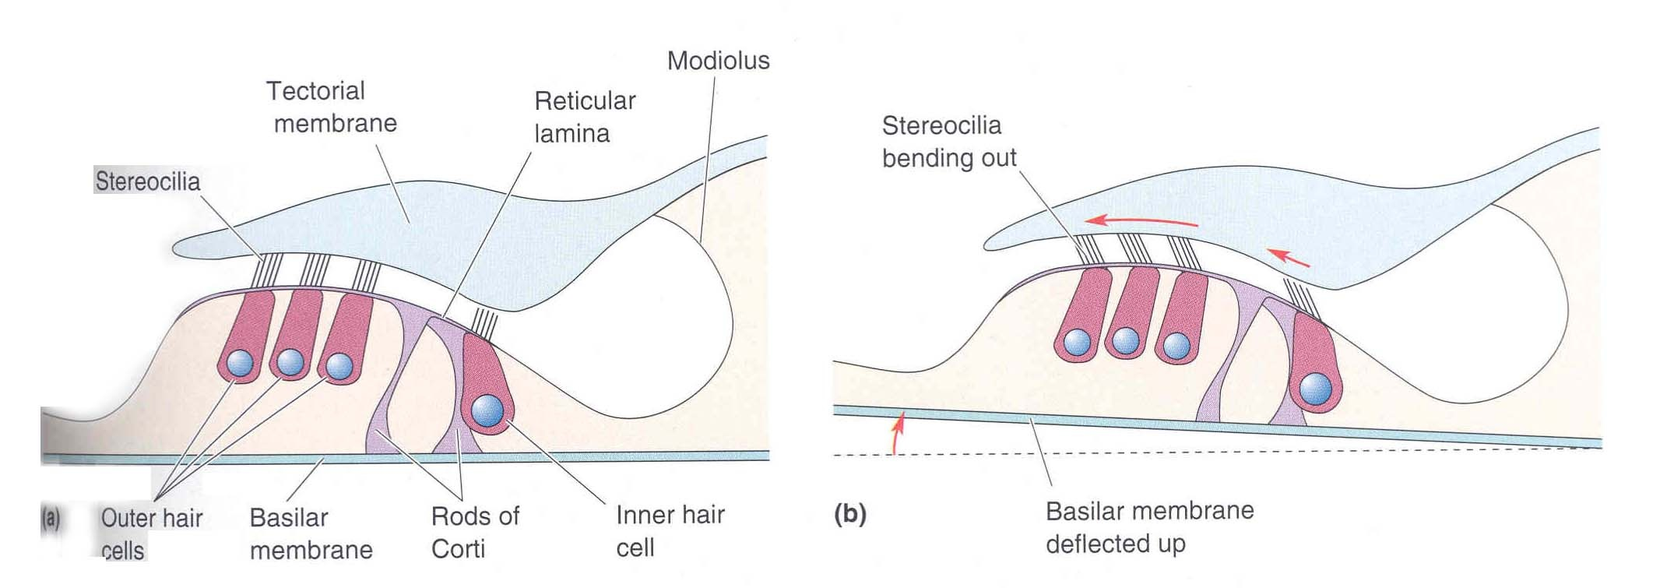
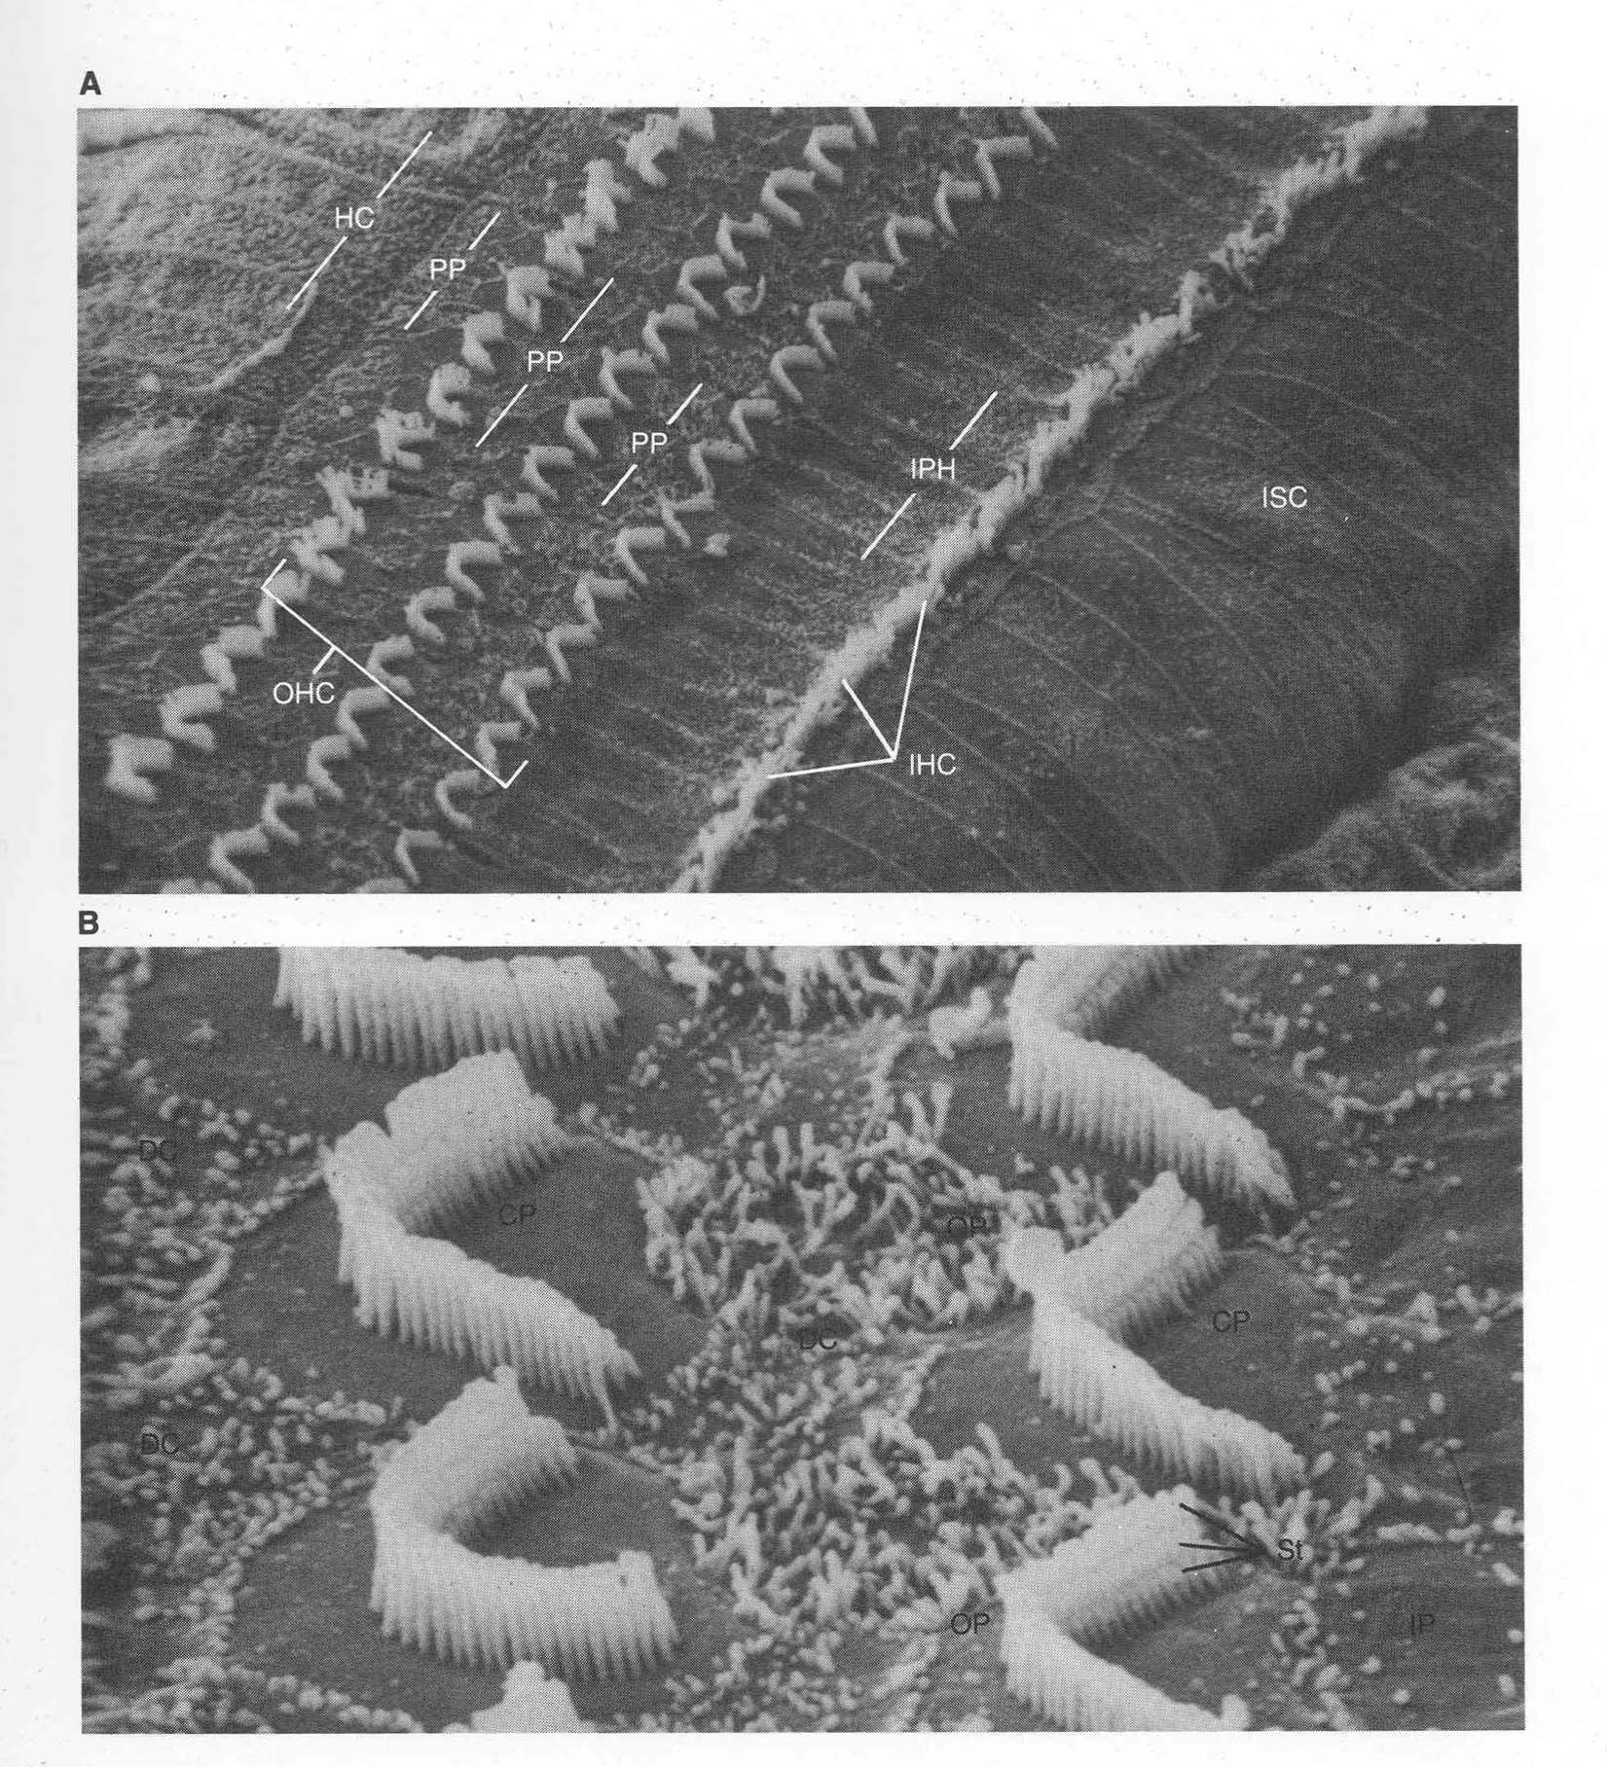
Hair Cells
Bear et al.
Hair cells transduce vibrations into depolarization. This in turn leads to vesicular release that excites auditory afferent fibers and causes them to discharge.
Hair cells are firmly attached to the basilar membrane and therefore move up and down with it as it vibrates. The “hairs” or cilia of these cells are attached to a tectorial membrane; this membrane is fixed- it does not vibrate in response to sound. So when the basilar membrane moves upward, the cilia will be bent.
A scanning electron microscopic view of the beautiful organization of hair cell cilia in the cochlea.
Kandel et al.

Slide 5
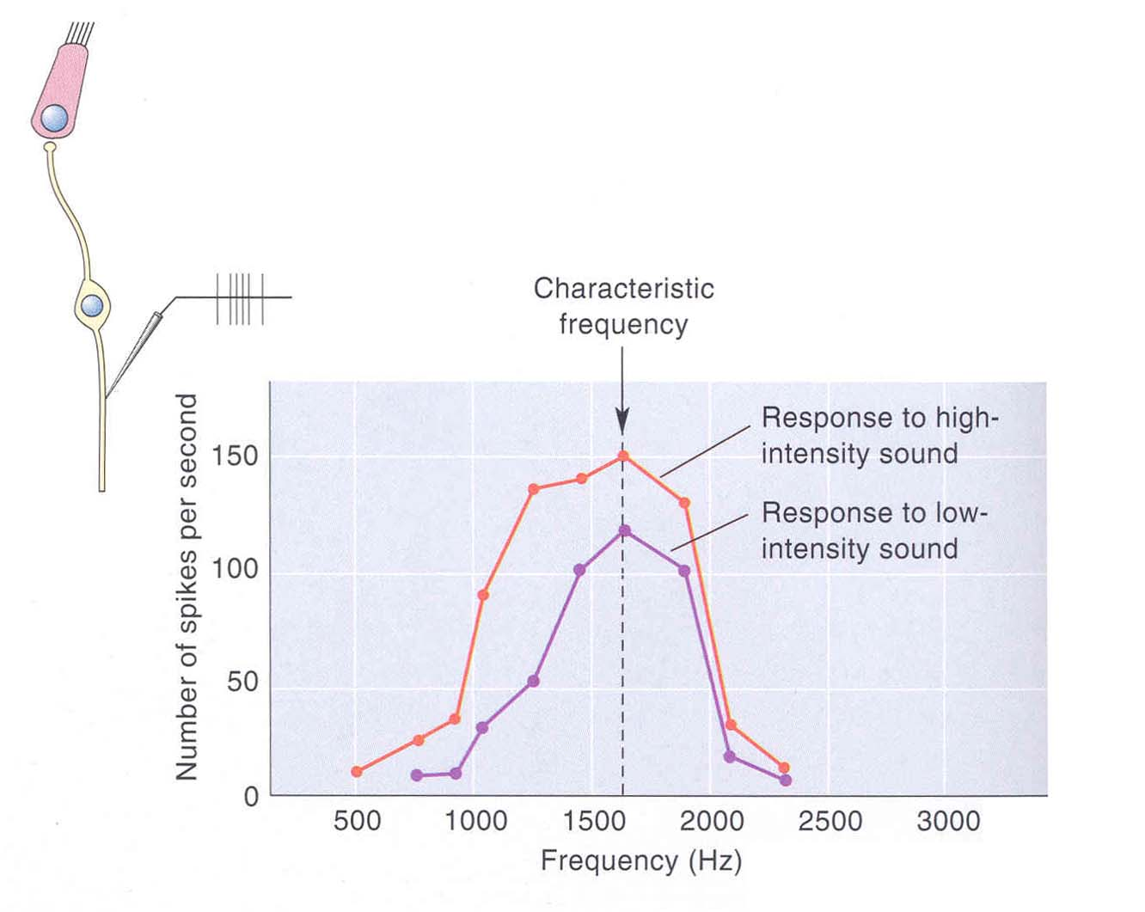
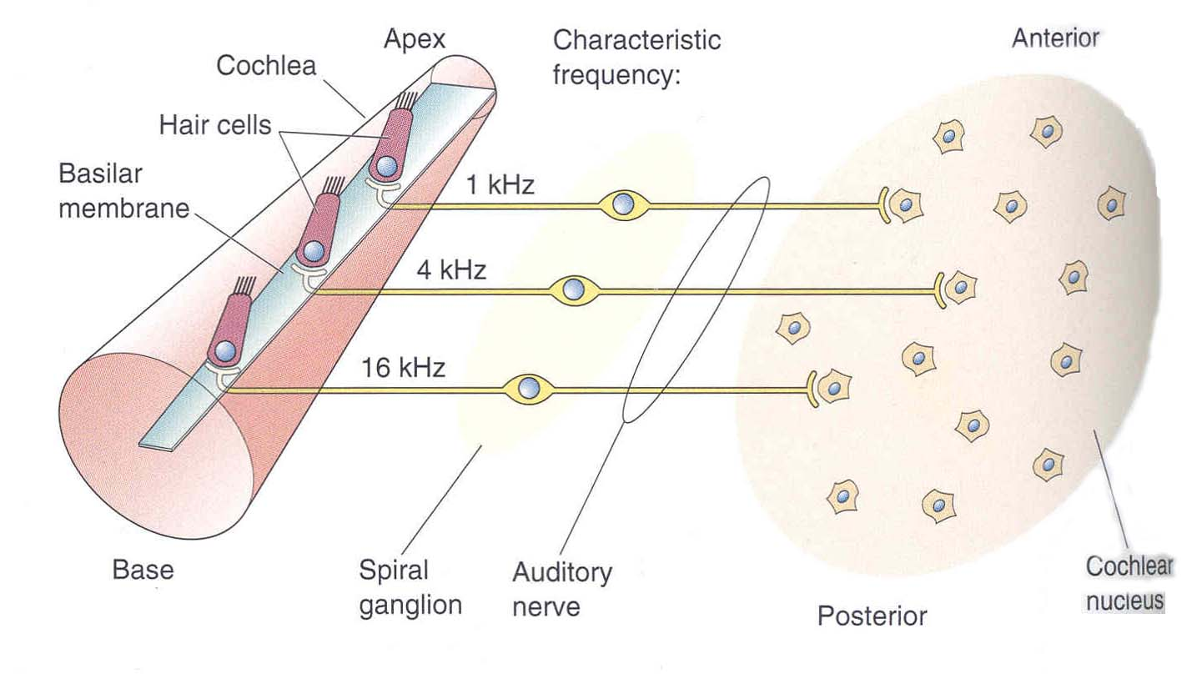
Auditory Afferent fibers
Each auditory afferent fiber is tuned to a specific frequency.
The tuning is simply due to the location of its hair cell along the cochlea. This tonotopic mapping is preserved in the projection of cochlear afferents to the cochlear nuclei in the medulla.
Bear et al.

Slide 6
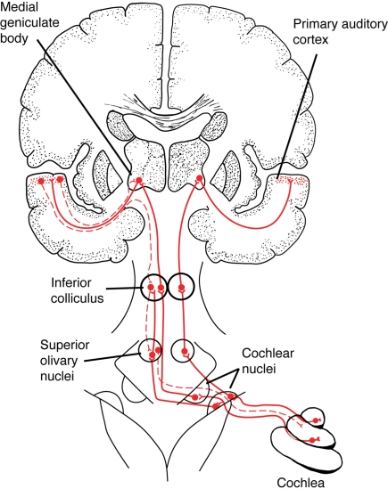
Central Auditory Pathways
https://www.researchgate.net/publication/51484381_Why_would_Musical_Training_Benefit_the_Neural_Encoding_of_Speech_The_OPERA_Hypothesis/figures?lo=1

Slide 7
Central Auditory Pathways
Auditory signals reach the cochlear nuclei of the medulla (DCN, VCN). From these nuclei a direct pathway goes to the inferior colliculus, then the thalamic medial geniculate nucleus (MGN) and then onto the auditory primary cortex.
Note that this pathway is bilateral unlike the contralateral somatosensory pathway. This makes sense since sound always reaches both ears.
On the way up to cortex axons from VCN also terminate in nuclei of the superior olivary complex. Neurons in this cell group use relative sound timing and intensity in the two ears to estimate the spatial location of a sound source.
Bear et al.

Slide 8
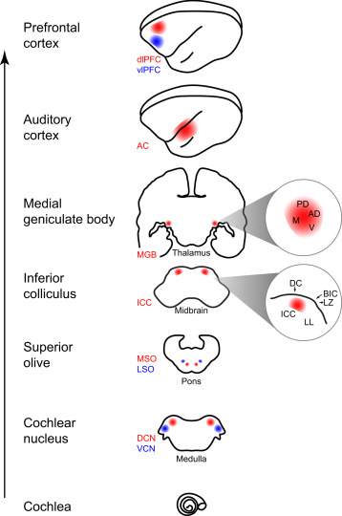
https://www.sciencedirect.com/topics/neuroscience/cochlear-nucleus

Slide 9
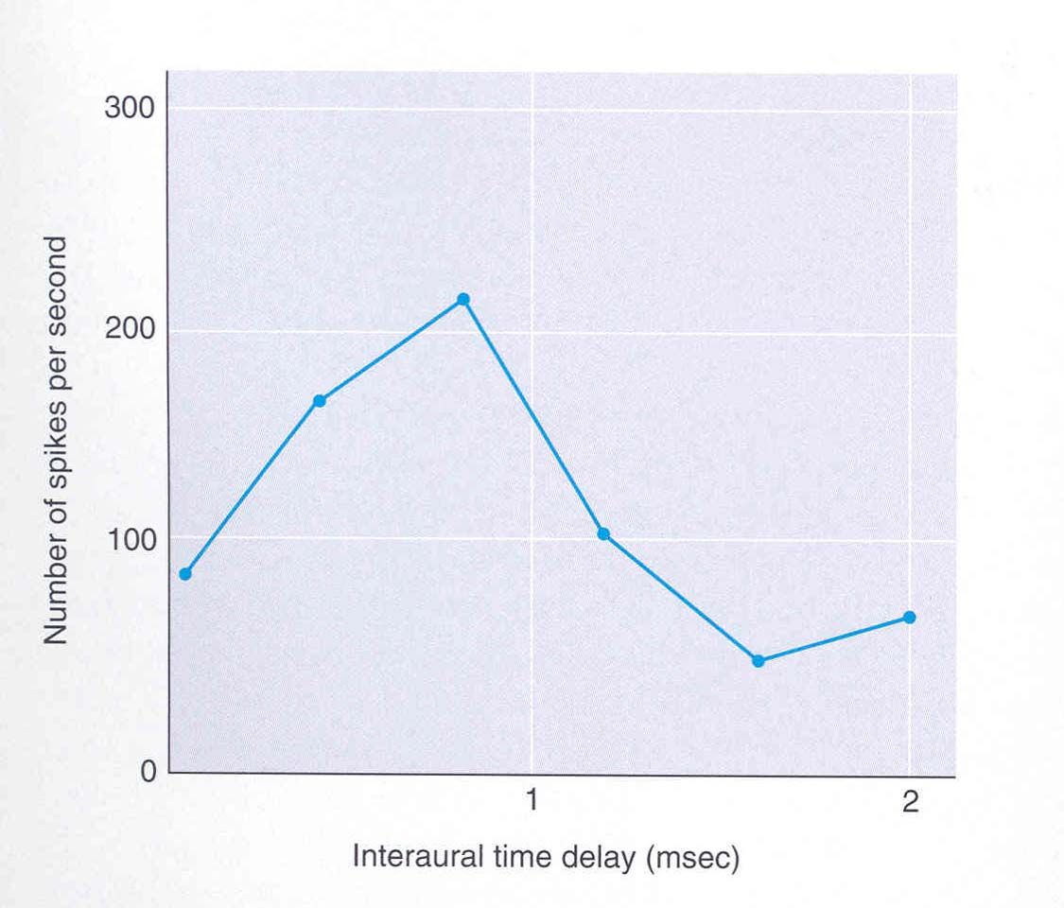
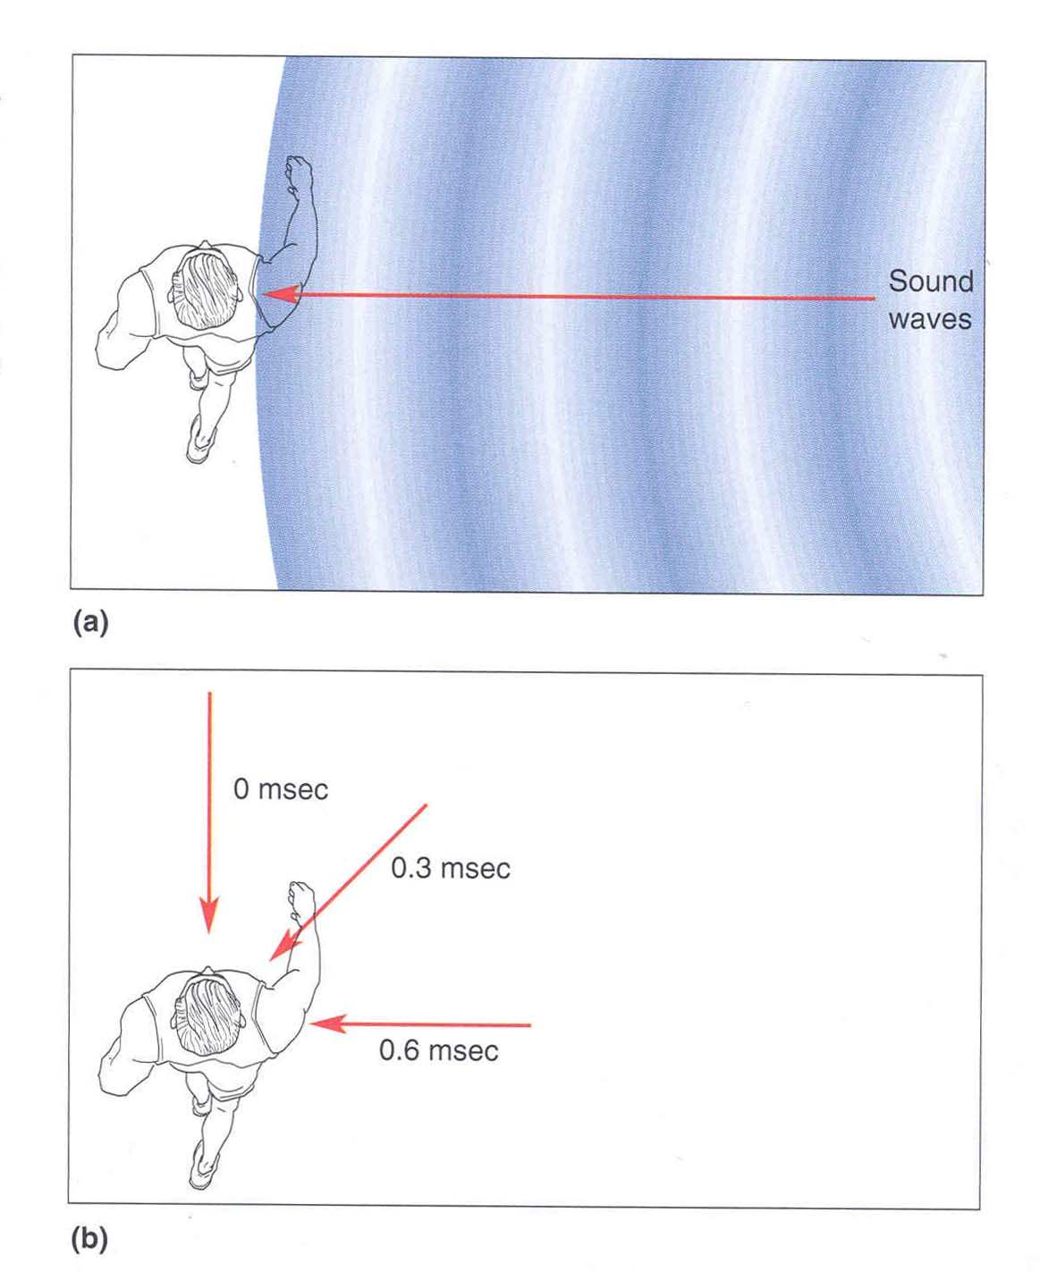
Sound Localization
A cell in the superior olive responds to:
- The time difference in the arrival of sound to the ears.
The relative sound intensity
This can be used to localize sound source
Sounds coming from the right arrive at the right ear a little earlier than the at the left ear. This small time difference is used by the superior olive.
Bear et al.

Slide 10
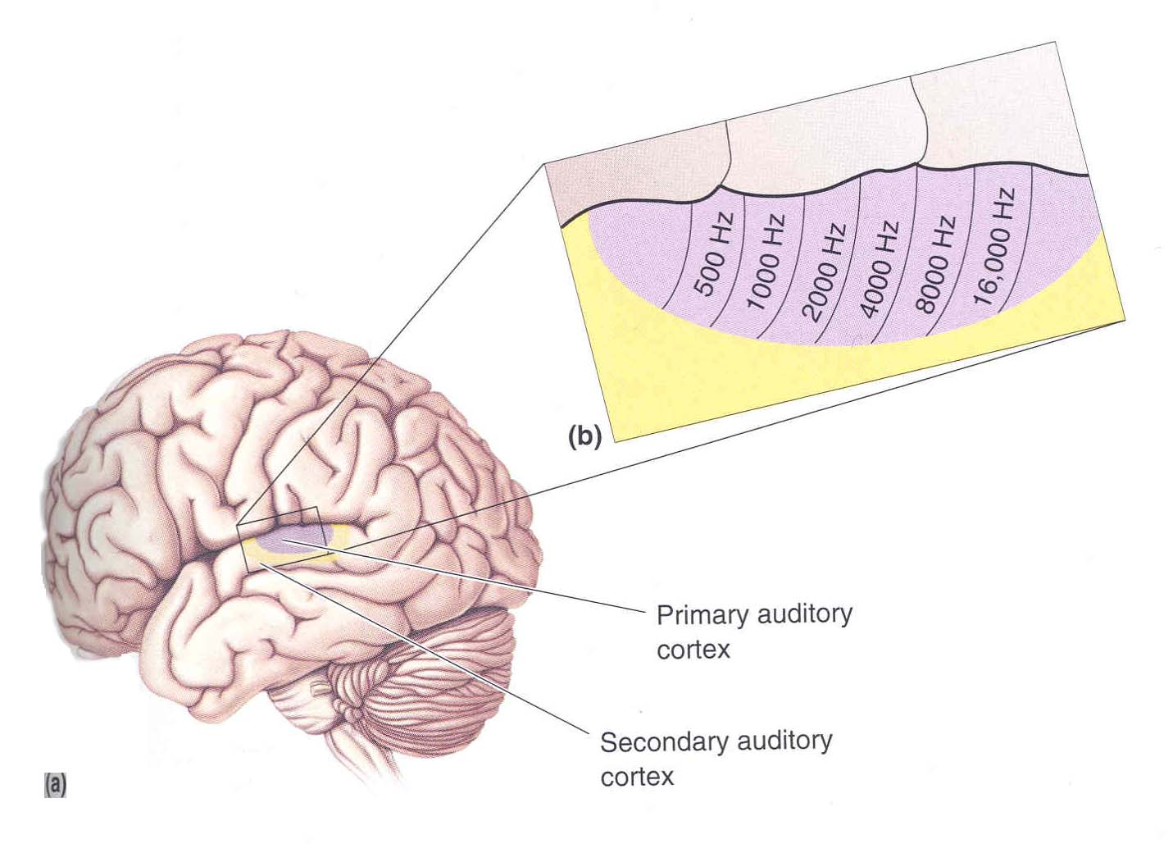
Cortical Processing of Sounds
Bear et al.
Primary auditory cortex has tonotopy – a map of frequencies on cortical surface.
However auditory cortex neurons also respond to complex features of sound such as modulations of amplitude or frequency

