Slide 1
Primary Visual Cortex
V1-Striate Cortex

Slide 2
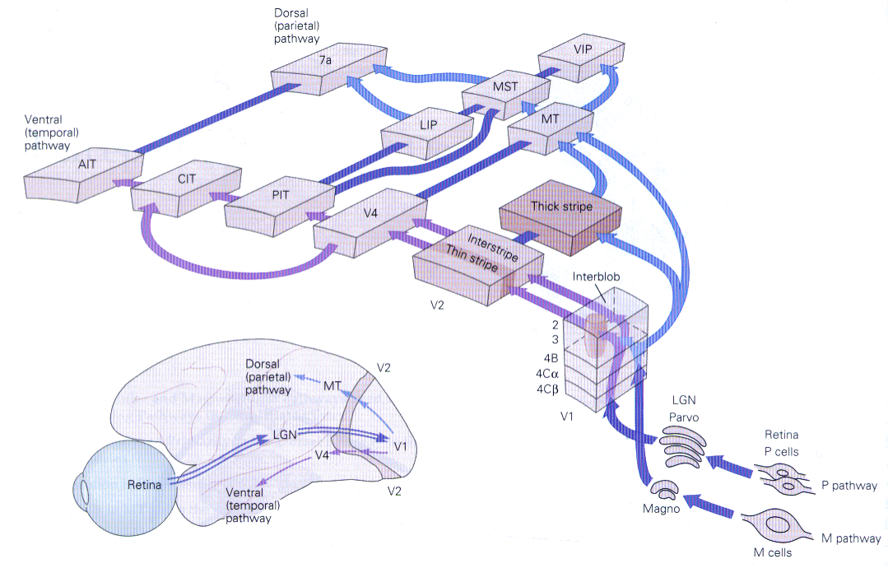

Slide 3
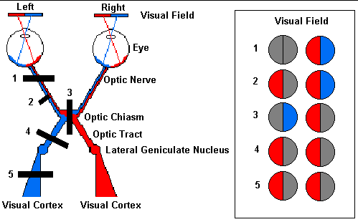
Damage at site #1: this would be like losing sight in the left eye.
The entire left optic nerve would be cut and there would be a total loss
of vision from the left eye.
Damage at site #2: partial damage to the left optic nerve.
Here, information from the nasal visual field of the left eye
(temporal part of the left retina) is lost.
Damage at site #3: the optic chiasm would be damaged.
In this case, the temporal (lateral) portions of the visual field would be lost.
The crossing fibers are cut in this example.
Damage at site #4 and #5: damage to the optic tract (#4) or the fiber tract from the
LGN to the cortex (#5) can cause identical visual loss.
In this case, loss of vision of the right side.

Slide 4
V1
First stopover of visual information in cortex
Retinotopic map:
  Retinal information is mapped onto V1 such that nearby points are mapped onto nearby neurons in V1

Slide 5
Visual Field
Consider the visual field as a sphere with the viewer at the center
“North pole” of the sphere is the fixation point; this point is mapped onto fovea
Latitude is called “eccentricity”, ε (0−70^{ο})
Longitude is called “azimuth,” a (-90º to 90º)

Slide 6
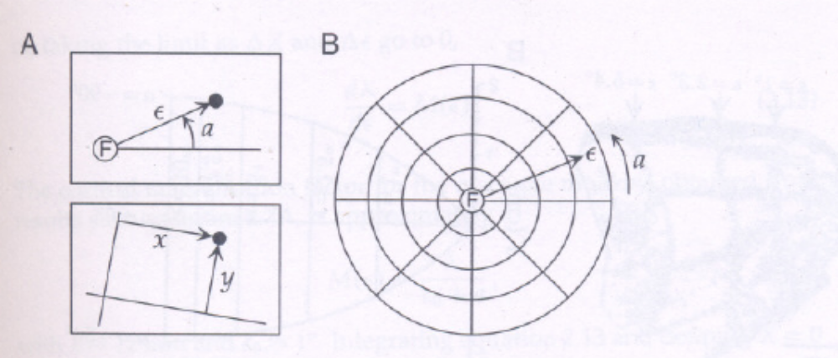
Visual field

Slide 7
Experiment to find Retinotopic Map
“Bull’s-eye” pattern is displayed on a screen
Pattern of activity in V1 is imaged by using a radioactive glucose; imaging reveals which neurons are active (taking up glucose)
Experiment performed on monkey

Slide 8
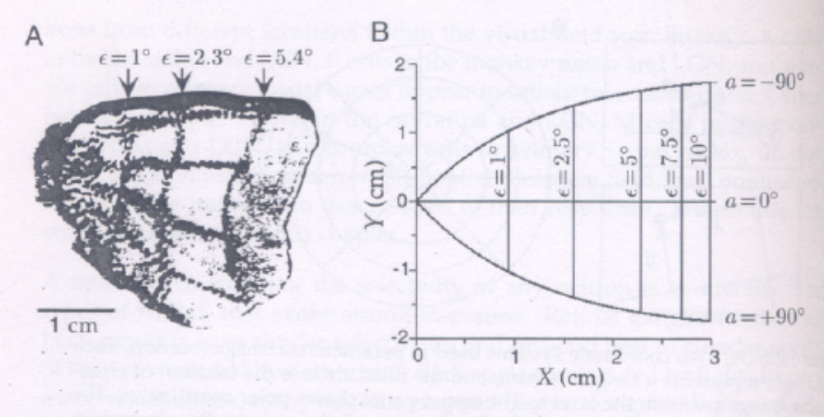
Retinotopic Map

Slide 9
Retinotopic Map Features
Vertical lines correspond to circles in the image
Roughly horizontal lines correspond to radial lines
Fovea is represented at the leftmost pole
Azimuthal angles are positive in lower half, and negative in the upper half

Slide 10
Responses of neurons in V1
Work of Hubel & Wiesel at Harvard in ’60s.
  Neurons in V1 respond to oriented bars and edges and not to spots.
  Some neurons also respond to moving bars.
  Different neurons respond to different orientations.Within a dia of 1mm, all orientations are represented.

Slide 11
Simple and Complex Cells
Simple cells: respond to an oriented line present in the center of their RF
Complex cells: respond to an oriented line present almost anywhere in their RF
End-stopping: some cells respond best when the line is not too long.

Slide 12
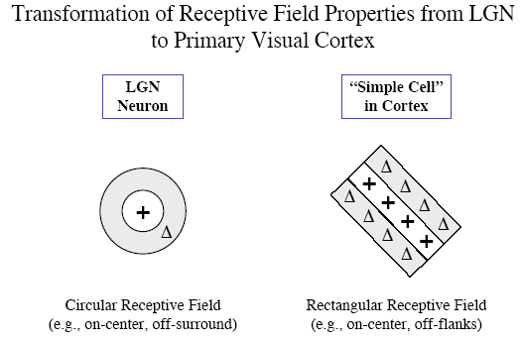

Slide 13
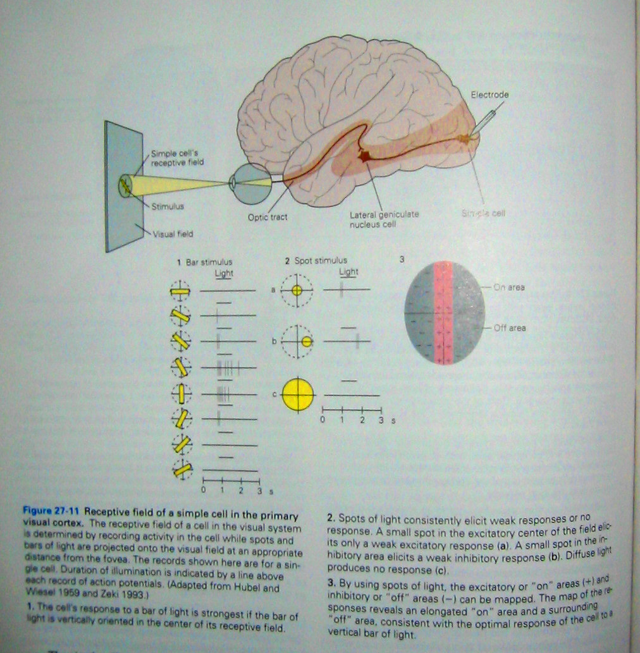

Slide 14
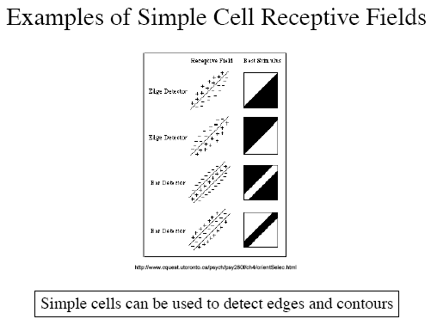

Slide 15
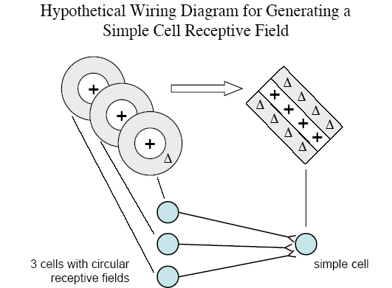

Slide 16
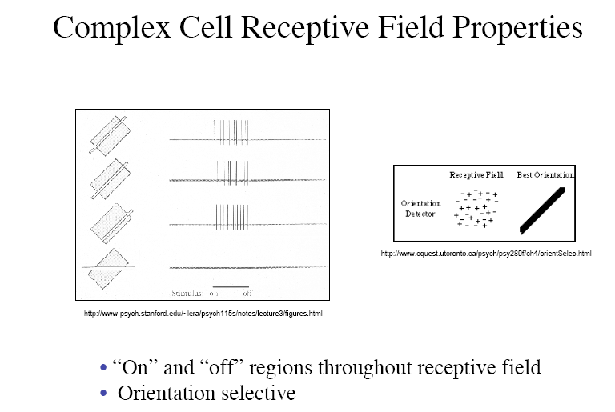

Slide 17
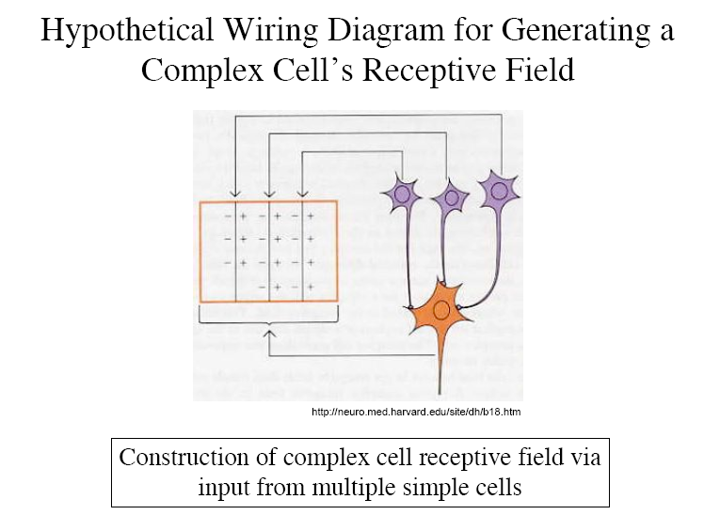

Slide 18
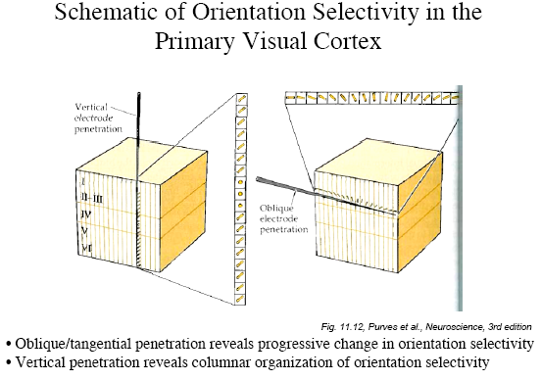

Slide 19
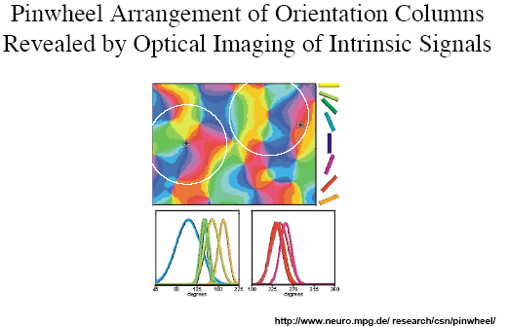

Slide 20
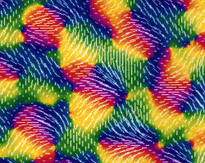
Orientation Columns

Slide 21
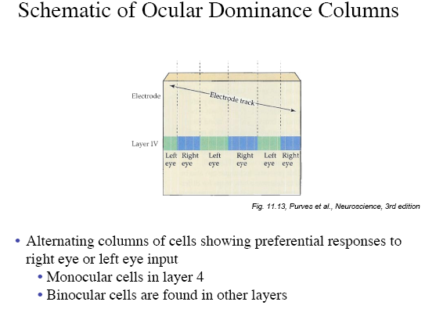

Slide 22
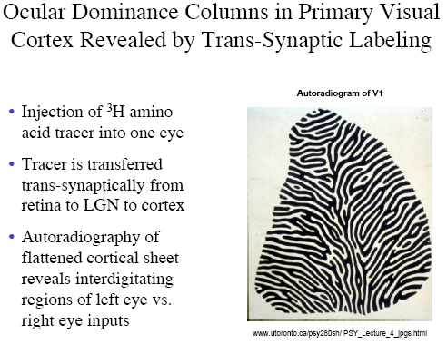

Slide 23
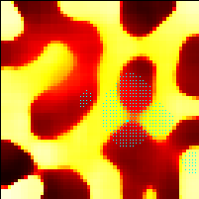
Ocular Dominance Columns in Simulations

Slide 24
Orientation sensitivity AND
Ocular Dominance
Properties of OrientationMaps:
  The maps of O.S. and O.D. are highly repetitive
  Orientation changes continuously as a function of cortical location except at isolated points.
  Orientation changes by 180 deg around singularities
  Both types of singularities appear in equal numbers
  There exist line-like regions (fractures), across which orientation preferences change rapidly with distance.
  (Obermeyer, Blasdel & Schulten 1992)

Slide 25
Orientation sensitivity AND
Ocular Dominance
Properties of Ocular Dominance Maps
  Ocular dominance changes continuously as a function of cortical location.
  The ocular dominance pattern is locally organized into parallel strips, which sometimes branch and terminate.
  Iso-orientation slabs often cross the borders of ocular dominance bands at approximately right angles.
  The singularities tend to align with the center of the ocular dominance bands.

Slide 26
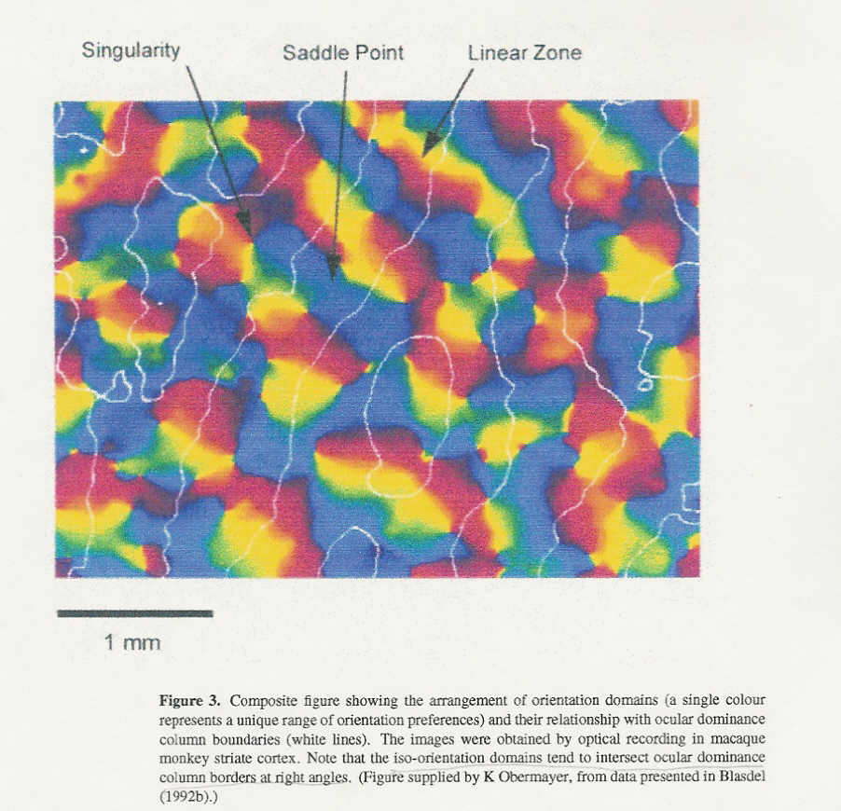

Slide 27
Blobs
Peg-shaped regions of cells
In layers 2 and 3 of V1
These cells respond to color, not orientation
About 0.2 mm dia

Slide 28
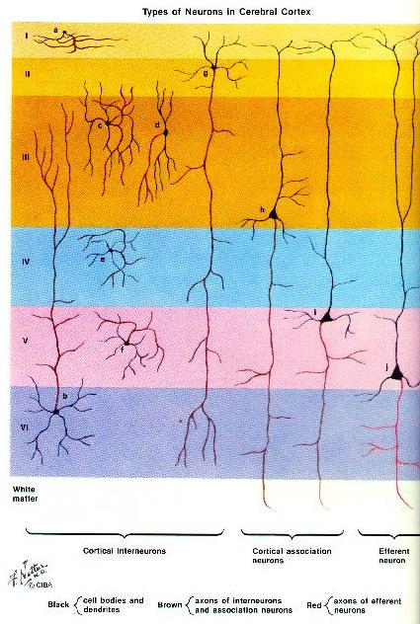
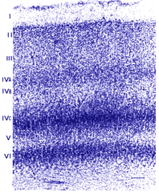
Cortical Layers

Slide 29
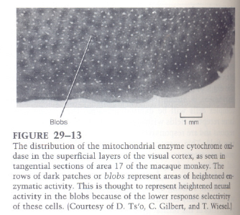
Blob regions

Slide 30
Hypercolumn
Smallest unit in V1 necessary to analyze all aspects of a region of visual field.
Area = 1 sqmm
Complete set of orientation columns (180º)
Inputs from both eyes.
Several blobs

Slide 31
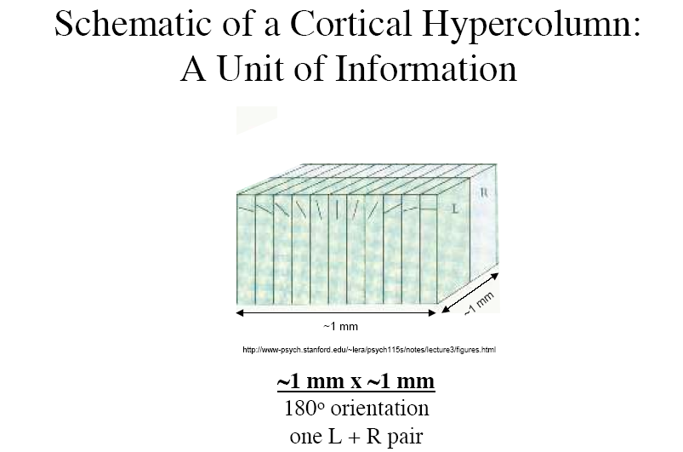
Each column
= 30 – 100 μm

Slide 32
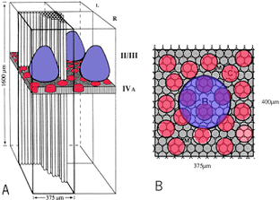
Hypercolumns

Slide 33
Horizontal connections among hypercolumns
Axon collaterals of pyramidal cells in layers 3 and 5 run long distances parallel with layers
They give rise to clusters of axon terminals at regular intervals that approximate the width of hypercolumn

Slide 34
Blob regions form a horizontal network
(Lund and Rockland)
Injected horseradish peroxidase into restricted regions within cortical layers 2 and 3
Found elaborate honeycomb-like lattice of labeled cells and axons that formed walls around unlabeled patches about 500 μm dia

Slide 35
Orientation sensitive cells form a horizontal network
Tso, Gilbert, Wiesel
Recorded cells that respond to a given orientation
Many cells fire simultaneously
Injected fluorescently labeled microbeads which were taken up axon terminals at the site of injected and transported to cell bodies.
Injected radio-labeled 2-deoxyglucose, which revealed active cells
Anatomical and metabolic patterns coincide well

Slide 36
Other visual areas
One in area 17 – V1 (striate cortex)
Two in area 18 – V2, V3
Three in area 19 – V3a, V4, V5 (Middle Temporal area)
Parietal cortex – V5a (Medial Superior Temporal area)

Slide 37
Functions of visual areas
V1 – primary visual analysis
V2 – more visual analysis
V3 – dynamic form
V4 – color and form
V5 - motion

Slide 38
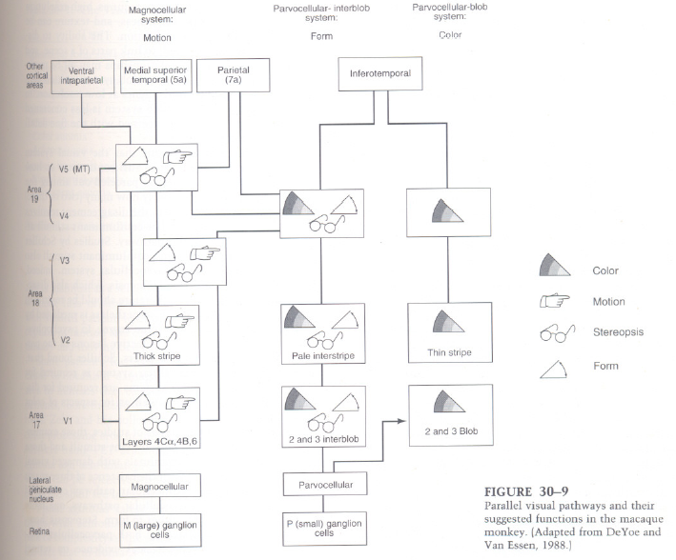

Slide 39
Visual streams at V1
Beginning of segregation of visual streams in V1
  Magnocellular system
  Parvocellular-interblob system
  Parvocellular-blob system

Slide 40
Magnocellular system
Specialized for: motion, spatial analysis, stereo vision etc
Relatively insensitive to color
Neurons respond rapidly but transiently
Layers 4Ca, 4B, 6 in V1

Slide 41
Parvocellular-interblob system
Specialized for form (and to some extent color)
Area 2 and 3 interblob
Neurons here respond to orientation of edges

Slide 42
Parvocellular-blob system
Specialized for color
2 and 3 layer in blob regions

Slide 43
Structure of V2
Located in area 18
Staining revealed 3 patches:
  Thick stripes
  Thin stripes
  Pale interstripes

