Slide 1
Linear neuron model: Hebbian learning

Slide 2
The output of a linear perceptron can be given:
Applying Hebb’s rule

Slide 3
For multiple patterns the learning rule is,
R is the autocorrelation matrix of training data. It is:
symmetric,
positive semi-definite

Slide 4
Proof:
Symmetric:
Positive semi-definite:
Consider the quadratic form associated with R, where u is a non-zero real vector.

Slide 5
,
In differential equation form
Maximize
Therefore, hebbian learning of a linear neuron
Maximizing the quadratic form, E, of R

Slide 6
Therefore, Hebbian learning of a linear neuron
Maximizing the quadratic form of R
Maximizing the average squared output of the neuron.
We also note that if the data is ‘zero mean’ (E[x] = 0), Hebbian learning also maximizes output variance. Since the neuron is linear, for zero-mean input data, mean squared value of the output equals output variance. i.e.,

Slide 7
But if R is positive semi-definite, E (w) does not have a maximum.
Therefore, E must be constrained. A simple constraint is to make w a unit norm vector. The unit norm constraint can be added as a cost to E(w), yielding the new E’ as follows:

Slide 8
Calculating the gradient,
which is an eigenvalue equation.
Therefore, when trained by Hebbian learning, the weight vector of a linear neuron converges to the eigenvectors of the autocorrelation matrix, R.
But since a symmetric real matrix of size ‘n X n’ has n eigenvectors, it is not clear which of them w tends to.
We will show that w tends to the eigenvector corresponding to the highest eigenvalue.

Slide 9
Proof: Let Q be a orthogonal, diagonalizing matrix Q such that,
Q = [q₁|…|q_{i}|…|q_{n}] where q_{i} are the eigenvectors of R.
Now consider the linear transformation, w = Qx, and express E(w) in terms of x, as follows,
Since Q is also a rotational transformation, maximum of the new function E(x) is the same as the maximum of the older function E(w). Let us consider the maximum of E’(x),

Slide 10
Let the eigenvalues of R be ordered such that,
We now impose the unit norm constraint on x as follows
The maximum of the above function can be found by solving the following differential equations,
There are (n-1) such equations corresponding to (n-1) components, x_{i} i = 2,…n.

Slide 11
λ₁ is the largest eigenvalue, in all the above differential equations, x_{i}➔ 0, i = 2,…n.
Since ||x|| = 1, the only remaining component x₁= 1. Therefore the maximum of E(x) occurs when,
x = [1 0 0 …0].
Since w = Qx, we have, w = q₁.
Thus the weight vector of the linear neuron of eqn
converges to the eigenvector corresponding to the highest eigenvalue of E, when trained by Hebbian learning.

Slide 12
Oja’s Rule
Under the action of Hebbian learning, weight vector of a linear neuron converged to the first eigenvector of R only when the weights are normalized as ||w||=1.
But such a condition is artificial and not part of the Hebbian mechanism which is biologically motivated. Therefore, Oja (1982) proposed a modification of Hebbian mechanism in which the weight vector is automatically normalized without explicitly an explicit step like,
w ➔ w/||w||
The weight update according to Oja (1982) is as follows:

Slide 13
In vector form, the update rule can be written as,
Let us prove that the above rule does the following:
Maximizes
||w|| = 1
Consider the average update in w for the entire data set S, when the weight vector converges.

Slide 14
The last equation is the eigenvalue equation in R.
Thus w is an eigenvector of R, where
or,
||w||=1.
Like Hebbian learning, an advantage of Oja’s rule is that it is local: update for the i’th component, w_{i}, of the weight vector, w, is dependent on quantities that are locally available at the presynaptic or postsynaptic ends of the synapse that is represented by w_{i},.
Example: Long term potentiation in hippocampal neurons of brain

Slide 15
Principal Component Analysis (PCA)
Before we proceed to prove an interesting result relating Hebbian learning and principal component analysis (PCA) we state a result from linear algebra.
Spectral Theorem: If R is a real symmetric matrix, and Q is an orthogonal, diagonalizing matrix such that,
Where
Then

Slide 16
Proof:
Since
To derive the last result, we used the following,
Where d(i,j) is the Kronecker delta, defined as,

Slide 17
We have shown earlier that, Hebbian learning of a linear neuron
Maximizing the quadratic form of R =
Maximizing the average squared output of the neuron.
We also note that if the data is ‘zero mean’ (E[x] = 0), Hebbian learning also maximizes output variance. Since the neuron is linear, for zero-mean input data, mean squared value of the output equals output variance. i.e.,

Slide 18
Hebbian learning for Data Compression
A vector, x, of dimension, n, can transformed into another vector, y, of dimension, m, (m <n), such that x can be reconstructed from y, with minimum reconstruction error.
To enable such compression, we assume, for the moment, the following:
Hebbian learning extracts the eigenvector corresponding to the largest eigenvalue of the autocorrelation matrix, R.
But we assume that it is possible to extract all the eigenvectors of R, by some sort of an extension of Hebbian learning (*???*).
But for now we assume such an extension, and describe how data compression can be achieved by Hebbian learning.

Slide 19
Let x, be a data point drawn from a data set S. R is the autocorrelation matrix associated with S. Assume that the data is zero-mean (E[x]=0). Q is a matrix constructed out of the eigenvectors of R as follows,
Q = [q₁|…|q_{i}|…|q_{n}]
Consider the following linear transformation,
Note that the components of y, are the projections of x onto the first m eigenvectors of R.
Let us calculate the variance of y_{i}, which we will use shortly.
Since the data set, S, is zero-mean,
E[x] = 0. Therefore, from linearity of eqn. above, we have E[y_{i} ]=0. Therefore,
Thus the variance of the i’th component, y_{i} , is the corresponding eigenvalue.

Slide 20
‘x’ can be reconstructed from y, by simply inverting the transformation
of eqn.
Which is
In the last equation, x can be expressed as a weighted sum eigenvectors as,
Eigenvectors are ordered such that the corresponding eigenvalues are in the descending order.
Now consider a reconstruction of x, denoted by , produced by taking only a partial summation of the expression above.
Reconstruction error,

Slide 21
Root Mean Square (RMS) value of the reconstruction error is,
Thus the reconstruction error is the sum of lower (corresponding to larger i) eigenvalues of R. As m increases, and approaches n, error reduces since there are fewer terms in the expansion of eqn above.
But error decreases also because the eigenvalues are sorted and lower eigenvalues are smaller in magnitude than higher ones (larger i).
If ‘m’ is chosen such that the larger eigenvalues are included, x can be expressed in a compressed form, y, and reconstructed again, , with minimal loss.

Slide 22
Extending to ‘m’ principle components
Hebb’s rule gives the weight vector that is the first eigenvector of the autocorrelation matrix R.
Oja’s rule also essentially provided the same result, with the distinction that it achieved normalization naturally.
It would be desirable to extend these results to the case of m-principal components.
Two such extensions are available
Sanger’s rule for extension (1989) and
Oja’s rule for extension(1989).

Slide 23
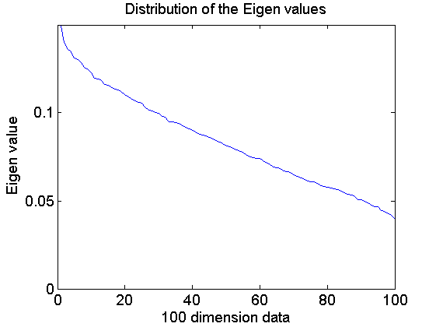
Example:
Take random 100 dim data. Show the distribution of eigenvalues.
Taken a random 100 dim data distributed between 0 and 1. The Eigen value is distributed is shown in the figure:.

Slide 24
Sanger’s model
Since M-principal components need to be discovered in this case, we have a network with ‘m’ output neurons.
The neurons are linear as before.
The output of the i’th output neuron can therefore be expressed as,
In matrix form:
Weight training:

Slide 25
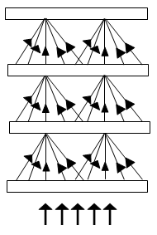
Linsker’s model
It is a model of the visual system that consists of a multilayered network trained by Hebbian learning.
The layers in the network are two-dimensional, analogous to the sheets of neurons in various stages of the real visual system.

Slide 26
Linsker’s model
Neurons are all layers are linear.
Each neuron in a given layer receives inputs from a local neighborhood in the previous layers, a feature that is also inspired the connectivity patterns in the visual system.
The training is done is stages, one layer at a time. Due to such layer-wise training, weights in each weight stage evolve differently.
Rich response patterns like orientation sensitivity is exhibited as a result

Slide 27
Consider the response, y, of a neuron in one of the layers of Linsker’s model.
Where V_{j} could be the input pattern, x_{j}, or the response of a neuron in the previous layer.
A variation of Hebb’s rule is used to train the weights, w_{i}:
The first term on the right-hand side (the product ) is the product term that appears in the original Hebb’s rule.
The parameters b, c and d can be tuned appropriately for various response properties.
The weights are prevented from blowing up by clipping them as follows,

Slide 28
To compute the final values to which the weights converge, let us consider the average change in weights, which must be zero at convergence.
Let , where and is the deviation from the mean. Then,
Where Cij is the the (i,j) element of the covariance matrix E[v_{i} v_{j}].

Slide 29
Terms in the last equation can be regrouped as,
where l and m are functions of the constants a, b, c, d and .
The above weight dynamics can be interpreted as gradient descent over a cost function:

Slide 30
Hence,
The first term is similar to standard Hebbian learning that maximizes quadratic form associated with the autocorrelation matrix of the input data. The second term is a Lagrangian multiplier that imposes the condition
on the weights.

Slide 31
Response on training
On 7 two-dimensional layers of neurons, A to G, where each layer projects to the subsequent layer in a ‘pyramidal’ fashion.
Training is done in a sequential fashion.
Weights of a stage are first trained to saturation, before the next stage is trained. Note that all training in this model is unsupervised governed by the model eqns.
In this kind of multilayer model, trained by simple Hebbian mechanism, neurons
Center-surround kind of receptive fields in lower layers,
Orientation sensitivity in higher layers.

Slide 32
Response of first two layers
Independent random noise is given as input to the first layer, A.
The autocorrelation matrix is an identity matrix.
For a range of parameters all the weight saturated to w₊ (since all the weights are the same).
The response of Layer B is simply a local average, or smoothed version of the image presented to layer A.
Neural activation turned out to have high local correlation.
Beyond a small radius of high correlation, layer B neurons had low correlation.

Slide 33
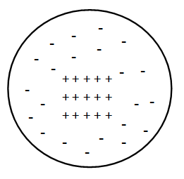
Centre surround receptive fields
Neurons in layer C developed center-surround kind of receptive fields.
They responded strongly either to a bright dot with a dark background, or to a black dot with a white background.
This trend continued to all the way to layer F where neurons had center-surround receptive fields.
The Center-Surround receptive field in lower layers

Slide 34
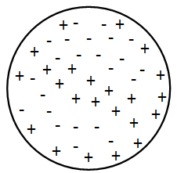
Response of higher layers
In Layer G the parameter values were changed.
It produced a variety of weight patterns on training, many of them were asymmetric.
Some neurons had receptive fields with alternating bands of positive and negative weights. Such cells had orientation sensitivity. Some other cells had a central positive region surrounding by several islands of negative regions.
The orientation sensitivity in higher layers

