Slide 1

Prof. Srinivasa Chakravarthy V
Dept: Biotechnology
IIT-Madras
schakra@iit.ac.in

Slide 2
Eigen value & Eigen vectors

Slide 3



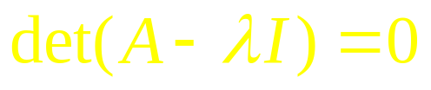
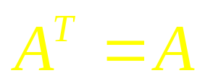

Eigen value & Eigen vectors
1. A is a square matrix
(n – Dimension complex vector)
Let A be a real symmetric matrix
Or
Hermitian matrix

Slide 4

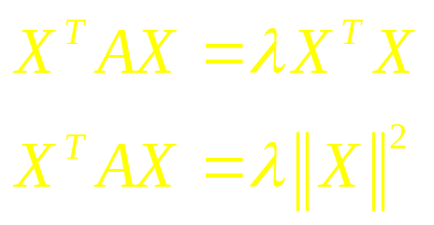
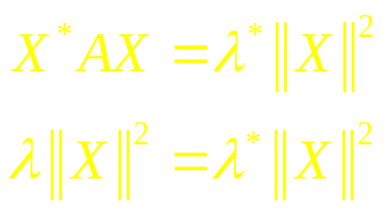

Theorem 1:
The Eigen values of a hermitian matrix are real.
Proof:
is real

Slide 5
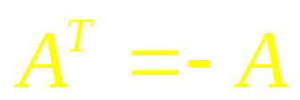
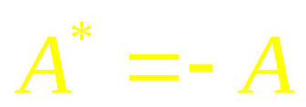
2. A is skew-symmetric
Or

Slide 6
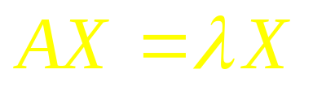
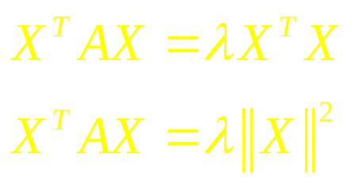
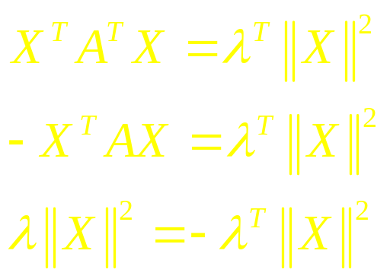

Theorem: Eigen values are purely imaginary
is purely imaginary.

Slide 7
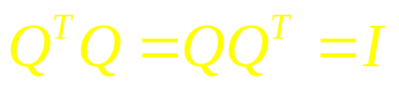
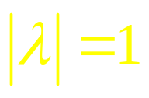
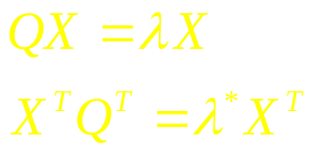


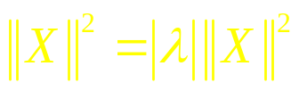
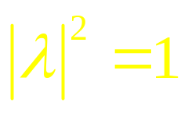

3) Q is an orthogonal matrix.

Slide 8
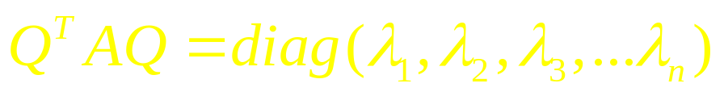
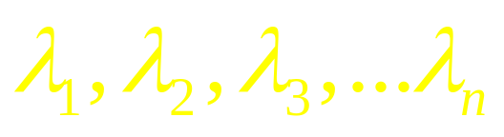
Theorem:
For every symmetric matrix, A, then exists on orthogonal matrix, Q, such that
Where,
are eigen values of A.

Slide 9
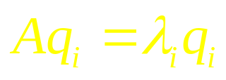
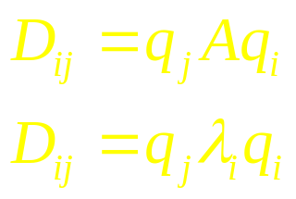
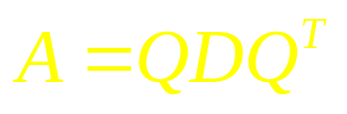
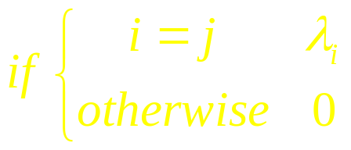
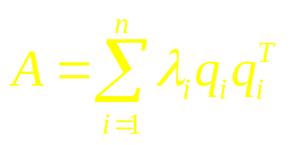
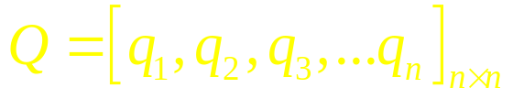

Proof:
Let be the Eigen vector corresponding to
Let D be a matrix where,
eigen decomposition of A.
orthogonal transformation
presents distances.

Slide 10
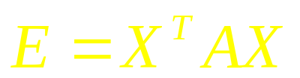
2.0. Quadratic form
Yet to be done by me
A quadratic form is a quadratic function associated with a symmetric matrix, A, and is expressed as:
A discussion of quadratic forms is relevant to study of neural systems since often it is required to minimize an “error function” that depends on a large number of parameters. To be able to do so, we must first define the minimum of a multivariate function. For a univariate function, the minimum is simply a point where f’=0 and f’’>0. To define the minimum of a multivariate function, the concepts corresponding to f’ and f’’ must be introduced.

Slide 11
For a multivariate function:
First derivative is the Gradient., G =
Second derivative is the Hessian, H =
H is defined more elaborately as,
Since H is a matrix and not a scalar like f’’, we need to
specify how to define a minimum in terms of the Hessian H.
It is here that we need quadratic forms. To understand this
let us expand a multivariate function as a Taylor series:

Slide 12
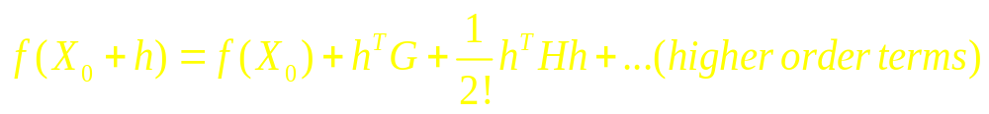
f(X0) is a constant and therefore does not affect the shape of f(X) around X0.
Since G = 0, we may ignore the linear term
The higher order terms beyond quadratic are too small and may be ignored.)
Therefore, the function f(X) has a minimum at X0, if the
function
has a minimum at h = 0. To verify this, we need to examine
the shape of a quadratic function around the origin (X=0).

Slide 13
It is easier to examine the shape of a quadratic function, in transformed coordinates, Y, obtained by rotating the original coordinates X, so that in the new coordinates the “cross-terms” are eliminated.

Slide 14
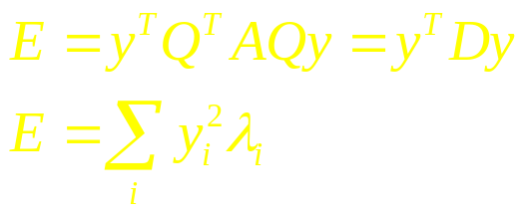
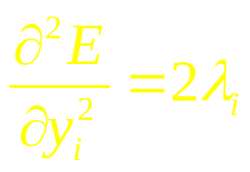
Geometric interpretation of eigenvalues in terms of quadratic forms:
For a real, symmetric matrix, A, let , where D is a diagonal matrix of eigen values. Let
Thus in the rotated coordinates, eigenvalues of A are proportional to the second derivatives of E.
Or,

Slide 15
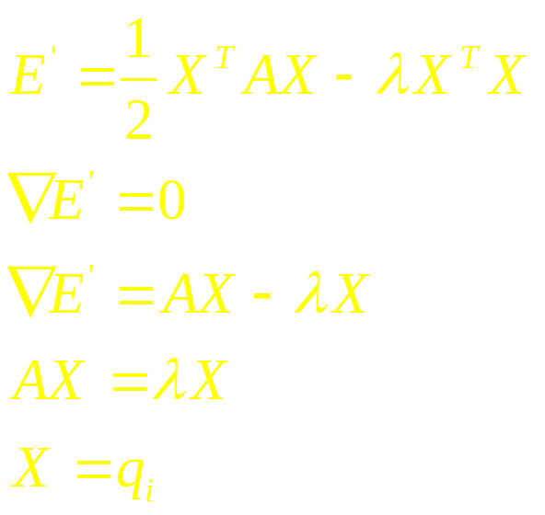
Geometric interpretation of eigenvectors in terms of quadratic forms:
Maximize the quadratic form, E, subject to
This can be done using the method of Lagrangian
multipliers as follows. Since there is only one constraint,the
Lagrange function may be written as:

Slide 16
That is, the directions along which E is stationary (DE’ = 0) under the constraint of is ||X||=1, correspond to the eigenvectors, of the matrix A, to which the quadratic form is associated.
Thus we can see that the shape of a quadratic form at the origin depends on the composition of the eigenvalues of A. Here we come to the notion of definiteness. There are 5 kinds of definiteness

Slide 17
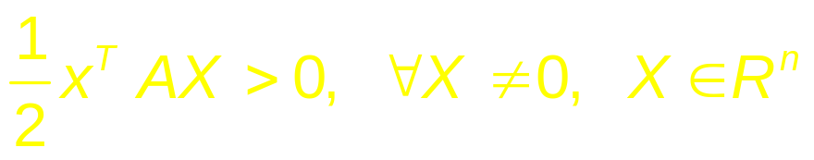
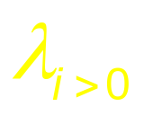
1. Positive definite :
An ‘n x n’ matrix ‘A’ is said to be positive definite if it meets the following condition:
This implies
This case corresponds to the “minimum.” Thus a multivariate function has a minimum at a point X0, if the Hessian of the function at X0, is positive definite.

Slide 18
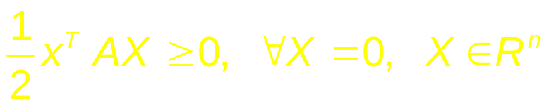

2. Positive semi-definite:
An ‘n x n’ matrix ‘A’ is said to be positive semi-definite if it meets the following condition:
This implies
.

Slide 19
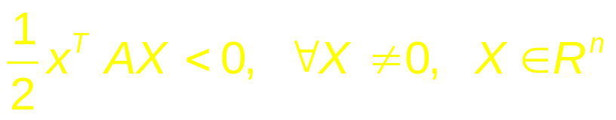

3. Negative definite:
An ‘n x n’ matrix ‘A’ is said to be negative definite if it meets the following condition:
This implies
This case corresponds to the “maximum.” Thus a multivariate function has a minimum at a point X0, if the Hessian of the function at X0, is negative definite.

Slide 20
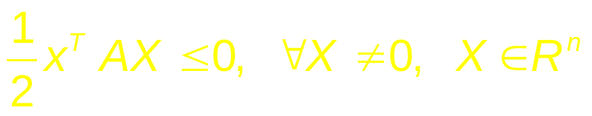

4. Negative semi-definite :
An ‘n x n’ matrix ‘A’ is said to be negative semi-definite if it meets the following condition:
This implies

Slide 21
5. Indefinite:
An ‘n x n’ matrix ‘A’ is said to indefinite if it does not meet any of the above four conditions.
Illustrations of various kinds of definiteness for two-variable functions.

Slide 22
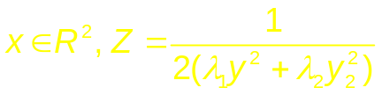



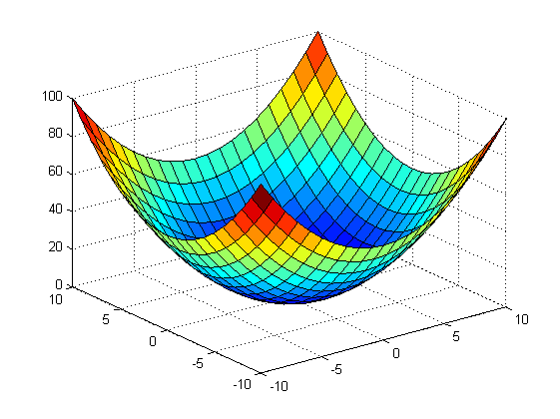
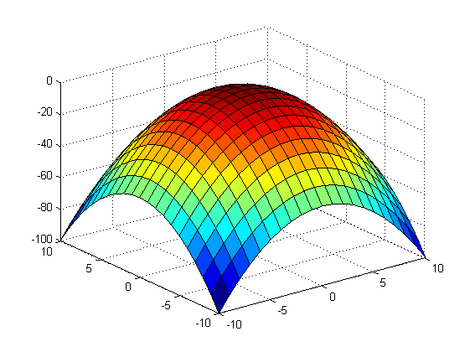
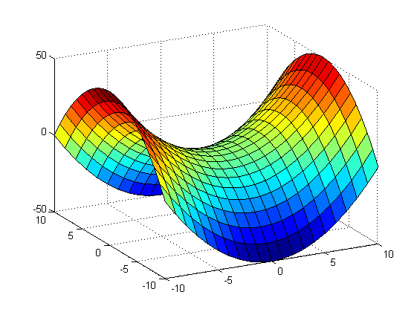
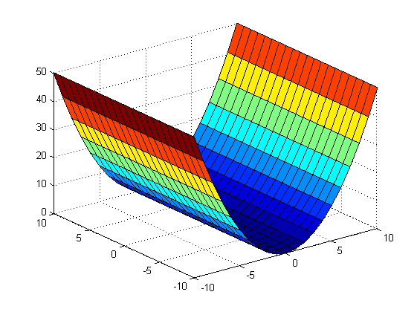
Example:
For n=2, , plot z for all possible values of
Case 1: and are both positive:
Case 1: and are both negative:
Case 1: is positive and is negative
Case 1: is positive and is negative

Slide 23
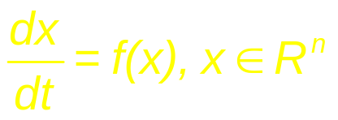
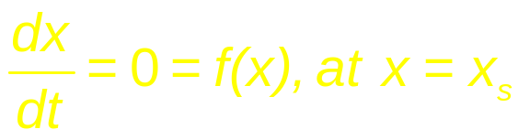
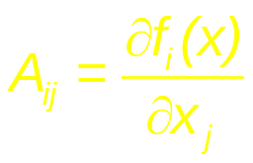
3.0 Dynamic Systems and fixed points:
(1)
Stationary Points (also called, critical points, equilibrium points etc):
(2)
The behavior of the system around xs, depends on the Jacobian of f(x),
(3)

Slide 24
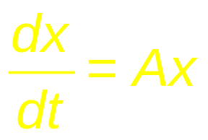
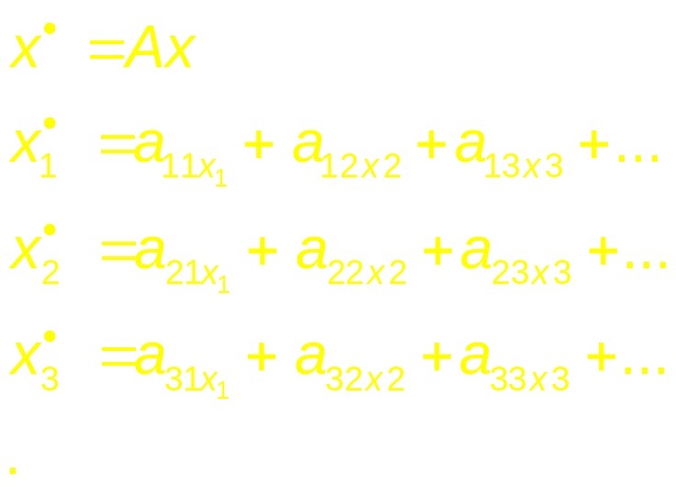
If you linearize (1) around x = xs,

Slide 25
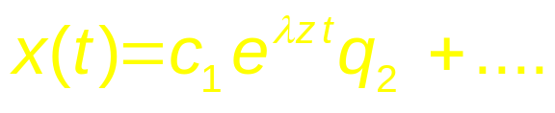
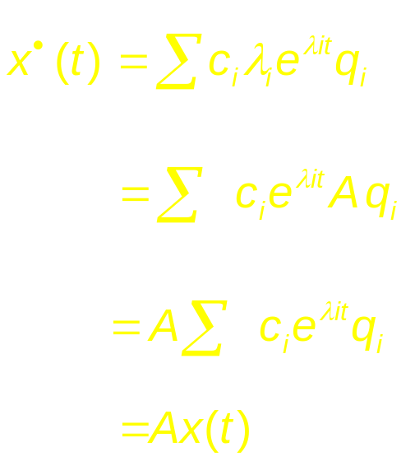
Hence
= a_{n1}x₁ + a_{n2}x₂ + a_{n3}x₃ + … ……….. … + a_{nn}x_{n}
Whose solution would be,
Verifying:

Slide 26
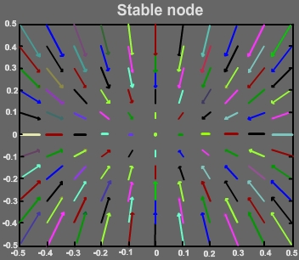
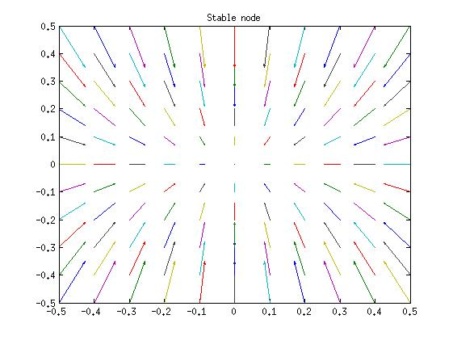
Types of stationary points (n = 2):
Description in terms of eigenvalues of A,
(Plots generated in Matlab using quiver function):
1.Stable node: Both eigenvalues are real, -ve

Slide 27
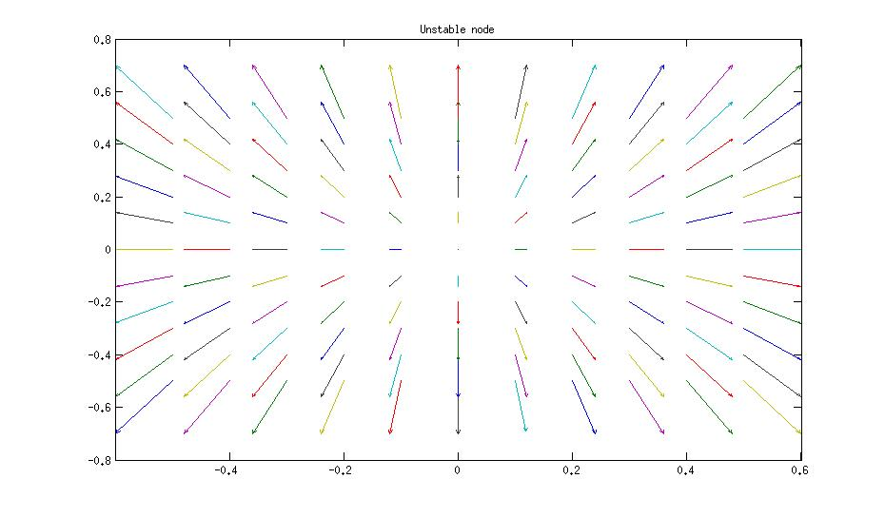
2.Unstable node: Both eigenvalues real, +ve.

Slide 28
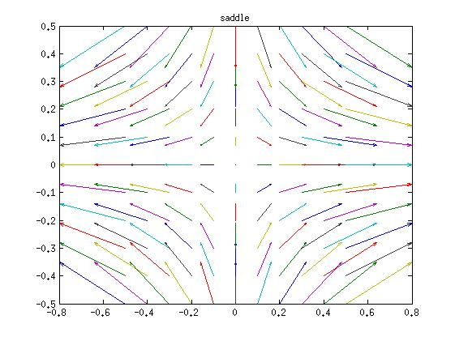
3.Saddle node: one +ve eigenvalue, one –ve eigenvalue

Slide 29
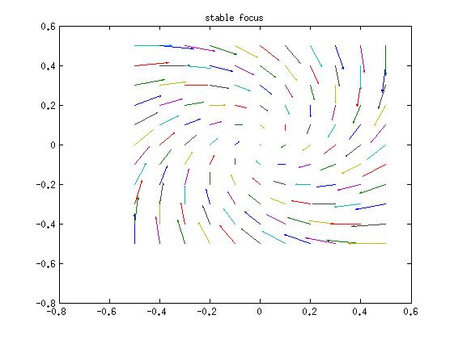
4.Stable focus: Both eigenvalues complex with –ve real parts.

Slide 30
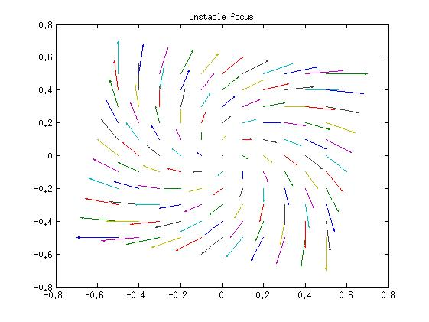
5.Unstable focus: Both eigenvalues complex, +ve real parts.

Slide 31

6.Center: Purely imaginary.

Slide 32

Other cases:
Star: Both the Lambda being real, equal, negative

Slide 33

Line of fixed Points:
One of the lambda’s is zero.

Slide 34



Classification of Fixed Points:
For a linear dynamic system,
the type of fixed point at the origin can be related to the trace and determinant of A.
This relationship can be easily derived when A is a 2 X 2 matrix, but the result applies to the general n X n matrix.
Let
The characteristic equation is,

Slide 35



Expanding the determinant, we get the following quadratic equation
Where
Solving for l, we have,
From the above form of the expression for the eigenvalues , of the Jacobian of the dynamic system, at the origin, we can infer a few things.

Slide 36
Case <0:
Eigenvalues are real and have opposite signs. Therefore,
the fixed point is a saddle node.\
Case >0:
If >0, both the roots are real. Further, is less than |t|. Therefore,
if t is positive, both the roots are positive → unstable nodes.
if t is negative, both the roots are negative → stable nodes.

Slide 37
If <0, the roots are complex conjugates. Furthermore,
If t is positive, the real part of the roots is positive → unstable focus
If t is negative, the real part of the roots is negative → stable focus
If t is 0, the roots are purely imaginary → center
If =0, the roots are equal → line of fixed points.

Slide 38
The above scheme of classification is summarized in the “map” shown below.

Slide 39
4.0 Phase-plane Analysis:
Above we have briefly listed out the types of fixed points that occur in a linear n-dimensional dynamic system. The origin is the only fixed point in such systems. But a nonlinear dynamic system can have multiple fixed points with a much larger repertoire of behaviors, and therefore much harder to analyze than a linear system.

Slide 40
Therefore it is convenient to study to two-dimensional nonlinear systems which offer several advantages:
They can be easily visualized
They have rich dynamics and are sufficiently interesting study (for example, they exhibit limit cycle behavior, which can be used to model rhythmic behavior in real systems)
They have a limited range of dynamics compared to n-dimensional (n>2) nonlinear dynamic systems. (for example, two-dimensional continuous dynamic systems do not exhibit chaos).

Slide 41


For these reasons, two-dimensional systems occupy a special place in study of dynamic systems.
A general form of a two-dimensional dynamic system can be expressed as:
The simplest kind of analysis that can be performed on such a system is to identify all the fixed points and classify each of them by local analysis.
(4.1a)
(4.1b)

Slide 42



Fixed points of eqns. (4.1a,b) may be calculated by solving,
Eqns (4.2a,b) represent curves in the x-y plane and are known as null-clines.
is the x-nullcline and is the y-nullcline. The intersection points of the two null-clines are the fixed points of the system.
(4.2a)
(4.2b)

Slide 43


Let (xo, yo) is a fixed point of the system described by eqns. (4.1a,b). Dynamics in the neighborhood of the fixed point may be expressed as:

Slide 44


A linear approximation of the above system is given as,
Where J denotes the Jacobian of the system eqns. (4.1a,b).
The above equation may be expressed more compactly as,
The fixed point at e = 0, can be classified by performing eigenvalue analysis of the above 2D system.

Slide 45
5.0 Limit Cycles:
Limit cycles are a type of oscillatory behavior characterized by two properties:
Periodicity:
A system exhibiting limit cycle behavior is confined to a closed loop trajectory and periodically visits every point on that loop. Thus, if a system whose state variable is denoted by x(t), visits a point, a, at time, t, and if ‘a’ is on a limit cycle, then
x(t) = x(t+T)=a,
where T is the period of the limit cycle.

Slide 46
Isolatedness
This property refers to the behavior of the system when it is slightly perturbed from the limit cycle. When a system begins at a point that is in the neighborhood of a limit cycle, it either approaches the limit cycle asymptotically, or moves away from it. In this respect, a limit cycle is different from a ‘center.’ In case of a center, when the system is slightly perturbed, it continues on a new periodic orbit and does not return to the previous orbit.
Limit cycles are relevant to neural dynamics because neural spiking activity may be conveniently modeled as a limit cycle.

Slide 47
There are several ways in which it can be proved that a system exhibits limit cycle behavior, some of which are discussed below.
1. Special systems
2. Lienard Systems
3. Poincare-Benedixon Theorem

Slide 48
Special systems: There is no general rule for determining if a system has limit cycle behavior. This absence of general, universal methods is characteristic of nonlinear systems. But some systems have a convenient form so that it can be easily shown that they have limit cycle behavior.

Slide 49



Example: We can easily show the system given below has limit cycles –
(5.1a)
(5.1b)
Let us rewrite the above equations in polar form by substituting:

Slide 50


Combining eqns. (5.1a,b) as shown below
and expressing the result in polar coordinates we have
(5.2)

Slide 51




Now consider,
Differentiating both sides,
Using eqns. (5.1a,b) we have,
Combining eqn. (5.3) and eqn. (5.4) we have,
Thus eqns. (5.1a,b) are reexpressed as, eqns. (5.2) and eqn. (5.5).
(5.3)
(5.4)
(5.5)

Slide 52


From eqn. (5.20) we can see that r approaches the stable of value 1: dr/dt is positive for r < 1, and is negative for r >1.
Thus we have a limit cycle which is a circle of unit radius and angular velocity of
1.
2.Lienard systems: This represents a slight improvement over showing limit cycles only in individual systems. Lienard systems are a general class of systems that exhibit limit cycles under some conditions.
Liénard’s equation is equivalent to the system

Slide 53
The following theorem states that this system has a unique, stable limit cycle under appropriate hypotheses on and g. For a proof, see Jordan and Smith (1987), Grimshaw (1990), or Perko (1991).

Slide 54

Liénard’sTheorem :Suppose that f (x) and g9(x) satisfy the following conditions :
Then the system (2) has a unique, stable limit cycle surrounding the origin in the phase plane.
After this sir moved to biology part , and kept next for later

Slide 55
3. Poincare-Benedixson Theorem:
This theorem specifies conditions in 2D systems under which limit cycle exists. It is based on the idea that in a dynamic system dx/dt = f(x), where f(x) is continuous, no two trajectories intersect. Therefore, if there is a limit cycle, then all trajectories that start from inside the limit cycle will remain confined within the limit cycle. They can never come out of the limit cycle since to come out they have to cross the limit cycle, which is disallowed.

Slide 56

A formal statement of Poincare-Benedixson theorem is given below.
represents a continuously differentiable vector field on an open set containing a region R,
Where R is a closed, bounded subset of the plane, which is devoid of any fixed points, and
There exists a trajectory C that is “confined” in R (if it starts in R it stays in R forever).
If the above conditions are satisfied, C is a closed orbit.

Slide 57
It is not straightforward to apply Poincare-Benedixson theorem to a given system and show presence of limit cycles. Such demonstration depends crucially on construction of a trapping region, R, such that vector field on the borders of R points inwards everywhere.
T here is a theorem from Index theory that any closed orbit must enclose one or more fixed points. Since Poincare-Benedixson requires that R must not include any fixed points, we need to construct an R that excludes all fixed points. Typically a ring-like, annular region is chosen such that vector field is pointed inwards on the outer boundary, and outwards on the inner boundary. If such a region can be constructed, Poincare-Benedixson assures us that a limit cycle exists inside R. Exact construction of R depends on the details of the equations that describe the system.

Slide 58
6.0 Limit Cycle generation by Bifurcation:
As the parameters of a dynamic system are changed gradually, at certain critical values of the parameters, the dynamics can change qualitatively. For example, a stable node may change into an unstable node. Such qualitative changes in dynamics are known as bifurcations. The parameter values where such changes occurs are called bifurcation points.
The map of fig. ** which shows different types of fixed points on the t- D plane is a simple example of bifurcations. The plane is divided into several regions, where each region represents one type of fixed point, or a dynamical regime. When we crossover from one region to a neighboring, dynamics suddenly changes, and a bifurcation occurs. For example, when we cross the D -axis (t = 0 line), saddle node become either stable or unstable nodes.

Slide 59
Two important types of bifurcations by which limit cycles can be produced are
Supercritical Andronov-Hopf bifurcation
Subcritical Andronov-Hopf bifurcation
Saddle-node bifurcation
Saddle-node on invariant circle bifurcation

Slide 60
6.1 Andronov-Hopf Bifurcation – supercritical and subcritical
In Andronov-Hopf bifurcation, a stable focus gets converted into an unstable focus giving rise to a limit cycle in the process. A stable focus, as we know from the previous section, has complex valued eigenvalues with negative real parts; the eigenvalues of the unstable focus has positive real parts. Thus Andronov-Hopf bifurcation occurs when a pair of complex conjugate eigenvalues cross over from the left halfplane to the right.
X’
X

Slide 61
Depending on the precise manner in which a stable focus gets destabilized and leads to a limit cycle, the Andronov-Hopf bifurcation can be classified into two types.
In supercritical Andronov-Hopf bifurcation, when a stable focus becomes a limit cycle, the limit cycle first starts with a small/infinitesimal amplitude and gradually increases in size.
This behavior can be seen in an example.

Slide 62


Example:
6.1.1a
Note that q does not influence evolution of r (in eqn. (6.1.1.a)) but r influences q (in eqn. (6.1.1.b)). Therefore changes in amplitude may be studied solely by studying eqn. (6.1.1.a).
Note how the steady state value of r changes as m is increased from a negative value to a positive value. For m <0, the only real solution is r = 0; for m >0, there are three real solutions: r = 0, + sqrt(m). Since r has to be positive, the solutions are r = 0 and sqrt(m). Eqn. (6.1.1.b) simply says that angular velocity increases with increasing radius.
6.1.1b

Slide 63

Therefore, if we express the steadystate radius, rs, as a function of bifurcation parameter, m ,
It can be easily verified that in the system defined by eqns. (6.1.1.a,b), the eigenvalues at the origin cross over from the left half-plane to the right, as m crosses over from negative to positive values.
for m>0, and

Slide 64




Eigen values analysis for eqns. (6.1.1.a,b)

Slide 65




Slide 66
Properties of supercritical Andronov-Hopf bifurcation
1. Size of the limit cycle,r_{0,} grows as for close to.
r₀
0

Slide 67




2. Frequency , evaluated at
Formula is exact at birth of the limit cycle.

Slide 68
Subcritical Andronov-Hopf bifurcation:-
In a subcritical Andronov-Hopf bifurcation, when the unstable focus destabilized, a limit cycle of finite size sudden appears, unlike in the supercritical case the limit cycle starts of small and grows gradually as the bifurcation parameter increases.

Slide 69



An example of a system which exhibits subcritical Andronov-Hopf bifurcation is given below:
Thus for m < 0, there is no limit cycle; there is a stable fixed point at the origin.

Slide 70


But when m >0, there is suddenly a limit cycle at r = r0, a finite value.

Slide 71

Thus, in supercritical Andronov-Hopf bifurcation, the size of limit cycle varies as a function of m as follows:

Slide 72
Saddle node bifurcation of cycles:
In saddle node bifurcation of cycles (also called a fold bifurcation), two limit cycles coalesce and annihilate each other. A simple example system that exhibits Saddle node bifurcation of cycles is,
Note the system is the same as the used in case of the subcritical Andronov-Hopf bifurcation above. But the difference lies in the value of bifurcation parameter at which the bifurcation occurs.

Slide 73

In case of subcritical Andronov-Hopf bifurcation, the bifurcation occurred at m = 0. For m < 0, there is a stable focus at the origin, an unstable limit cycle of lesser radius, and a stable limit cycle of larger radius. When m > 0, the unstable limit cycle merges with the origin and disappears. The stable limit cycle only remains.
In case of Saddle node bifurcation of cycles, the bifurcation occurs at m = -1/4.
For m < -1/4, origin is the only stable point. There are no limit cycles (stable or unstable).

Slide 74

For m > -1/4, origin is still a stable point. But in addition there are now two limit cycles (one stable and the other unstable).
Therefore a key difference between subcritical Andronov-Hopf bifurcation and Saddle node bifurcation of cycles is the former, the stable focus at the origin becomes unstable after bifurcation, whereas in the latter the focus at the origin remains stable throughout.

Slide 75

Saddle node on invariant Circle:
In this type of bifurcation, a node and saddle are located on a loop – the invariant circle. By varying a bifurcation parameter, the saddle and the node come together, coalesce and annihilate each other leaving the loop, the limit cycle, intact.
A sample system that displays Saddle node on invariant Circle behavior:

Slide 76


For m < 1, the phase dynamic equation has two solutions – saddle and a node located on the unit circle (r = 1). Phase portrait is shown in the figure below. As m → 1, the saddle and the node approach each other and coalesce. When m > 1, the saddle and the node annihilate each other leaving a limit cycle at r = 1.
m > 1
m < 1

Slide 77
Homoclinic Bifurcation:
In a homoclinic bifurcation, a closed loop approaches a saddle. At bifurcation, the saddle touches the loop, transforming the loop into a homoclinic orbit. Thus trajectories that start from the saddle go along the loop and return to the saddle in the opposite direction.

Slide 78


The limit cycle with the
saddle outside
b. The saddle had merged with the limit cycle.
The cycle has now become a homoclinic orbit.

Slide 79

Thank You

