Slide 1

Dynamical Systems: Preliminaries
Prof. Srinivasa Chakravarthy V
Dept: Biotechnology
IIT-Madras
schakra@iit.ac.in

Slide 2
Eigenvalue & Eigenvectors

Slide 3

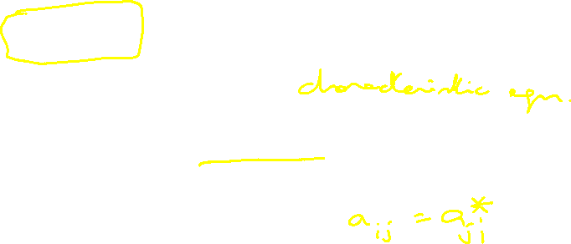


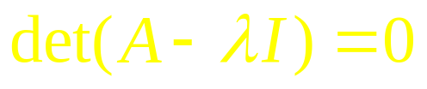


Eigen value & Eigen vectors
1. A is a square matrix
(n – Dimension complex vector)
Let A be a real symmetric matrix
Or
Hermitian matrix

Slide 4

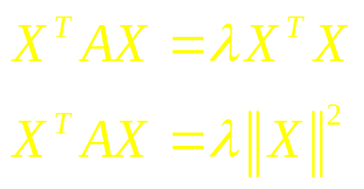

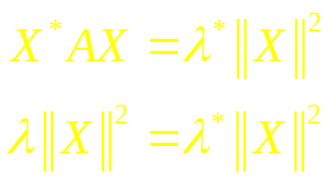

Theorem 1:
The Eigen values of a hermitian matrix are real.
Proof:
is real

Slide 5
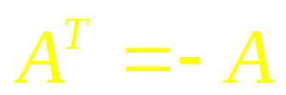
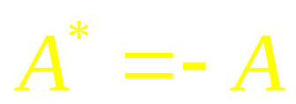
2. A is skew-symmetric
Or

Slide 6
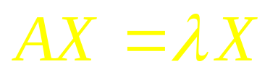
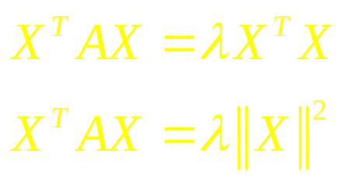
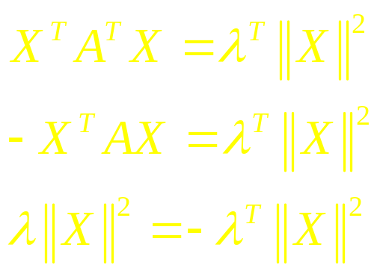


Theorem: Eigen values of a skew-Hermitian are purely imaginary
is purely imaginary.

Slide 7
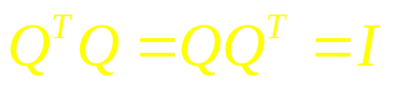
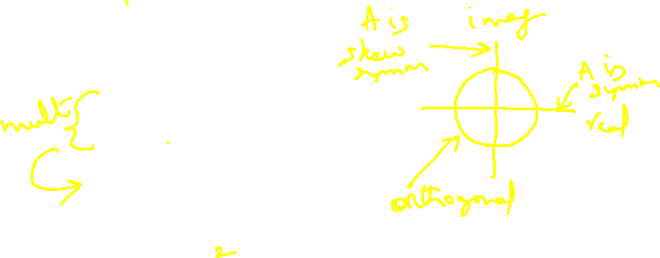
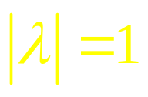
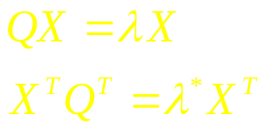


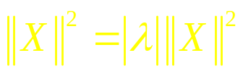
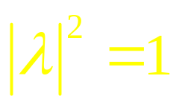

3) Q is an orthogonal matrix
Eigenvalues lie on the unit circle.

Slide 8
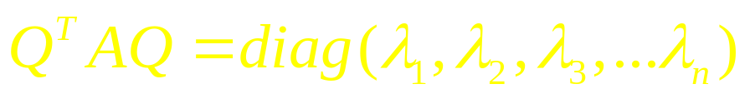

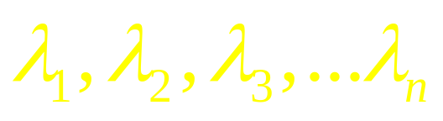
4) Theorem
For every symmetric matrix, A, then exists on orthogonal matrix, Q, such that
Where,
are eigenvalues of A.

Slide 9
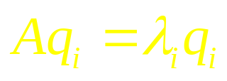
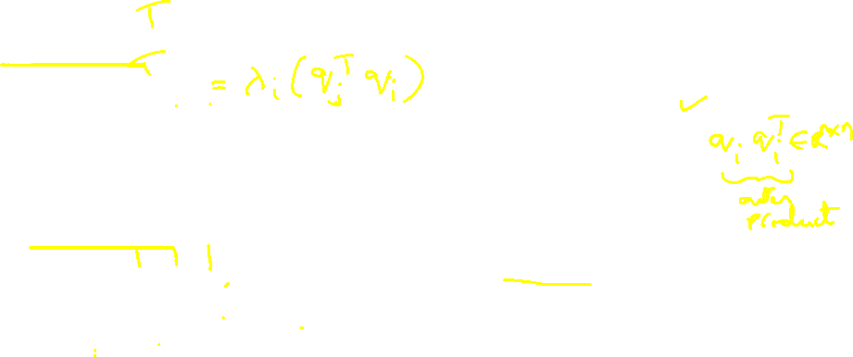
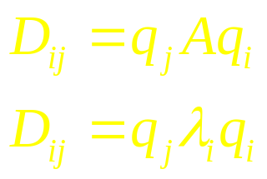
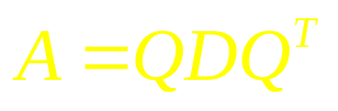
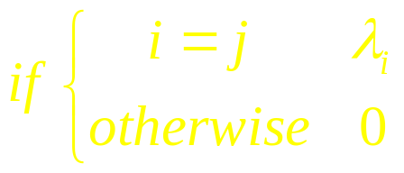
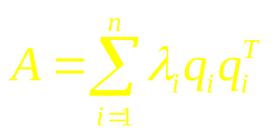
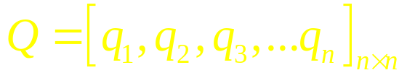

Proof:
Let be the Eigenvector corresponding to
Let D be a matrix where,
eigen decomposition of A.
orthogonal transformation
presents distances.

Slide 10
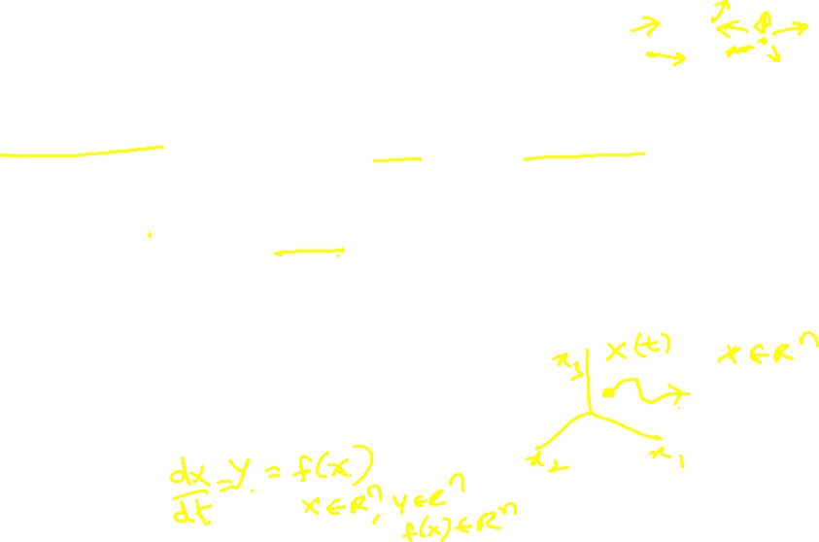
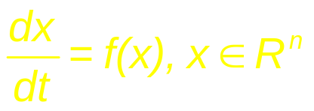
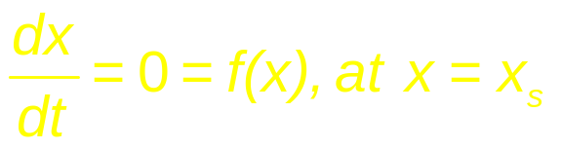
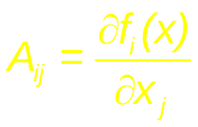
3.0 Dynamic Systems and fixed points:
(1)
Stationary Points (also called, critical points, equilibrium points etc):
(2)
The behavior of the system around x_{s}, depends on the Jacobian of f(x),
(3)

Slide 11
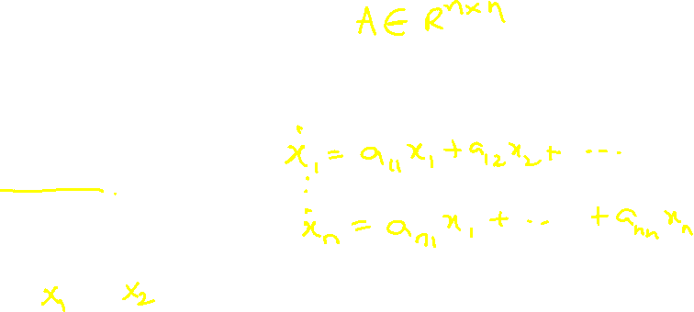
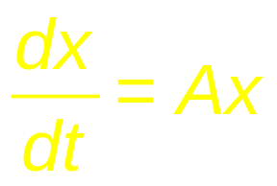
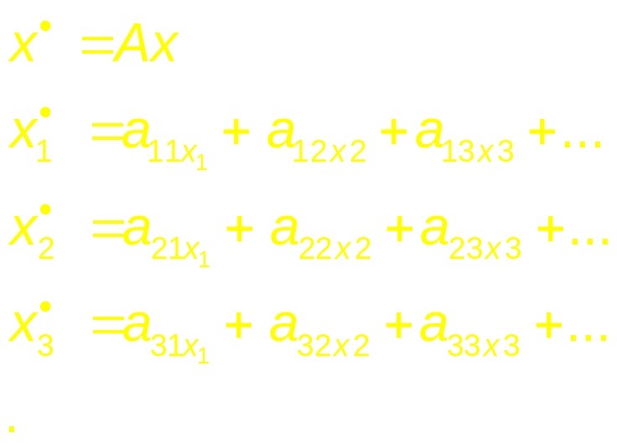
If you linearize (1) around x = x_{s},
= a_{n1}x₁ + a_{n2}x₂ + a_{n3}x₃ + … ……….. … + a_{nn}x_{n}

Slide 12
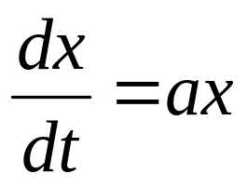
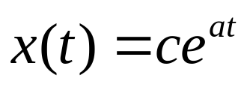
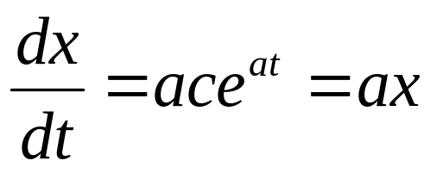
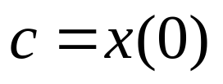
n=1
Let

Slide 13

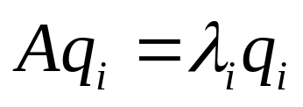
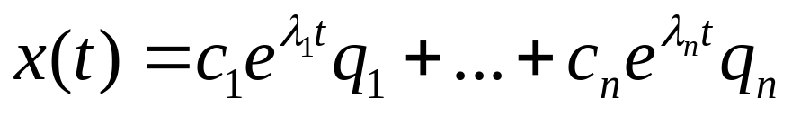
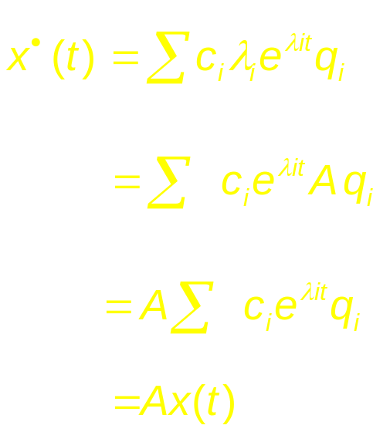
General case (n>=1)
Consider the solution,
λ_{i}= eigenvalues of A
q_{i} = eigenvectors of A
Verifying:

Slide 14
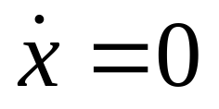
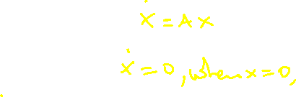
Fixed points
Points where:
Two objectives:
Find out if a fixed point stable
Classify the fixed point based on
the pattern of the field in its neighborhood

Slide 15
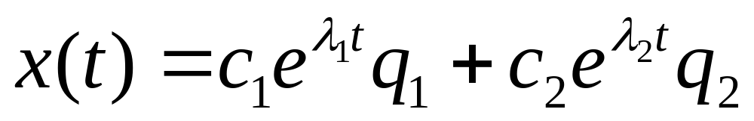

n=2
Let q¹ and q₂ be orthogonal to each other
(Assume A is symmetric)
Assume q¹ is along x1-axis, and q₂ is along x2-axis.
(Can always rotate the field.
Rotating the field does not change the stability)
Let us classify fixed points in terms of eigenvalues of A.

Slide 16
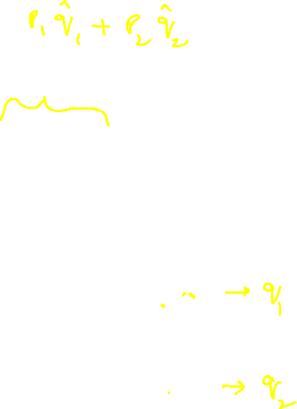
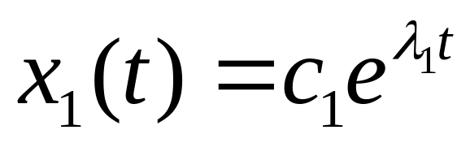
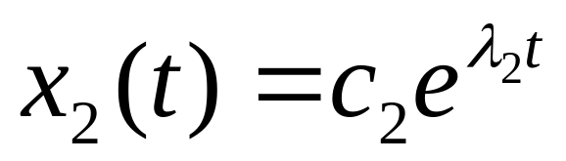

Slide 17

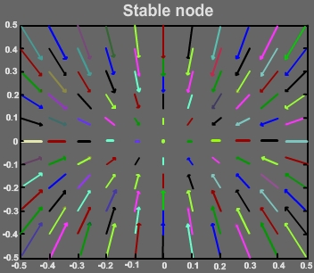
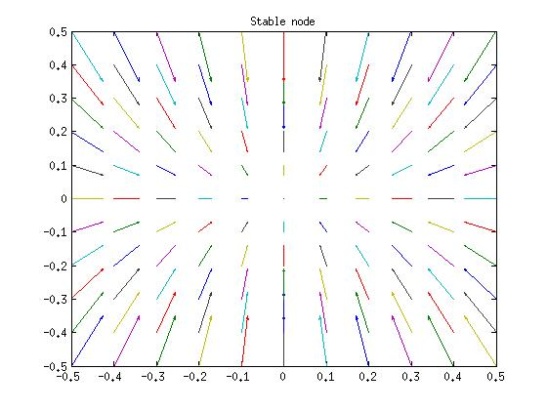
Types of stationary points (n = 2):
(Plots generated in Matlab using quiver function):
1.Stable node: Both eigenvalues are real, -ve

Slide 18
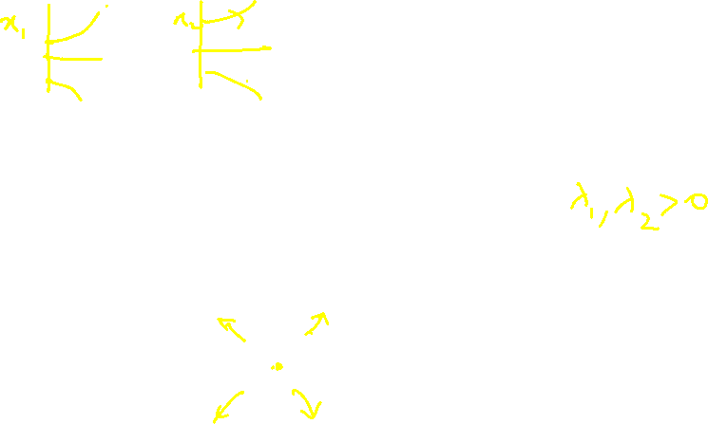
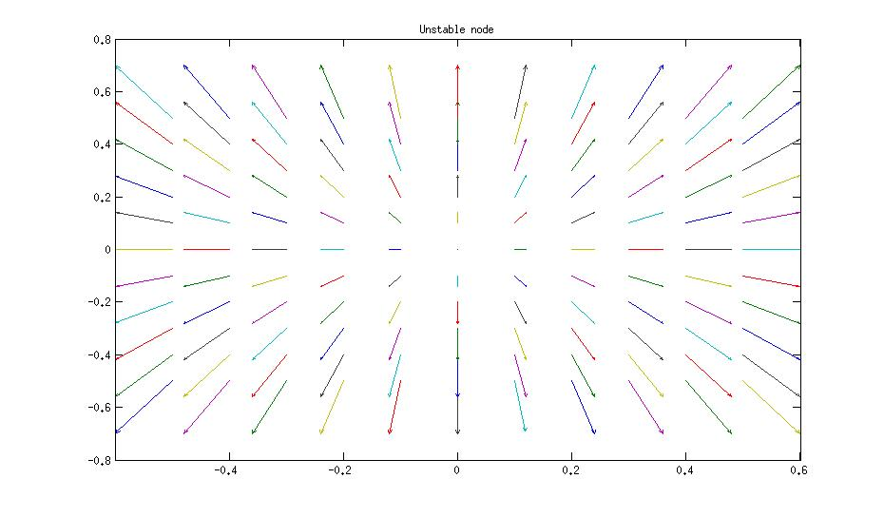
2.Unstable node: Both eigenvalues real, +ve.

Slide 19
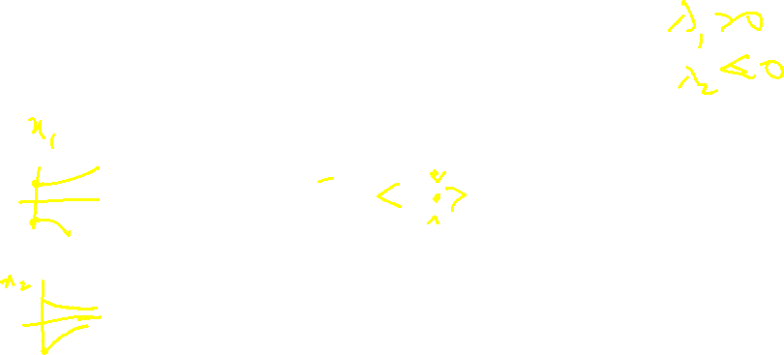
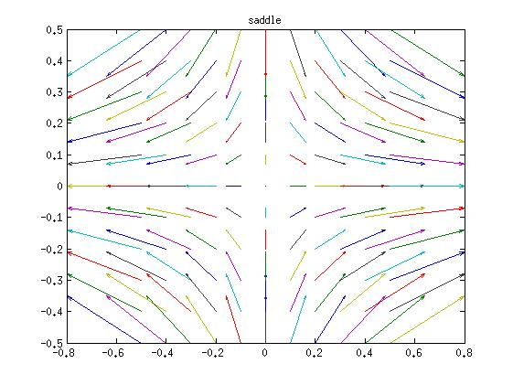
3.Saddle node: one +ve eigenvalue, one –ve eigenvalue

Slide 20






4.Stable focus: Both eigenvalues complex with –ve real parts.

Slide 21


5.Unstable focus: Both eigenvalues complex, +ve real parts.

Slide 22


6.Center: Purely imaginary.

Slide 23


Other cases:
Star: Both the Lambda being real, equal, negative

Slide 24




Line of fixed Points:
One of the lambda’s is zero.

Slide 25


Slide 26




Classification of Fixed Points:
For a linear dynamic system,
the type of fixed point at the origin can be related to the trace and determinant of A.
This relationship can be easily derived when A is a 2 X 2 matrix, but the result applies to the general n X n matrix.
Let
The characteristic equation is,

Slide 27





Expanding the determinant, we get the following quadratic equation
Where
Solving for l, we have,
From the above form of the expression for the eigenvalues , of the Jacobian of the dynamic system, at the origin, we can infer a few things.

Slide 29

Case <0:
Eigenvalues are real and have opposite signs. Therefore,
the fixed point is a saddle node.

Slide 30

Case >0:
If >0, both the roots are real. Further, is less than | τ |. Therefore,
if τ is positive, both the roots are positive → unstable nodes.
if τ is negative, both the roots are negative → stable nodes.

Slide 31

If <0, the roots are complex conjugates. Furthermore,
If τ is positive, the real part of the roots is positive → unstable focus
If τ is negative, the real part of the roots is negative → stable focus

Slide 32

If τ is 0, Δ>0, the roots are purely imaginary → center
If Δ =0, one root is 0 → line of fixed points.
The two roots are equal → star

Slide 33


Bifurcation map of a 2D linear Dynamical System
The above scheme of classification is summarized in the “map” shown below.
(Strogatz 1994)

Slide 34

A “lovely” example (Strogatz 1988)
Romeo is in love with Juliet, but in our version of this story, Juliet is a fickle lover. The more Romeo loves her, the more Juliet wants to run away and hide. But when Romeo gets discouraged and backs off, Juliet begins to find him strangely attractive.
Romeo, on the other hand, tends to echo her: he warms up when she loves him, and grows cold when she hates him.

Slide 35


R(t) = Romeo's love(+ve)/hate (-ve) for Juliet at time t
J(t) = Juliet's love(+ve)/hate(-ve) for Romeo at time t .
a, b >0
A=[0 a
-b 0]
λ= + i sqrt(ab)
|A-λI|=0

Slide 36


Center
Two purely imaginary eigenvalues ➔ Center
A never ending saga of love and hate…

Slide 37
THE PHASE PLANE

Slide 38

4.0 Phase-plane Analysis:
Graphical analysis of (generally nonlinear) 2-dimensional Dynamical Systems
Above we have briefly listed out the types of fixed points that occur in a linear n-dimensional dynamic system. The origin is the only fixed point in such systems. But a nonlinear dynamic system can have multiple fixed points with a much larger repertoire of behaviors, and therefore much harder to analyze than a linear system.

Slide 39

Therefore it is convenient to study to two-dimensional nonlinear systems which offer several advantages:
They can be easily visualized
They have rich dynamics and are sufficiently interesting study (for example, they exhibit limit cycle behavior, which can be used to model rhythmic behavior in real systems)
They have a limited range of dynamics compared to n-dimensional (n>2) nonlinear dynamic systems. (for example, two-dimensional continuous dynamic systems do not exhibit chaos).

Slide 40


A general form of a 2-dimensional dynamic system can be expressed as:
The simplest kind of analysis that can be performed on such a system is to identify all the fixed points and classify each of them by local analysis.
(4.1a)
(4.1b)

Slide 41




Fixed points of eqns. (4.1a,b) may be calculated by solving,
Eqns (4.2a,b) represent curves in the x-y plane and are known as null-clines.
is the x-nullcline
is the y-nullcline.
The intersection points of the two null-clines are the fixed points of the system.
(4.2a)
(4.2b)

Slide 42


Nullclines
Fixed points

Slide 43





Let (xo, yo) is a fixed point of the system described by eqns. (4.1a,b). Dynamics in the neighborhood of the fixed point may be expressed as:

Slide 44



A linear approximation of the above system is given as,
Where J denotes the Jacobian of the system eqns. (4.1a,b).
The above equation may be expressed more compactly as,
The fixed point at ε = 0, can be classified by performing eigenvalue analysis of the above 2D system.

Slide 45

Example
Find all the fixed points of the system
dx/dt = -x + x³,
dy/dt = -2y,
and use linearization to classify them.
Then check your conclusions by deriving the phase portrait for the full nonlinear system. (Strogatz – example 6.3.1)
Nulllclines
X-nullcline
f(x,y)=-x + x³ = 0
➔ x=0,1,-1; (y=anything)
Y-nullcline
g(x,y)=-2y=0
➔ y=0 (x = anything)

Slide 46


Nullclines
X-nullclines
Y-nullclines

Slide 47




Stability Analysis
Jacobian
λ₁, λ₂ = -1, -2
Stable node
λ₁, λ₂ = 2, -2
Saddle nodes

Slide 48
Fixed Points and their stability
Saddle Node
(1,0)
Saddle Node
(-1,0)
Stable Node (0,0)

Slide 49



Slide 50


Slide 51

Practice these

Slide 52

Thank You

