Slide 1

Prof. Srinivasa Chakravarthy V
Dept: Biotechnology
IIT-Madras
schakra@iit.ac.in

Slide 2
5.0 Limit Cycles:
Limit cycles are a type of oscillatory behavior characterized by two properties:
Periodicity:
A system exhibiting limit cycle behavior is confined to a closed loop trajectory and periodically visits every point on that loop. Thus, if a system whose state variable is denoted by x(t), visits a point, a, at time, t, and if ‘a’ is on a limit cycle, then
x(t) = x(t+T)=a,
where T is the period of the limit cycle.

Slide 3
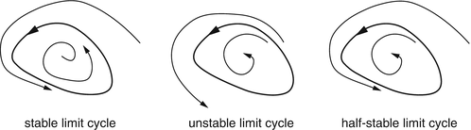
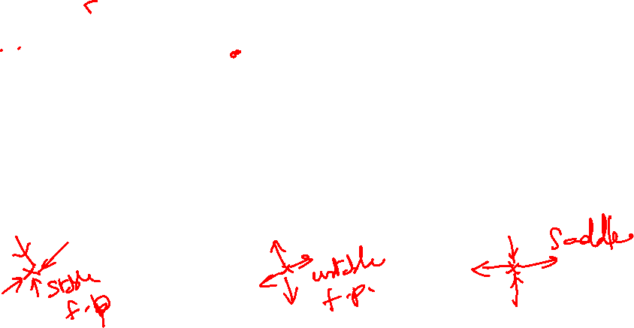
Limit Cycles

Slide 4
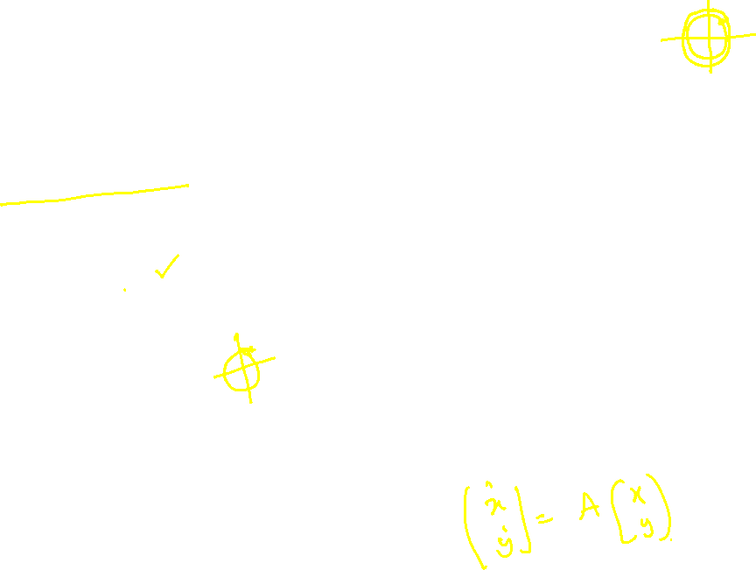
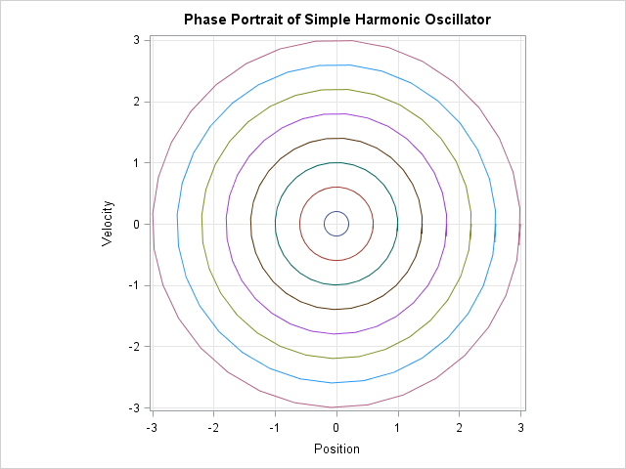
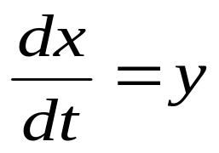
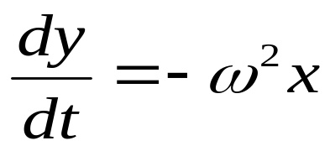
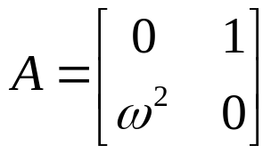

Simple Harmonic Oscillator
d²x/dt² + ω² x =0

Slide 5
Center vs Limit Cycle
Limit Cycle is periodic,
- fixed Amplitude, irrespective of the initial condition
Center is periodic,
- amplitude depends on the initial condition

Slide 6
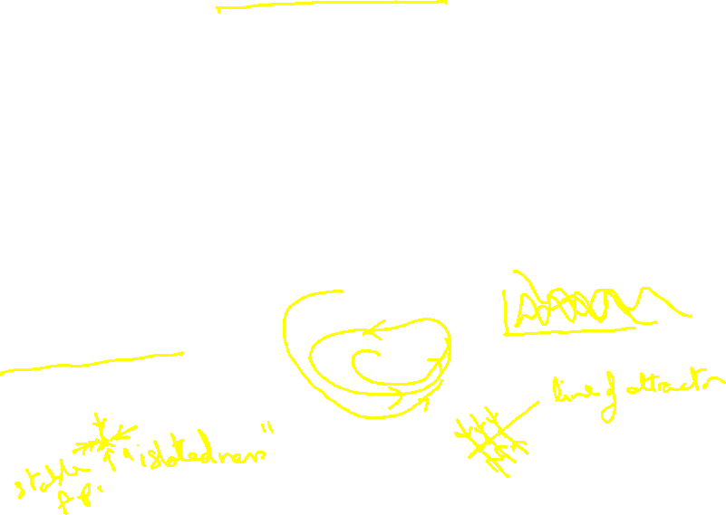
Isolatedness
This property refers to the behavior of the system when it is slightly perturbed from the limit cycle.
When a system begins at a point that is in the neighborhood of a limit cycle, it either approaches the limit cycle asymptotically, or moves away from it.
“Fixed amplitude”

Slide 8
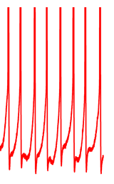
Neural Dynamics and Limit Cycles
Limit cycles are relevant to neural dynamics because neural spiking activity may be conveniently modeled as a limit cycle.
V(t) is periodic and has a fixed
Amplitude irrespective of the
Initial condition
V(t)

Slide 9
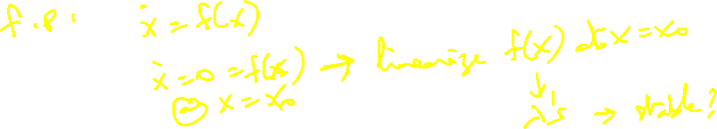
There are several ways in which it can be proved that a system exhibits limit cycle behavior, some of which are discussed below.
1. Special systems
2. Lienard Systems
3. Poincare-Benedixon Theorem

Slide 10
Special systems:
There is no general rule for determining if a system has limit cycle behavior.
This absence of general, universal methods is characteristic of nonlinear systems.
But some systems have a convenient form so that it can be easily shown that they have limit cycle behavior.

Slide 11
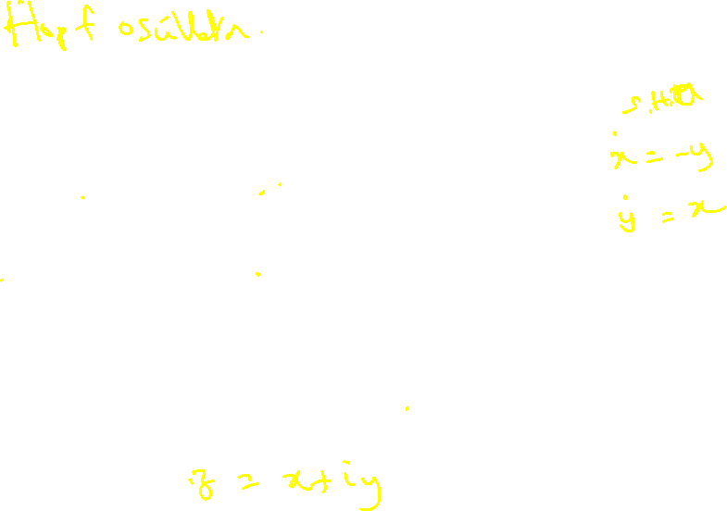
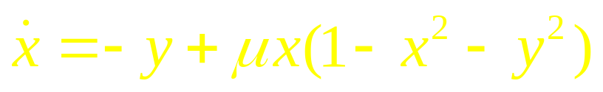
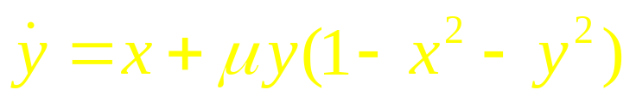
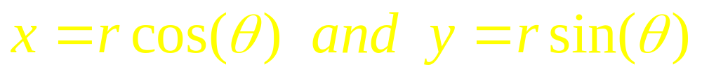
Example
Show the system given below has limit cycles –
(5.1a)
(5.1b)
Let us rewrite the above equations in polar form by substituting:

Slide 12
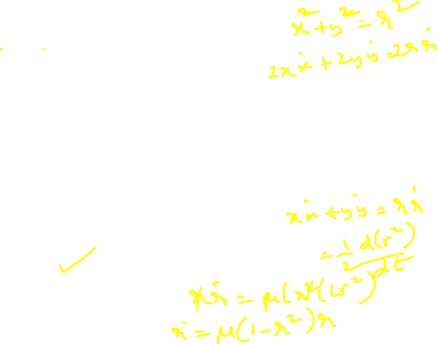
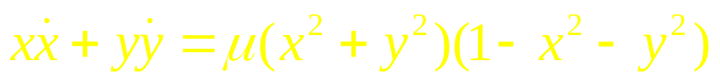
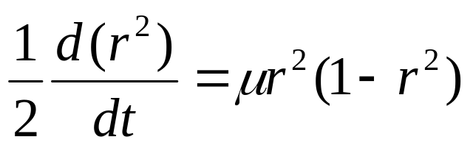
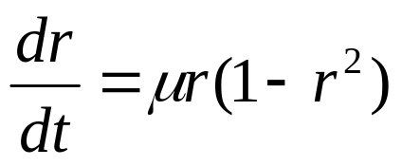
Combining eqns. (5.1a,b) as shown below
and expressing the result in polar coordinates we have
(5.2)

Slide 13
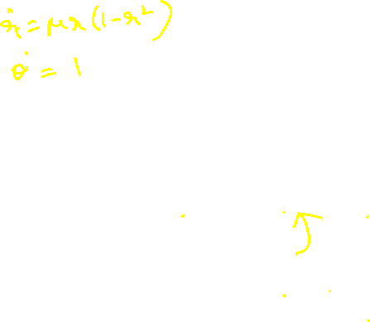
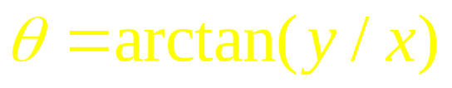
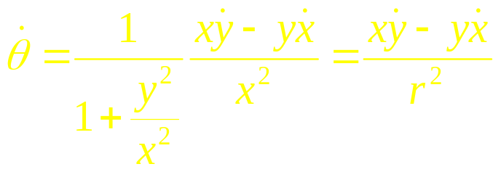
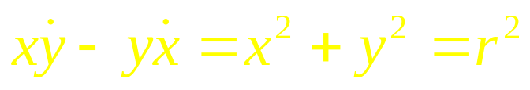

Now consider,
Differentiating both sides,
Using eqns. (5.1a,b) we have,
Combining eqn. (5.3) and eqn. (5.4) we have,
Thus eqns. (5.1a,b) are reexpressed as, eqns. (5.2) and eqn. (5.5).
(5.3)
(5.4)
(5.5)

Slide 14
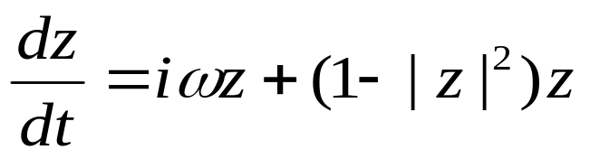
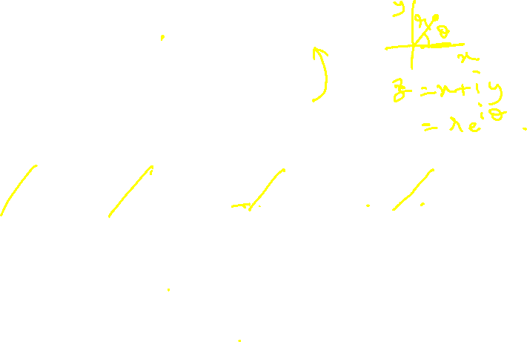
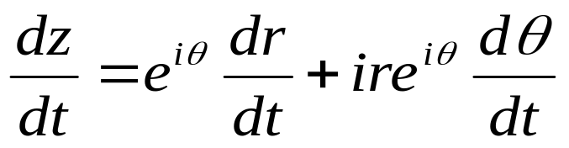

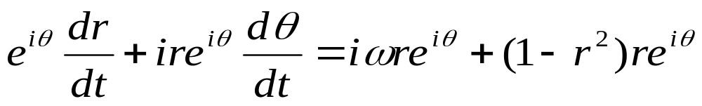
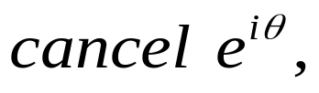
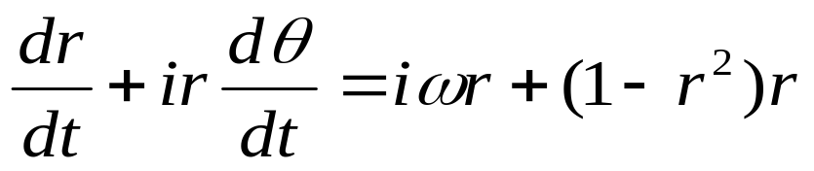
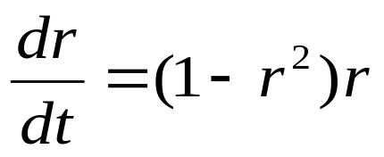
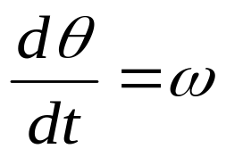
In Complex variable form
Let
Equating real and
imaginary parts:

Slide 15
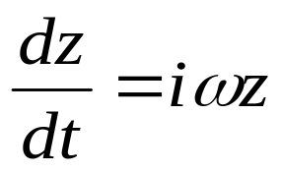
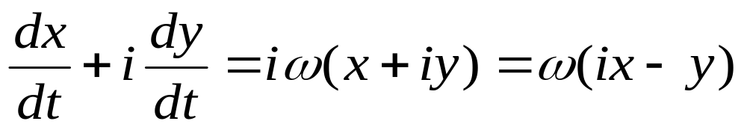
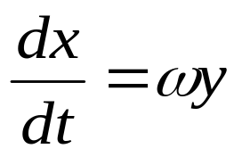
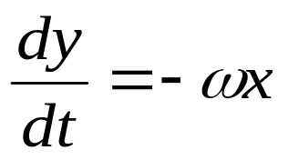
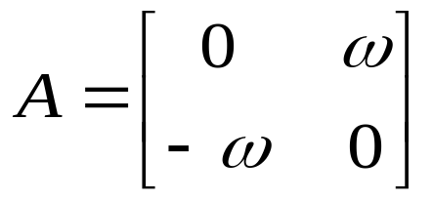

No nonlinearity → SHM
Eliminating nonlinearity…

Slide 16
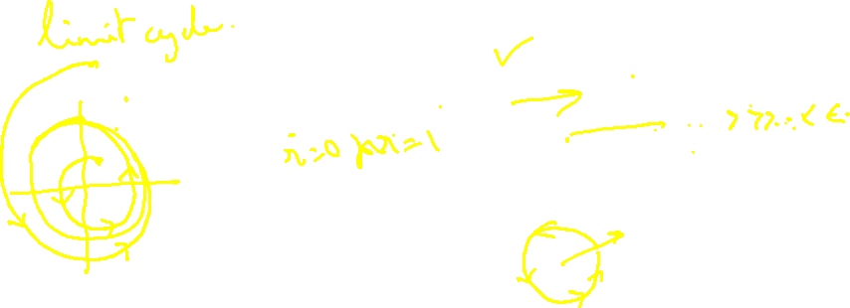
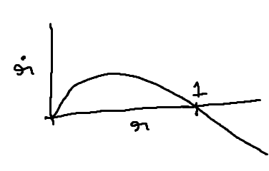
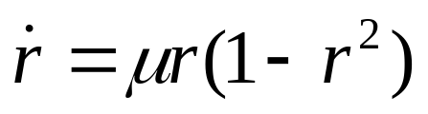
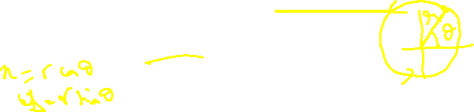
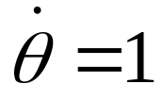
Dynamics in polar form
r approaches the stable of value 1: dr/dt is positive for r < 1, and is negative for r >1.
Thus we have a limit cycle which is a circle of unit radius and angular velocity of

Slide 17
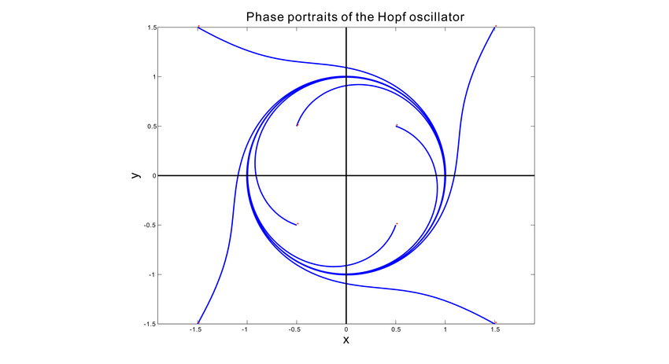
Hopf Oscillator

Slide 18
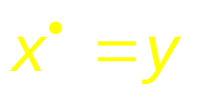
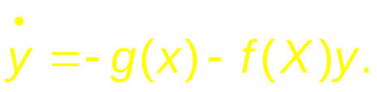
2.Lienard systems
This represents a slight improvement over showing limit cycles only in individual systems.
Lienard systems are a general class of systems that exhibit limit cycles under some conditions.
Liénard’s equation is equivalent to the system

Slide 19
The following theorem states that this system has a unique, stable limit cycle under appropriate hypotheses on and g. For a proof, see Jordan and Smith (1987), Grimshaw (1990), or Perko (1991).

Slide 20
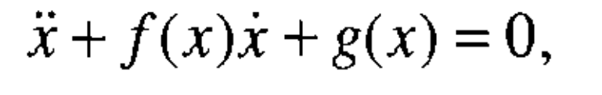
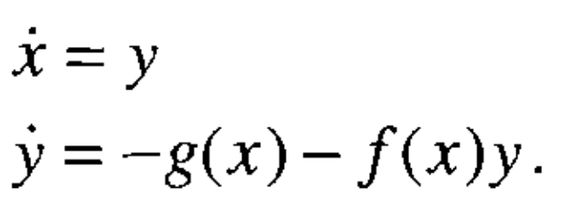
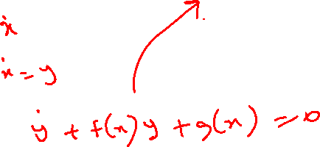
Lienard’s Theorem

Slide 21
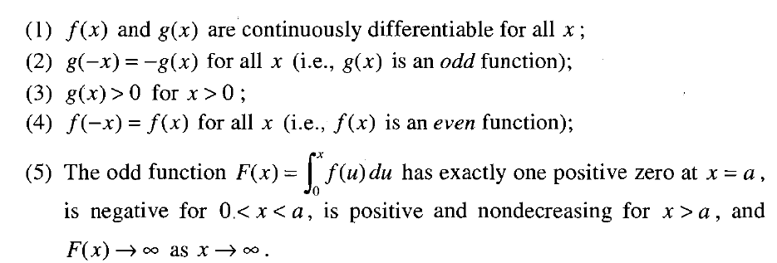
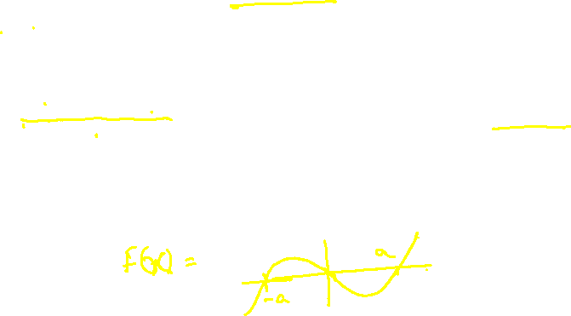
Lienard’s Theorem
Suppose that f (x) and g(x) satisfy the following conditions :
Then the system has a unique, stable limit cycle surrounding the origin
(Strogatz – Section 7.4)

Slide 22

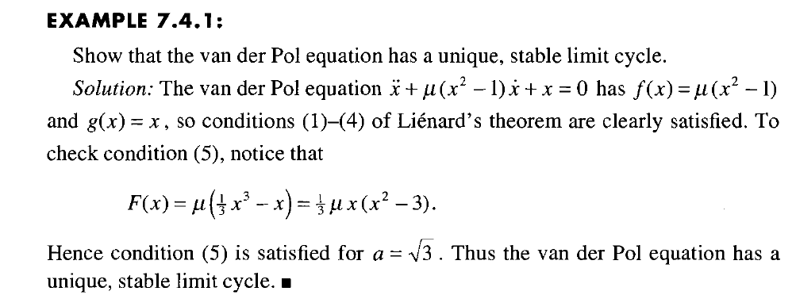
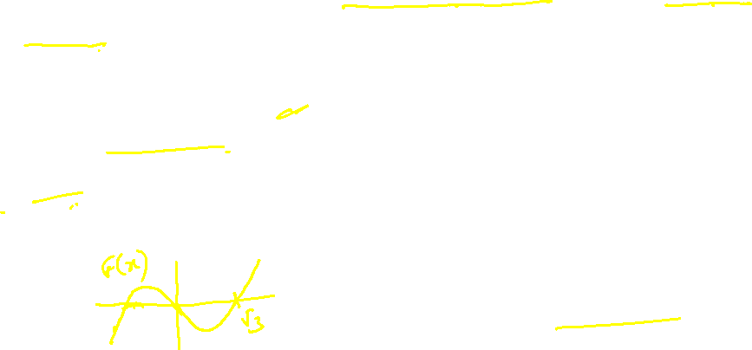
Example
(Strogatz)

Slide 23




Even function
Odd function; g(x)>0 for x>0

Slide 24



Slide 25
3. Poincare-Benedixson Theorem:
This theorem specifies conditions in 2D systems under which limit cycle exists. It is based on the idea that in a dynamic system dx/dt = f(x), where f(x) is continuous, no two trajectories intersect.
Therefore, if there is a limit cycle, then all trajectories that start from inside the limit cycle will remain confined within the limit cycle. They can never come out of the limit cycle since to come out they have to cross the limit cycle, which is disallowed.
X
After this sir moved to biology part , and kept next for later

Slide 26

A formal statement of Poincare-Benedixson theorem is given below.
represents a continuously differentiable vector field on an open set containing a region R, Where
R is a closed, bounded subset of the plane, which is devoid of any fixed points, and
There exists a trajectory C that is “confined” in R (if it starts in R it stays in R forever).
If the above conditions are satisfied, C is a closed orbit.

Slide 27
It is not straightforward to apply Poincare-Benedixson theorem to a given system and show presence of limit cycles. Such demonstration depends crucially on construction of a trapping region, R, such that vector field on the borders of R points inwards everywhere.
There is a theorem from Index theory that any closed orbit must enclose one or more fixed points. Since Poincare-Benedixson requires that R must not include any fixed points, we need to construct an R that excludes all fixed points.
Typically a ring-like, annular region is chosen such that vector field is pointed inwards on the outer boundary, and outwards on the inner boundary.
If such a region can be constructed, Poincare-Benedixson assures us that a limit cycle exists inside R. Exact construction of R depends on the details of the equations that describe the system.

Slide 28

(Strogatz 1994)

Slide 29


Slide 30



A method for
Drawing the Vector Field on the Phase Plane

Slide 31


Example for application of PB theorem

Slide 32


Slide 33


Slide 34

X nullcline
Y nullcline

Slide 35

Slope = -1

Slide 36


Slide 37


Slide 38


Slide 39


Slide 40


Slide 41

6.0 Limit Cycle generation by Bifurcation:
Bifurcation: As the parameters of a dynamic system are changed gradually, at certain critical values of the parameters, the dynamics can change qualitatively.
For example, a stable node may change into an unstable node.
Such qualitative changes in dynamics are known as bifurcations.
The parameter values where such changes occurs are called bifurcation points.

Slide 42



A Simple example

Slide 43
Two important types of bifurcations by which limit cycles can be produced are
Supercritical Andronov-Hopf bifurcation
Subcritical Andronov-Hopf bifurcation

Slide 44
6.1 Andronov-Hopf Bifurcation – supercritical and subcritical
In Andronov-Hopf bifurcation, a stable focus gets converted into an unstable focus giving rise to a limit cycle in the process. A stable focus, as we know from the previous section, has complex valued eigenvalues with negative real parts; the eigenvalues of the unstable focus has positive real parts. Thus Andronov-Hopf bifurcation occurs when a pair of complex conjugate eigenvalues cross over from the left halfplane to the right.
λ1
λ2

Slide 45
Depending on the precise manner in which a stable focus gets destabilized and leads to a limit cycle, the Andronov-Hopf bifurcation can be classified into two types.
In supercritical Andronov-Hopf bifurcation, when a stable focus becomes a limit cycle, the limit cycle first starts with a small/infinitesimal amplitude and gradually increases in size.
This behavior can be seen in an example.

Slide 46


Supercritical Andronov-Hopf Bifurcation
6.1.1a
Note that θ does not influence evolution of r (in eqn. (6.1.1.a)) but r influences θ (in eqn. (6.1.1.b)). Therefore changes in amplitude may be studied solely by studying eqn. (6.1.1.a).
Note how the steady state value of r changes as m is increased from a negative value to a positive value. For μ <0, the only real solution is r = 0; for μ >0, there are three real solutions: r = 0, + sqrt(μ). Since r has to be positive, the solutions are r = 0 and sqrt(m). Eqn. (6.1.1.b) simply says that angular velocity increases with increasing radius.
6.1.1b

Slide 47



Slide 48

Therefore, if we express the steady-state radius, r_{s}, as a function of bifurcation parameter, μ ,
It can be easily verified that in the system defined by eqns. (6.1.1.a,b), the eigenvalues at the origin cross over from the left half-plane to the right, as μ crosses over from negative to positive values.
for μ>0, and

Slide 49




Eigen values analysis for eqns. (6.1.1.a,b)

Slide 50





Slide 51

Properties of supercritical Andronov-Hopf bifurcation
Size of the limit cycle,r_{0,} grows as for μ close to μ_{c}.
r₀
0

Slide 52





2. Frequency , evaluated at
Formula is exact at birth of the limit cycle.

Slide 53




Analogy
Top view
Stable Limit
Cycle
Unstable
Fixed point
Side View
“Mexican hat”
Side View – “Cross-section”

Slide 54
Subcritical Andronov-Hopf bifurcation:-
In a subcritical Andronov-Hopf bifurcation, when the unstable focus destabilized, a limit cycle of finite size sudden appears, unlike in the supercritical case the limit cycle starts of small and grows gradually as the bifurcation parameter increases.

Slide 55



μ<0
An example of a system which exhibits subcritical Andronov-Hopf bifurcation is given below:
Thus for μ < 0, there is no limit cycle; there is a stable fixed point at the origin.

Slide 56


μ<0

Slide 57


But when μ >0, there is suddenly a limit cycle at r = r0, a finite value.

Slide 58

μ>0

Slide 59

Thus, in supercritical Andronov-Hopf bifurcation, the size of limit cycle varies as a function of μ as follows:

Slide 60



Analogy
Top view
Stable Limit
Cycle
Stable
Fixed point
Unstable Limit
Cycle
Side View
“Mexican hat”
Side View – “Cross-section”

Slide 61

Thank You

