Slide 1
Get those recipes Group 4 By Tanuja Tanushree-0104, Atharva Saney-0069, Mayank Khurana-0004, Pushkar Pushp-0061

Slide 2
Problem
Solution
The objectives is to create a recipe parser that can extract structured information from a recipe, such as the ingredients, quantities, and instructions, in a format that is easy to use and manipulate.
We created a parser using different NLP techniques and regular expression which could capture every required parameters in a group and do manipulation according to the query

Slide 3
Methodology
Extract the required information using regular expression and selenium then use features such as question and answers, speech and user interactions
Data Collection | We have a 2 source of data collection one is by scrapping the renowned website and other is the already created Kaggle dataset
Configuration | Input include website to scrape, attributes including quantity, unit, suffix, display name and other GUI information.
Build | Define the regular expression pattern. This can include specific characters, wildcard characters, or a combination of both.
Helper Functions | Pre defined helper functions are used that are applied before or after the pattern is returned to push out the garbage value
Features | To identify and classify different components of a recipe, such as ingredients, units of measurement, cooking methods, and equipment, and to organize them into a consistent and well-defined structure, question answer generations, speech recognition and user interactions
GUI | Created GUI using tkinter which handles user interaction.

Slide 4

Result
We can now extract and organize information from a recipe in a structured and useful format, and to enable the integration and analysis of this information in a variety of applications and contexts such as handling question and answers of the steps followed and speech suggestions.

Slide 5
Examples
Inputs
website = 'https://recipes.timesofindia.com/recipes/'
recipe = 'dal makhani'
req_attrib = ['quantity','unit','suffix','displayname']
serving = 10
Outputs
Ingredients - {1: {'quantity': '2', 'unit': 'cup', 'suffix': 'soaked overnight', 'displayname': 'red kidney beans'}, 2: {'quantity': '1', 'unit': 'teaspoon', 'suffix': '', 'displayname': 'red chilli powder'}, 3: {'quantity': '4', 'unit': 'tablespoon', 'suffix': '', 'displayname': 'butter'}, 4: {'quantity': '1', 'unit': 'large', 'suffix': 'chopped', 'displayname': 'onion'}, 5: {'quantity': '1/2', 'unit': 'cup', 'suffix': '', 'displayname': 'tomato puree’}….
Steps - {0: 'To prepare this popular dish, soak sabut urad and rajma overnight in three cups of water. Drain it and pressure cook in 6 cups of water with salt as per taste. This makes the rajma and dal soft.',
1: 'Take a kadhai on medium flame, then heat the oil and add the cumin seeds.}…

Slide 6
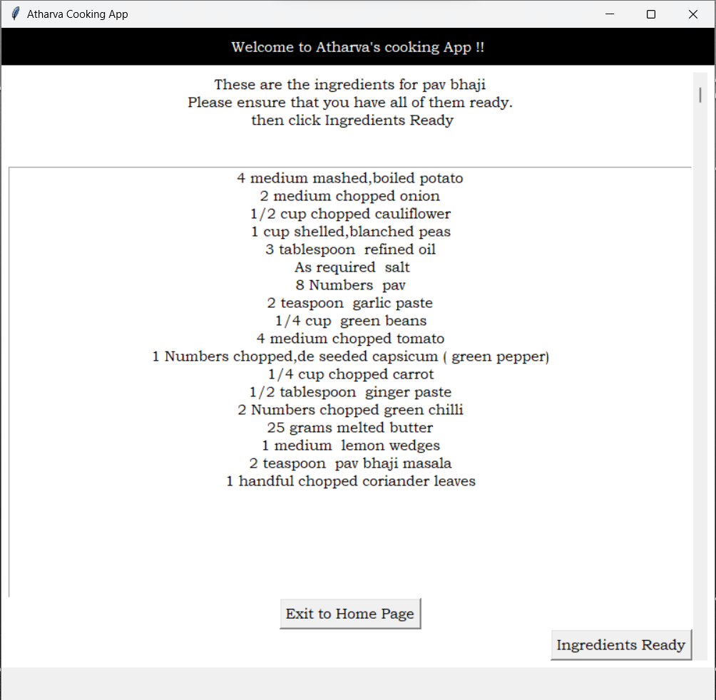
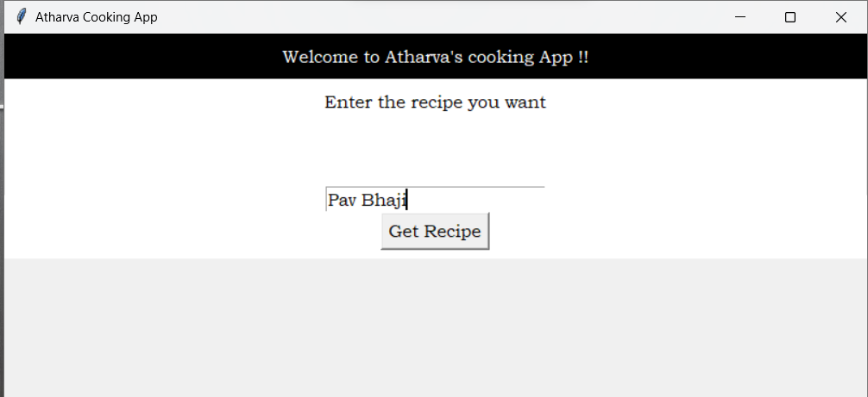
GUI Outputs

Slide 7
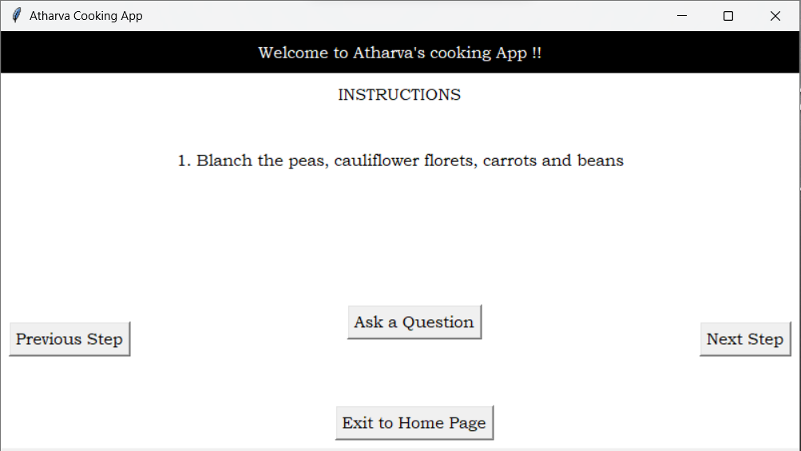
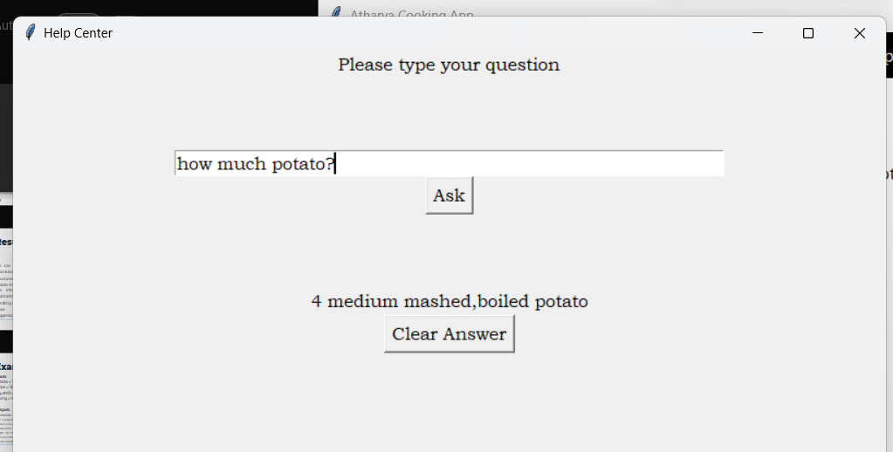
GUI Outputs

Slide 8
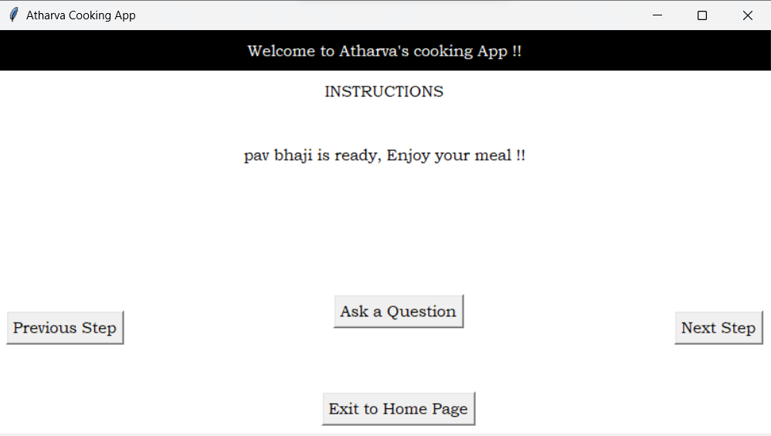
GUI Outputs

Slide 9
Error analysis
Inconsistent formatting: Recipe data may be presented in a variety of formats, making it difficult to parse and extract the information in a consistent and standardized way. For example, a recipe may use different fonts, colours, or layout styles, or it may include images or other non-text elements that cannot be easily parsed.
Ambiguity or uncertainty: Recipe data may be ambiguous or uncertain, making it difficult to accurately interpret the intended meaning. For example, a recipe may use vague or imprecise language, such as "a pinch of salt" or "a handful of nuts," which cannot be easily quantified or standardized.

