Slide 1
Real-Time Vital Signs Monitoring System
Safety-Critical Healthcare Monitoring Using Python
Atharva Shaileshbhai Patel
Introduction to Software Engineering
224833528

Slide 2
Problem & Vision
Problem Statement:
Traditional monitoring may fail to detect early signs of deterioration.
Alarm fatigue is common due to frequent alerts.
Vision Statement:
Develop a Python-based simulation of vital signs monitoring.
Trigger alerts when thresholds are crossed to improve response time and patient safety.
Continuous patient monitoring is critical in healthcare.
Challenges: -
Manual threshold management leads to human error.
Static alert systems may generate false alarms.
Requirement engineering in safety-critical systems is complex.
Limitations of Requirement Engineering:
Challenges in Traditional Systems:
Standard interviews/user stories may miss emergent safety-critical requirements.
Difficulty capturing dynamic patient state and risk mitigation in early design.

Slide 3
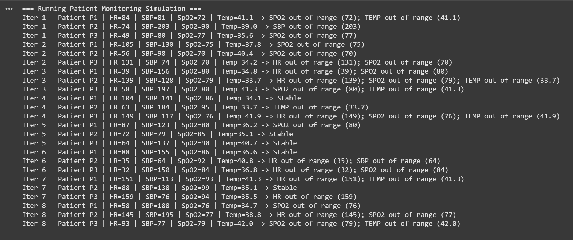
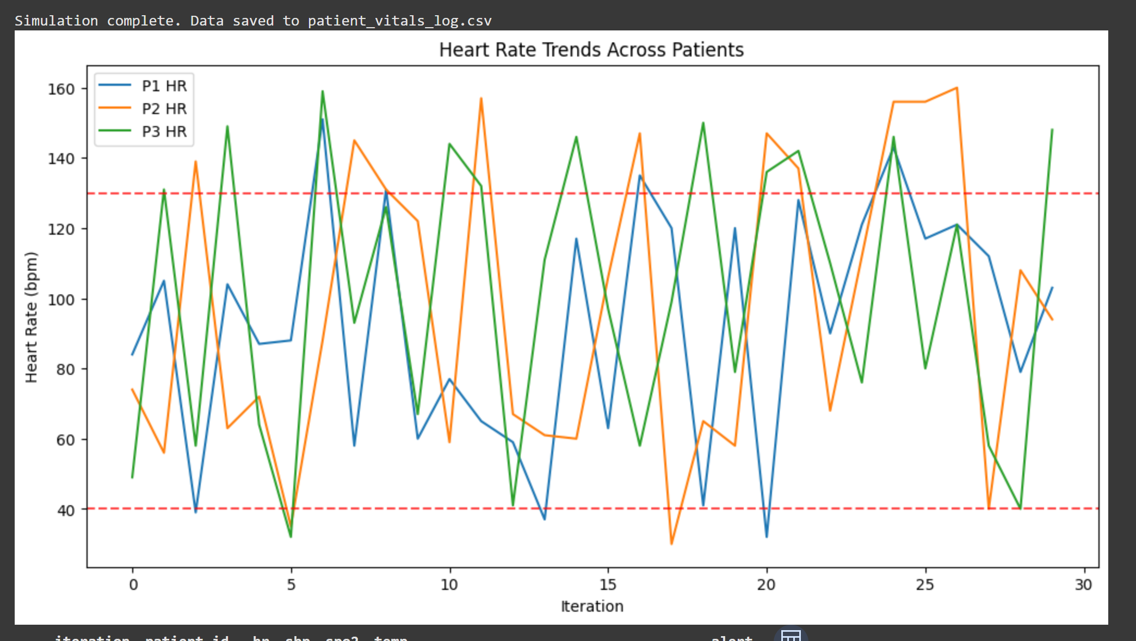
Prototype & Approach
Proposed Solution:
Python console app simulates vital signs: heart rate, temperature, oxygen saturation.
Randomized values mimic real-time variability.
Alerts triggered when thresholds crossed.
Engineering Approach:
Requirements gathered from safety-critical system guidelines.
Rapid prototype validates core functionalities before expansion.
Follows software engineering best practices (systematic testing, modular design).
Screenshot / Demo Preview:

Slide 4
thank you
BRITA TAMM
502-555-0152
brita@firstupconsultants.com
www.firstupconsultants.com

