Slide 1
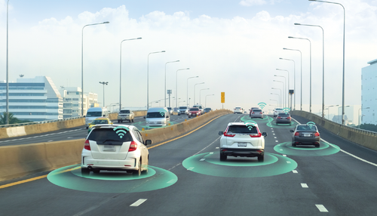
Cloud-Based Crash Detection Using Arduino Nano 33 IoT
SIT225 Final Project Presentation
Atharva Shaileshbhai Patel
224833528

Slide 2

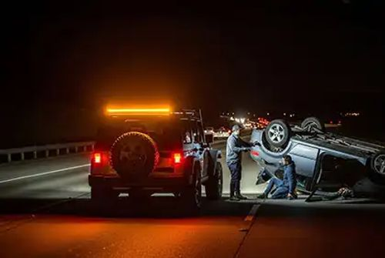
Problem Statement
Road accidents cause over 1.3 million deaths annually (WHO, 2023).
Existing crash detection systems are expensive and inaccessible to low-resource users.
Many rely on proprietary hardware, lack real-time cloud integration, or are difficult to validate.
Goal: Build a low-cost, real-time crash detection system using Arduino Nano 33 IoT and cloud-based monitoring.

Slide 3
Literature Review
Existing Solutions Reviewed:
AlGadi et al. (2024) Developed an Arduino + GSM-based accident detection system.
Focused on secure architecture but lacked cloud
dashboard and real-time analytics. Source: SpringerLink
Kumar et al. (2016) Used smartphone accelerometer with threshold logic.
Simple and cost-effective, but no structured logging or
cloud integration. Source: IEEE Sensors Journal
Zhou et al. (2021) Explored cloud-integrated IoT sensing for motion detection.
Scalable design, but not tailored to crash-specific
scenarios. Source: MDPI Sensors
Omar et al. (2024) Built a GPS-based Arduino system for accident tracking.
Sent alerts via GSM but lacked dashboard
visualization and validation tools. Source: SSRG Journal
Identified Gaps:
No real-time cloud dashboard
No structured CSV logging for validation
Limited use of onboard IMUs
No iterative refinement or analytics

Slide 4
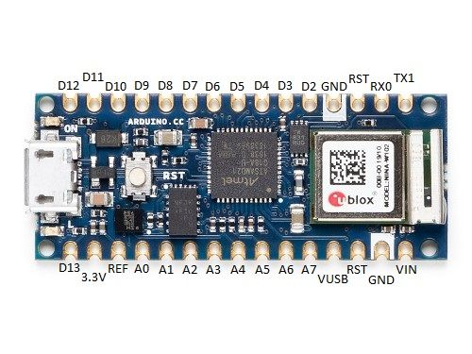
System Architecture
This system is built around the Arduino Nano 33 IoT, chosen for its onboard LSM6DS3 IMU and native cloud support.
Sensor Input: The IMU captures X, Y, Z acceleration data at 2 Hz.
Microcontroller Logic: A threshold-based algorithm classifies motion events into three categories: Normal, Sudden Movement, and Crash Detected.
Cloud Sync: Data is transmitted to the Arduino IoT Cloud, where variables are visualized in real time.
Local Logging: Serial output is captured by a Python script and saved to crashdata.csv for offline analysis.
Modularity: The system is designed to easily integrate GPS, ML models, or alert mechanisms in future iterations.
This architecture balances simplicity, scalability, and academic rigor — ideal for real-world deployment and classroom validation.

Slide 5
Methodology
The system uses a threshold-based decision model to classify motion events based on linear acceleration:
Data Capture:
IMU samples X, Y, Z acceleration at 2 Hz
Linear acceleration is computed using √(x² + y² + z²)
Classification Logic:
10–20 m/s² → Sudden Movement
20 m/s² → Crash Detected
Cloud Dashboard:
Live widgets display acceleration values and crash status
Visual feedback enables real-time monitoring
CSV Logging:
Python script captures Serial output
Structured data saved to crashdata.csv
Enables validation, pattern analysis, and future ML training
This method ensures real-time responsiveness while maintaining a clear audit trail for academic and
technical evaluation.

Slide 6
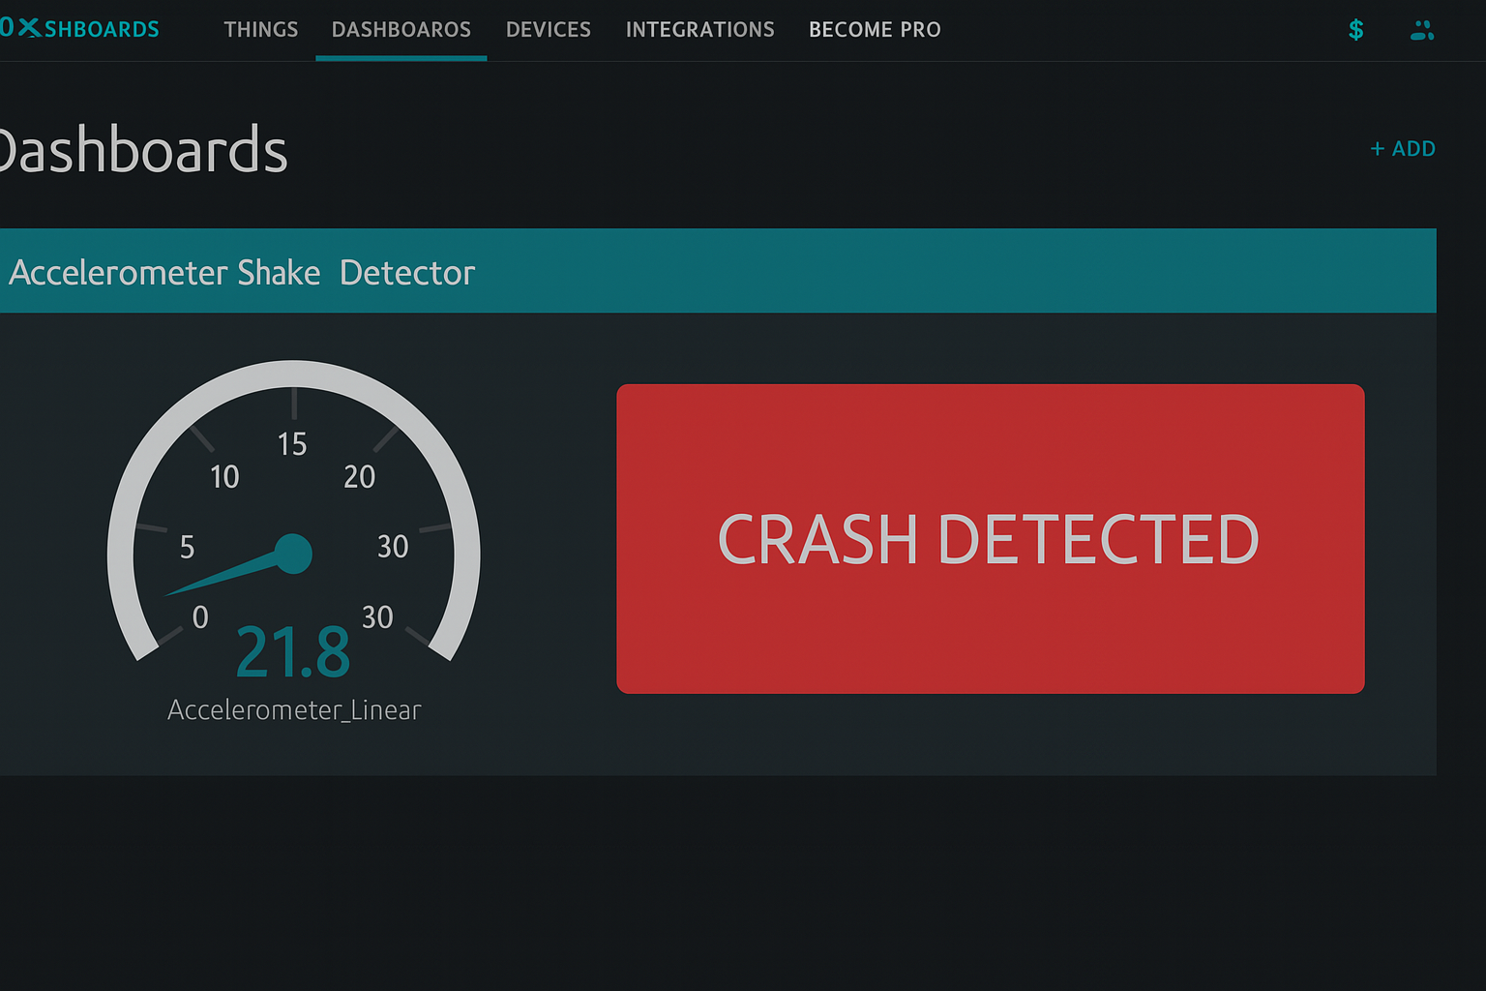
Dashboard & Analytics
Real-Time Monitoring:
Arduino IoT Cloud dashboard displays live acceleration values (X, Y, Z).
Crash status updates instantly based on threshold logic.
Widgets Used:
Gauge meters for each axis.
Text box for crash status: “Normal”, “Sudden Movement”, “Crash Detected”.
CSV Logging:
Python script captures Serial output.
Structured data saved to crashdata.csv for offline analysis.
Analytics Insights:
Identified false positives during braking.
Adjusted threshold to 22 m/s² for better accuracy.
Z-axis weighting improved vertical impact detection.

Slide 7

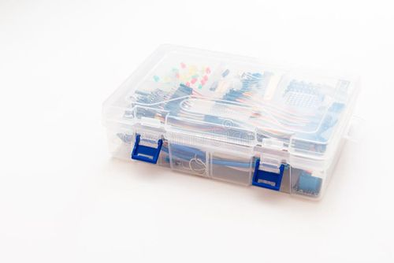
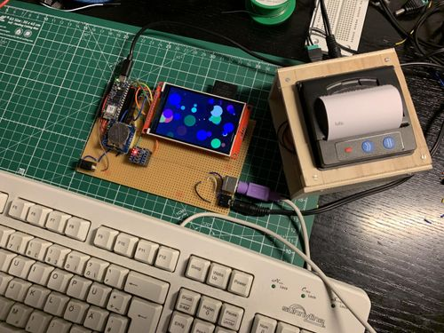
Budget and Ethical Considerations
Hardware Costs:
Arduino Nano 33 IoT – $45 AUD
USB Cable – $5 AUD
SD Card Module (optional) – $12 AUD
Breadboard & Jumper Wires – $8 AUD
Power Bank (optional) – $15 AUD
Total: ~$85 AUD
Privacy & Security:
No personal or location data collected.
Cloud data encrypted via Arduino IoT Cloud.
Local CSV stored securely.
Risk Mitigation:
No GPS tracking in current version.
Future ML training will use anonymized data.
User consent protocols planned for future alert systems.
Ethical Design Goals:
Transparency in data use.
Responsible handling of motion data.
Scalable without compromising privacy.

Slide 8

Conclusion
Project Summary:
Built a real-time, cloud-integrated crash detection system.
Validated using simulated motion patterns.
Dashboard and CSV logging support academic and technical evaluation.
Impact:
Affordable, scalable, and academically rigorous.
Ideal for low-resource environments and student-led innovation.
Next Steps:
Add GPS for location-based alerts.
Integrate emergency notification system.
Train ML models using labeled CSV data.
Develop mobile app interface for real-time alerts.

