Slide 1
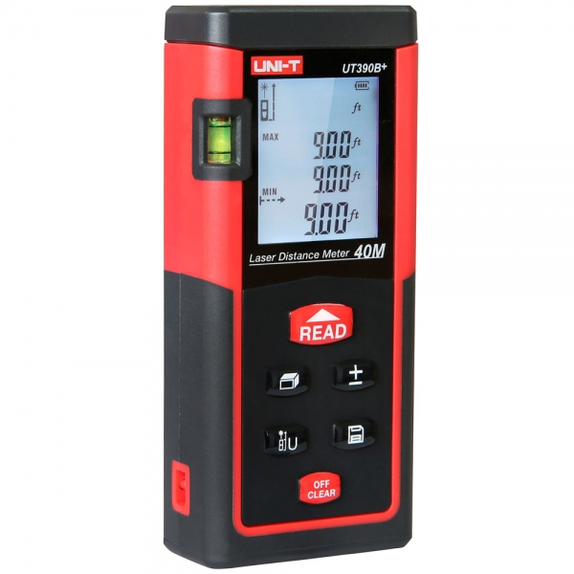
AUTOMATION Of Laser Distance Meter
Project Member
Rahul Kelaskar
Manthan Rathod
Atharva Ajgaonkar

Slide 2
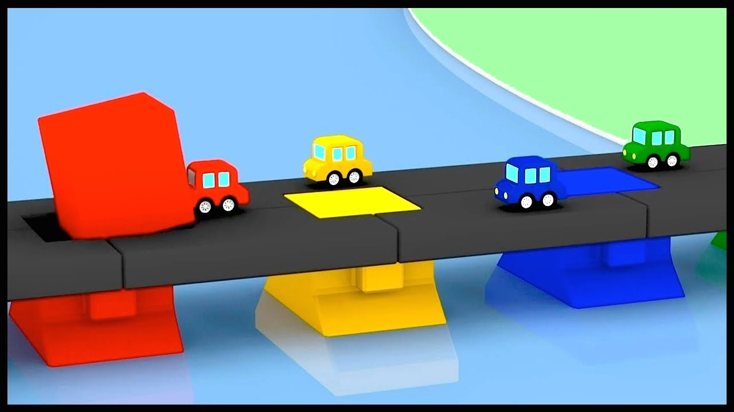
Problem Statement
In Civil Engineering Testing of bridge & its strength is measured by deflection in bridges by passing different loads on it.

Slide 3
Problem Statement
For calculating deflections Laser Distance Meter is used .
It is mounted beneath bridge and bridge is tested for different loads.
BUT , Laser Distance Meter can only be operated manually so one must have to be there on site , So how can we change this scenario ?

Slide 4
Introduction :
Laser Distance Meter has accuracy of 1mm .
It has range upto 100 m .
Automation of laser sensor can be done by using iot ,edge computing also known as fog computing .

Slide 5
Objective
Node -
Collecting data from Laser Sensor and Sending it to Edge via tcp.
Take Incoming commands from edge and change configuration of laser sensor .
Edge -
Edge will collect Data from all Nodes and store it to Database.
Forward data to Cloud via websockets.
Forward command coming from cloud to specified Node .

Slide 6
Objective
Cloud –
Cloud will perform role of webserver and creates websocket with each client .
Cloud code will run on Heroku platform .
Pass commands coming from web to edge .
Web –
Web interface will take inputs from users and send it to Cloud & displays data coming from nodes to web.

Slide 7





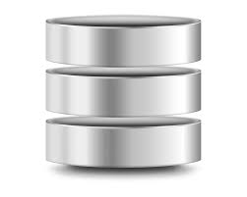

Cloud
Edge
websocket
Web Interface
http, websocket
Server
tcp
tcp
tcp

Slide 8
Hardware and Software
Hardware
Laser Distance Meter MODULE
Esp8266
Computer for Edge Computing.
Software
Golang – BACKEND , EDGE ANALYTICS .
MySQL/MongoDb database
HTML5,CSS3,JAVASCRIPT FRONT END

