Slide 1
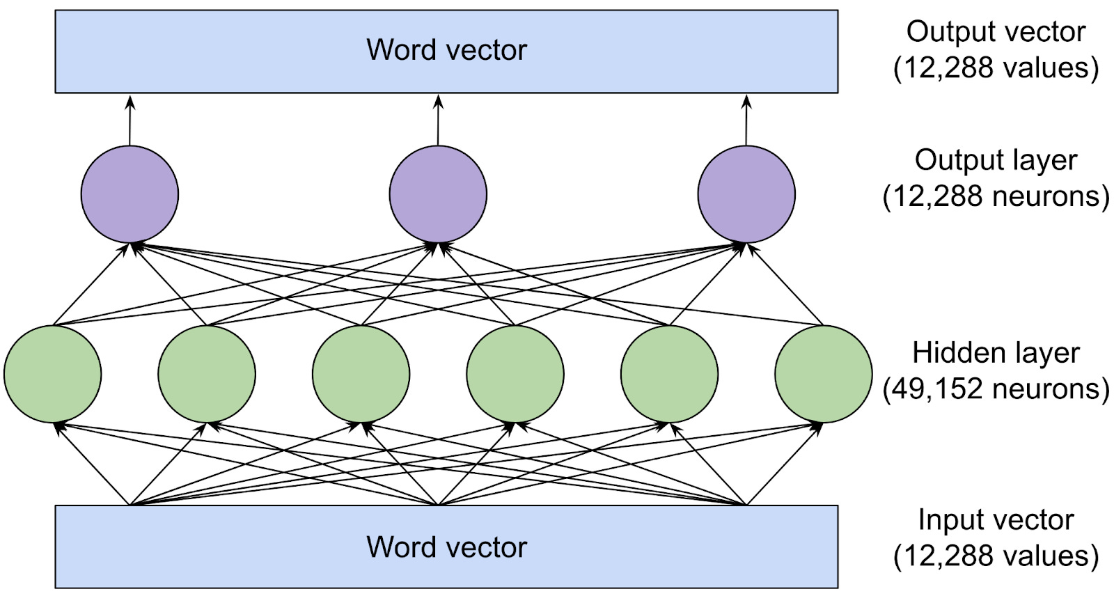
What is an LLM?

Slide 2
Introduction to LLMs
Definition: Scaled transformer models (billions of parameters) for NLP tasks.
Purpose: General-purpose language understanding and generation.
Examples: BERT, GPT, T5, Mistral, DistilBERT.
Use Cases:
BFSI: Chatbots for customer support.
Healthcare: Q&A for medical queries.
IT: Automated log analysis.
Relevance: Power modern Gen AI and Agentic AI.

Slide 3
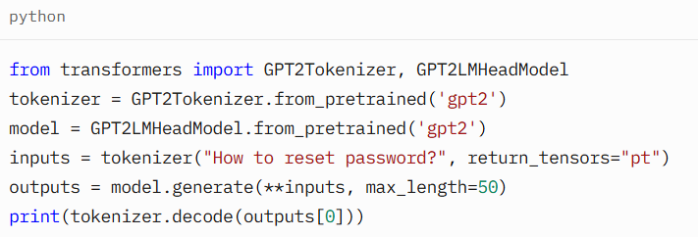
LLM Architecture
Base: Transformers (encoder, decoder, or both).
Components: Multi-head attention, FFNs, positional encoding, normalization.
Scaling: 100M–175B parameters (e.g., GPT-3: 175B).
Training: Pre-training on massive text (e.g., Wikipedia, Common Crawl), fine-tuning for tasks.
Example: GPT-2 generating IT support responses.

Slide 4
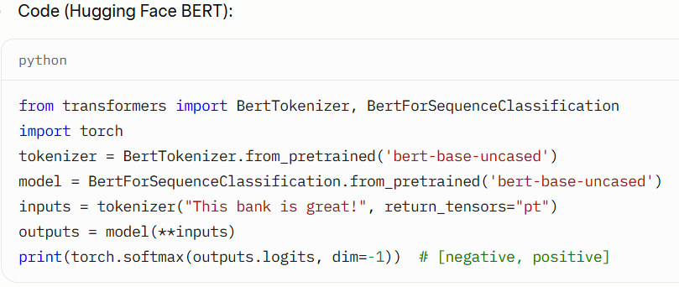
LLM Variants - BERT and DistilBERT
BERT: Bidirectional, Masked Language Modeling (MLM), classification tasks.
DistilBERT: Smaller, faster BERT (40% fewer parameters, 60% faster).
Example: Sentiment analysis of “This bank is great!” (BFSI).

Slide 5
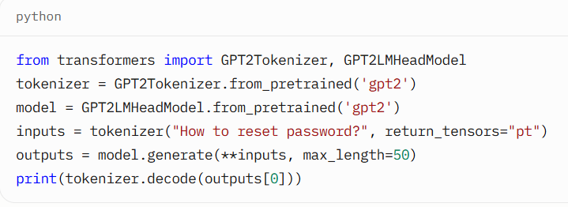
LLM Variants - GPT and Mistral
GPT: Decoder-only, autoregressive, text generation.
Mistral: Efficient decoder-only (e.g., Mixtral 8x7B), open-source.
Example: Generating IT support responses.

Slide 6
A Large Language Model predicts the next word/token in a sequence
It learns:
✅ Grammar & sentence structure ✅ Relationships between words (king ↔ queen) ✅ World knowledge (Mysuru, India, rulers, etc.)
Learned from billions of text examples → forms patterns, not stored facts

Slide 7
What happens when you type a prompt?
Example prompt: “Who was the last king of Mysuru?”
LLM pipeline:
1 Break text into tokens 2 Convert tokens → vectors (embeddings) 3 Model processes vectors using learned parameters 4 Predicts next tokens → forms final answer

Slide 8
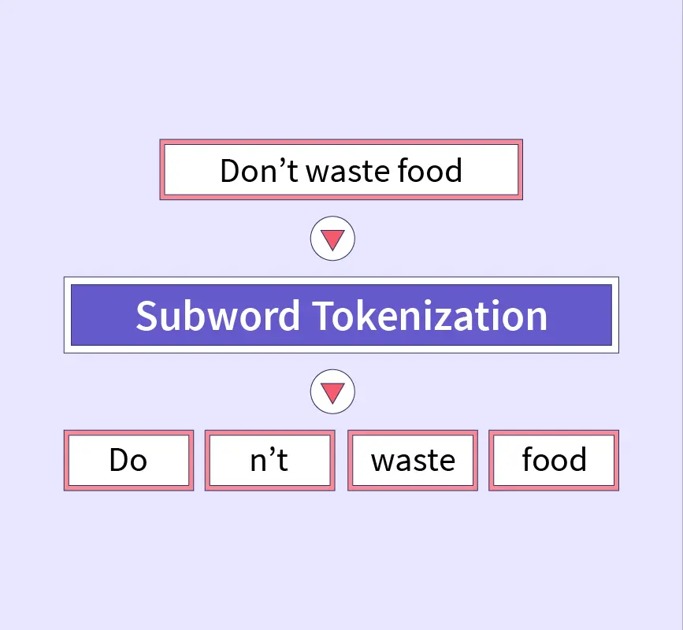
What is a Token?

Slide 9
What is a Token?
Smallest pieces of text model understands
Not always full words
Can be: ➤ Words ➤ Sub-words ➤ Characters ➤ Special symbols

Slide 10
Word-Based Tokenization
Splits on spaces/punctuation.
Pros: Simple, human-readable.
Cons: Rare words (e.g., "Mysuru") become "unknown" tokens (UNK), handled as [UNK].
Example: "Who was the last king of Mysuru?" → ["Who", "was", "the", "last", "king", "of", "Mysuru", "?"]

Slide 11
Subword Tokenization (e.g., Byte-Pair Encoding – BPE)
Merges frequent character pairs into subwords (e.g., "ing" or "un").
Pros: Handles rare words by breaking them (e.g., "Mysuru" → "Mys" + "uru"); smaller vocab.
Cons: Less intuitive splits.
How It Works: Start with characters, iteratively merge common pairs (e.g., "t" + "h" → "th").

Slide 12
Why subwords?
✔ Reduces vocabulary size ✔ Handles rare/new words like “Mysuru” better ✔ Efficient training

Slide 13
Character-Based Tokenization
Splits into single characters.
Pros: Tiny vocab (~100 tokens); no unknown words.
Cons: Long sequences (e.g., sentence needs 50+ tokens); slower processing.

Slide 14
Tokenization Techniques
Technique | How it splits | Pros | Cons | Models
Word-level | Full words | Simple | Fails on rare words | Old models
Character-level | Every character | Handles anything | Very long sequences | Some research
BPE (Byte Pair Encoding) | Frequent chunks | Good balance | Sometimes weird splits | GPT-2, Llama
WordPiece | Subword optimized | Great for search | Needs vocabulary | BERT
SentencePiece | Unicode-level | Multi-language | Requires training | GPT-3, PaLM

Slide 15
Differences Table:
Technique | Vocab Size | Handles Rare Words? | Speed | Example Split for "Mysuru"
Word-Based | Large | Poor (uses UNK) | Fast | ["Mysuru"]
Subword (BPE) | Medium | Good (subparts) | Medium | ["Mys", "uru"]
Character | Small | Excellent | Slow | ["M", "y", "s", "u", "r", "u"]

Slide 16
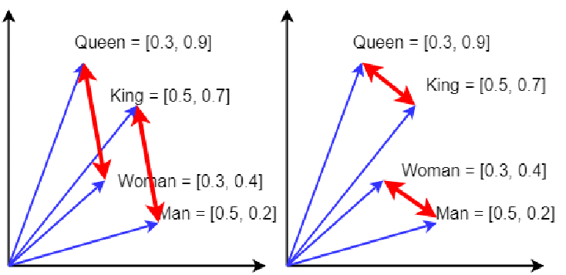
Embeddings: From Words to Vectors
Example semantic relation: queen — king = woman — man
Embeddings give meaning, not just spelling

Slide 17
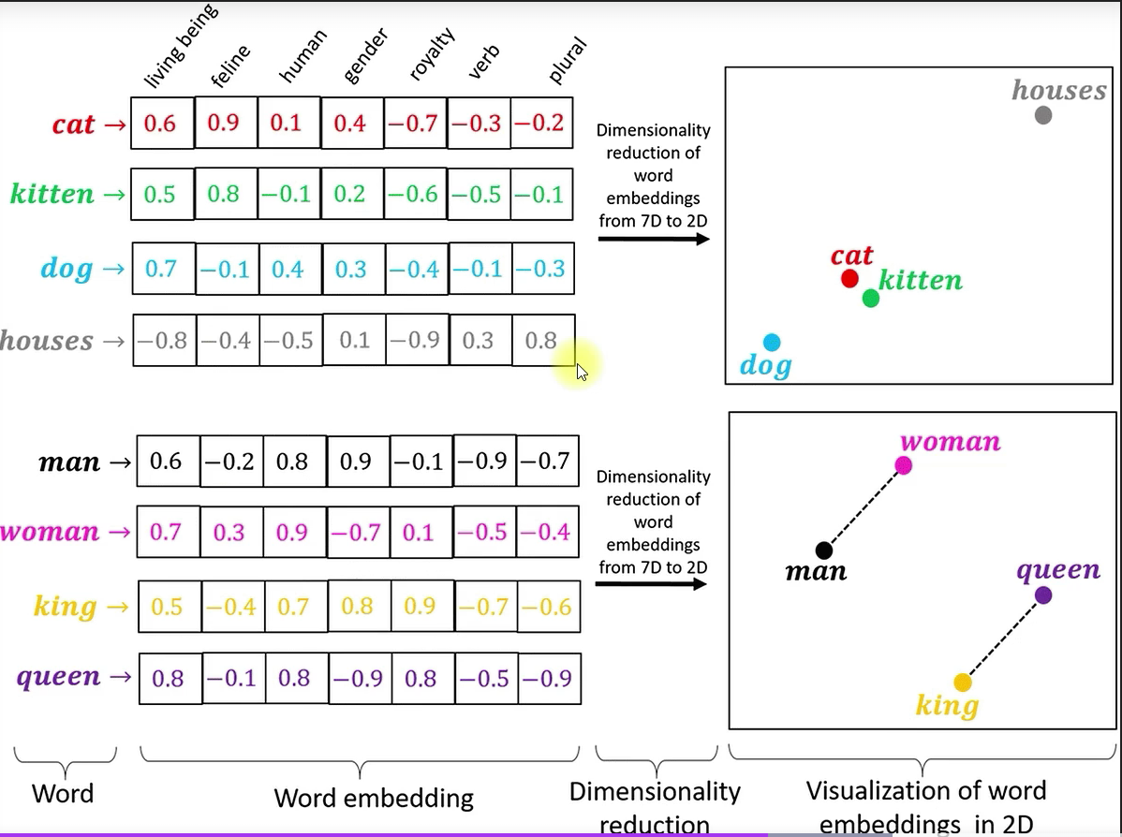

Slide 18
Embeddings: From Words to Vectors
What Are Embeddings? Numerical representations of tokens – high-dimensional vectors (e.g., 768 numbers) capturing meaning.
How Learned: During training on huge datasets, model adjusts vectors so similar words are "close" in space.
Vocabulary Example: Model trained on 50,000 unique tokens. "King" stored as: [0.23, -0.45, 1.12, ..., 0.67] (a 768-float vector).
Analogy: Like coordinates on a map – "king" at (5, 3), "queen" nearby at (5.1, 2.9) because they're related.
Process: Token ID → Lookup embedding table → Vector ready for math in the model.

Slide 19
What has the model “learned”?
LLMs learn statistical relationships from massive text corpus:
Example: “king” → royalty, ruler, historical context “Mysuru” → city in Karnataka, Wodeyar dynasty
So when prompt says: → “last king of Mysuru” Model connects king + Mysuru via embeddings + learned knowledge
⚠️ It does not copy from database — it predicts based on patterns

Slide 20
The Model's "Brain" – Parameters and Processing
Parameters = weights inside neural network
Represent model memory + knowledge
Example sizes: GPT-3: 175B | Llama2: 70B
Bigger parameters → ✔ Better understanding ✔ More knowledge ✘ More compute required

Slide 21
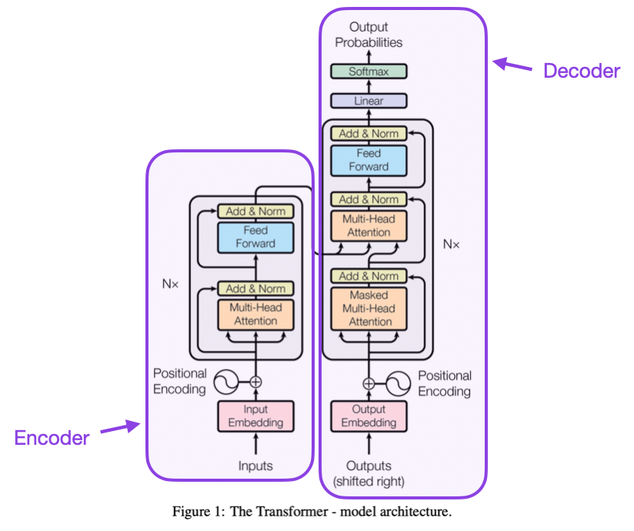

Slide 22
Attention Mechanisms and Transformers
Attention Mechanisms - The Spotlight of A
Objective: Understand how attention powers transformers.
What is Attention?: Like a spotlight, it focuses on important words in a sentence for better context (e.g., “loan” in “Bank offers loan”).
Types:
Additive: Adds weights to score importance (older, less common).
Multiplicative: Uses dot products for efficiency.
Scaled Dot-Product: Balances large vectors (used in transformers).

Slide 23
How It Works:
Queries (Q), Keys (K), Values (V) compute weights.
Formula: Attention(Q, K, V) = softmax(QK^T / sqrt(d_k))V.
Example: In “HDFC Bank offers loan,” “loan” gets high weight for sentiment.
Use Case: BFSI (sentiment analysis), Healthcare (Q&A), IT (log analysis).
Visual: Attention heatmap for “HDFC Bank offers loan.”

Slide 24
Transformer Architecture - The LLM Backbone
What is a Transformer?: A neural network using attention to process text, replacing slow RNNs with parallel speed.
Components:
Encoder: Reads input (e.g., BFSI contract).
Decoder: Generates output (e.g., IT support response).
Attention: Links words for context.
Feed-Forward: Adds reasoning layers.
Positional Encoding: Tracks word order.
Use Case: BFSI (contract translation), Healthcare (report summarization), IT (chatbots).
Visual: Encoder-decoder diagram; trace “Bank offers loan” flow.

Slide 25
Self-Attention & Multi-Head Attention - Deep Dive
Self-Attention:
Each word “looks” at all words (e.g., “Bank” attends to “loan”).
Computes weights to focus on relevant words.
Example: In “Patient has diabetes,” “diabetes” links to “has.”
Multi-Head Attention:
Runs attention multiple times (e.g., 8 heads) for diverse patterns.
Captures relationships (e.g., “Bank” to “loan” and “offers”).
Use Case: BFSI (sentiment), Healthcare (diagnostics), IT (log triage).
Visual: Self-attention matrix; multi-head split diagram.

Slide 26
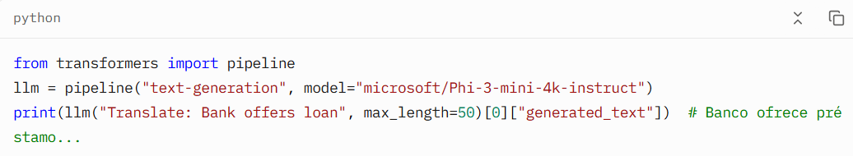
Full Architecture:
Stack encoders/decoders (e.g., 6 layers each).
Add normalization (stabilizes training).
Use positional encoding for sequence order.
Output via softmax for text generation.

Slide 27
Transformer Architecture (Simplified)
Attention: Focuses on relevant tokens (e.g., "king" attends to "last" and "Mysuru").
Layers: Stack of math ops on embeddings to predict next token.

Slide 28
Tokens & Context Window
Model | Context Window
GPT-3 | 2K tokens
GPT-4 | up to 128K
Claude 3 Opus | 200K+

Slide 29
Full Pipeline Example – From Prompt to Answer
Prompt: "Who was the last king of Mysuru?" Tokenize (BPE): ["Who", " was", " the", " last", " king", " of", " Mys", "uru", "?"]
Embed: Each → Vector (e.g., "king" = [0.23, -0.45, ...])
Process: Model uses params to link "last king Mysuru" → Historical pattern match.
Generate: Predicts tokens: "The", " last", " king", " of", " Mysuru", " was", " Krishnaraja", " Wadiyar", " IV", "." (Within context window).

Slide 30
Quick Probability Example
Token | Probability
Jayachamarajendra | 0.65
Wadiyar | 0.20
Tipu | 0.05
Fake names | <0.02

Slide 31
Why do LLMs sometimes hallucinate?
No direct access to live facts (unless using RAG)
If training data is incomplete → model “fills gaps”
Prediction ≠ Truth
Fix: ✅ Retrieval-Augmented Generation (RAG) ✅ Guardrails ✅ Human review

Slide 32
Popular Tokenization Techniques
Byte Pair Encoding (BPE)
Used by: GPT-2, GPT-3, GPT-4 (variant of BPE)
How it works:
Starts with individual characters.
Iteratively merges the most frequent pair of tokens (bigrams) into one token.
Builds a vocabulary of subwords.
Example:
yaml
CopyEdit
Text: "lower" Initial tokens: [l, o, w, e, r] After merges: [low, er]
Pros:
Handles rare words well by breaking them into known subwords.
Efficient and compact vocabulary.
Embeddings: One vector per BPE token.

Slide 33
WordPiece
Used by: BERT
How it works:
Similar to BPE, but uses a likelihood-based criterion for merging.
Splits unknown words into known subwords or characters with ## prefix.
Example:
arduino
CopyEdit
"unhappiness" → [un, ##happi, ##ness]
Pros:
Good for understanding word morphology.
Prevents OOV (out-of-vocabulary) issues.
Embeddings: One vector per subword, including prefixes like ##.

Slide 34
SentencePiece
Used by: T5, ALBERT, XLNet
How it works:
Learns subword units without needing pre-tokenized input.
Treats input as a raw byte stream, allowing it to work with any language.
Can use BPE or Unigram Language Model internally.
Example:
scss
CopyEdit
"Hello world" → ['▁Hello', '▁world'] (▁ indicates space)
Pros:
Handles multilingual data better.
Robust to whitespace and punctuation variation.

