Slide 1
photosynthesis
biology
Notes:
Introduction to the presentation on photosynthesis.

Slide 2
introduction
Key concept about introduction in the context of photosynthesis
Important aspect of introduction relevant to biology
Fundamental principle related to introduction
Practical application of introduction in photosynthesis
Core understanding of introduction
Essential knowledge about introduction
Significant detail regarding introduction
Critical point about introduction in biology
Notes:
Explain introduction in the context of photosynthesis.

Slide 3
cells
Key concept about cells in the context of photosynthesis
Important aspect of cells relevant to biology
Fundamental principle related to cells
Practical application of cells in photosynthesis
Core understanding of cells
Essential knowledge about cells
Significant detail regarding cells
Critical point about cells in biology
Notes:
Explain cells in the context of photosynthesis.

Slide 4

chrolophyll
Key concept about chrolophyll in the context of photosynthesis
Important aspect of chrolophyll relevant to biology
Fundamental principle related to chrolophyll
Practical application of chrolophyll in photosynthesis
Core understanding of chrolophyll
Essential knowledge about chrolophyll
Significant detail regarding chrolophyll
Critical point about chrolophyll in biology
Notes:
Explain chrolophyll in the context of photosynthesis.

Slide 5
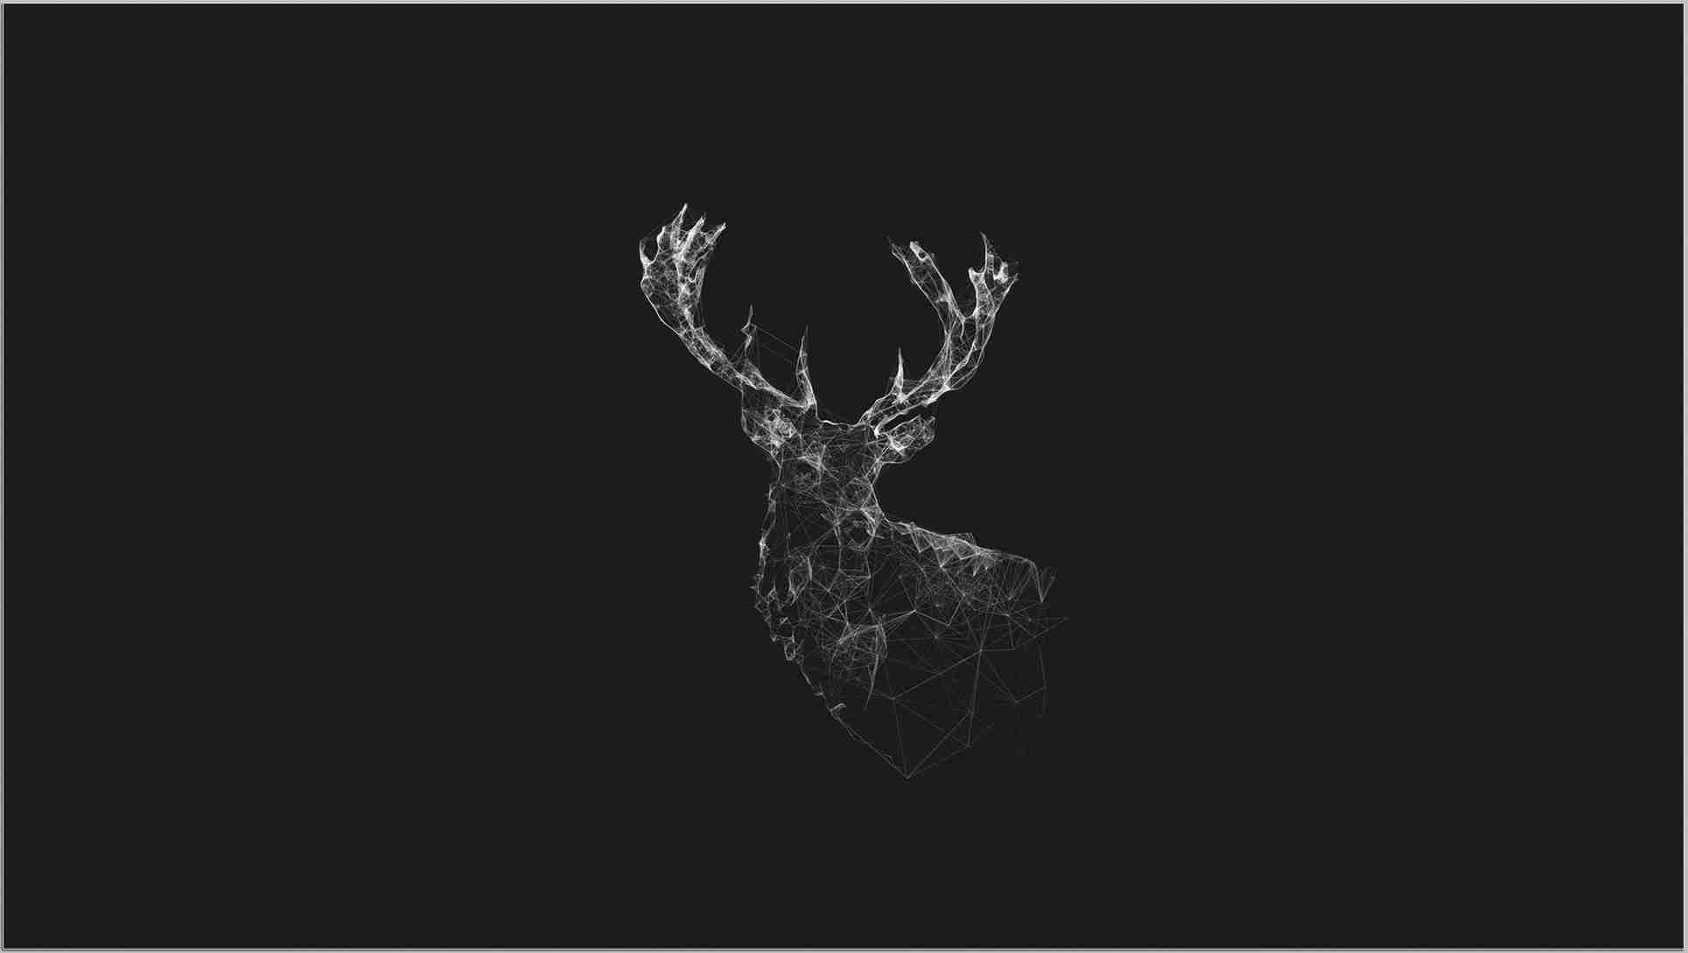
sun
Key concept about sun in the context of photosynthesis
Important aspect of sun relevant to biology
Fundamental principle related to sun
Practical application of sun in photosynthesis
Core understanding of sun
Essential knowledge about sun
Significant detail regarding sun
Critical point about sun in biology
Notes:
Explain sun in the context of photosynthesis.

Slide 6
conclusion
Key concept about conclusion in the context of photosynthesis
Important aspect of conclusion relevant to biology
Fundamental principle related to conclusion
Practical application of conclusion in photosynthesis
Core understanding of conclusion
Essential knowledge about conclusion
Significant detail regarding conclusion
Critical point about conclusion in biology
Notes:
Explain conclusion in the context of photosynthesis.

