Slide 1
RNNs
DL
Notes:
Introduction to the presentation on RNNs.

Slide 2
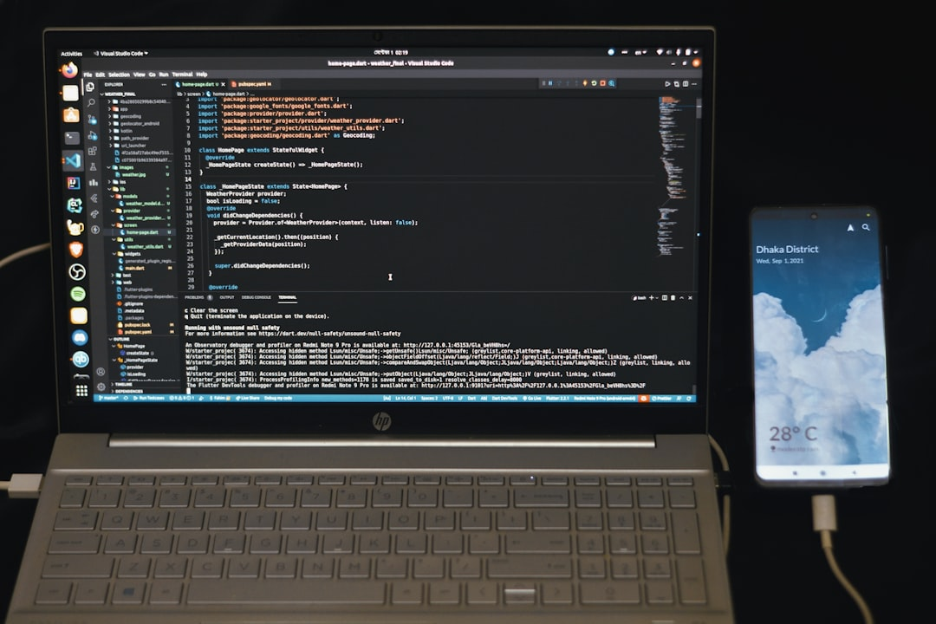
Introduction
Goal: Simulate human intelligence
RNNs: Recurrent Neural Networks
Use: Sequence prediction tasks
Formula: h_t = f(h_(t-1), x_t)
Backprop: Through time algorithm
Activation: Sigmoid, tanh functions
Training: Stochastic gradient descent
Complexity: O(n log n) time
Applications: NLP, speech recognition
Notes:
Explain Introduction in the context of RNNs.

Slide 3

Core Concept / Architecture
Goal: Model sequential data
Use: Recurrent connections h_t = f(h_t-1, x_t)
Formula: h_t = tanh(W_h*h_t-1 + W_x*x_t)
Backprop: Compute dE/dh_t, dE/dW_h, dE/dW_x
Training: Use BPTT, Truncated BPTT
Architecture: Simple RNN, LSTM, GRU
Equation: LSTM gate z_t = sigmoid(W_z*x_t)
Complexity: O(n*t*d) for n sequences
Optimization: Use SGD, Adam, RMSProp
Notes:
Explain Core Concept / Architecture in the context of RNNs.

Slide 4
Mathematical / Logical Explanation
Goal: Simulate human intelligence
RNNs: Recurrent Neural Networks
F = sigmoid(Wx + Uh)
h(t) = f(h(t-1), x(t))
O(t) = softmax(Vh(t))
E = -Σ(y(t) log O(t))
BPTT: Backpropagation Through Time
LSTM: Long Short-Term Memory
GRU: Gated Recurrent Unit
Notes:
Explain Mathematical / Logical Explanation in the context of RNNs.

Slide 5
Applications / Use Cases
Language Modeling: P(w|context) = softmax(y)
Time Series: Forecasting y(t+1) = f(y(t))
Sentiment Analysis: classify text as positive/negative
Machine Translation: map x to y, x ∈ X, y ∈ Y
Speech Recognition: map audio to text, O(n log n)
Dialogue Systems: generate response, r = f(context)
Text Summarization: compress text, preserve meaning
Anomaly Detection: identify patterns, y = σ(Wx + b)
Notes:
Explain Applications / Use Cases in the context of RNNs.

