Slide 1
RNNs
DL

Slide 2
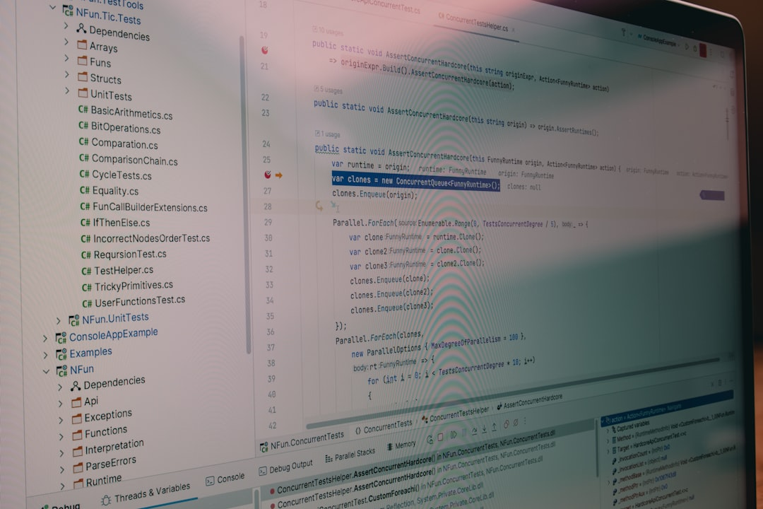
Introduction
Goal: Simulate human intelligence
RNNs: Recursive neural network models
O(n) time complexity for training
h_t = sigmoid(Wx_t + Uh_t-1)
BPTT: Backpropagation through time
LSTM: Long short-term memory units
GRU: Gated recurrent unit architecture
E = -sum(y_true * log(y_pred))
Optimization: Stochastic gradient descent
Notes:
Explain Introduction in the context of RNNs.

Slide 3
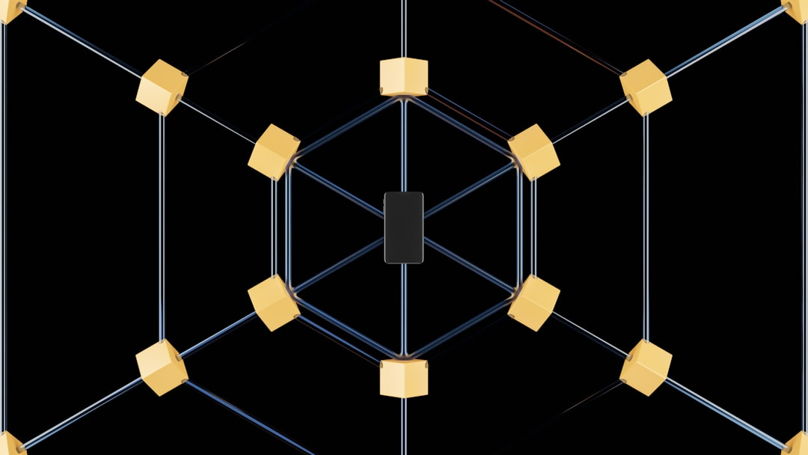
Core Concept / Architecture
Goal: Model sequential data
Use: Recurrence relation
Formula: h_t = f(h_t-1, x_t)
Backprop: Through time (BPTT)
Training: Stochastic gradient descent
Activation: Sigmoid, tanh, ReLU
Output: Softmax, linear layers
Complexity: O(n^2) time, O(n) space
Variants: LSTM, GRU, Bidirectional
Notes:
Explain Core Concept / Architecture in the context of RNNs.

Slide 4
Mathematical / Logical Explanation
Goal: Simulate human intelligence
RNNs: Recurrent Neural Networks
Formula: h_t = tanh(W_h * h_t-1)
Backprop: Compute gradients O(n log n)
Activation: sigmoid, tanh, ReLU
Loss: Cross-entropy, MSE
Optimization: SGD, Adam
Time complexity: O(n*t)
Space complexity: O(n)
Notes:
Explain Mathematical / Logical Explanation in the context of RNNs.

Slide 5
Applications / Use Cases
Modeling sequential data with h_t = f(h_t-1, x_t)
Natural language processing with LSTM networks
Time series forecasting using RNNs and ARIMA
Sentiment analysis via gated recurrent units
Image captioning with CNN-RNN architectures
Speech recognition using CTC loss function
Machine translation with attention mechanisms
Dialogue systems with memory-augmented RNNs
Anomaly detection in sequences with Autoencoders
Notes:
Explain Applications / Use Cases in the context of RNNs.

Slide 6
THANK YOU SLIDE

