Slide 1
RNNs
DL

Slide 2

Introduction
Goal: Simulate human intelligence
Use: Sequential data processing
Model: Recurrent neural networks
Equation: h_t = f(h_(t-1), x_t)
Activation: Sigmoid, tanh, ReLU
Training: Backpropagation through time
Challenge: Vanishing gradients O(n)
Optimization: LSTM, GRU architectures
Application: NLP, speech recognition
Notes:
Explain Introduction in the context of RNNs.

Slide 3
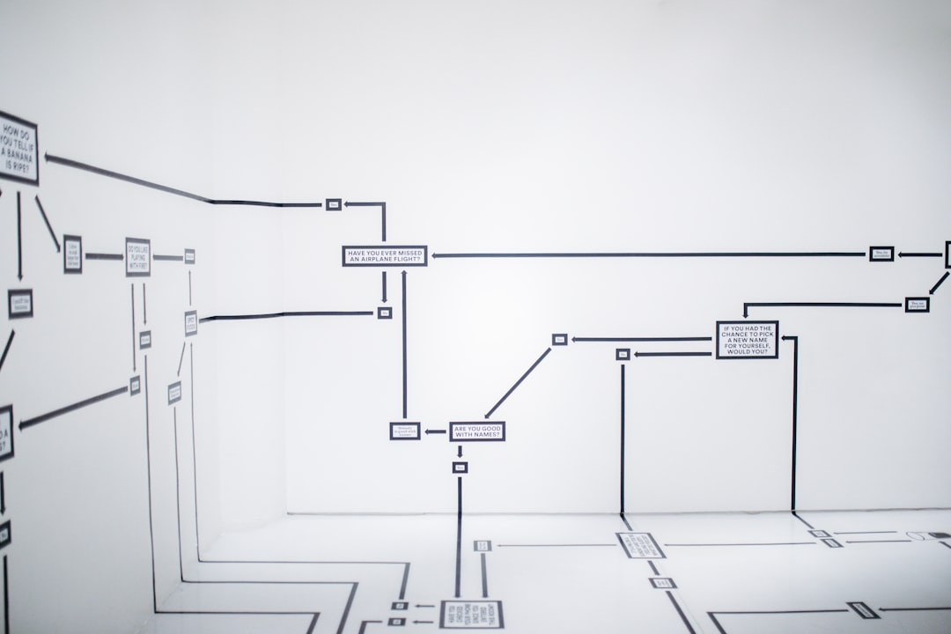
Core Concept / Architecture
Goal: Model sequential data
Use: Recurrent connections
Formula: h_t = f(h_(t-1), x_t)
Backprop: Through time (BPTT)
Training: Stochastic gradient descent
Activation: Sigmoid, tanh, ReLU
Output: Softmax, linear layers
Optimization: O(n log n) complexity
Error: Mean squared, cross-entropy
Notes:
Explain Core Concept / Architecture in the context of RNNs.

Slide 4
Mathematical / Logical Explanation
RNNs: Recurrent Neural Networks
Goal: Simulate human intelligence
Backpropagation: Optimizes weights
Activation: Sigmoid, tanh, ReLU
Loss: Mean Squared Error (MSE)
Gradient: dE/dt = -λ(dE/dx)
Learning: Stochastic Gradient Descent
Complexity: O(n^2) time, O(n) space
Convergence: Guaranteed by SGD
Notes:
Explain Mathematical / Logical Explanation in the context of RNNs.

Slide 5
THANK YOU SLIDE

