Slide 1
RNNs
DL

Slide 2
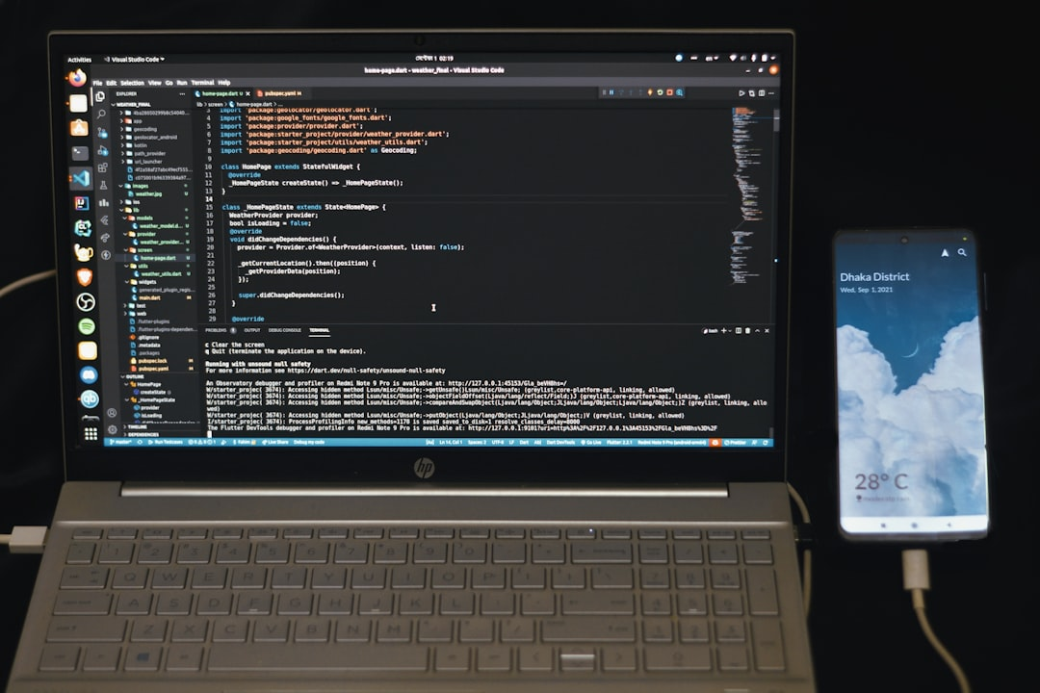
Introduction
Goal: Simulate human intelligence
RNNs: Recurrent Neural Networks
Feedback loops: h_t = f(h_t-1, x_t)
Activation: sigmoid, tanh, ReLU
Backprop: minimize loss, E = (1/2)(y - y^)^2
Training: Stochastic Gradient Descent, SGD
Vanishing gradients: exp(-n) stability issue
LSTM: Long Short-Term Memory, c_t = f(i_t, c_t-1)
Time complexity: O(n log n) for backprop
Notes:
Explain Introduction in the context of RNNs.

Slide 3
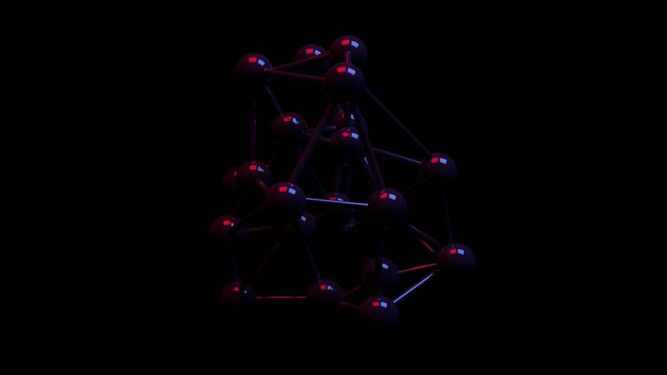
Core Concept / Architecture
Goal: Model sequential data patterns
Architecture: Feedback connections enabled
Activation: Sigmoid, tanh, ReLU used
Backprop: Truncated BPTT applied
Equation: h_t = f(h_(t-1), x_t)
Output: y_t = g(h_t, x_t)
Training: Optimizing loss function L
Complexity: O(n^2) time, O(n) space
Variants: LSTMs, GRUs, BRNNs exist
Notes:
Explain Core Concept / Architecture in the context of RNNs.

Slide 4
Mathematical / Logical Explanation
Goal: Simulate human intelligence
RNNs: Recurrent Neural Networks
Formula: h_t = tanh(Wx_t + Uh_{t-1})
Activation: sigmoid, tanh, ReLU
Backprop: Train using BPTT algorithm
Equation: E = -sum(y_i * log(y_i))
Complexity: O(n * t * h)
Optimization: Use SGD, Adam, RMSprop
Stability: Ensure gradient norm < 1
Notes:
Explain Mathematical / Logical Explanation in the context of RNNs.

Slide 5
Applications / Use Cases
Speech recognition: y = sigmoid(x)
Natural language processing: f(x) = softmax(x)
Time series forecasting: y(t) = y(t-1) + ε
Sentiment analysis: P(pos|X) = 1 / (1 + e^(-z))
Machine translation: P(Y|X) = ∏ P(y|X, y-1)
Text summarization: L = - ∑ (y_true * log(y_pred))
Anomaly detection: p(x) = (1 / √(2π)) * e^(-x^2/2)
Chatbots: R = ∑ (γ^t * r_t)
Language modeling: P(w|context) = softmax(w)
Notes:
Explain Applications / Use Cases in the context of RNNs.

Slide 6
THANK YOU SLIDE

