Slide 1
RNNs
DL

Slide 2
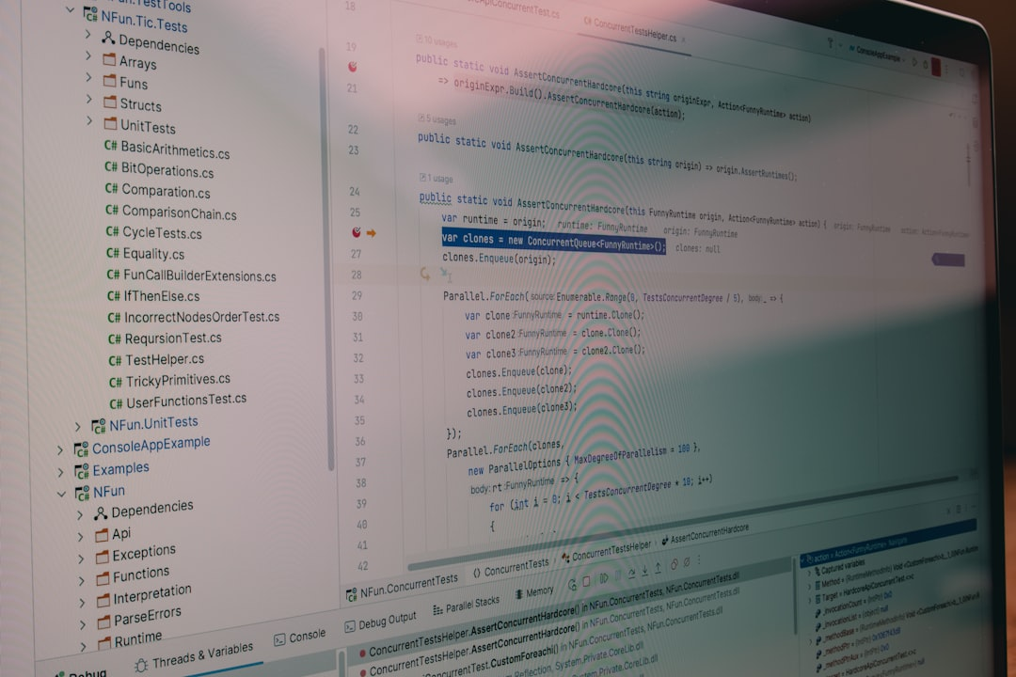
Introduction
Goal: Simulate human intelligence
RNNs: Recurrent Neural Networks
Function: Map inputs to outputs
Key: Feedback loops O(t) = f(h)
Equation: h(t) = sigmoid(Ux + Wh)
Training: Backpropagation through time
Challenge: Vanishing gradients O(n log n)
Solution: Long Short-Term Memory LSTMs
Application: Natural Language Processing
Notes:
Explain Introduction in the context of RNNs.

Slide 3
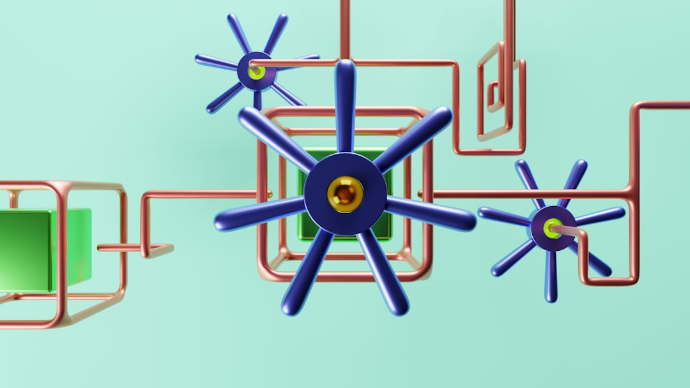
Core Concept / Architecture
Goal: Simulate human intelligence
Uses: Sequential data analysis
Architecture: Feedback connections
Function: Maps input to output
Equation: h_t = f(h_(t-1), x_t)
Training: Backpropagation through time
Optimization: Stochastic gradient descent
Complexity: O(n^2) time complexity
Variants: LSTMs, GRUs, Bidirectional RNNs
Notes:
Explain Core Concept / Architecture in the context of RNNs.

Slide 4
Mathematical / Logical Explanation
RNNs: Recursive Neural Networks
Goal: Simulate human intelligence
Function: f(h, x) = tanh(Wx + Uh)
Activation: sigmoid, tanh, ReLU
Error: E = (1/2) * (y - y')^2
Optimization: SGD, Adam, RMSprop
Complexity: O(n * t * h)
Training: BPTT, Truncated BPTT
Gradient: dE/dW = dE/dy * dy/dW
Notes:
Explain Mathematical / Logical Explanation in the context of RNNs.

Slide 5
Applications / Use Cases
Predicting sequences: x_t = sigmoid(Wx + Uh)
Natural language processing: NLP tasks
Time series forecasting: ARIMA, LSTM
Speech recognition: acoustic models
Machine translation: seq2seq models
Sentiment analysis: text classification
Anomaly detection: O(n log n) algorithms
Recommendation systems: collaborative filtering
Goal: Minimize loss function E = (y - y^) ^ 2
Notes:
Explain Applications / Use Cases in the context of RNNs.

Slide 6
THANK YOU SLIDE

