Slide 1


RNNs
THESIS DEFENSE
Deep Learning

Slide 2
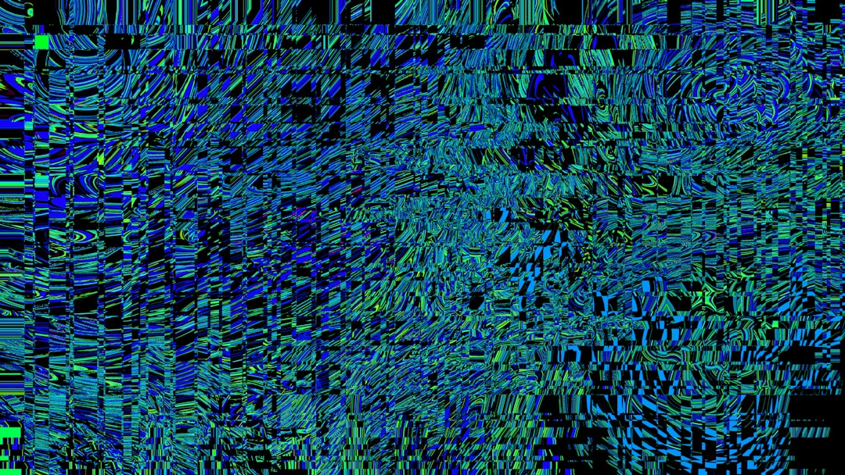
Introduction
Goal: Simulate human intelligence
RNNs: Recurrent Neural Networks
Input: Sequential data x(t)
Output: Prediction y(t)
Activation: Sigmoid σ(x) = 1/(1+e^(-x))
Backprop: Error minimization δE/δw
Training: Stochastic gradient descent
Equation: h(t) = f(h(t-1), x(t))
Complexity: O(n^2) time, O(n) space
Notes:
Explain Introduction in the context of RNNs.

Slide 3

Core Concept / Architecture
Goal: Simulate human intelligence
Uses: Sequential data processing
Architecture: Feedback connections exist
Formula: h_t = f(h_(t-1), x_t)
Backprop: Through time algorithm
Training: Stochastic gradient descent
Equation: E = -∑(y_i * log(y'_i))
Complexity: O(n * t * h)
Optimization: Regularization techniques
Notes:
Explain Core Concept / Architecture in the context of RNNs.

Slide 4
Mathematical / Logical Explanation
Goal: Simulate human intelligence
RNNs: Recurrent Neural Networks
Feedback loop: h_t = f(h_(t-1), x_t)
Activation: sigmoid, tanh, ReLU
Error: E = (1/2) * (y - y^) ^2
Backprop: dE/dw = dE/dy * dy/dh * dh/dw
Optimization: SGD, Adam, RMSprop
Complexity: O(n * t * h)
Training: BPTT, Truncated BPTT
Notes:
Explain Mathematical / Logical Explanation in the context of RNNs.

Slide 5
Applications / Use Cases
Speech Recognition: y = sigmoid(x)
Natural Language: f(x) = softmax(x)
Time Series: y(t) = LSTM(x(t-1))
Machine Translation: P(y|x) = seq2seq
Sentiment Analysis: y = tanh(x)
Text Generation: x(t) = GRU(x(t-1))
Anomaly Detection: P(x) = Gaussian(x)
Predictive Modeling: y = ARIMA(x)
Dialogue Systems: f(x) = attention(x)
Notes:
Explain Applications / Use Cases in the context of RNNs.

Slide 6

THANKYOU

