Slide 1
RNNs
Deep Learning

Slide 2
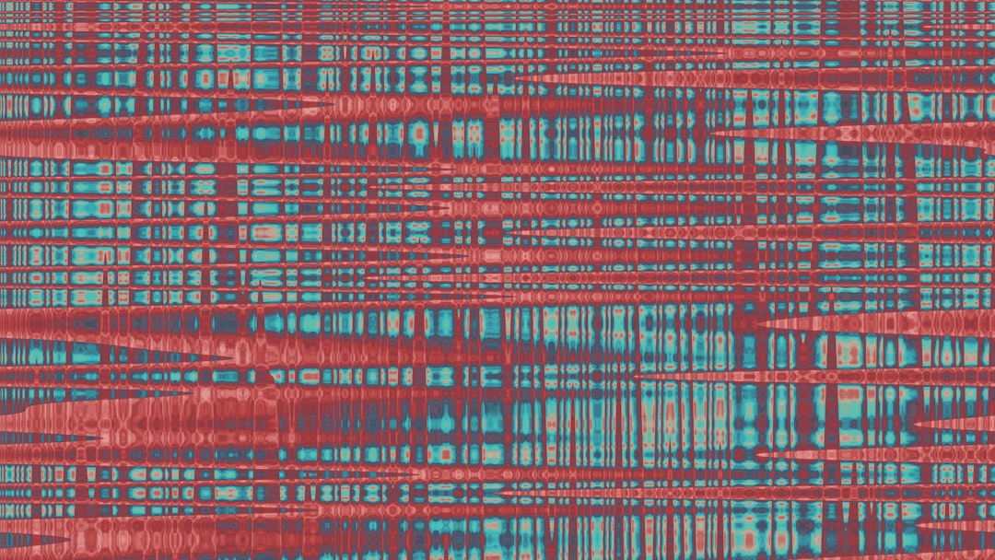
Introduction
Goal: Simulate human intelligence
RNNs: Recurrent Neural Networks
O(n) time complexity
h_t = f(h_t-1, x_t)
Backpropagation: train RNNs
BPTT: Backpropagation Through Time
LSTM: Long Short-Term Memory
GRU: Gated Recurrent Unit
Vanishing gradients: major issue
Notes:
Explain Introduction in the context of RNNs.

Slide 3
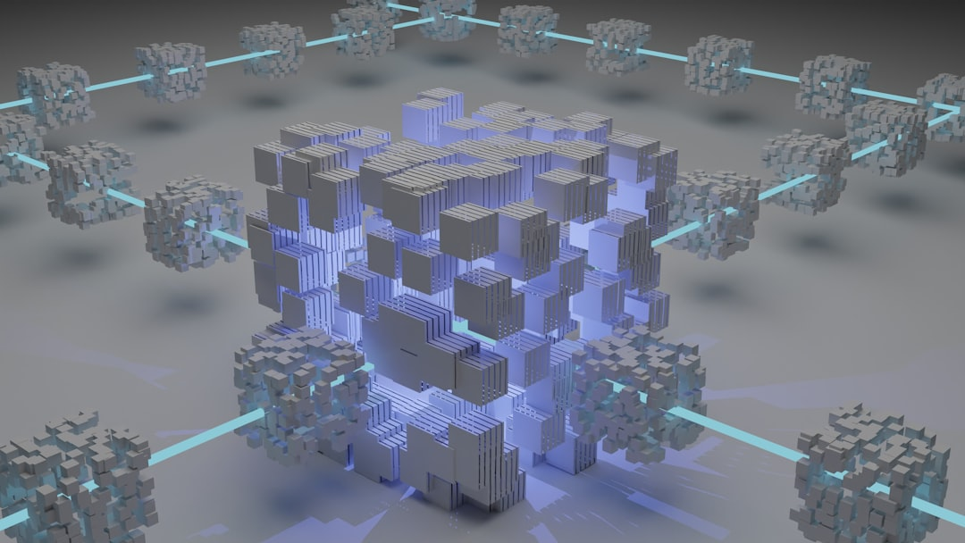
Core Concept / Architecture
Goal: Simulate human intelligence
RNNs: Recurrent Neural Networks
h_t = f(h_(t-1), x_t)
O(t) = g(h_t, x_t)
BPTT: Backpropagation Through Time
LSTM: Long Short-Term Memory
GRU: Gated Recurrent Unit
Activation: sigmoid, tanh, ReLU
Error: MSE, Cross-Entropy
Notes:
Explain Core Concept / Architecture in the context of RNNs.

Slide 4
Mathematical / Logical Explanation
Goal: Model temporal dependencies
Use: Recurrent connections, h_t = f(h_t-1, x_t)
Formula: h_t = tanh(W_h*h_t-1 + W_x*x_t)
Error: Calculated via cross-entropy loss
Backprop: Through time, O(n^2) complexity
Training: Requires BPTT, truncated BPTT
Activation: Sigmoid, tanh, ReLU functions
Optimization: SGD, Adam, RMSprop algorithms
Complexity: O(n log n) for LSTM variants
Notes:
Explain Mathematical / Logical Explanation in the context of RNNs.

Slide 5
Applications / Use Cases
Speech recognition: y = sigmoid(x)
Natural language processing: f(x) = softmax(x)
Time series forecasting: y = LSTM(x)
Sentiment analysis: accuracy = TP / (TP + FN)
Machine translation: loss = cross-entropy
Text summarization: ROUGE score = recall + precision
Anomaly detection: threshold = mean + 2*std
Chatbots: response = argmax(probability)
Predictive modeling: RNNs = f(x, h, W)
Notes:
Explain Applications / Use Cases in the context of RNNs.

