Slide 1
RNNs
Deep Learning

Slide 2
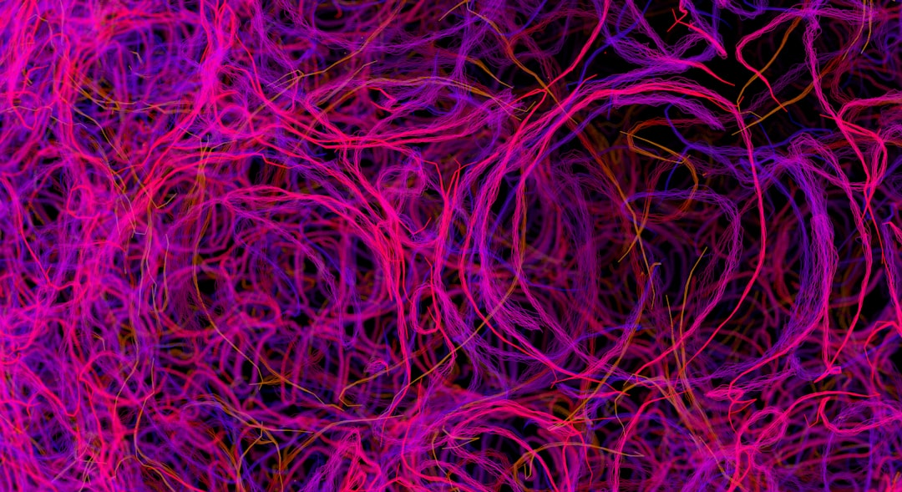
Introduction
Goal: Simulate human intelligence
RNNs: Recurrent Neural Networks
Feedback loops: h_t = f(h_t-1, x_t)
Activation: sigmoid, tanh, ReLU
Backprop: train using BPTT, O(n^2)
Vanishing gradients: sigmoid, tanh
LSTMs: Long Short-Term Memory
GRUs: Gated Recurrent Units
Optimization: Adam, RMSprop, SGD
Notes:
Explain Introduction in the context of RNNs.

Slide 3
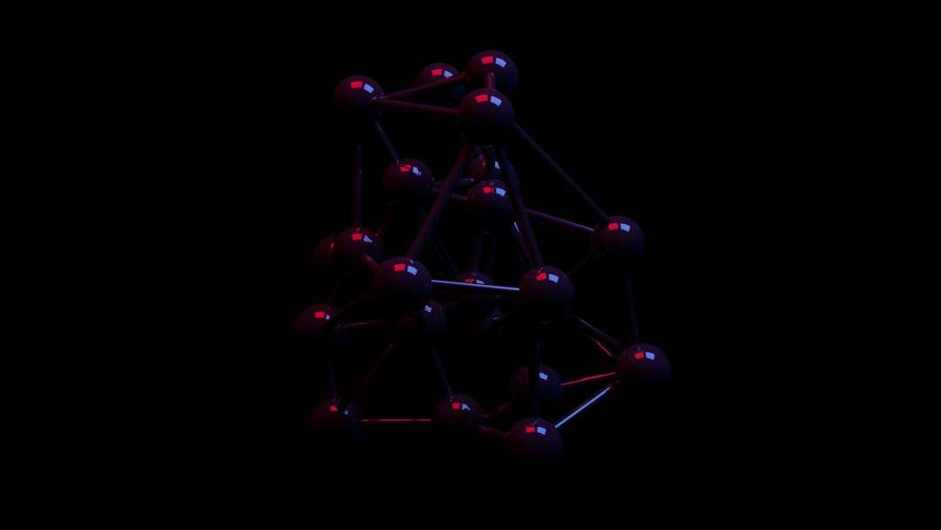
Core Concept / Architecture
Goal: Simulate human intelligence
RNN: Recurrent Neural Network
Feedback: h(t) = f(h(t-1), x(t))
Activation: sigmoid, tanh, ReLU
Backprop: dE/dw = dE/dy * dy/dw
BPTT: Truncated backpropagation
Vanishing: Gradient < 1, exploding > 1
LSTM: Long Short-Term Memory
GRU: Gated Recurrent Unit
Notes:
Explain Core Concept / Architecture in the context of RNNs.

Slide 4
Mathematical / Logical Explanation
Goal: Model sequential data
Use: Recurrence relation f(h, x)
Formula: h_t = sigmoid(Uh_{t-1} + Wx_t)
Backprop: Compute dE/dh, dE/dx
Optimize: Update U, W, b weights
Activation: Sigmoid, tanh, ReLU used
Training: BPTT, Truncated BPTT applied
Complexity: O(n^2) time, O(n) space
Equation: E = -sum(y*log(y_hat))
Notes:
Explain Mathematical / Logical Explanation in the context of RNNs.

Slide 5
Applications / Use Cases
Modeling sequential data with h(t) = sigmoid(Wx)
Predicting time series with LSTM networks
Speech recognition via CTC loss function
Machine translation using attention mechanisms
Sentiment analysis with recurrent neural nets
Natural language processing with GRU gates
Image captioning using RNN encoders
Forecasting stock prices with RNN architectures
Anomaly detection in sequences with autoencoders
Notes:
Explain Applications / Use Cases in the context of RNNs.

