Slide 1
RNNs
Deep Learning

Slide 2

Introduction
Goal: Simulate human intelligence
RNNs: Recurrent Neural Networks
Feedback loops: h(t) = f(h(t-1))
Training: Backpropagation Through Time
Activation: Sigmoid, Tanh functions
Loss: Mean Squared Error, Cross-Entropy
Optimization: Stochastic Gradient Descent
Complexity: O(n log n) time complexity
Applications: NLP, Time Series Prediction
Notes:
Explain Introduction in the context of RNNs.

Slide 3
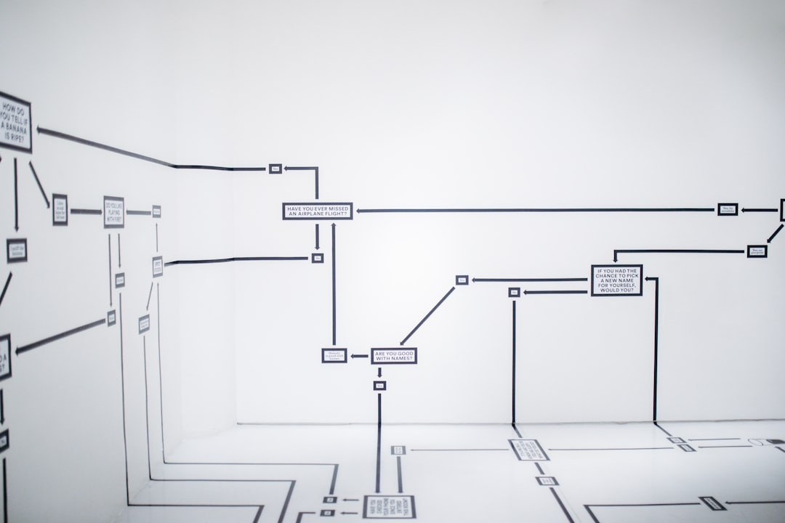
Core Concept / Architecture
Goal: Model sequential data
Architecture: Feedback connections
RNN: h_t = f(h_(t-1), x_t)
Activation: sigmoid, tanh, ReLU
Backprop: Truncated BPTT, O(n^2)
Training: Stochastic gradient descent
Error: Mean squared, cross-entropy
Optimization: Adam, RMSprop, SGD
Complexity: O(n log n) time
Notes:
Explain Core Concept / Architecture in the context of RNNs.

Slide 4
Mathematical / Logical Explanation
Goal: Model sequential data
RNNs: Recurrent Neural Networks
Formula: h_t = tanh(Wx_t + Uh_{t-1})
Backprop: Compute gradients
BPTT: Backpropagation Through Time
Vanishing gradients: exp(-n) problem
LSTM: Long Short-Term Memory
GRU: Gated Recurrent Unit
Time complexity: O(n log n)
Notes:
Explain Mathematical / Logical Explanation in the context of RNNs.

Slide 5
Applications / Use Cases
Modeling sequential data with h_t = f(h_t-1, x_t)
Time series forecasting using LSTM networks
Natural language processing with RNNs
Sentiment analysis via gated recurrent units
Speech recognition using CTC loss function
Machine translation with attention mechanisms
Text summarization with sequence-to-sequence
Anomaly detection in time series data
Predicting stock prices with recurrent neural
Language modeling with E = -∑(y_true * log(y_pred))
Notes:
Explain Applications / Use Cases in the context of RNNs.

