Slide 1
RNNs
DL

Slide 2
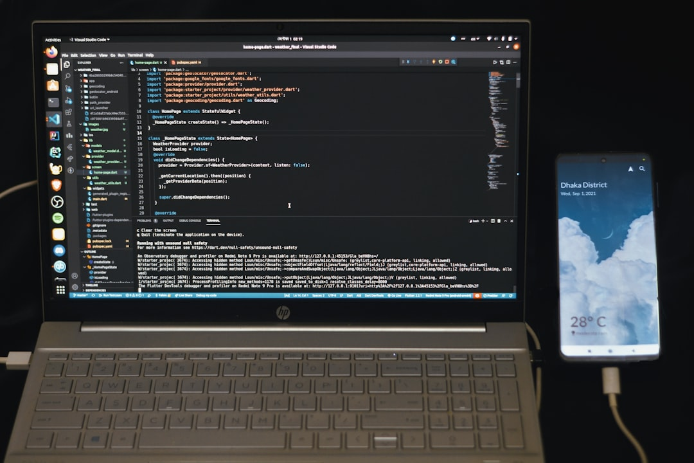
Goal: Simulate human intelligence
RNNs: Recurrent Neural Networks
Feedback loops: h_t = f(h_(t-1))
Activation: sigmoid, tanh, ReLU
Backprop: train using BPTT algorithm
Vanishing gradients: sigmoid, tanh
LSTM: Long Short-Term Memory
Equation: h_t = O_t * tanh(C_t)
Time complexity: O(n log n)
Notes:
Explain Introduction in the context of RNNs.

Slide 3

Goal: Simulate human intelligence
RNN: Recurrent Neural Network
Feedback loop: h_t = f(h_t-1, x_t)
Activation: sigmoid, tanh, ReLU
Loss: Cross-Entropy, MSE
Backprop: Compute gradients
Optimization: SGD, Adam
Training: Sequences, BPTT
State: Hidden, Cell, Output
Notes:
Explain Core Concept / Architecture in the context of RNNs.

Slide 4
Goal: Simulate human intelligence
RNNs: Recurrent Neural Networks
Backpropagation: dE/dt = dE/dy * dy/dt
Activation: sigmoid(t) = 1 / (1 + e^(-t))
Output: h(t) = sigmoid(W * x(t) + U * h(t-1))
Error: E = (1/2) * (y - y_hat)^2
Optimization: O(n log n) time complexity
Training: minimize E using gradient descent
State Update: h(t) = f(W * x(t) + U * h(t-1))
Weight Update: W = W - alpha * dE/dW
Notes:
Explain Mathematical / Logical Explanation in the context of RNNs.

Slide 5
Sequence prediction: y = f(x, h)
Natural language processing: NLP = tokens + grammar
Time series forecasting: y(t) = f(y(t-1))
Speech recognition: S = acoustic + linguistic
Machine translation: MT = encoder + decoder
Sentiment analysis: SA = text + emotions
Anomaly detection: AD = patterns + outliers
Recommendation systems: RS = user + item
Chatbots: C = dialogue + response
Notes:
Explain Applications / Use Cases in the context of RNNs.

