Slide 1
RNNs
Deep Learning

Slide 2
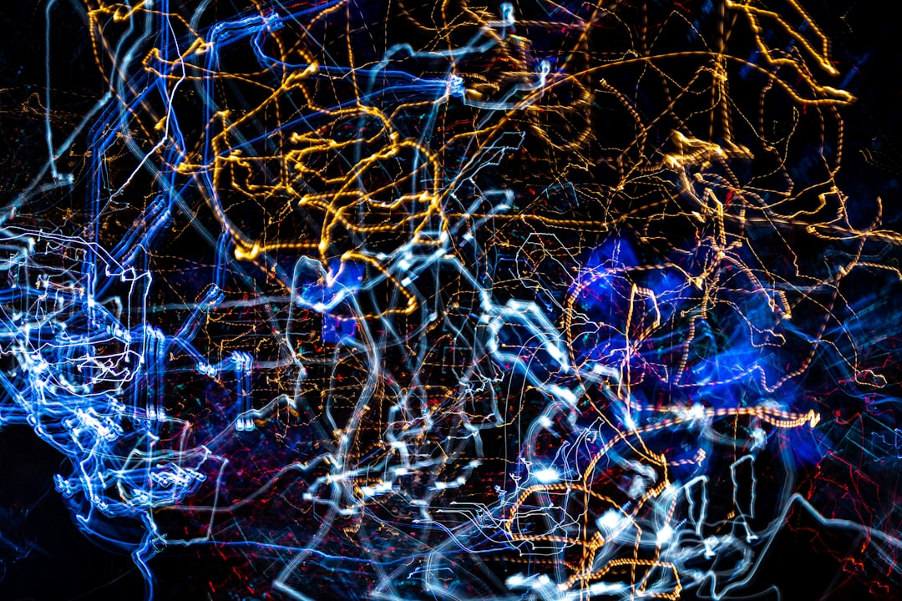
Goal: Simulate human intelligence
RNNs: Recurrent Neural Networks
Feedback loops: h_t = f(h_t-1, x_t)
Activation: sigmoid, tanh, ReLU
Training: Backpropagation Through Time
Optimization: Stochastic Gradient Descent
Loss: Cross-Entropy, Mean Squared Error
Applications: NLP, Time Series Prediction
Challenges: Vanishing Gradients, O(n^2) complexity
Notes:
Explain Introduction in the context of RNNs.

Slide 3

Goal: Simulate human intelligence
RNNs: Recurrent Neural Networks
Feedback: h_t = f(h_t-1, x_t)
Activation: sigmoid, tanh, ReLU
Backprop: dE/dh_t = dE/dy_t * dy_t/dh_t
Training: BPTT, Truncated BPTT
Architecture: Encoder, Decoder, LSTM
Optimization: Adam, RMSprop, SGD
Complexity: O(n * t * h)
Applications: NLP, Time Series, Speech
Notes:
Explain Core Concept / Architecture in the context of RNNs.

Slide 4
RNNs: Recurrent Neural Networks
Goal: Simulate human intelligence
Formula: h_t = tanh(Wx_t + Uh_{t-1})
Activation: sigmoid, tanh, ReLU
Backprop: Truncated BPTT, O(n log n)
Training: Stochastic Gradient Descent
Error: Mean Squared Error, Cross-Entropy
Optimization: Adam, RMSprop, SGD
Complexity: O(n^2), O(n log n)
Notes:
Explain Mathematical / Logical Explanation in the context of RNNs.

Slide 5
Modeling sequential data with RNNs
Time series forecasting uses LSTM
Natural language processing applies GRU
Speech recognition utilizes RNNs
Sentiment analysis uses recursive nets
Machine translation employs seq2seq
Text generation uses Markov chains
Predicting stock prices with RNNs
Anomaly detection in sequences
Notes:
Explain Applications / Use Cases in the context of RNNs.

