Slide 1
RNNs
DL

Slide 2
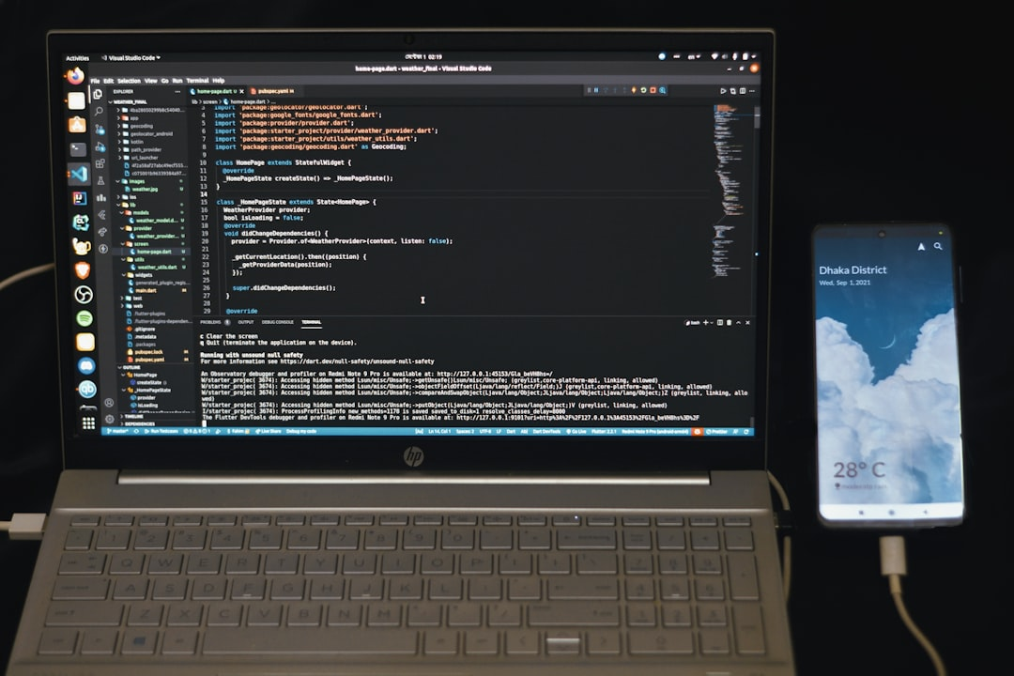
Introduction
Goal: Simulate human intelligence
RNNs: Recurrent Neural Networks
Feedback loops: h_t = f(h_(t-1), x_t)
Activation: sigmoid, tanh, ReLU
Training: Backpropagation Through Time (BPTT)
Optimization: Stochastic Gradient Descent (SGD)
Error: Mean Squared Error (MSE), Cross-Entropy
Complexity: O(n^2) for sequence length n
Applications: NLP, Time Series, Speech Recognition
Notes:
Explain Introduction in the context of RNNs.

Slide 3
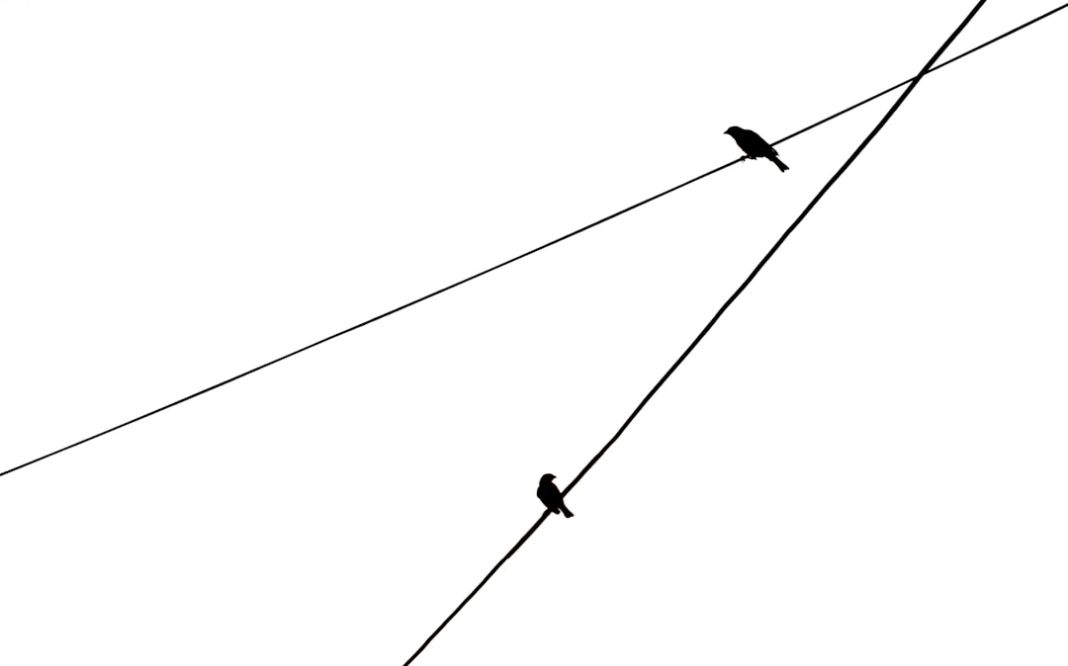
Core Concept / Architecture
Goal: Model sequential data patterns
RNN: Recurrent Neural Network architecture
Cells: Memory, Input, Output, Hidden
Activation: sigmoid, tanh, ReLU functions
Backprop: Training via BPTT algorithm
Equation: h_t = f(W*h_(t-1) + U*x_t)
Optimization: Minimize loss, O(n log n)
Variants: LSTM, GRU, Bidirectional RNNs
Applications: NLP, Time series forecasting
Notes:
Explain Core Concept / Architecture in the context of RNNs.

Slide 4
Mathematical / Logical Explanation
Goal: Simulate human intelligence
RNNs: Recurrent Neural Networks
Backprop: ∂E/∂w = ∂E/∂y * ∂y/∂w
Activation: σ(x) = 1 / (1 + e^(-x))
Hidden state: h_t = f(h_(t-1), x_t)
Output: y_t = g(h_t, x_t)
Loss: E = (1/2) * (y - y^) ^ 2
Optimization: w = w - α * ∂E/∂w
Gradient clipping: ∂E/∂w = max(-c, min(c, ∂E/∂w))
Notes:
Explain Mathematical / Logical Explanation in the context of RNNs.

Slide 5
Applications / Use Cases
Natural Language Processing: text classification
Time Series Forecasting: predict stock prices
Speech Recognition: voice to text systems
Machine Translation: language conversion models
Sentiment Analysis: emotion detection algorithms
Dialogue Systems: chatbot conversation models
Image Captioning: generate image descriptions
Sequence Generation: music and text creation
Anomaly Detection: identify data outliers
Notes:
Explain Applications / Use Cases in the context of RNNs.

