Slide 1
RNNs
Deep Learning

Slide 2
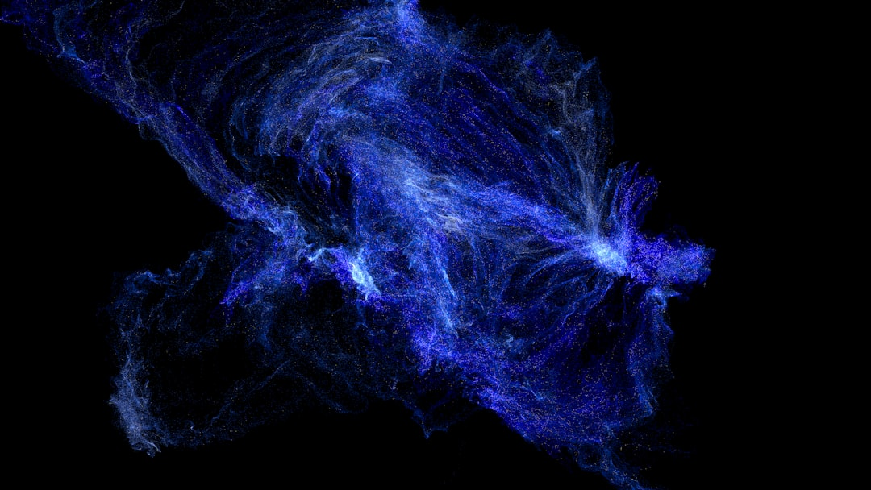
Introduction
Goal: Simulate human intelligence
RNNs: Recurrent Neural Networks
Feedback loops: h_t = f(h_t-1, x_t)
Activation: sigmoid, tanh, ReLU
Backprop: train using BPTT, O(n^2)
Vanishing gradients: exp(-n) problem
LSTM: Long Short-Term Memory
GRU: Gated Recurrent Unit
Optimization: Adam, RMSprop, SGD
Notes:
Explain Introduction in the context of RNNs.

Slide 3
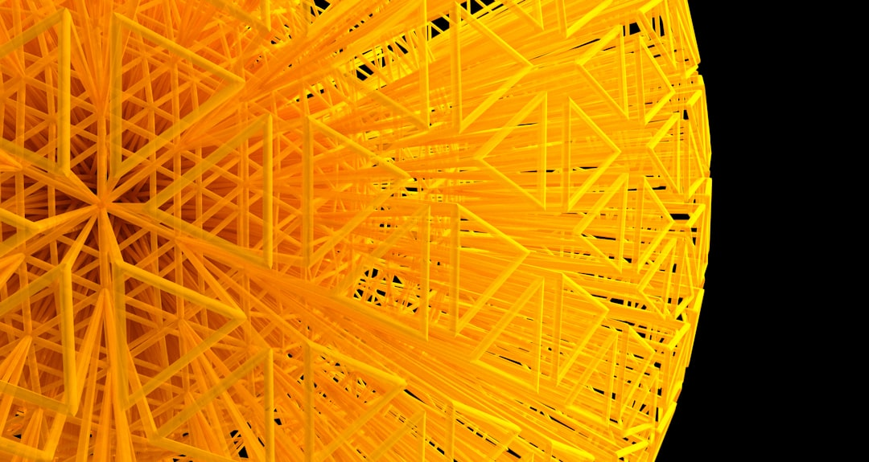
Core Concept / Architecture
Goal: Simulate human intelligence
RNN: Recurrent Neural Network
Feedback loops: h_t = f(h_(t-1), x_t)
Activation: sigmoid, tanh, ReLU
Backprop: compute dE/dh_t, dE/dx_t
BPTT: truncate gradients, O(n) time
Vanishing gradients: sigmoid, tanh
LSTM: Long Short-Term Memory
GRU: Gated Recurrent Unit
Notes:
Explain Core Concept / Architecture in the context of RNNs.

Slide 4
Mathematical / Logical Explanation
RNNs: Recurrent Neural Networks
Goal: Simulate human intelligence
Function: f(h, x) = tanh(Wx + Uh)
Activation: sigmoid, tanh, ReLU
Backprop: dE/dt = dE/dy * dy/dt
Optimization: SGD, Adam, RMSprop
Complexity: O(n^2 * t)
Training: BPTT, Truncated BPTT
Equation: h_t = f(h_(t-1), x_t)
Notes:
Explain Mathematical / Logical Explanation in the context of RNNs.

Slide 5
Applications / Use Cases
Time series forecasting uses RNNs
Natural language processing relies on LSTM
Sequence generation via Markov chains
Speech recognition utilizes HMM models
Goal: Optimize f(x) = sigmoid(x)
Image captioning with CNN + RNN
Sentiment analysis uses tanh activation
Dynamic systems modeling with ODEs
Predicting outcomes via Bayesian nets
Notes:
Explain Applications / Use Cases in the context of RNNs.

Slide 6
Thank You

