Slide 1
RNNs
Deep Learning

Slide 2

Introduction
Goal: Simulate human intelligence
Uses: Sequential data analysis
Architecture: Feedback loops enabled
Equation: h_t = f(h_(t-1), x_t)
Training: Backpropagation through time
Challenge: Vanishing gradients occur
Solution: LSTM, GRU cells used
Complexity: O(n log n) time
Application: Speech recognition systems
Notes:
Explain Introduction in the context of RNNs.

Slide 3
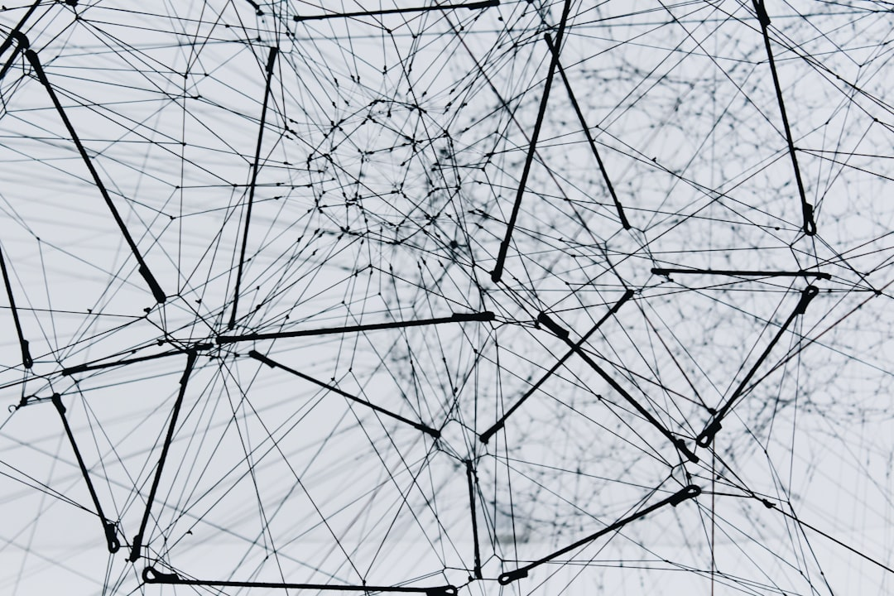
Core Concept / Architecture
Goal: Model sequential data
RNN: Recurrent Neural Network
h_t = f(h_(t-1), x_t)
Output: o_t = g(h_t)
Backprop: Compute gradients
BPTT: Backpropagation Through Time
LSTM: Long Short-Term Memory
GRU: Gated Recurrent Unit
Activation: tanh, sigmoid, ReLU
Notes:
Explain Core Concept / Architecture in the context of RNNs.

Slide 4
Mathematical / Logical Explanation
Goal: Simulate human intelligence
RNNs: Recurrent Neural Networks
Backprop: dE/dt = dE/dy * dy/dt
Activation: sigmoid(t) = 1/(1+e^(-t))
Hidden State: h(t) = f(h(t-1), x(t))
Output: y(t) = g(h(t), x(t))
Loss: E = (1/2) * (y_true - y_pred)^2
Optimization: O(n log n) time complexity
Training: dE/dw = dE/dy * dy/dw
Notes:
Explain Mathematical / Logical Explanation in the context of RNNs.

Slide 5
Applications / Use Cases
Sequence prediction: y = f(x, h)
Natural language processing: NLP
Time series forecasting: ARIMA, LSTM
Speech recognition: acoustic models
Machine translation: seq2seq, attention
Sentiment analysis: text classification
Anomaly detection: O(n log n)
Recommendation systems: collaborative filtering
Chatbots: dialogue management systems
Notes:
Explain Applications / Use Cases in the context of RNNs.

Slide 6
Thank You

